Slide 1

Major Project Presentation
Title: Image Captioning Using Deep Learning
Submitted By:
Newtan Kumar Rai -17BCS086
Azzam Jafri -17BCS092
Uzma Afzal - 17BCSA085
Group No.: 19

Slide 2
Image Captioning is a problem in computer vision where the algorithm
detects objects in an image, understands the relationship among those
objects and outputs a grammatically consistent sentence summarizing
the key information in the image.
Encoder-Decoder architecture . Typically, a model that generates sequences
will use an Encoder to encode the input into a fixed form and a Decoder to
decode it, word by word, into a sequence.

Slide 3
Attention.
The use of Attention networks is widespread in deep learning, and
with good reason. This is a way for a model to choose only those parts of the
encoding that it thinks is relevant to the task at hand. The same mechanism
you see employed here can be used in any model where the Encoder's output
has multiple points in space or time. In image captioning, we consider some
pixels more important than others. In sequence to sequence tasks like machine
translation, we consider some words more important than others.

Slide 4
Steps involved…

Slide 5
Since it is a supervised learning task we are provided with a training data set which consists of sentences labeled with “1” or “0” and a test data set without labels.
-> label “0”: Positive Sentiment
-> label “1”: Negative Sentiment
Read the data using pandas python library
Data preprocessing and Feature Engineering
-> Removal of punctuations.
-> Removal of commonly used stopwords.
-> Normalization of words.

Slide 6
Vectorization and Model Selection:
The well-known techniques for vectorization of words in Natural Language Processing are: CountVectorization and Tf-IDF transformation. The well-known techniques for vectorization of words in Natural Language Processing are: CountVectorization and Tf-IDF transformation.
CountVectorization generates a sparse matrix representing all the words in the document.
Tf(d,t) (Term frequency) is defined as the number of occurrence of the term t in document d.
Idf(t) (Inverse document of frequency) is defined as log(D/t), where D: Total number of documents and t: Number of documents with the term.

Slide 7
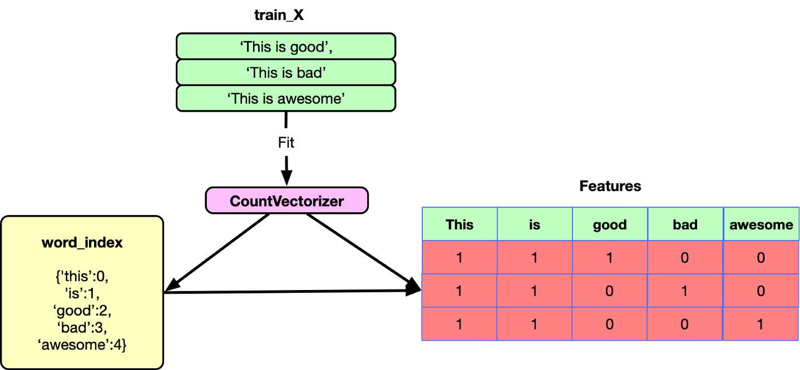
Demonstration of Count Vectorization

Slide 8
Binary Classification
We have chosen Naive Bayes classifier for the binary classification.
We have used machine learning pipeline technique which is a built-in function of scikit-learn to pre-define a workflow of algorithm. This saves much time and computational power.

Slide 9
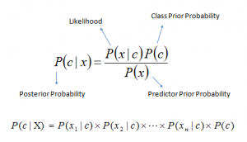
Naive Bayes algorithm:
It is a classification technique based on Bayes’ Theorem with an assumption of independence among predictors. In simple terms, a Naive Bayes classifier assumes that the presence of a particular feature in a class is unrelated to the presence of any other feature.
Bayes theorem provides a way of calculating posterior probability P(c|x) from P(c), P(x) and P(x|c). Look at the equation below:
where,
P(c|x) is the posterior probability of class (c, target) given predictor (x, attributes).
P(c) is the prior probability of class.
P(x|c) is the likelihood which is the probability of predictor given class.
P(x) is the prior probability of predictor

Slide 10
Model Validation
Since we are working on Natural Language Processing, we have to validate it with the existing training data set before applying to the test data set. We have used the train_test_split technique to split the training data set with the test size of 0.2 and let our pipeline model be validated on the split data sets. Once we are satisfied with the validation accuracy, we can go forward to apply the obtained model to the test data set. Accuracy is measured using the built-in function of scikit-learn, confusion matrix and classification report.
An accuracy of 0.93837 is obtained for our sentiment analysis model
Two graphs have been plotted:
Average word length vs Label
Label count

Slide 11
App Development…

Slide 12
Mobile App Development Frontend:
Login and Signup completed.
Homepage of the app is ready.
Posts page is complete.
Comments section is complete.
Backend:
a) Authentication has been implemented. Authentication includes: i) registering a user with email and password ii) forgot password option iii) OAuth2 implemented
b) Backend Schema is ready to implement.
c) All functionalities implemented on server side.

Slide 13
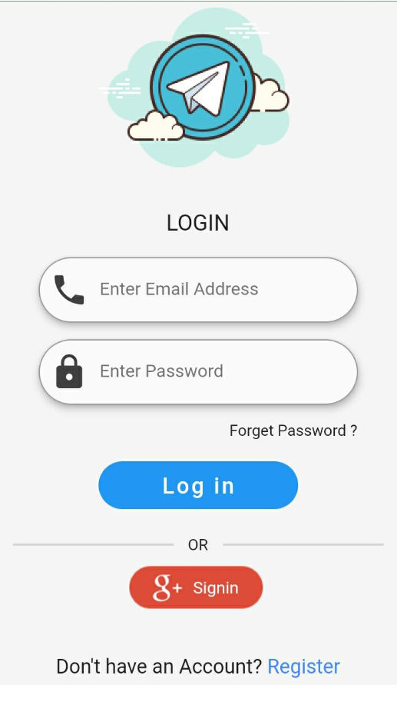
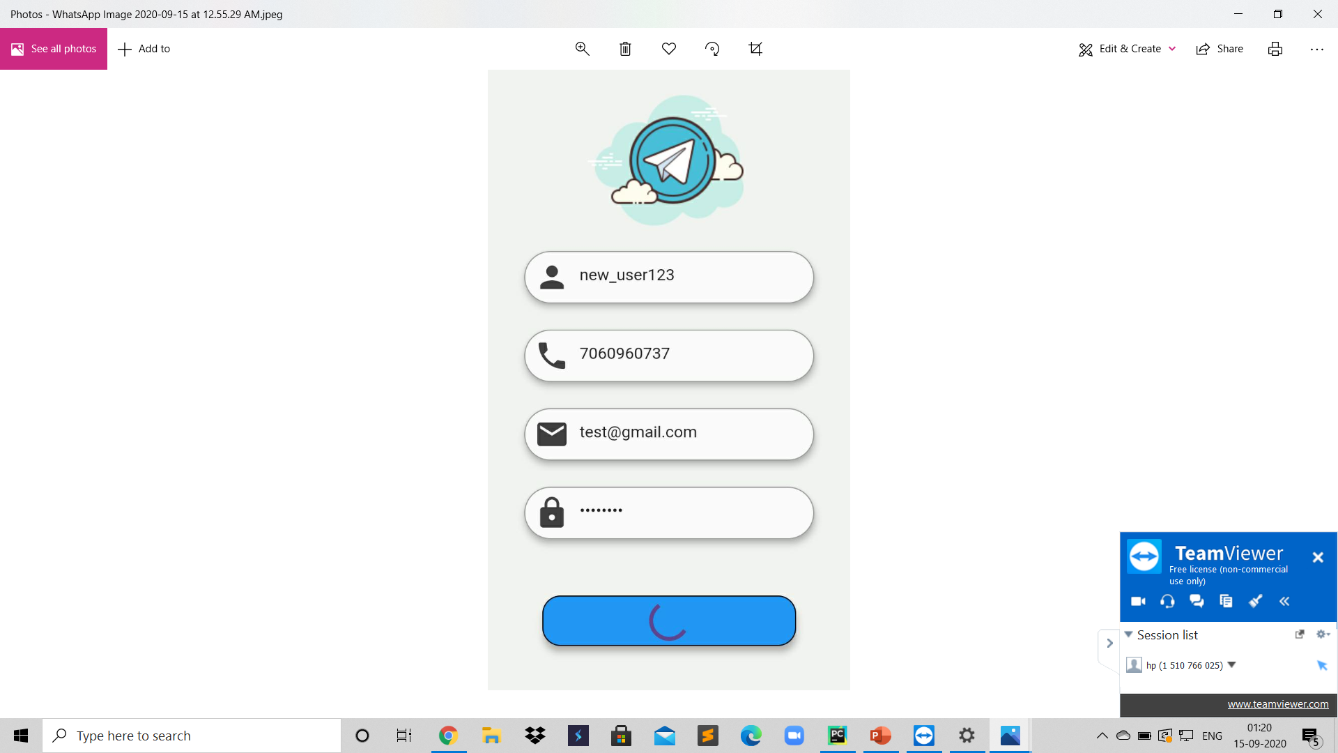
1.Login Page 2.Registering User

Slide 14
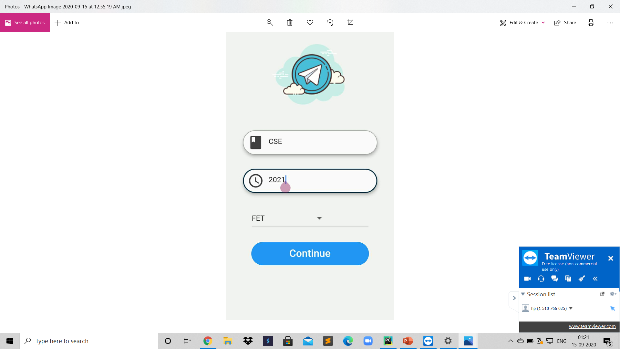
3.Adding User Details

Slide 15
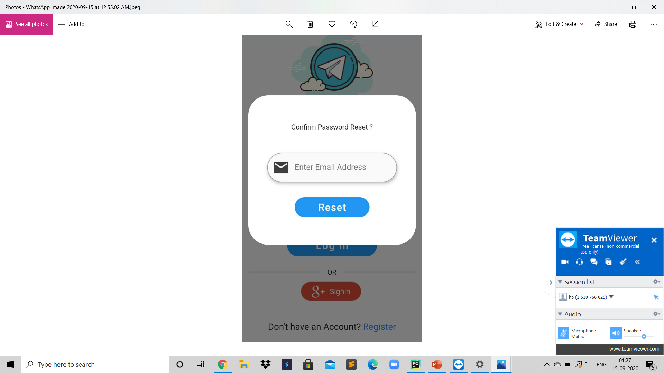
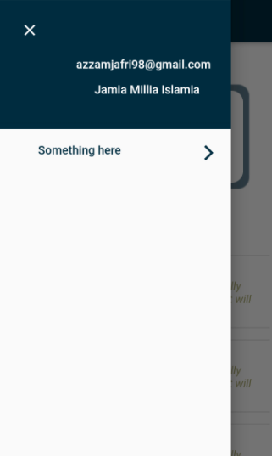
5. Password Reset

Slide 16
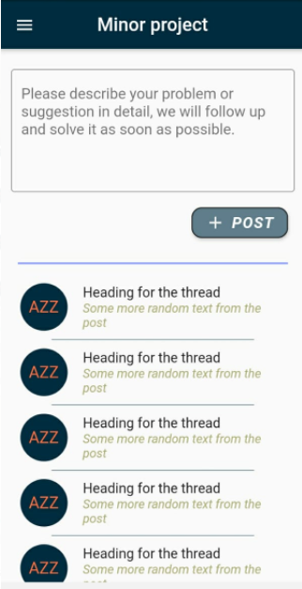
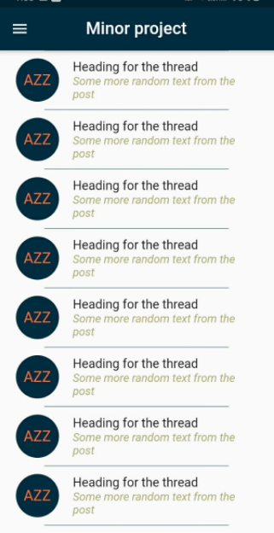

Slide 17
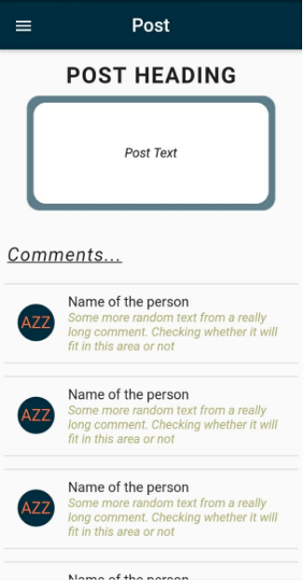
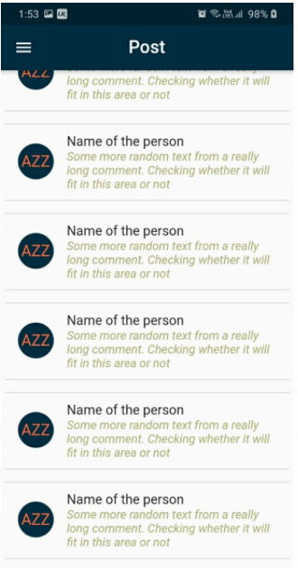

Slide 18
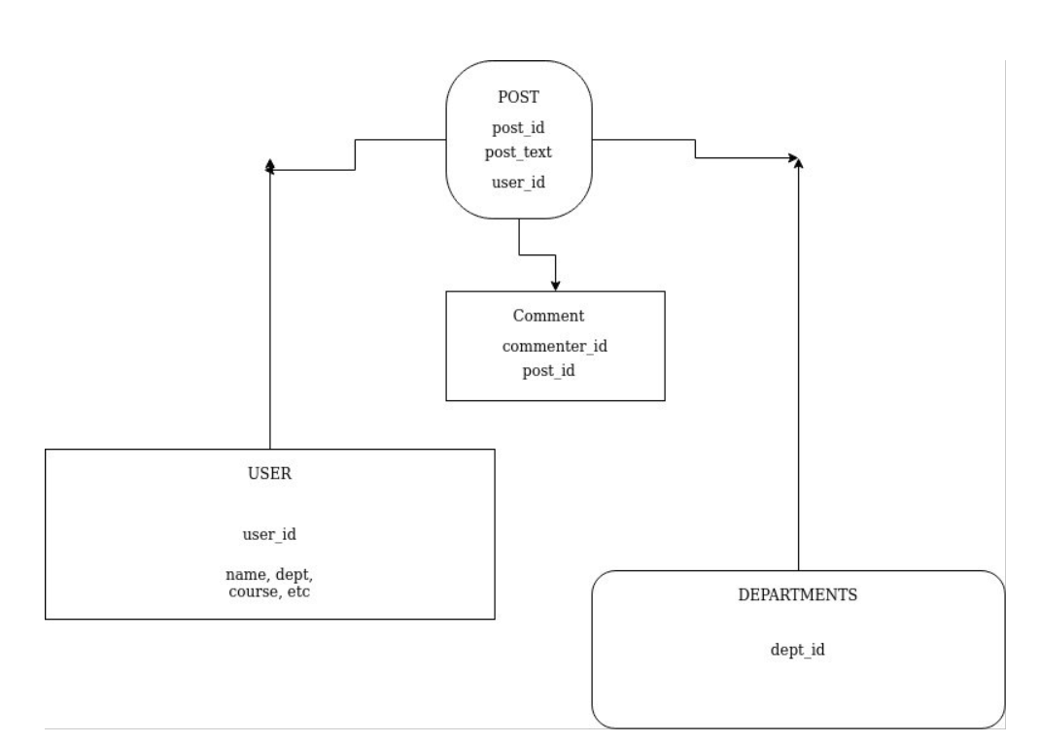

Slide 19
References
A Study on Sentiment Analysis: Methods and Tools Abhishek Kaushik, Anchal Kaushik, Sudhanshu Naithani, Kiel University of Applied Sciences, Computer and Electrical Department, Sokratesplatz 1, 24149 Kiel, German
https://pdfs.semanticscholar.org/c151/dfad8c1bf88b0afc716758c77d533ded7dd0.pdf
International Journal of Computer Applications (0975 – 8887) Volume 133 – No.9, January 2016 7, A Survey on Sentiment Analysis Algorithms for Opinion Mining by Vidisha M. Pradhan, Jay Vala and Prem Balani
https://www.ijcaonline.org/research/volume133/number9/pradhan-2016-ijca-907977.pdf
International Journal of Advance Engineering and Research
Development, Volume 4, Issue 11, November -2017
Short Survey on Naive Bayes Algorithm, by Pouria Kaviani, Mrs. Sunita Dhotre
https://www.researchgate.net/publication/323946641_Short_Survey_on_Naive_Bayes_Algorithm

Slide 20
Thank you…

