Slide 1


Application Proposal
Yinni
AI-Assisted Shopping
Abdullah Azzam
2026
Yinni
AI-Assisted Shopping

Slide 2

Yinni
AI-Assisted Shopping
We have seen that E-Commerce Service retain its position as an irreplaceable service in modern industry. Even in the middle of rapid development of AI. Shopping need is universal and eternal need for people. The idea to compete with is definitely a bad idea. But, what if we can build a better service on top of it. Indeed, we can build a service that is constructed not to compete with E-Commerce, but to augment it with the power of AI. Here is Yinni coming for you.
Motivation
Yinni is an AI-Assisted Shopping service built for people who want to use prompting for all shopping activity, including browsing, choosing, and purchasing. No more confusion of using the E-Commerce application interface with a lot of unfamiliar customization. Just say what do you want to do, and we will do it for you. Yinni is a robust and logical solution for E-Commerce activity problem perfectly leveraging the power of AI.
APPLICATION PROPOSAL
02

Slide 3
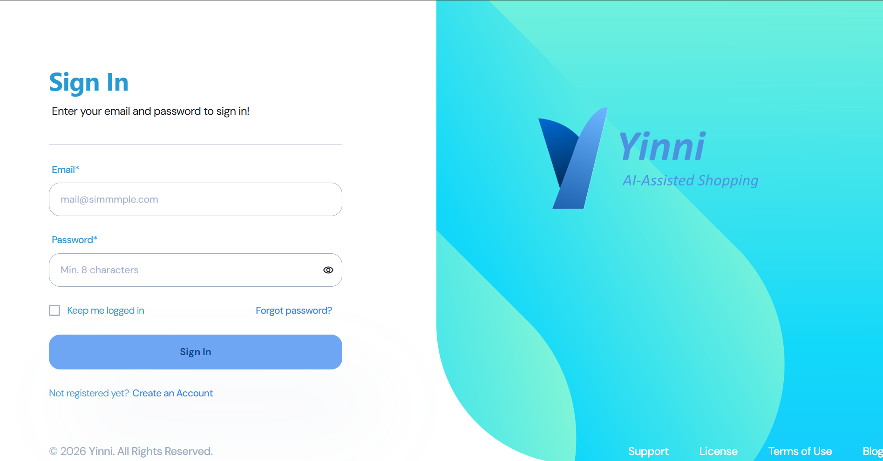
Yinni
AI-Assisted Shopping
QUICK DEMONSTRATION (Part 1)
Here is a quick demonstration showing phase-1 development prototype of Yinni Application.
Open http://76.13.17.200:3000, you will be redirected to Login page of Yinni Application.
If you don’t have account yet, you can click [Create an Account] below the [Sign In] button.
APPLICATION PROPOSAL
03

Slide 4
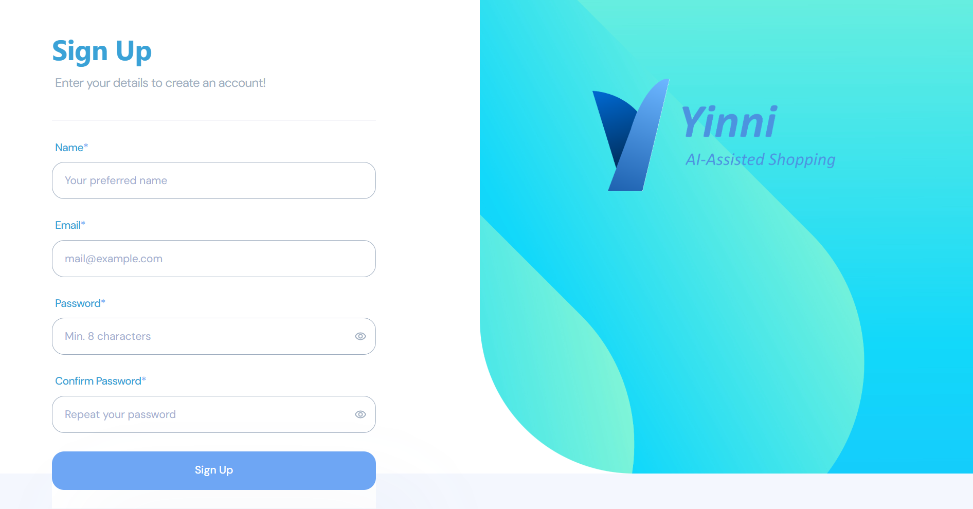
Yinni
AI-Assisted Shopping
QUICK DEMONSTRATION (Part 2)
After you click [Create an Account], you will be redirected to register page, as shown in this image.
You can input your name, email, and password, along with password confirmation, and then click [Sign Up], then you will be registered as user in the Yinni application.
After you are successfully registered, back to Login Page by clicking back button in Browser, and input you email and password.
APPLICATION PROPOSAL
04

Slide 5
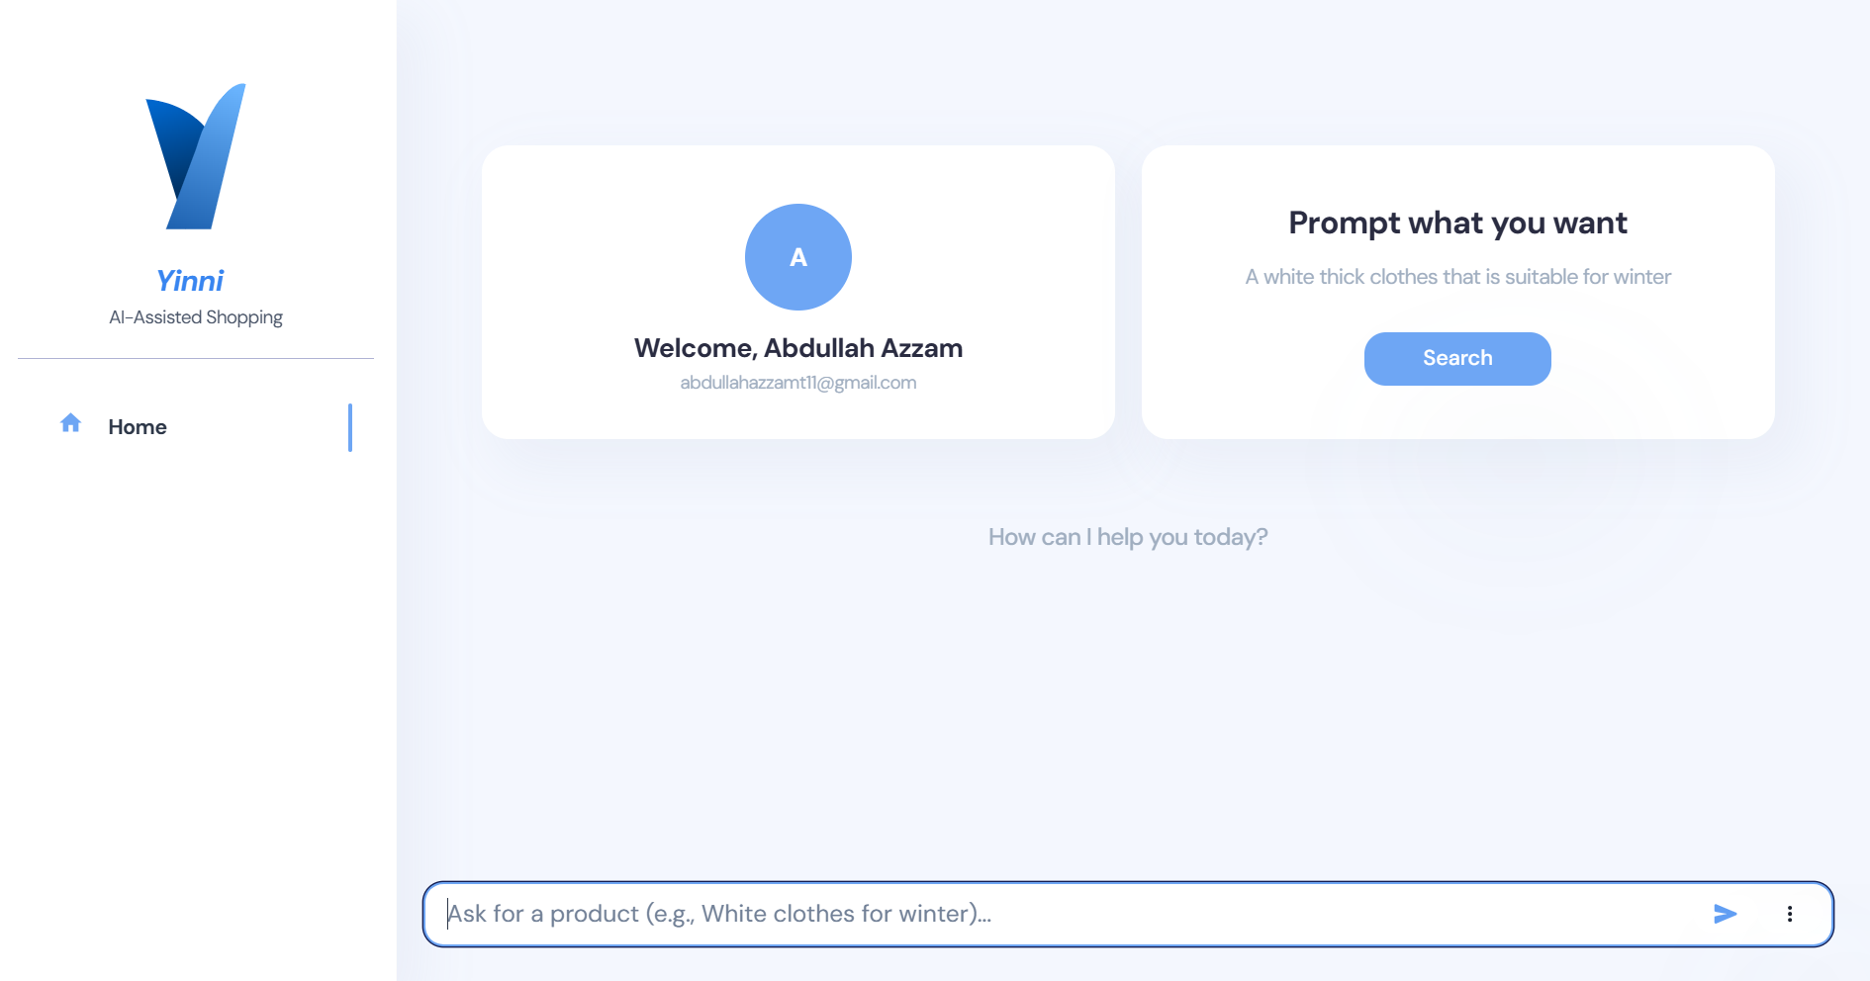
Yinni
AI-Assisted Shopping
QUICK DEMONSTRATION (Part 3)
After successfully logged-in, you will see the app home page look exactly like this.
You can test this app by writing your first prompt in the prompt field and clicking the paper-plane button on the right side on the prompt field, or by clicking [Search] in the “Prompt what you want” box in the center-right of the prompt window.
APPLICATION PROPOSAL
05

Slide 6
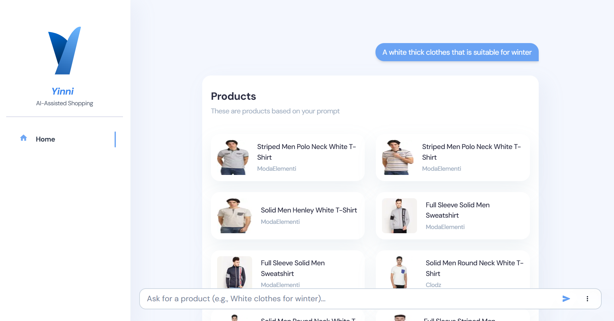
Yinni
AI-Assisted Shopping
QUICK DEMONSTRATION (Part 4)
After submitting your first prompt, you will see the chat display in the prompt window.
For this phase-1 development version, there is only 3 types of prompt:
Finding product
Selecting product from the list
Making payment
This image shows the first type, finding product.
To find the product, you just need to type the keyword or key-description of the product you desired.
APPLICATION PROPOSAL
06

Slide 7
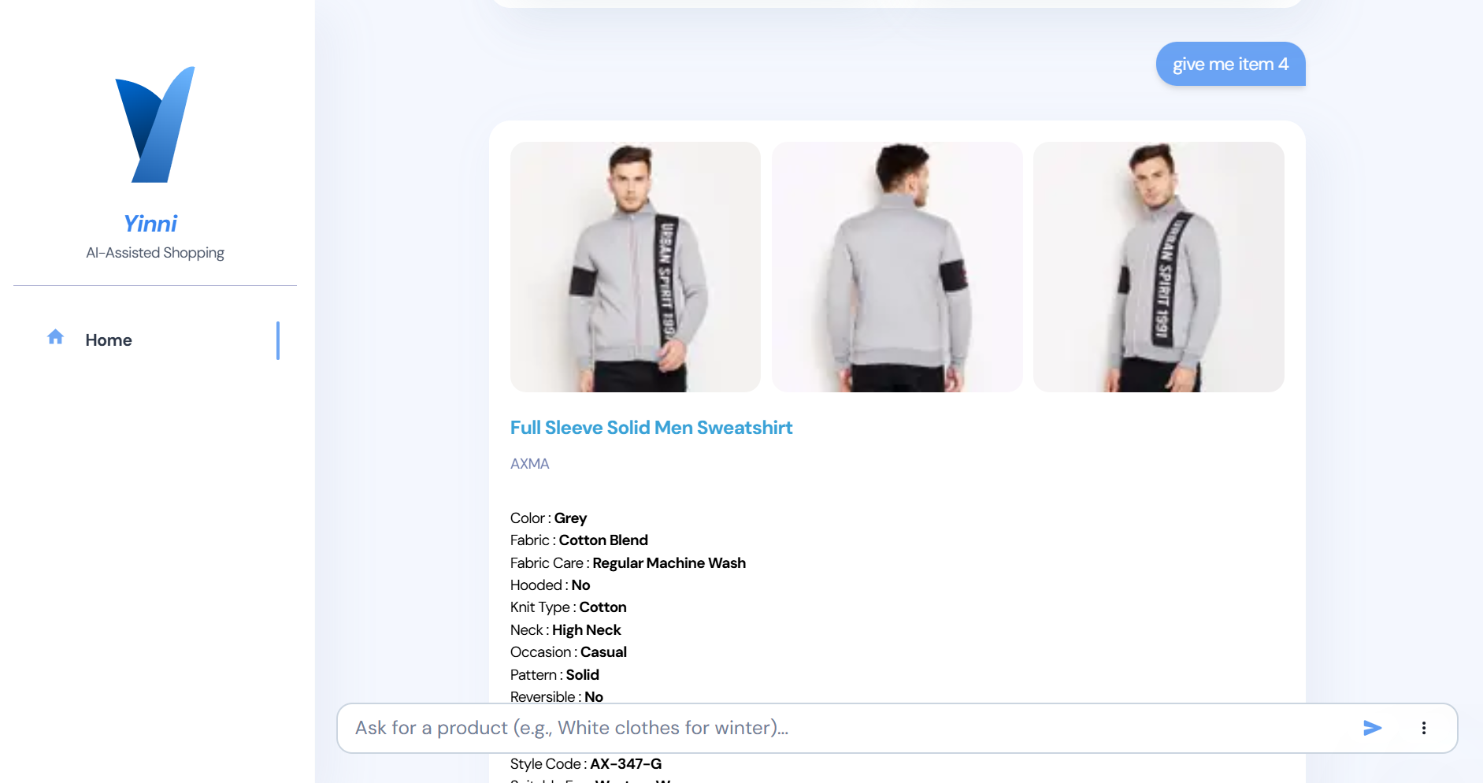
Yinni
AI-Assisted Shopping
QUICK DEMONSTRATION (Part 5)
After seeing what you want in the list, you can simply choose the item by typing “give me item 4” or “I want the first” or “give me the last item”. The prompting engine will give you the product detail of the item you chosen.
APPLICATION PROPOSAL
07

Slide 8
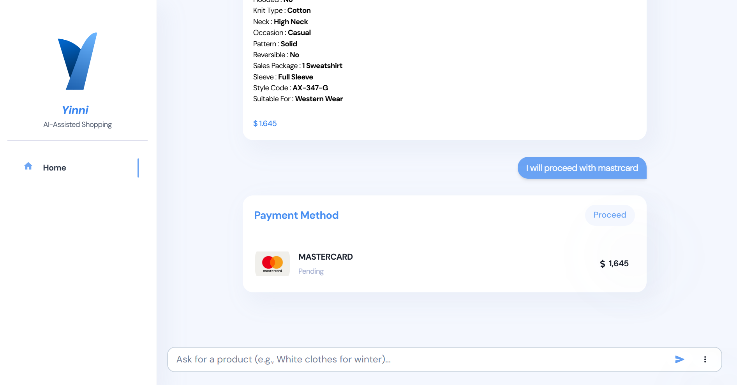
Yinni
AI-Assisted Shopping
QUICK DEMONSTRATION (Part 6)
Next, for the payment, you only need to type “I proceed with mastercard” or “I will purchase it with Dana”.
You can see that I intendedly writing typo in the prompt to test if the prompting engine still understand what I really mean.
Since the prompting engine is using the machine-learning classifier and advanced fuzzy string matching to map the prompt meaning, the prompting engine will understand what you want even if you typing it in a lot of typo.
APPLICATION PROPOSAL
08

Slide 9
Yinni
AI-Assisted Shopping
Application Stacks
01.
Backend
02.
Frontend
03.
AI & Machine Learning
01.
01.
METODE SATU
METODE SATU
For Backend stack, Yinni App uses Kratos-Go Microservices framework which is a brand-new microservices framework developed by Alibaba Group designed for Enterprise use with modern, scalable, clean, and neat structure. [Kratos-Go]
For Frontend stack, Yinni App uses React.js framework with Chakra-UI and the touch of Horizon-UI template which is a standard template for enterprise use. [Horizon-UI] [Chakra-UI]
For AI and Machine Learning stack, Yinni App uses OpenAI API, leveraging OpenAI Text Embedding 3 Small model for embedding layer and PyTorch Embedding Bag model for prompt classifier. [OpenAI Text Embedding 3 (small)] [PyTorch Embedding Bag]
APPLICATION PROPOSAL
09

Slide 10
Yinni
AI-Assisted Shopping
Backend Architecture
OpenAI
In the backend, briefly, there is 12 steps running for the entire workflows as figured in this diagram:
Client Sign-In or Sign-Up via Auth Service
Auth Service retrieves data from the database and generates JWT token
Prompt Service get the session from Auth-Middleware
The JWT token is sent to Client
Client send a prompt
Classifier Service classify the prompt
Classifier Service returning {type, value} to Prompt Service
Prompt Service send the value to the corresponding service based on the type
Product Service process the Embedding for the prompt through OpenAI API and send back the Embedding vector for Similarity Search
Each services retrieve the data from the database (The product service retrieves product data along with its corresponding embedding vectors)
Each services calculates and serializes the data and send the result back to Prompt Service
Prompt Service encapsulates the data from each services and send it back to Client
⑨
Yinni Backend (Kratos-Go Microservices)
01.
Classifier Service (Python)
Product Service (Go)
Database (MySql)
01.
METODE SATU
METODE SATU
Payment Service (Go)
⑩
⑥
⑦
⑧
⑪
Prompt Service (Go)
Auth Service (Go)
②
③
⑫
④
①
⑤
Yinni Client
APPLICATION PROPOSAL
10

Slide 11
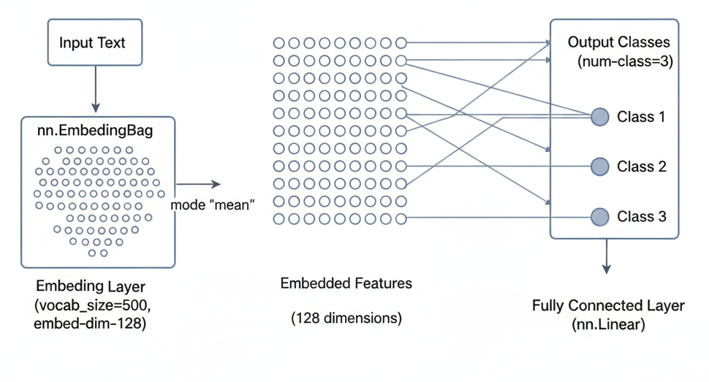
Yinni
AI-Assisted Shopping
Classifier Service (Part 1)
For the Classifier Service, Yinni App uses Ultra-Lite-Classifier model built using PyTorch Embedding-Bag model as an embedding layer with embedding dimension of 128 and fully connected linear layer classifying to 3 classes of prompt type (FIND ITEM, SELECT OPTION, MAKE PAYMENT), trained using datasets of 640 samples, spanning 300 vocab size, with only 38,787 parameters making it so incredibly lite for extremely fast process.
01.
APPLICATION PROPOSAL
11

Slide 12
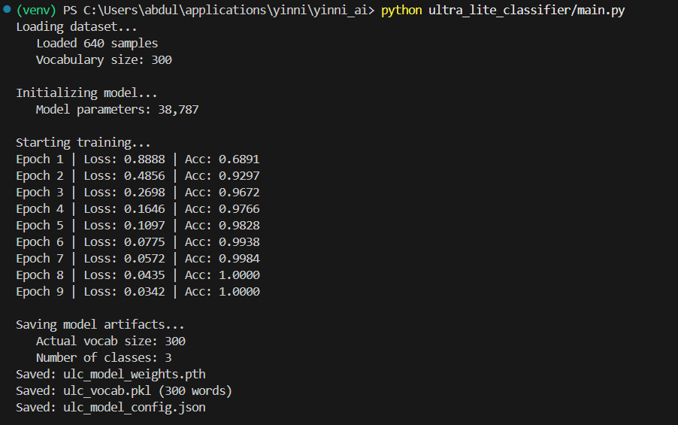
Yinni
AI-Assisted Shopping
Classifier Service (Part 2)
This illustration shows the training process using epoch value 9.
The output is ulc_model_weight.pth as trained model.
01.
APPLICATION PROPOSAL
12

Slide 13
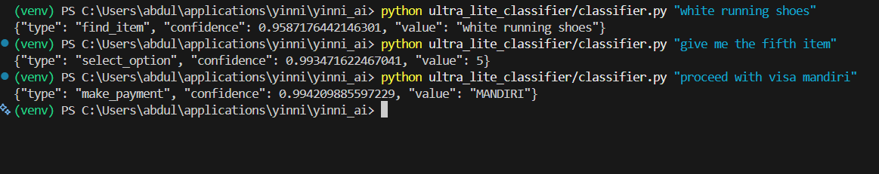
Yinni
AI-Assisted Shopping
Classifier Service (Part 3)
This illustration shows the testing of the classifier model using the previously resulted ulc_model_weight.pth as a model weight.
01.
APPLICATION PROPOSAL
13

Slide 14
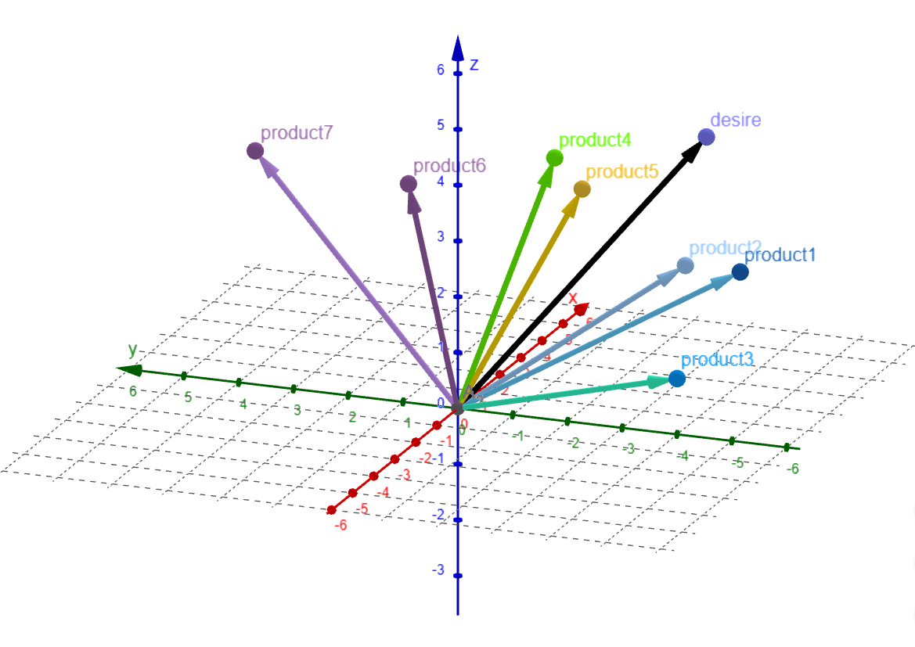
Yinni
AI-Assisted Shopping
Similarity Search (Part 1)
Yinni App Product Service utilizes standard embedding-based similarity search via the OpenAI text-embedding-3-small model.
This model maps product descriptions and user prompts into a 1536-dimension float-vector space, employing cosine similarity to determine the semantic relationship between vectors.
01.
APPLICATION PROPOSAL
14

Slide 15
Yinni
AI-Assisted Shopping
Similarity Search (Part 2)
The deployment-implementation step is as following:
At the beginning, Authenticated Admin run GenerateAllEmbedding function through Product Service API
Product Service fetch products one-by-one from database
Each product description is forwarded to OpenAI API to get unique embedding vector
Embedding vector for each products is stored in the product database
Authenticated Client send a prompt
Prompt Service send the prompt text to Product Service
Product Service send prompt text to OpenAI API to get embedding vector
Product Service fetch products from database along with its embedding vectors and calculate the cosine-similarity to determine N closest product vectors to the prompt’s embedding vector
Product Service returning N products closest to prompt description
List of N products is sent back to client
Yinni Backend (Kratos-Go Microservices)
Database (MySql)
01.
Classifier Service (Python)
01.
Payment Service (Go)
④
②
⑧
⑦
Product Service (Go)
⑥
Prompt Service (Go)
Auth Service (Go)
OpenAI
③
⑨
①
⑤
⑩
Yinni Admin
Yinni Client
APPLICATION PROPOSAL
15

Slide 16
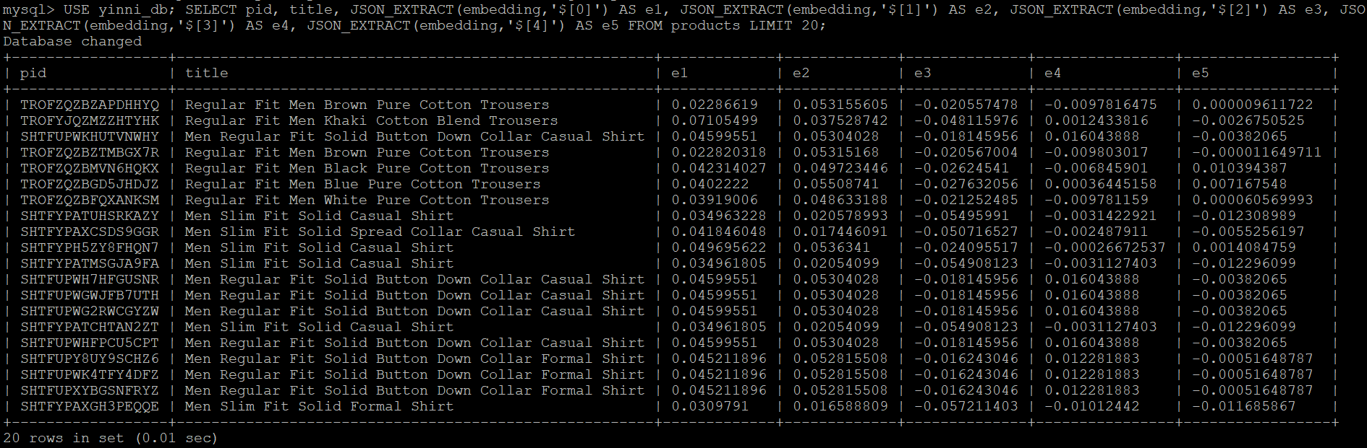
Yinni
AI-Assisted Shopping
Similarity Search (Part 3)
The following picture shows first 20 products along with first 5 elements of their embedding vector.
01.
APPLICATION PROPOSAL
16

Slide 17
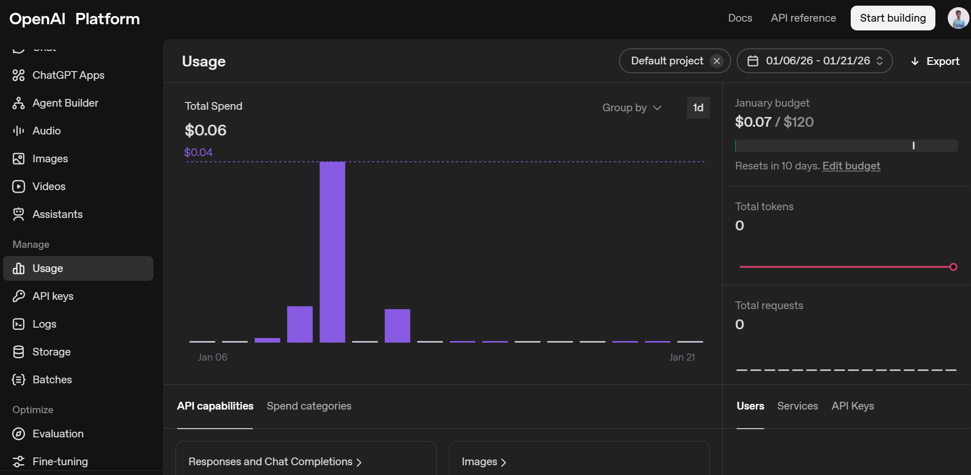
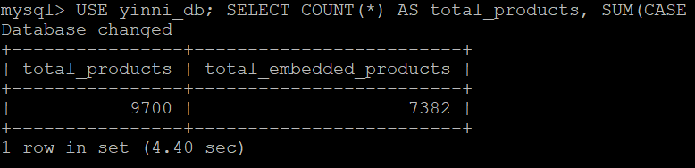
Yinni
AI-Assisted Shopping
Similarity Search (Part 4)
The following picture shows the OpenAI quota allocation for embedding activities for 7382 successfully embedded products out of 9700 total products.
APPLICATION PROPOSAL
17

Slide 18
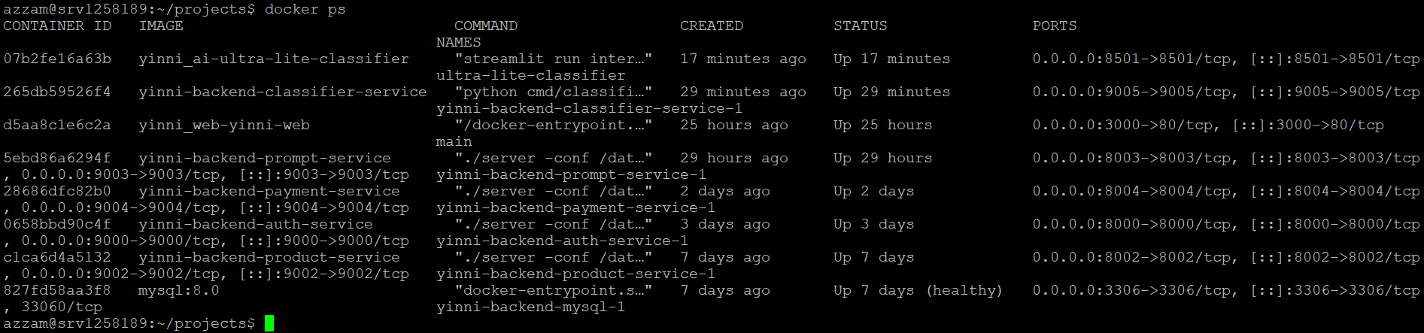
Yinni
AI-Assisted Shopping
Deployment in VPS
All my application stacks are deployed Docker-container-wise to VPS. Since I have a trouble processing my payment in AWS, I cannot proceed the deployment to AWS Elastic Kubernetes Service or AWS Elastic Container Service as I desired.
APPLICATION PROPOSAL
18

Slide 19


Yinni
Here I will explain the reasons of why my Application is safe.
1. Reduced Attack Surface via Compiled Binaries
By using Go, a statically compiled language, the production environment does not require a language interpreter (like Python or Node.js) or source code to be present on the server. This significantly limits the tools available to an attacker, effectively mitigating common scripting engine exploits and making the environment inherently more resilient against unauthorized code execution.
2. Type-Safe Data Persistence with Ent ORM
Kratos-Go Microservices utilize Ent ORM, which enforces strict type-safety and uses parameterized queries for all database interactions. By abstracting the data layer through Meta’s high-performance framework, we programmatically prevent SQL Injection vulnerabilities. This ensures that user input is never executed as command logic at the database level.
3. Containerized Microservice Isolation
The application is deployed using a Microservices Architecture where each component is isolated within its own Docker container. This provides logical sandboxing and namespace isolation. By restricting inter-container communication to specific, encrypted pathways, this containerization strategy minimizes the risk of lateral movement, ensuring that a compromise in one service does not grant immediate access to the entire infrastructure.
AI-Assisted Shopping
Security Concern
APPLICATION PROPOSAL
19

Slide 20
Yinni
AI-Assisted Shopping
For the further progress, I realize that Classifier Service is still context-agnostic and just blindly hard-strict-categorize prompt without any semantic understanding, so, in the next version, I am aiming to deploy Context Service which is context-aware to the prompt. This new service will implement Transformers-Embedding-Transformers architecture to properly map user prompt to the exact desired meaning. This approach of-course requires a super big dataset and high quality of computational resources as a trade-of. Currently I don’t have any of that requirements, so it might be takes time to get everything ready.
Further Progress
APPLICATION PROPOSAL
20

Slide 21
Yinni
AI-Assisted Shopping
There are a lot of Fullstack Engineers in Indonesia and maybe a lot of them are in a better skills, but I guarantee that I am the one with the fastest skill development progress among all of them. And also, as you know, most of Fullstack Engineers do not fluent in the AI implementation, they maybe barely know how to make machine learning service and incorporate it into Microservices App. You can give me the opportunity to be the Cofounding Fullstack Engineer Intern for your company, I will show you how eligible I am for Cofounding Fullstack Engineer position.
Why you should hire me
APPLICATION PROPOSAL
21

Slide 22

Yinni
AI-Assisted Shopping
Links
1. Yinni Backend
Auth Service Live API: http://76.13.17.200:8000/v1/auth/sign-in
Prompt Service Live API: http://76.13.17.200:8003/v1/prompt
Product Service Live API: http://76.13.17.200:8002/v1/products
Github Repository: https://github.com/azzamt11/yinni_backend
2. Yinni Web
Live Demonstration: http://76.13.17.200:3000
Github Repository: https://github.com/azzamt11/yinni_web
3. Yinni AI – Ultra Lite Classifier
Live Testing: http://76.13.17.200:8501
Github Repository: https://github.com/azzamt11/yinni_ai
Note: For Live API use, refer to:
https://github.com/azzamt11/yinni_backend/blob/main/yinni_api_collection.json
METODE SATU
APPLICATION PROPOSAL
22

Slide 23



Yinni
AI-Assisted Shopping
Thank You

