Slide 1
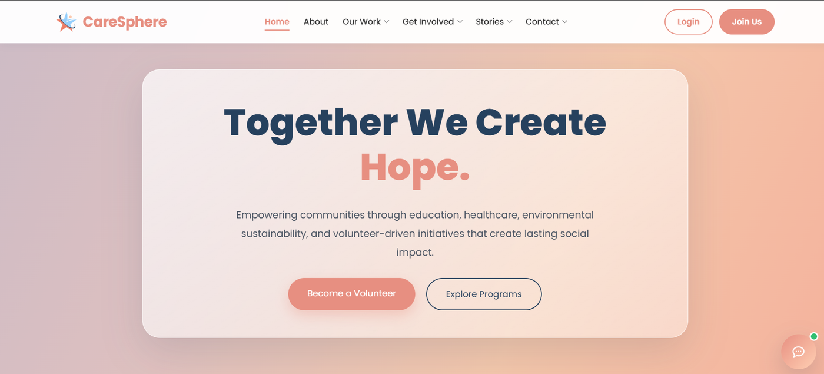
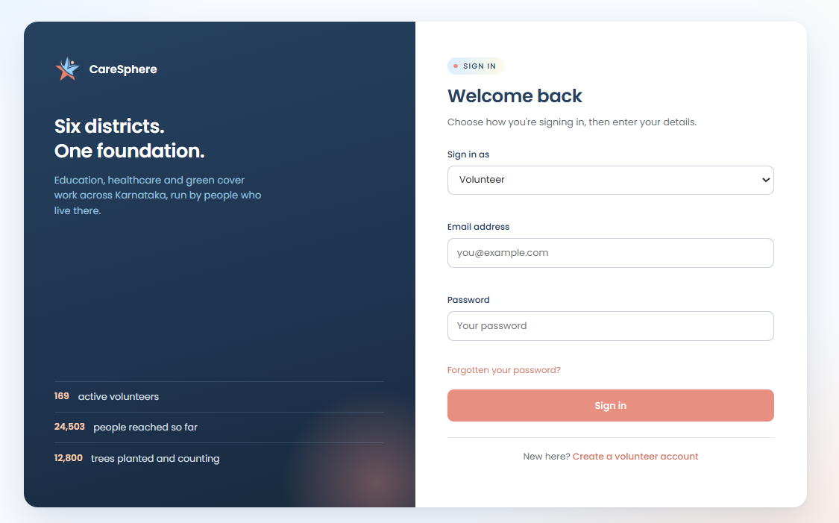
MSC COMPUTER SCIENCE PROJECT
CareSphere
A website that runs a whole NGO, from the first volunteer form to the final certificate
Frontend, backend, database and API explained from scratch.
HTML · CSS · JS
FastAPI
PostgreSQL
St Joseph's University, Bengaluru

Slide 2
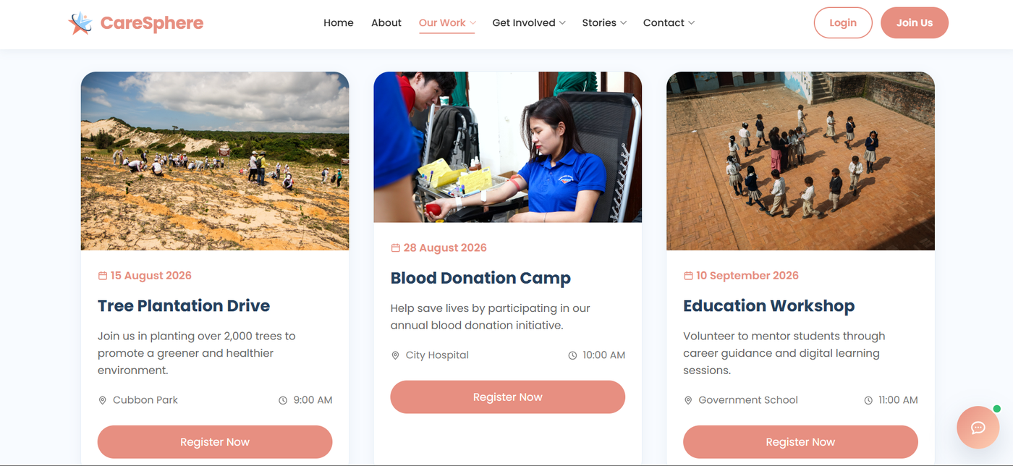


What is CareSphere?
THE IDEA
The problem
An NGO has volunteers, events, hours, donations and messages to keep track of. On paper and spreadsheets, things get lost and nobody sees the full picture.
The solution
One website where the public can join and take part, and the NGO staff can manage everything from a single admin panel.
The public events page. Visitors see every event and register in one click.
3
6
3
focus areas: education, healthcare, green cover
districts of Karnataka
kinds of logged-in users

Slide 3




Who uses the website?
THE PEOPLE
Visitor
Volunteer
Admin
Super Admin
No login needed
Logs in after approval
NGO staff
Head of the NGO
Reads news and events
Donates
Sends a message
Asks to partner as a school
Registers for events
Logs hours worked
Downloads certificates
Shares a story
Approves applications
Verifies hours
Runs events and news
Replies to messages
Everything an admin can do
Manages admin accounts
Donations and settings
Only one who can delete
Each role sees a different menu, and the server double-checks the role before doing anything.

Slide 4




A website has three parts, like a restaurant
THE BIG PICTURE
Frontend
Backend
Database
The dining area
The kitchen
The store room
Everything you see and click: pages, buttons, forms, colours.
Hidden from you. Takes the order, checks it, does the work and sends the result back.
Where everything is kept safely: users, events, hours, donations.
HTML · CSS · JavaScript
Python · FastAPI
PostgreSQL
And the waiter? That is the API. It carries each request from the frontend to the backend and brings the answer back. The frontend never touches the database directly.

Slide 5


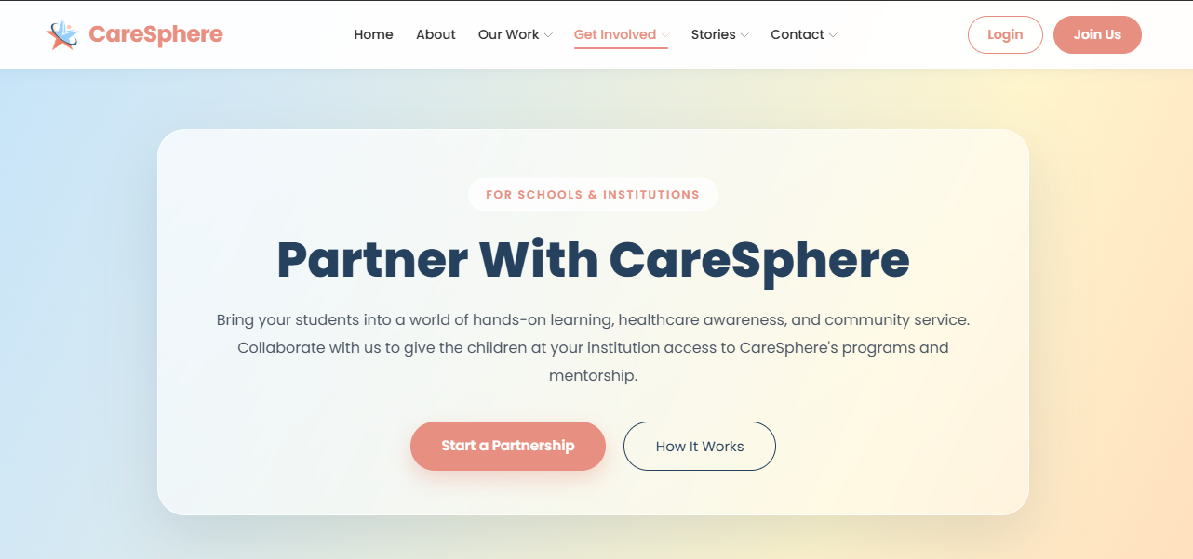

The public site: what a visitor sees
FRONTEND
HTML builds the page
The skeleton: headings, text, forms, buttons.
CSS makes it look good
Coral buttons, navy headings, soft pastel backgrounds, Poppins font.
JavaScript makes it work
Checks forms, loads events and news from the backend, draws charts.
Pages
Home, About, Programs, Events, News, Volunteer, Institutions, Donate, Contact, FAQ, Hall of Fame, Impact dashboard

Slide 6
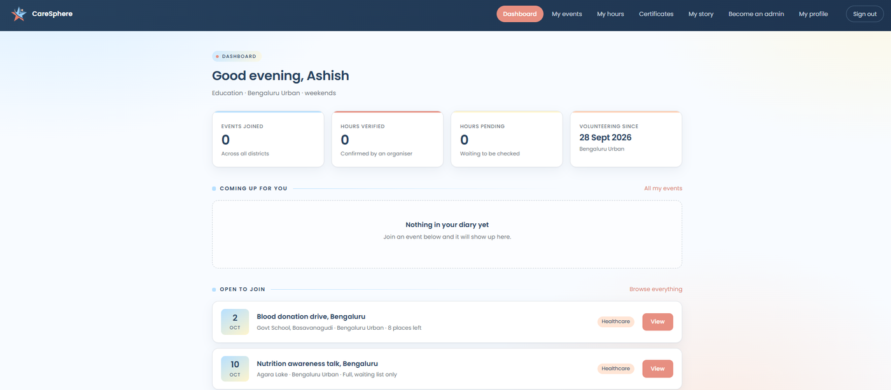
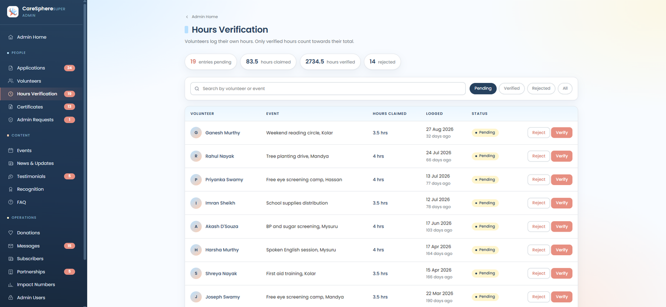


After login: two different worlds
FRONTEND
Volunteer portal
Admin panel
A personal dashboard: events joined, hours verified, hours still pending, and events open to join.
The control room. Here an admin checks the hours volunteers claim and clicks Verify or Reject.

Slide 7
The backend: the brain you never see
BACKEND
The backend is a Python program that stays running on the server and waits for requests. For every request it does the same four things:
Built with
The programming language.
Python
1
Who is asking?
Reads the login token to find the user and role.
The framework that turns Python functions into web addresses the frontend can call.
FastAPI
2
Is the data OK?
Rejects empty, wrong or badly shaped data.
The server that keeps the backend running on port 8000.
Uvicorn
3
Do the work
Reads from or writes to the database.
Checks that incoming and outgoing data has the right shape.
Pydantic
4
Reply
Sends the answer back to the page as JSON.

Slide 8

The database: tables, like smart Excel sheets
DATABASE
20+
A table is one sheet. Each row is one record, each column is one detail. This is roughly what the users table looks like:
tables in PostgreSQL, grouped like this
id | name | role | district
1 | Azeen | Super Admin | Bengaluru Urban
2 | Saija | Admin | Bengaluru Urban
3 | Ashish | Volunteer | Bengaluru Urban
People
users, applications, admin requests
Activity
events, registrations, hours, certificates
Sample rows for illustration
Content
news, testimonials, recognition, FAQ
Tables are linked
Operations
donations, messages, partnerships, subscribers, settings
An hours entry stores the id of the volunteer and the id of the event. So the system always knows whose hours they are and which event they belong to.
SQLAlchemy lets Python talk to tables without writing SQL by hand. Alembic records every change to the table structure.

Slide 9
The API: how the page talks to the backend
API
An API is a list of addresses the backend understands. The page sends a request to an address, and the backend replies with data.
Examples from CareSphere
POST
/api/auth/login
Check the password and log the user in
Four kinds of request
/api/events
GET
GET
Read something
Give me the list of events
POST
Create something new
POST
/api/applications
Save a new volunteer application
PATCH
Change something
/api/registrations/{id}
PATCH
DELETE
Remove something
Cancel or update one registration
GET
/api/stats
About 60 addresses in total
Live counts for the impact dashboard

Slide 10
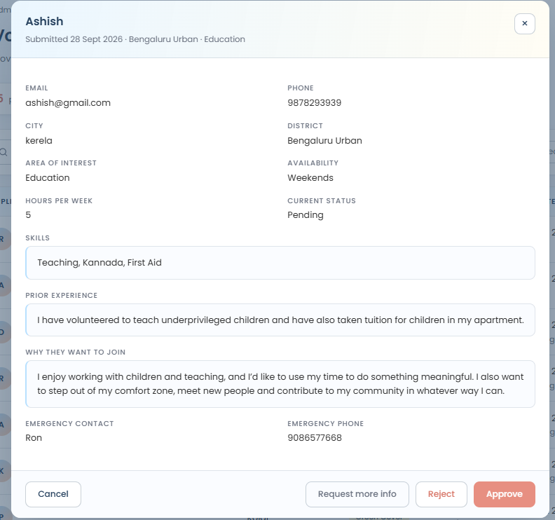






One application, start to finish
WORKING
STEP 1
STEP 2
Volunteer fills the form
Frontend sends it
Name, skills, district, why they want to join.
JavaScript posts the form to the API.
STEP 3
STEP 4
Backend checks it
Database saves it
Is the user logged in? Is every field valid?
A new row is added with status Pending.
STEP 5
STEP 6
Admin reviews it
Volunteer is in
It appears in the admin queue, as on the right.
Admin clicks Approve and the dashboard unlocks.
Step 5 on screen: Approve, Reject or Request more info.

Slide 11




Keeping accounts and data safe
SECURITY
Passwords are scrambled
Stored with bcrypt hashing. Even someone who opens the database cannot read a password.
A token after login
The backend gives the browser a signed pass (JWT). It is shown with every request, like an ID card.
Roles checked three times
Menu items are hidden, the page checks on load, and the server refuses the action if the role is wrong.
The login page. The role picked here must match the real role stored in the database.
Safe file uploads
File type is checked from its content, and the server gives every file a new name.

Slide 12

Problems solved, and what comes next
WRAPPING UP
Images broke between the two ports (5500 and 8000)
Future scope
Fix: One helper function now builds every image link
Host the site online
Online payment for donations
Automatic email updates
A mobile app for volunteers
Login kept sending users back to the login page
Fix: Session data is merged instead of overwritten
Password library clashed with its own dependency
Fix: Switched to using bcrypt directly
Thank you
Data lived only in the browser (localStorage)
Questions are welcome
Fix: Moved to a real PostgreSQL database behind an API

