Slide 1
Free octocats for a free society
Presented By Azzen abidi
urukproject.org

Slide 2

Let’s celebrate

Slide 3





I have worked on...

Slide 4


That’s the dream!

Slide 5
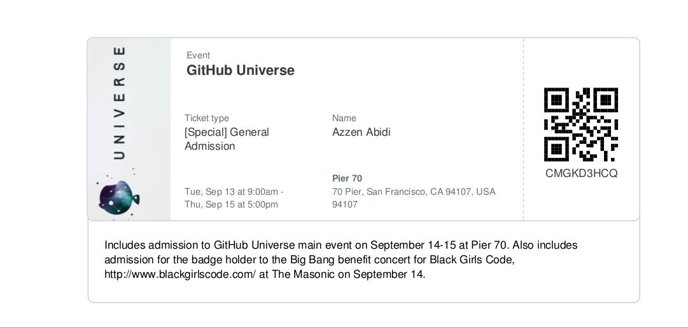
A ticket to heaven ?

Slide 6
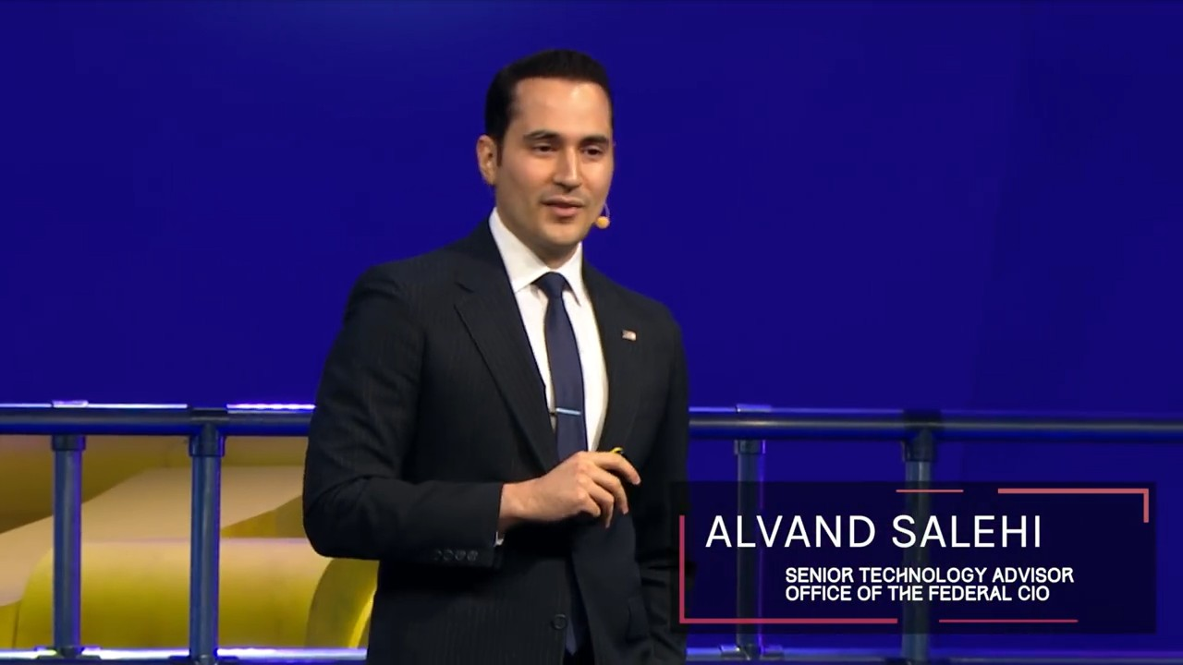
The man of the day

Slide 7
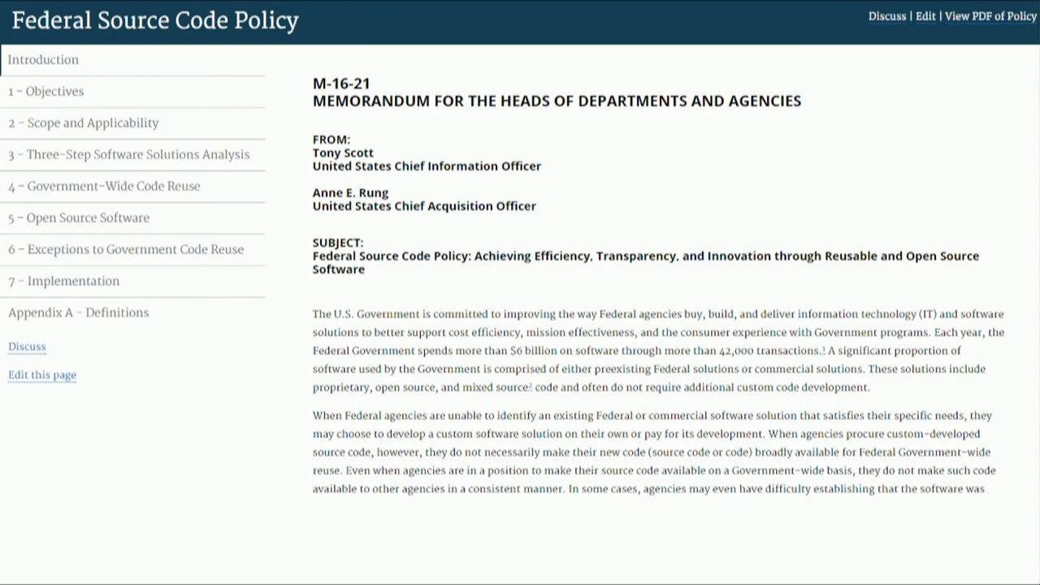
Federal source code policy

Slide 8
Bullet point
government wide code reuse policy

Slide 9
Just Do it !
Releasing government code as open source

Slide 10

Who cares?

Slide 11
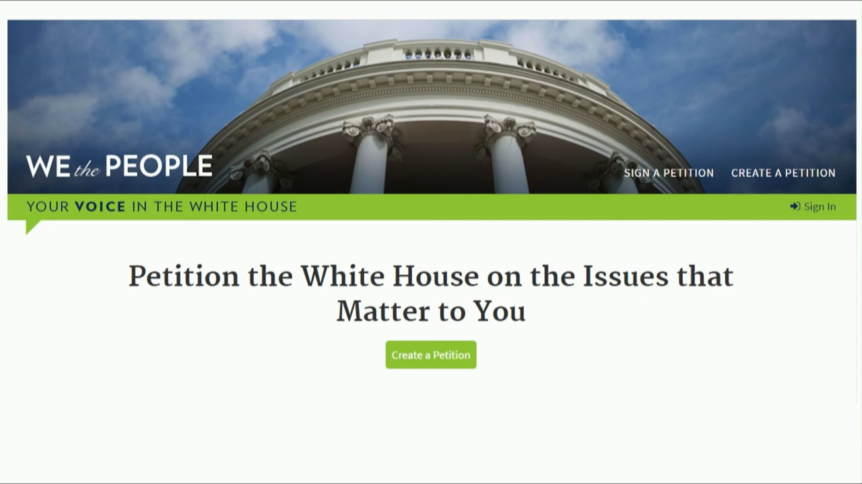
We the people

Slide 12
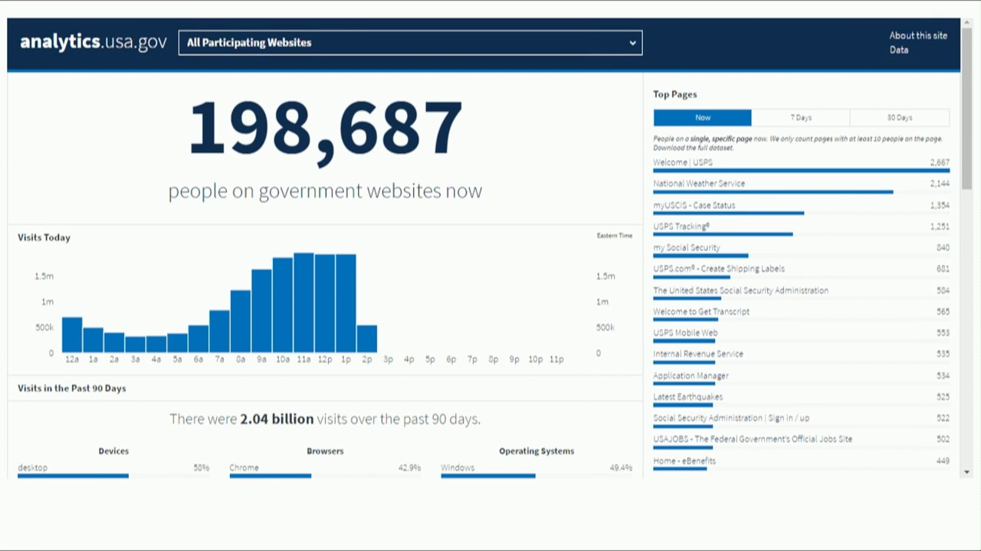
Analytics.gov

Slide 13
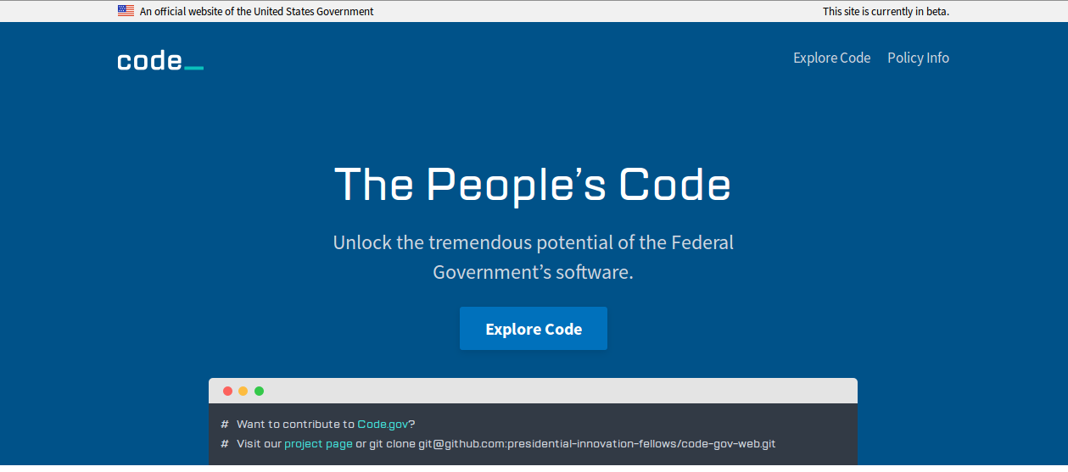
Code.gov

Slide 14
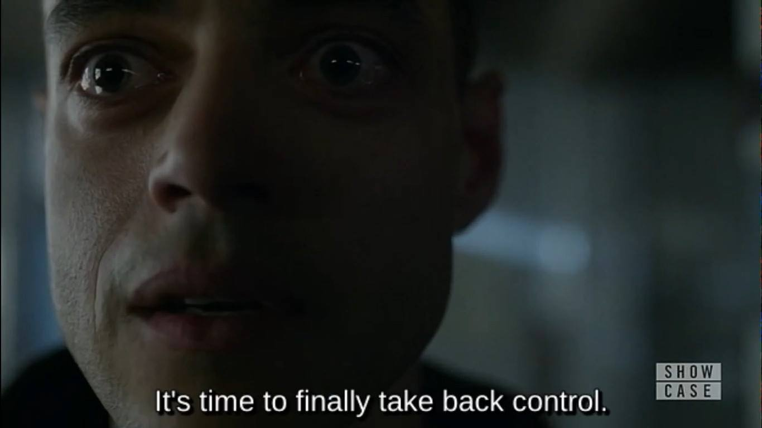
One last thing

