Slide 1
Tech. App. Launcher
21 Jun 2021
Prepared by: | Reviewed by: | Endorsed by: | Approved by:
Project Leader | STA Geology | Head, R&D Exploration Technology | Head, Exploration Technology

Slide 2
Table of contents
1.
2.
3.
4.
5.
6.
7.
8.
9.
10.
11.
Objective
Overview
Roadmap / Timeline
Application Flow
Conclusions
03
04
05
06
07
08
11
17
28
29
30

Slide 3
Problems
Admin Right user permission control prevent installation.
Statistics Analytics
Poor User Experience.
Complicated Approval Process.
Installation is prohibited on the workstation without internet access.

Slide 4
Objective
Initiative to enhance installation experience from Tech. App Store.
To automate Petrel’s Plugin installation. Optionally provides local installation for workstation which has no internet access.
To enable installation without Admin-Right user permission.

Slide 5
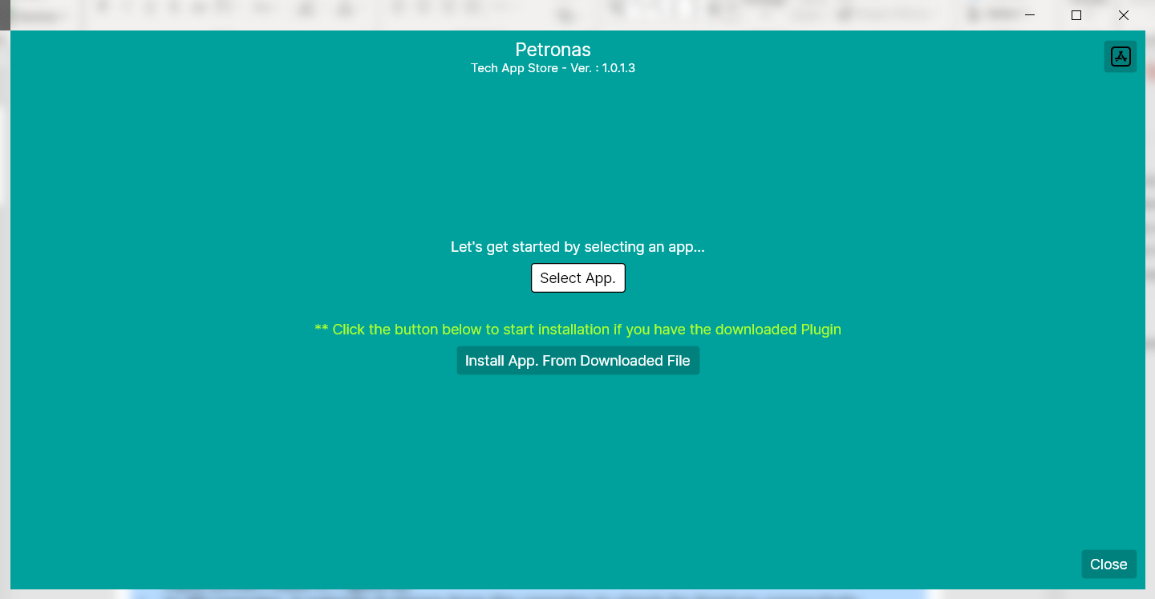
Overview
.Net Core 5.0 (Avalonia Framework).
Cross platform.
Standalone executable application – Easy distribution and installation.

Slide 6
Roadmap / Timeline
1st Week May ‘21
Endorsement
2nd Week May ’21
3rd Week May ‘21
Software Development
1st Week Jun ‘21
Published to Software Center
2nd Week Jun ‘21
UAT
3rd Week Jun ‘21
Continuous Improvement
System Architecture and Design

Slide 7
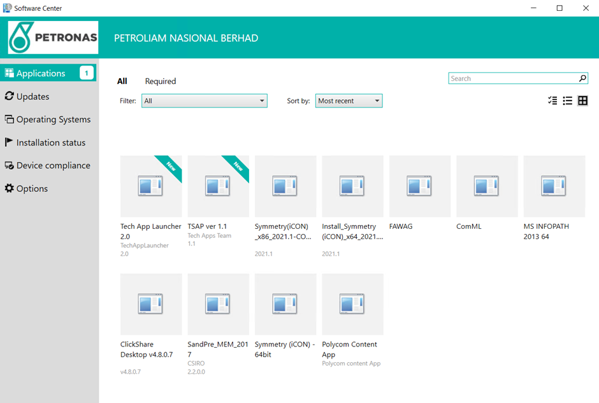
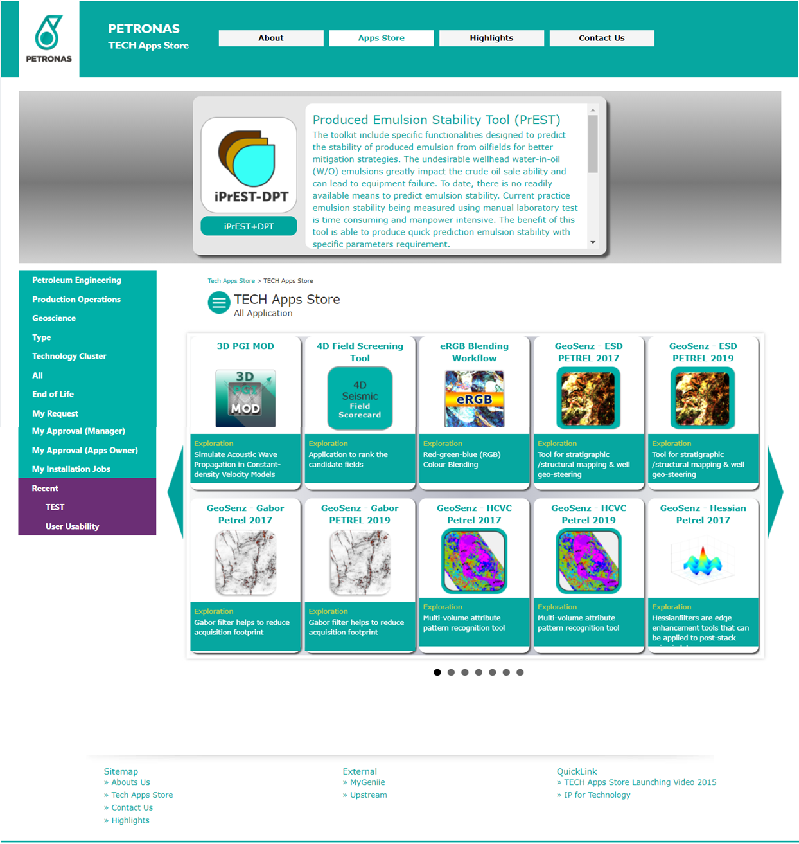
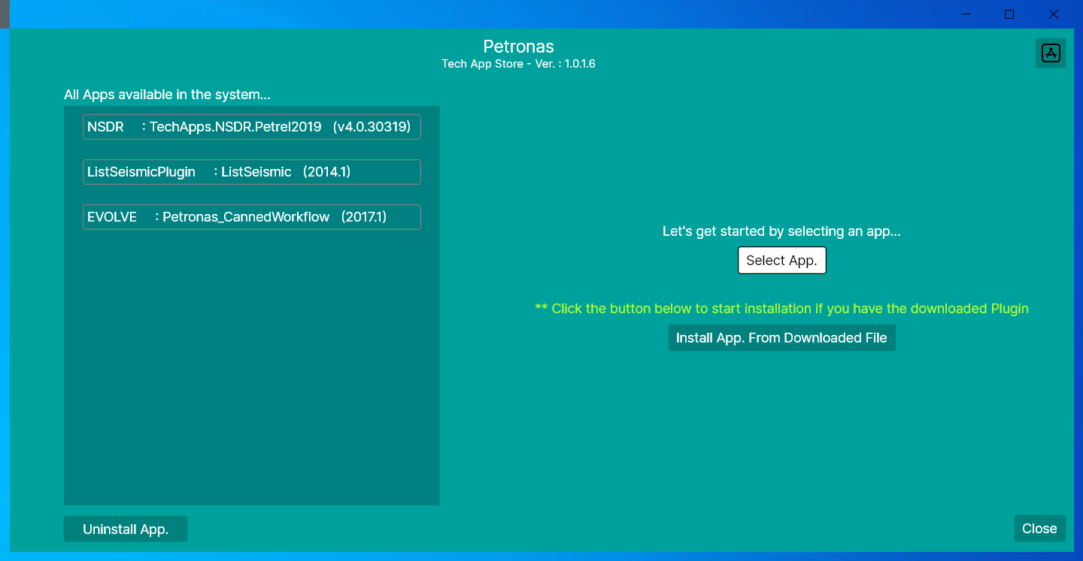

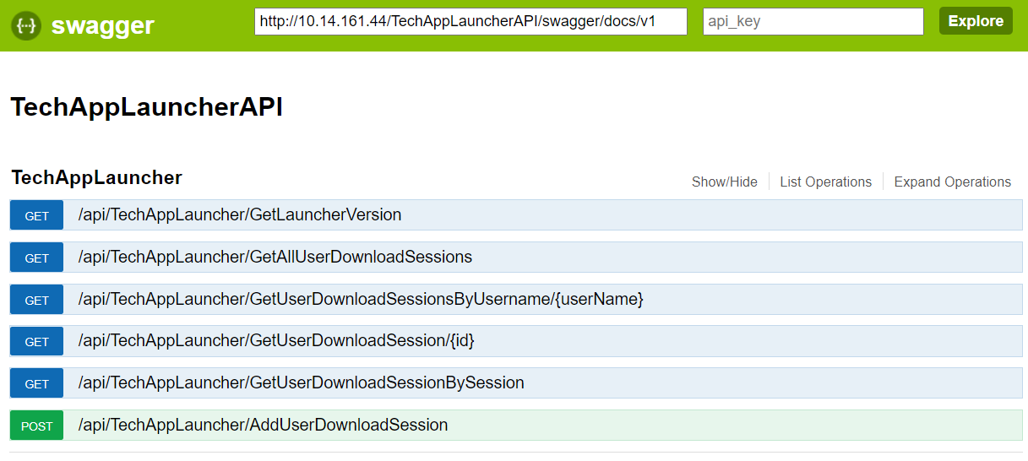

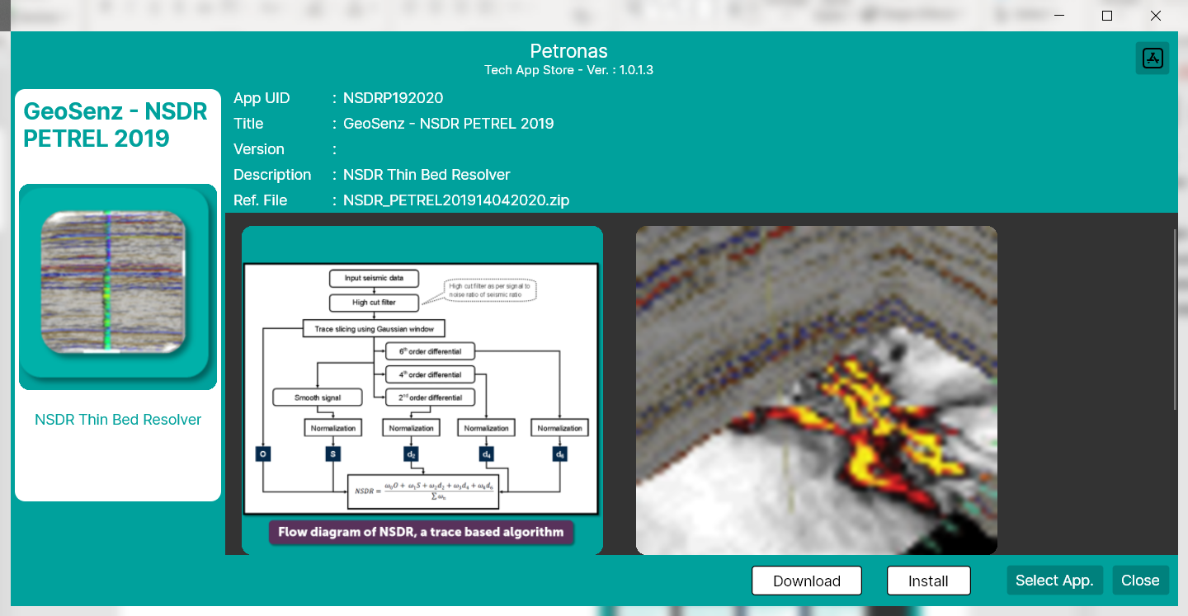
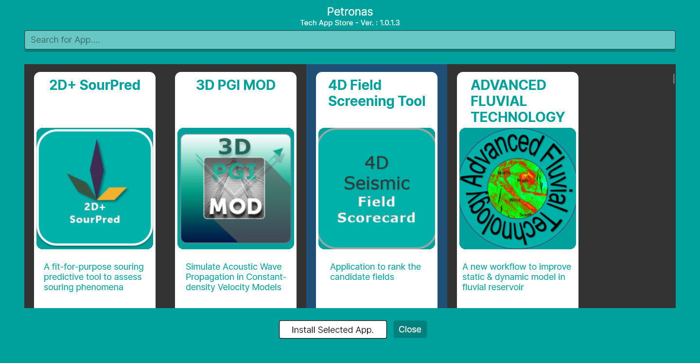
Application Workflow
Software Center
TechApp Portal
TechAppLauncher
Connect to TechApp Server via Http
2
1
Software Center
SQL Database
Saving Data
6
3
Connect to API to log event
Available Petrel Plugin
5
The Plugin can be installed or download
4
TechAppLauncher
TechAppLauncher

Slide 8
Conclusions
TechAppLauncher used the latest .Net technology (.Net5.0) which is cross platform support.
TechAppLauncher engaged with the Avalonia UI framework in order to provide better UI experience.
TechAppLauncher makes plugin installation easy to user.

Slide 9
Thank you

