Slide 1
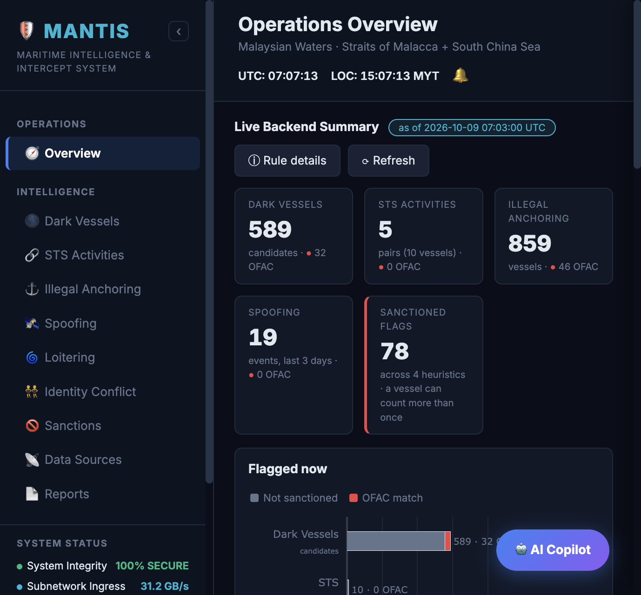
MARITIME INTELLIGENCE & INTERCEPT SYSTEM
MANTIS
Platform architecture, analytics modules
and the path to machine learning
Malaysian waters
Straits of Malacca and South China Sea
Leadership review | October 2026
MANTIS | Maritime Intelligence & Intercept System
October 2026
1

Slide 2
EXECUTIVE SUMMARY
MANTIS converts AIS traffic into reviewable maritime intelligence
The platform is in its data collection and validation phase. All modules and pipelines described here are in production; planned items appear on the roadmap.
Coverage. Six analytics modules run on live AIS data for Malaysian waters: ship-to-ship transfer (STS), dark vessels, illegal anchoring, AIS spoofing, loitering and identity conflict. OFAC sanctions screening is applied across all of them.
Processing. Each module is backed by a scheduled data pipeline on the processing server. Pipelines write their results to the operational database; the dashboard and REST API read those results through a read-only connection.
Review workflow. Every STS observation becomes a review case, enriched with the outputs of the other modules. Cases that remain unexplained after that enrichment are raised to analysts, who record a final classification.
Infrastructure. The platform runs on the existing processing server, API server and databases. No additional infrastructure was introduced for this phase.
Next phase. Analyst classifications form the labelled dataset for machine learning. Model development starts once that dataset is large and consistent enough to be trained and evaluated against.
PLATFORM AT A GLANCE
6
analytics modules on the dashboard
6
scheduled data pipelines in production
30 s
refresh cycle for STS proximity
5
review classes recorded by analysts
MANTIS | Maritime Intelligence & Intercept System
October 2026
2

Slide 3
PLATFORM ARCHITECTURE
Four tiers: data sources, processing, storage and service
Pipelines are the only components that write analytical results. The API and dashboard are read-only consumers.
DATA SOURCES
PROCESSING SERVER | DATA PIPELINES
OPERATIONAL DATABASE
API SERVER | CONSUMERS
AIS position history
Movement activity
Activity records
MANTIS REST API
ClickHouse, full track per vessel
Every 20 s
Movement, slow movement, loitering
Gunicorn, two workers. Read-only connection pool. Review verification uses one separate write connection.
Slow movement
Latest AIS position and static data
Every 20 s
Postgres, one row per vessel
STS observations
Proximity (STS)
Clusters, members, suspicion score
Dashboard
JKPTG licence register
Every 30 s
Live operating picture
Dredging project licences
Loitering
Position anomalies
Every 15 min
One row per vessel per UTC day
Notification and review
OFAC sanctions lists
SDN and Consolidated vessel entries
Position anomaly
Unexplained STS cases, analyst decisions
Every 15 min
STS review cases
Zone definitions
STS review case
Enrichment flags and analyst decision
Reports and dataset
Anchorage, watch and restricted polygons
Every 15 min
Unreviewed backlog, labelled cases
MANTIS | Maritime Intelligence & Intercept System
October 2026
3

Slide 4
DATA PIPELINES
Each module is fed by a scheduled pipeline with a defined input and output
Pipelines run as managed services on the processing server and restart automatically on failure.
Data pipeline | Input | Cycle | Output | Consumed by
Movement activity | Latest AIS position per vessel | 20 s | Movement records (stop at 0.5 kn) | Illegal anchoring, STS candidates
Slow movement | Latest AIS position per vessel | 20 s | Slow-movement records (3 kn) | Dark vessels, STS enrichment
Proximity (STS) | Movement records, static data, licence cache | 30 s | STS observations and members | STS module, review cases
Loitering | AIS track, previous 2 hours | 15 min | Loitering events with context flags | Loitering module, STS enrichment
Position anomaly | AIS position history (cargo, tanker) | 15 min | Daily position anomaly per vessel | Spoofing module, STS enrichment
STS review case | STS observations and all outputs above | 15 min* | Enriched review cases | Notification, review, dataset
Licence cache | JKPTG project licence register | 12 h | In-memory licence list | Proximity admission, review cases
Identity and sanctions | Static data, OFAC lists | On request | API response | All modules
* The review-case pipeline processes 100 observations per batch. While a backlog exists it continues every 5 seconds, then returns to the 15-minute cycle.
MANTIS | Maritime Intelligence & Intercept System
October 2026
4

Slide 5
DASHBOARD
Operations overview
A single summary of the four primary modules, refreshed on demand.
HOW THE OVERVIEW IS ASSEMBLED
Single request. The dashboard calls one overview endpoint. The API runs the dark-vessel, STS and illegal-anchoring queries on the operational database in one thread and reads the stored position anomalies in a second thread, then returns summary counts only.
Same rules as the module pages. Each tile applies exactly the rule used on its module page. Selecting a tile opens that module with the full vessel list.
Short cache. The summary is cached in the API for up to two minutes so repeated page loads do not re-run the queries. A module page opened afterwards can reflect a slightly later refresh.
Sanctioned flags. The total of OFAC matches across the four modules. A vessel that appears in two modules is counted in both.
Flagged now. Each module's count, split into sanctioned and non-sanctioned vessels.
Dashboard location: Operations > Overview
MANTIS | Maritime Intelligence & Intercept System
October 2026
5

Slide 6
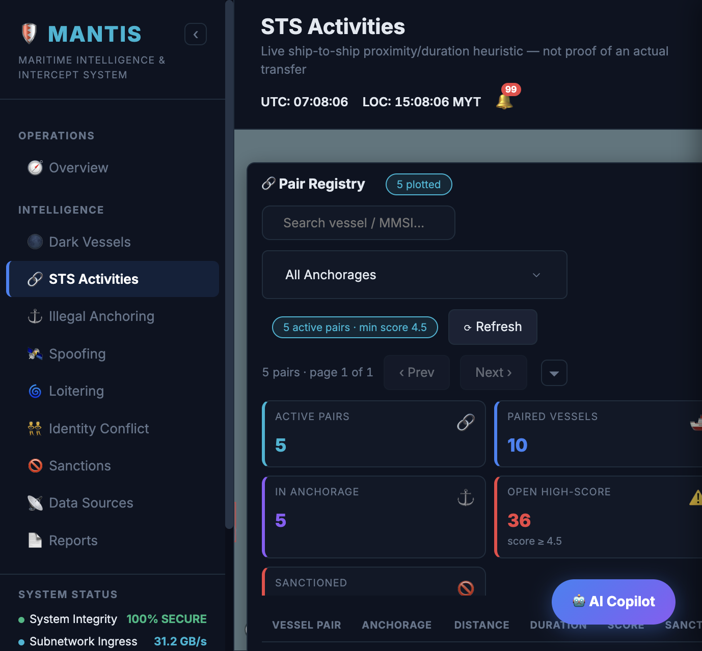
ANALYTICS MODULE | SHIP-TO-SHIP TRANSFER
Ship-to-ship transfer (STS)
Identifies large vessels holding position alongside each other long enough to allow a cargo transfer.
DATA PIPELINE AND PROCESSING LOGIC
HOW THE DASHBOARD FIGURES ARE DERIVED
1. Candidate selection. Every 30 seconds the pipeline reads the latest movement record per vessel and keeps cargo and tanker vessels (AIS type 70 to 89) that have been stopped for at least one hour or have not reported for 30 minutes.
2. Dredger admission. A dredger is admitted only when its MMSI holds an in-force JKPTG licence and its type is not excluded. Fishing, tug, towing, pilot, passenger, pleasure, sailing, high-speed craft, port tender and search-and-rescue vessels are always excluded.
3. Pair search. Great-circle distance is computed between candidates. Pairs within 30 m are kept; a licensed dredger must be paired with a cargo or tanker vessel. Two MMSIs belonging to the same hull are never paired.
4. Observation lifecycle. Connected pairs form one cluster with a stable signature. The cluster is updated each cycle, its suspicion score is recalculated, and it is closed after 60 seconds without the vessels in range.
5. Dashboard filter. The API keeps open clusters scoring 4.5 or more whose centre lies inside an anchorage polygon extended by 1 km, removes designated exclusion zones, and re-measures pairs at up to 35 m to allow for GPS drift.
Active pairs
Vessel pairs remaining after the dashboard filter.
Paired vessels
Distinct vessels across those pairs.
In anchorage
Open clusters scoring 4.5 or more whose centre is inside the extended anchorage area.
Open high-score
All open clusters scoring 4.5 or more, regardless of location. Clusters outside the anchorage area are still converted into review cases.
Sanctioned
Pairs in which at least one vessel matches the OFAC list.
Dashboard location: Intelligence > STS Activities
KEY PARAMETERS
Cycle 30 s, closed after 60 s out of range
Distance 30 m stored, 35 m on the dashboard
Score threshold 4.5 (configurable per request)
Anchorage buffer 1 km on parent polygons
MANTIS | Maritime Intelligence & Intercept System
October 2026
6

Slide 7
ANALYTICS MODULE | SHIP-TO-SHIP TRANSFER
STS suspicion score: formula and rationale
The score determines the order in which STS observations are reviewed. It is recalculated every time an observation is updated.
Score = 2 x ln(1 + hours) + (vessels - 1) + 1.5 x composition
Hours: time the cluster has been open. Vessels: number in the cluster. Composition: 1.0 with two or more tankers, 0.5 with two or more cargo ships, otherwise 0.
WHY DURATION USES A LOGARITHM
Starts at zero. ln(1 + 0) = 0, so a pair that has only just formed carries no duration weight.
Diminishing returns. The first hours carry the most weight. The first six hours add 3.9 points; the whole second day adds 1.3. A long routine wait still raises the score, but not by a fixed amount every hour.
Balance between terms. Because duration flattens, the vessel count (+1.0 per additional vessel) and the composition term (up to +1.5) keep their influence. With a linear term, a long berth wait would outrank a shorter meeting with a more significant composition.
Scale. The coefficient 2.0 sets how quickly duration accumulates. The weights follow operational rules today and will be calibrated against analyst-reviewed cases in the modelling phase.
DURATION TERM 2 x ln(1 + hours)
TIME TO REACH 4.5
1.4
1 hour
3.9
6 hours
6.4
24 hours
7.8
48 hours
1.7 h
3.0 h
4.8 h
Tanker and tanker
Cargo and cargo
Cargo and tanker
MANTIS | Maritime Intelligence & Intercept System
October 2026
7

Slide 8
ANALYTICS MODULE | SHIP-TO-SHIP TRANSFER
Vessel composition: why tanker-to-tanker carries the highest weight
The composition term reflects how transfers are carried out in Malaysian waters. Cargo is AIS type 70 to 79; tanker is 80 to 89.
Cluster composition | Weight | Typical activity | Interpretation
Two or more tankers (a cargo ship may also be present) | +1.5 | Crude oil or fuel moved from one tanker to another. | The pattern used to change the vessel carrying a cargo and obscure where it came from. Highest weight.
Two or more cargo ships | +0.75 | Bulk transhipment, for example dredged sand or minerals. | Often lawful, but also used to move undeclared bulk cargo. Moderate weight.
Cargo ship beside one tanker | 0 | Bunkering: a bunker tanker refuelling a cargo ship. | Routine across the Straits, one of the largest bunkering markets in the world. No weight, so bunkering does not crowd the review queue.
WHY TANKER-TO-TANKER TRANSFERS RANK FIRST IN MALAYSIAN WATERS
Regional transfer area. Waters off eastern Johor and the southern South China Sea are widely reported as a transfer area where crude from sanctioned sources is moved between tankers and re-documented before onward shipment.
Change of carrying vessel. A tanker-to-tanker transfer moves the cargo onto a different hull, which breaks the documented link between origin and destination. A bunker delivery to a cargo ship does not change who carries the cargo.
Lawful transfers have a known setting. Authorised lightering normally takes place in designated areas with approval. A tanker pair outside the anchorage area, or alongside a dark or sanctioned vessel, is the case analysts need to see first.
MANTIS | Maritime Intelligence & Intercept System
October 2026
8

Slide 9
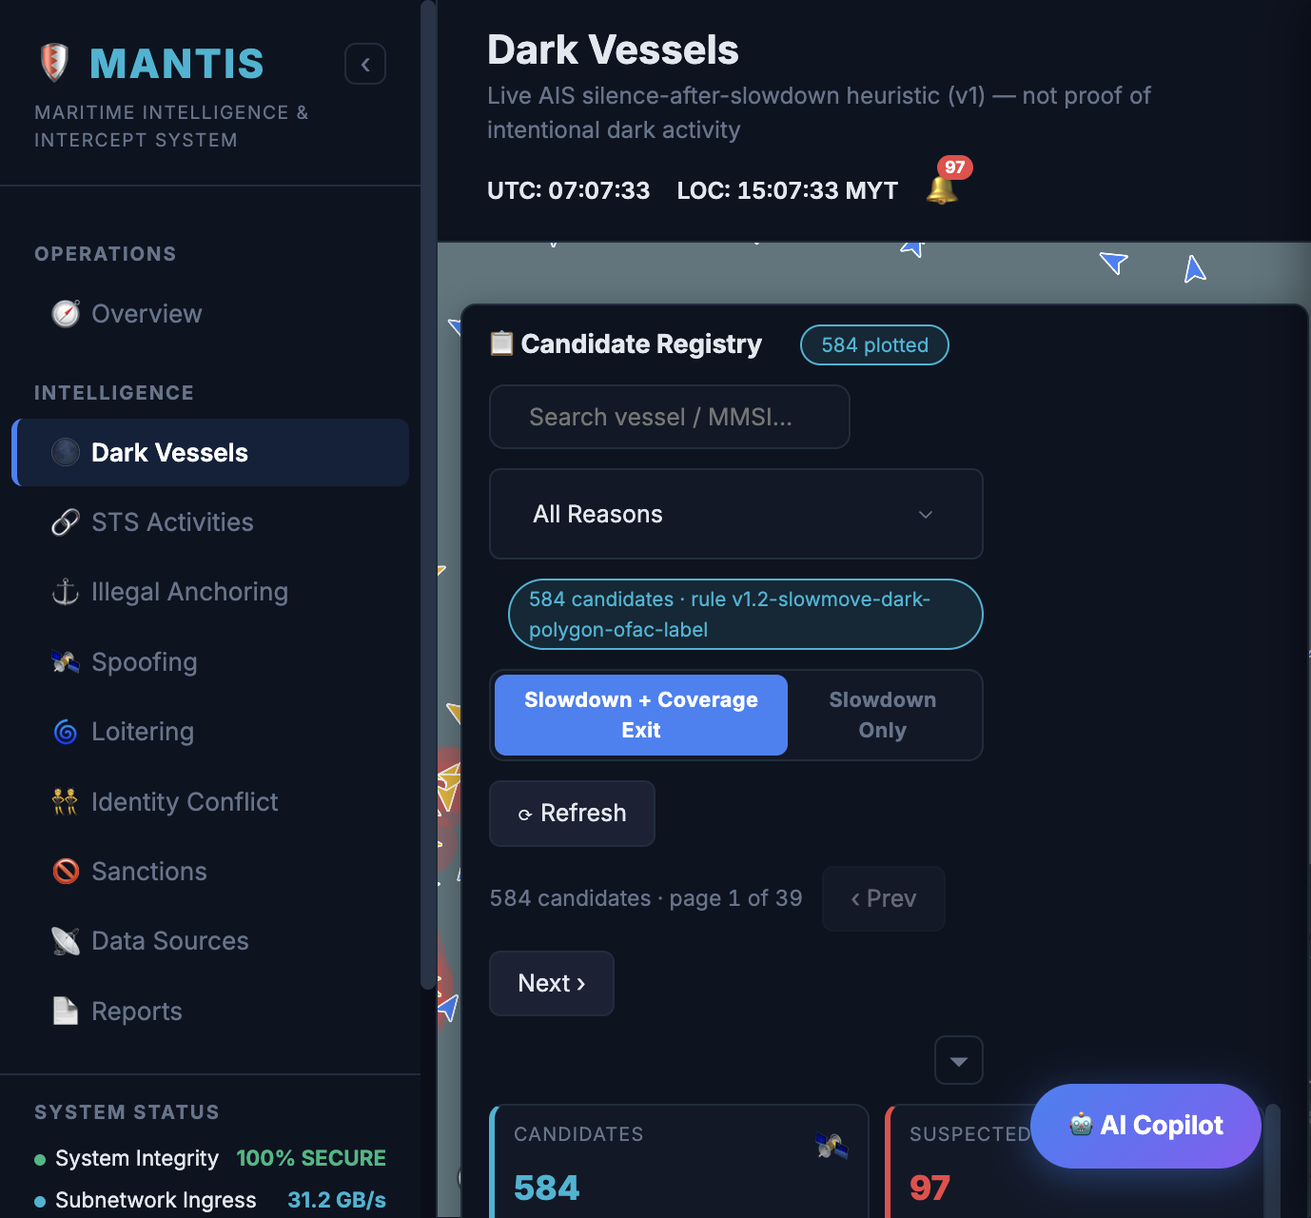
ANALYTICS MODULE | DARK VESSELS
Dark vessels
Flags large vessels that slowed down and then stopped transmitting AIS while still in the area.
DATA PIPELINE AND PROCESSING LOGIC
HOW THE DASHBOARD FIGURES ARE DERIVED
1. Slow-movement tracking. Every 20 seconds the pipeline reads the latest AIS report per vessel. A report at or below 3 knots opens or extends a slow-movement record, which counts position updates and keeps the latest position, speed and time.
2. Stop marking. A record is marked stopped when it reaches 30 updates within 30 m (a stop that is still being transmitted), or when no new report has arrived for 30 minutes (a transmission gap).
3. Record closure. A record is closed once the vessel sustains a speed above 3 knots and has moved at least 100 m from where the record started.
4. Candidate rule. The API selects open, stopped records for AIS type 70 to 89 with fewer than 30 updates and a last report at least 30 minutes old. Records with 30 or more updates are excluded because the vessel was still transmitting when it stopped.
5. Location labelling. The last position is labelled with the anchorage or exclusion zone it falls in. Zones label a record; they never remove it.
Candidates
Records passing the candidate rule. The Slowdown Only view removes possible coverage exits.
Suspected dark
5 to 29 updates during the slowdown and a last report within the past 3 days.
Coverage exit
Last report older than 3 days, or last speed above 3 knots. The vessel has more likely left receiver coverage.
High confidence
Same condition as suspected dark. Coverage exits are low confidence; the remainder is medium.
Sanctioned
Candidates matching the OFAC list.
Dashboard location: Intelligence > Dark Vessels
KEY PARAMETERS
Slow speed 3 knots or below
Silence 30 minutes since the last report
Confirmed stop 30 updates within 30 m
Coverage window 3 days
MANTIS | Maritime Intelligence & Intercept System
October 2026
9

Slide 10
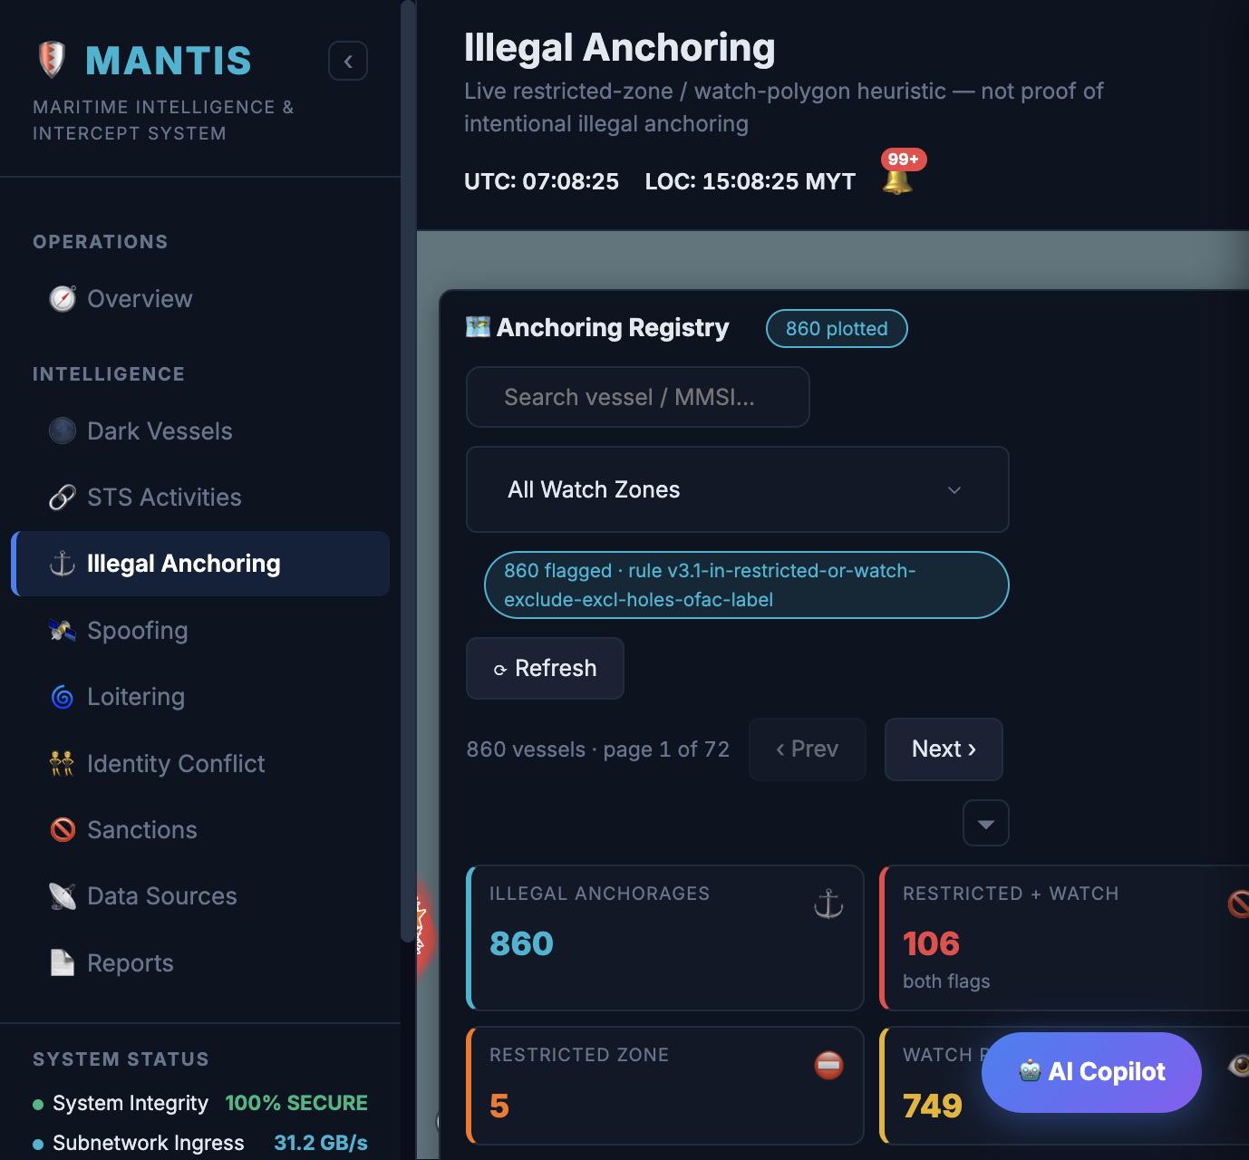
ANALYTICS MODULE | ILLEGAL ANCHORING
Illegal anchoring
Flags large vessels that have stopped inside restricted or monitored waters.
DATA PIPELINE AND PROCESSING LOGIC
HOW THE DASHBOARD FIGURES ARE DERIVED
1. Movement tracking. Every 20 seconds the pipeline reads the latest AIS report per vessel. A report at or below 0.5 knots opens or extends a movement record, which is marked stopped after 20 updates within 30 m.
2. Stopped population. The API takes the latest open movement record per vessel for AIS type 70 to 89 that has been stopped for at least one hour, or has not reported for 30 minutes.
3. Zone test. Each last position is tested against the restricted-limit polygon and the anchorage and watch polygons using a spatial point-in-polygon query.
4. Exclusions. Positions inside designated exclusion zones, which are carve-outs within a parent polygon, are removed.
5. Labelling. Each vessel is labelled restricted zone, watch polygon, or both. OFAC matching is applied afterwards and sanctioned vessels are listed first.
Illegal anchorages
Stopped vessels that pass the zone test after exclusions.
Restricted + watch
Vessels inside both the restricted limit and a watch polygon.
Restricted zone
Vessels inside the restricted limit only.
Watch polygon
Vessels inside a watch polygon only. The three zone counts do not overlap and add up to the total.
Sanctioned
Flagged vessels matching the OFAC list.
Dashboard location: Intelligence > Illegal Anchoring
KEY PARAMETERS
Stop speed 0.5 knots or below
Stopped 20 updates within 30 m, held 1 hour
Stale report 30 minutes
Vessel types AIS 70 to 89, cargo and tanker
MANTIS | Maritime Intelligence & Intercept System
October 2026
10

Slide 11
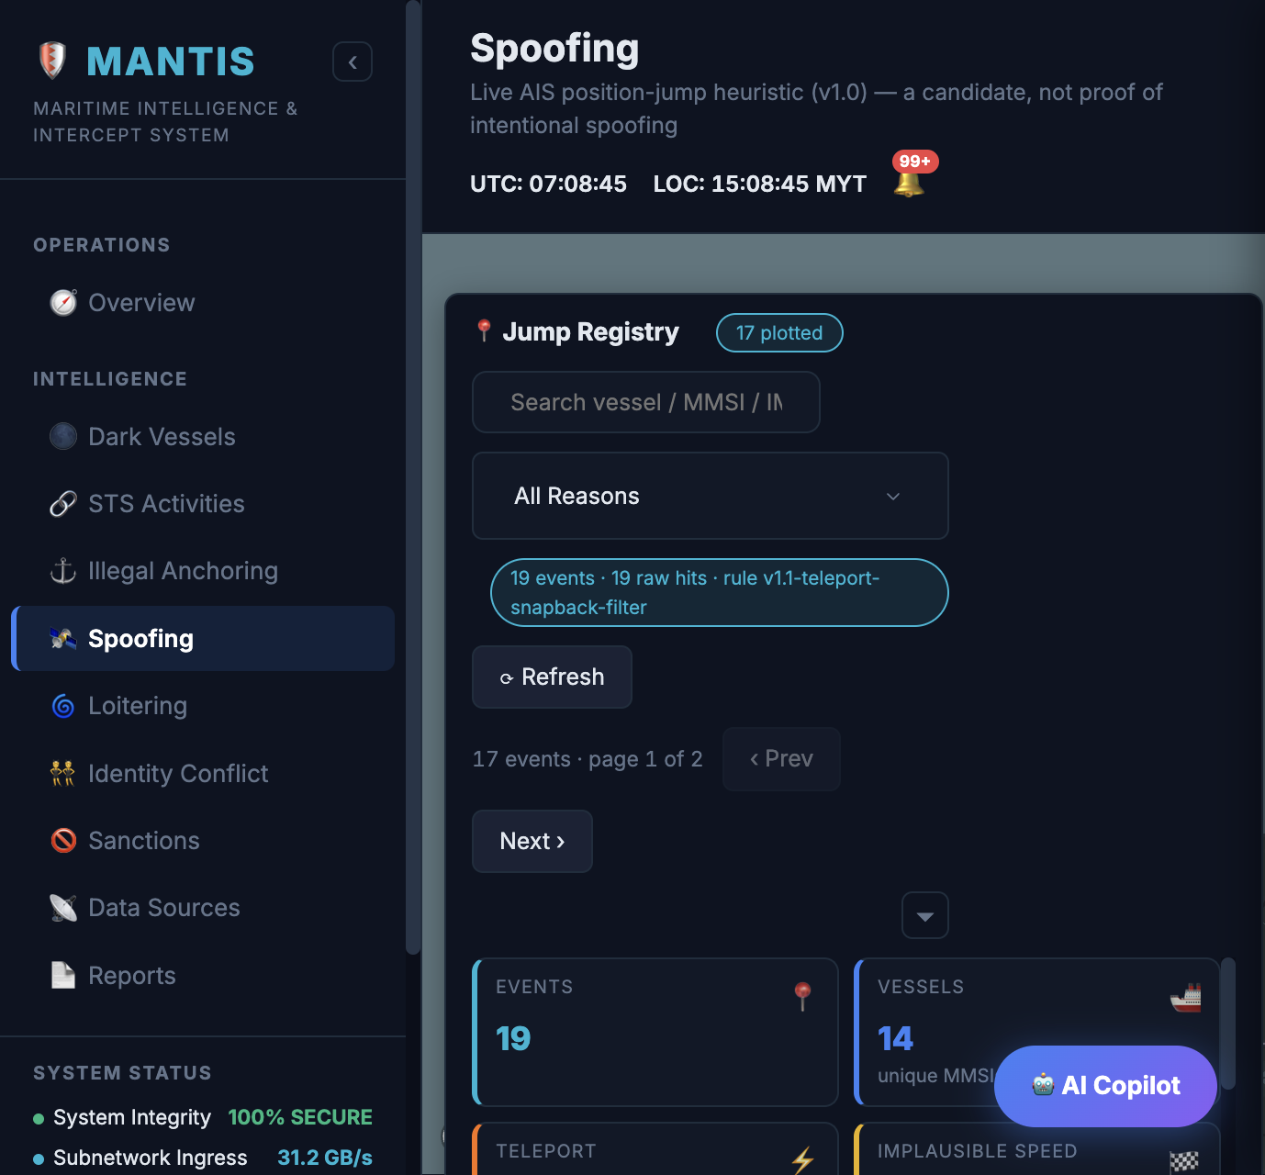
ANALYTICS MODULE | AIS SPOOFING
AIS spoofing (position anomaly)
Identifies AIS position reports that imply a movement no merchant vessel can make.
DATA PIPELINE AND PROCESSING LOGIC
HOW THE DASHBOARD FIGURES ARE DERIVED
1. Input. Every 15 minutes the pipeline reads the AIS position history for cargo and tanker vessels. The list of those vessels is refreshed every 12 hours.
2. Consecutive comparison. A window function pairs each report with the previous one for the same vessel and calculates great-circle distance, time gap and implied speed in knots.
3. Threshold. The gap must be 10 to 900 seconds and the jump at least 1 km. The pair is kept when the jump is 20 km or more at over 50 knots (teleport), or when the implied speed exceeds 80 knots (implausible speed).
4. Single-point filter. When the reports before and after a suspect point lie within 2 km of each other, and that gap is less than 10 percent of the jump, the point is treated as a bad fix and discarded.
5. Storage. One row is kept per vessel per UTC day, holding the highest implied speed. It is replaced only by a faster jump on the same day. The dashboard reads these stored rows.
Events
Stored daily anomalies within the last three days.
Vessels
Distinct vessels across those events.
Teleport
Jump of 20 km or more at an implied speed above 50 knots.
Implausible speed
Implied speed above 80 knots that is not a teleport.
Sanctioned
Events where the vessel matches the OFAC list.
Dashboard location: Intelligence > Spoofing
KEY PARAMETERS
Time gap 10 to 900 seconds
Teleport 20 km or more and above 50 knots
Implausible speed Above 80 knots
Bad-fix filter 2 km, under 10 percent of the jump
MANTIS | Maritime Intelligence & Intercept System
October 2026
11

Slide 12
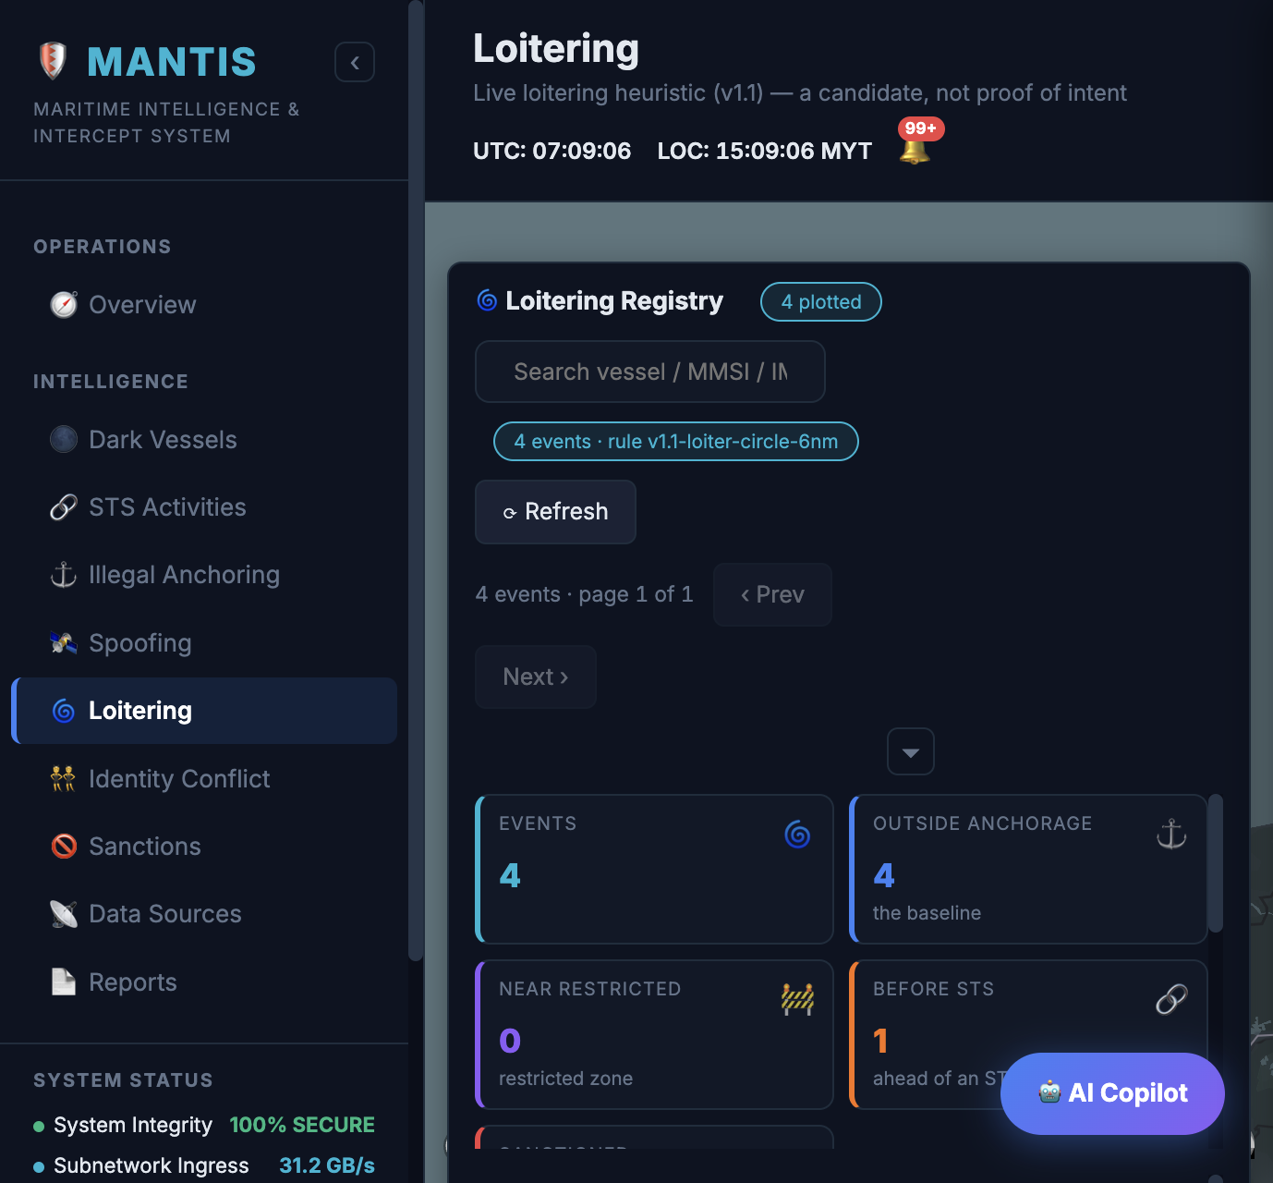
ANALYTICS MODULE | LOITERING
Loitering
Identifies vessels circling within a confined area for hours without making a passage.
DATA PIPELINE AND PROCESSING LOGIC
HOW THE DASHBOARD FIGURES ARE DERIVED
1. Input. Every 15 minutes the pipeline reads the previous two hours of AIS track for cargo and tanker vessels.
2. Track geometry. For each vessel it calculates the centre of the track, the radius (furthest point from the centre), the path length and the net displacement between the first and last position.
3. Storage rule. An event is stored when the track spans at least 2 hours with 8 or more reports, the radius is 100 m to 6 nautical miles, net displacement is under 0.5 nautical miles and net displacement is under 20 percent of the path.
4. Context flags. Outside anchorage: the centre is not in an anchorage polygon. Near restricted: inside or within 5 nautical miles of the restricted limit. Before STS: an STS observation for the vessel starts during the event or within 6 hours after it, within 5 nautical miles.
5. Pattern separation. Loitering requires a path of 2 nautical miles or more and a radius at least the hull length. A radius smaller than the hull is classified as anchor swing, which is normal behaviour.
Events
Open events carrying at least one context flag.
Outside anchorage
Events whose centre is outside every anchorage polygon.
Near restricted
Events inside or within 5 nautical miles of the restricted limit.
Before STS
Events followed by an STS observation for the same vessel within 6 hours.
Sanctioned
Events where the vessel matches the OFAC list.
Dashboard location: Intelligence > Loitering
KEY PARAMETERS
Window 2 hours, at least 8 reports
Radius 100 m to 6 nautical miles
Net movement Under 0.5 nautical miles
Hull floor Lengths under 300 m treated as 300 m
MANTIS | Maritime Intelligence & Intercept System
October 2026
12

Slide 13
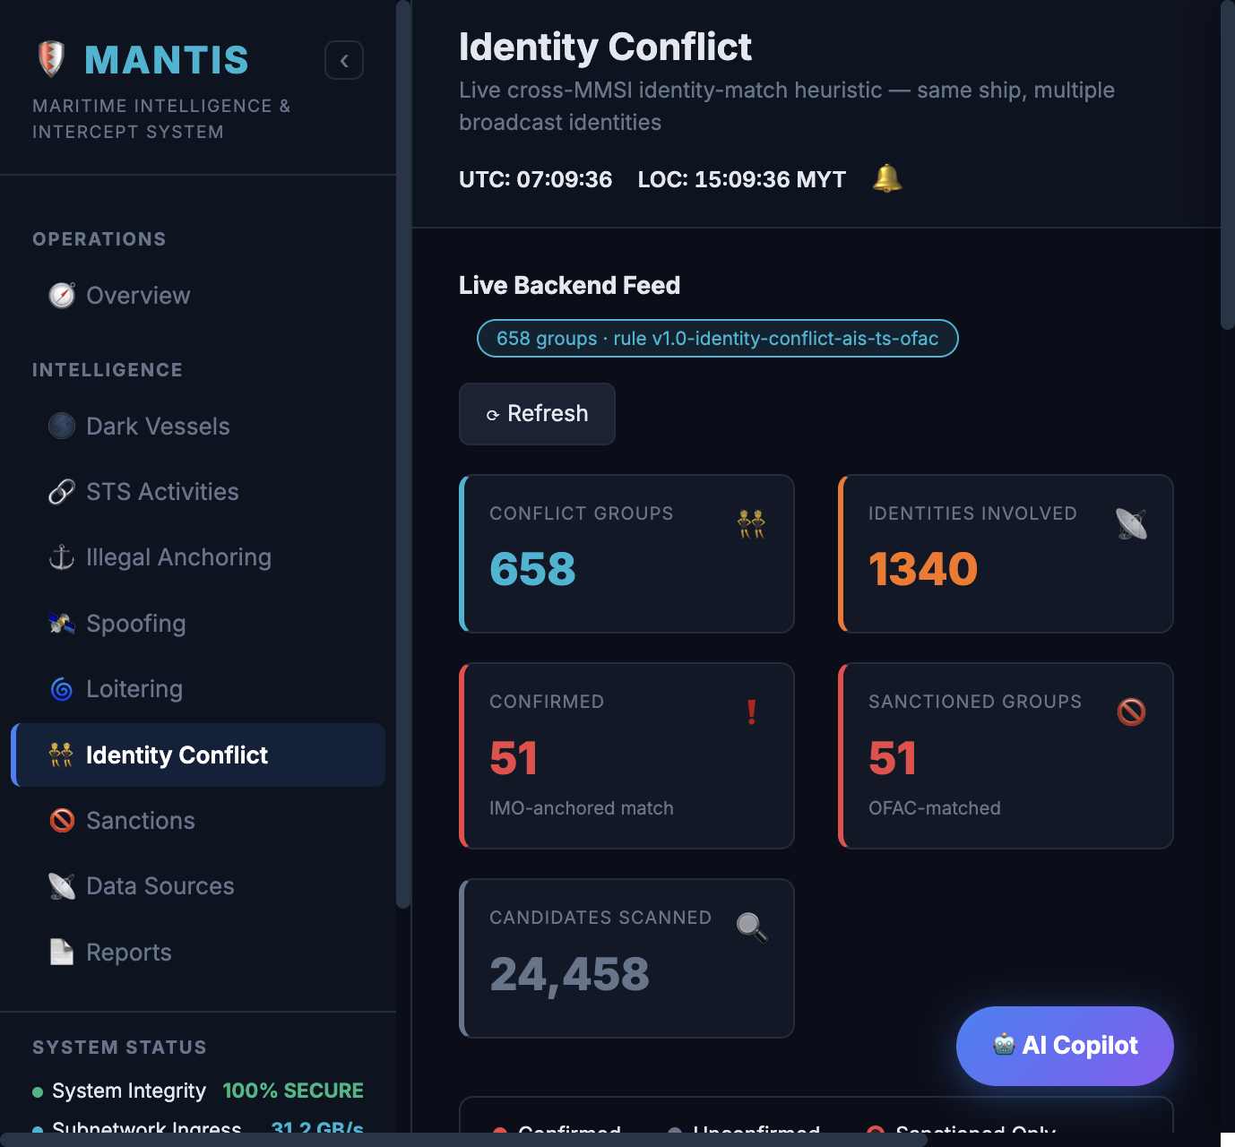
ANALYTICS MODULE | IDENTITY CONFLICT
Identity conflict
Finds a single physical vessel that is broadcasting under more than one MMSI.
DATA PIPELINE AND PROCESSING LOGIC
HOW THE DASHBOARD FIGURES ARE DERIVED
1. Input. On each request the API reads the current static record per MMSI for AIS type 70 to 89, joined to the vessel's last reported position.
2. Normalisation. Names and call signs are upper-cased and AIS padding is removed. Values under 3 characters are ignored. An IMO must be 7 digits; placeholder and repeated-digit IMOs are discarded.
3. Matching. Two MMSIs describe the same hull when the IMO matches together with the name, call sign or dimensions, or when the name matches together with the call sign or dimensions. One shared field is never sufficient.
4. Grouping. Matched pairs are merged into groups of two or more MMSIs using a union-find structure. Each group carries its latest AIS time and the distance between its members' last positions.
5. Screening. OFAC matching is applied to every member and sanctioned groups are listed first.
Conflict groups
Groups of two or more MMSIs resolved to one hull.
Identities involved
MMSIs across all groups.
Confirmed
Groups whose match is anchored on a shared, valid IMO number.
Sanctioned groups
Groups with at least one member matching the OFAC list.
Candidates scanned
Static records evaluated on this request.
Dashboard location: Intelligence > Identity Conflict
KEY PARAMETERS
Match rule IMO + one field, or name + one field
Fields IMO, name, call sign, dimensions
Ignored Placeholder IMOs, short names
Vessel types AIS 70 to 89
MANTIS | Maritime Intelligence & Intercept System
October 2026
13

Slide 14
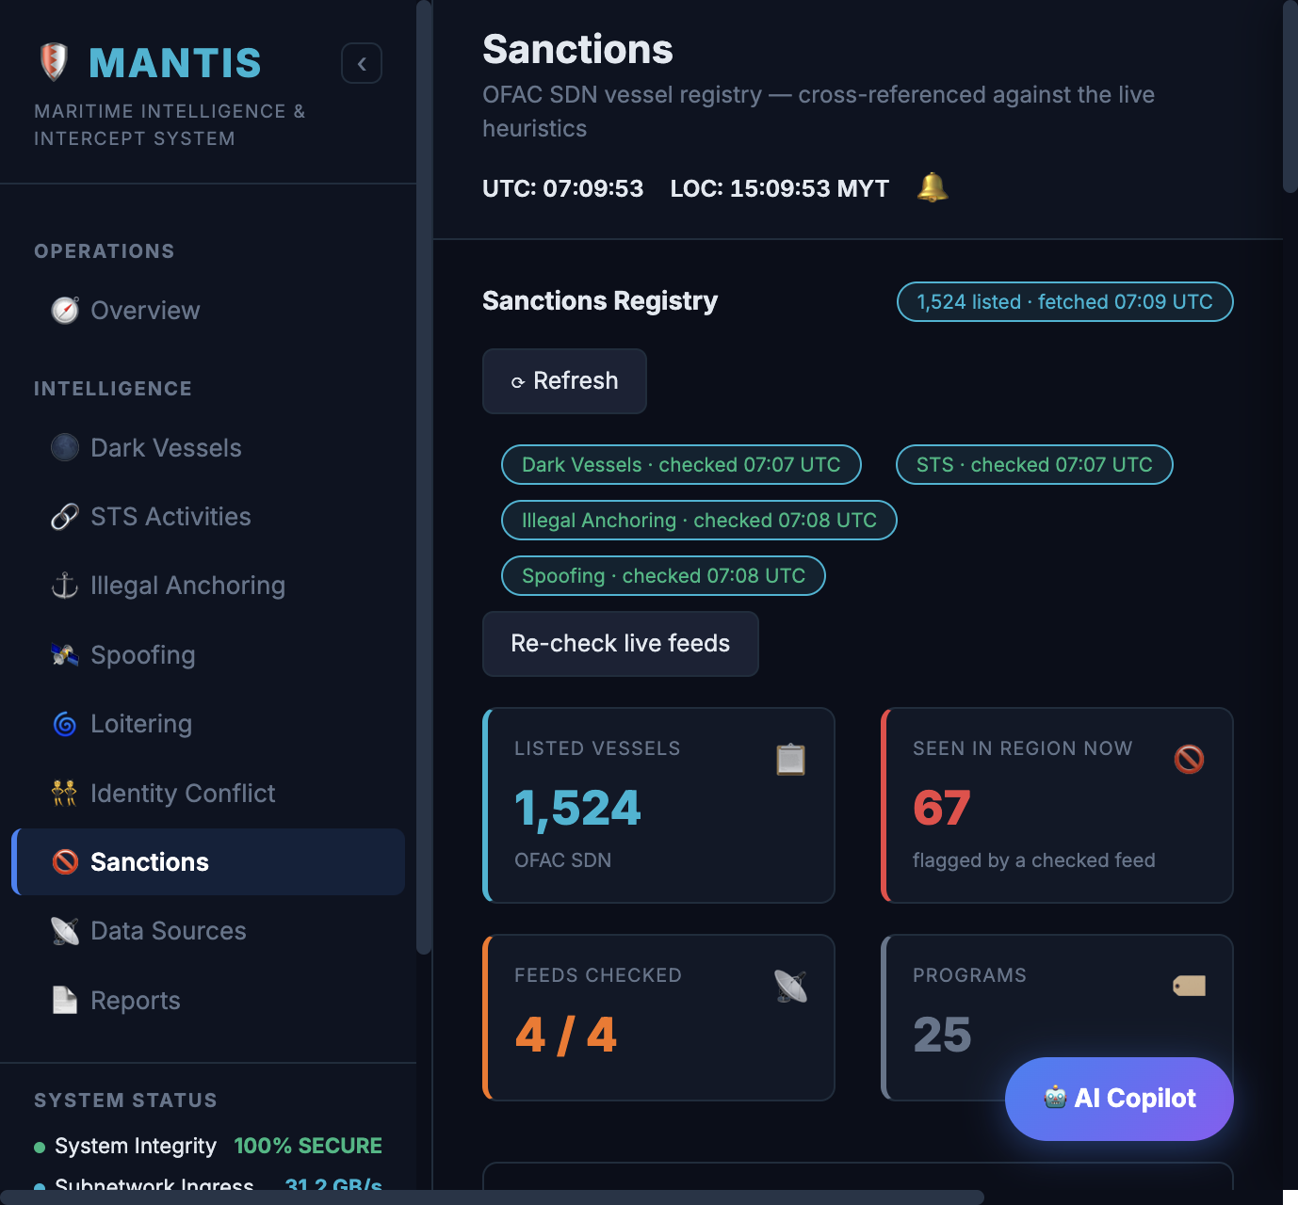
ANALYTICS MODULE | SANCTIONS SCREENING
Sanctions screening
Screens every vessel surfaced by the analytics modules against the OFAC sanctions lists.
DATA PIPELINE AND PROCESSING LOGIC
HOW THE DASHBOARD FIGURES ARE DERIVED
1. Reference data. OFAC SDN and Consolidated vessel entries are held in the operational database. IMO and MMSI numbers are extracted from each entry and indexed in the API, refreshed every 5 minutes.
2. Match order. An IMO match is recorded as confirmed. An MMSI match is used only when the vessel has no IMO and is recorded as possible. If the vessel has an IMO that does not match, the MMSI is not used, which avoids false matches on reassigned MMSIs. Names are not matched.
3. Application. The label is attached to dark vessels, both sides of an STS pair, illegal anchoring, spoofing, loitering and identity groups. Sanctioned vessels are sorted to the top of every list.
4. Scoring. The sanctions label affects priority only. It does not change the STS suspicion score or dark-vessel confidence.
Listed vessels
Vessel entries in the sanctions registry.
Seen in region now
Listed vessels present in at least one of the live module feeds.
Feeds checked
Live module feeds re-queried for matches: dark vessels, STS, illegal anchoring and spoofing.
Programmes
Distinct sanctions programmes across the listed entries.
Dashboard location: Intelligence > Sanctions
KEY PARAMETERS
Confirmed IMO match
Possible MMSI match, vessel has no IMO
Index refresh 5 minutes
Effect Ordering only, no score change
MANTIS | Maritime Intelligence & Intercept System
October 2026
14

Slide 15
MODULE INTEGRATION
Every STS observation is enriched with the outputs of the other modules
The review-case pipeline checks each STS observation against the other data pipelines for the same vessels and the same time window.
UNEXPLAINED SIGNALS
LAWFUL EXPLANATIONS
At least one is required for notification
Either one removes the case from notification
Sanctions match
Dredge licence
A member matches the OFAC list. Also the first sort key.
In-force JKPTG licence covering the observation period.
Outside anchorage
STS review case
Bunker vessel register
Centre outside the original anchorage polygon.
One case per STS observation, refreshed until an analyst closes it.
Field in place; populated once the register is supplied.
Dark overlap
CONTEXT RECORDED ON THE CASE
A cargo or tanker member has an open transmission gap.
Stored for the analyst; neither triggers notification
Loitering or anchor swing
Illegal anchoring overlap
Overlapping the observation window.
A member passes the zone rule.
Position anomaly
A stored daily anomaly inside the observation window.
MANTIS | Maritime Intelligence & Intercept System
October 2026
15

Slide 16
NOTIFICATION AND REVIEW
From STS observation to verified classification
Notification is delivered through the REST API today. The dashboard view of the review queue is the next integration step.
STS observation
Review case
Notification
Analyst review
Labelled dataset
Proximity pipeline, every 30 s
Enriched every 15 min
Unexplained cases only
Class, reviewer, time, notes
Input to the modelling phase
NOTIFICATION RULE (ALL CONDITIONS APPLY)
ANALYST DECISION
1. Case status is unreviewed.
2. Suspicion score is 4.5 or higher.
3. No in-force dredge licence on the pair.
4. No bunker register match.
5. At least one unexplained signal: sanctions match, outside anchorage, dark overlap or illegal anchoring overlap.
Classes. Illicit transfer, bunkering, dredging, other lawful activity, or uncertain.
Recorded with the class. Reviewer, timestamp and notes. Once a case is reviewed, the pipeline no longer updates it.
Unreviewed report. Lists every open case with an optional date range, so investigations that take days or weeks can be found again and closed.
Sanctioned cases are listed first, then by suspicion score.
API ENDPOINTS
GET /mantis/sts-review notification queue
GET /mantis/sts-review/unreviewed?from=&to= unreviewed report
POST /mantis/sts-review/{caseId}/verify analyst decision
MANTIS | Maritime Intelligence & Intercept System
October 2026
16

Slide 17
ROADMAP
From validated data to a machine-learning model
A reliable model needs verified outcomes to learn from. The current phase is building that record.
PHASE 1
Current
PHASE 2
Next
PHASE 3
After phase 2
Data collection and validation
Labelled dataset
Model development
All six modules and their data pipelines in production.
Every STS observation converted into an enriched review case.
Analysts classify notified cases and close older ones through the unreviewed report.
Dashboard view of the review queue.
Bunker vessel register integrated as a lawful explanation, expected within three months.
Export of reviewed cases with their features and the analyst class.
Supervised model trained on analyst classes, never on the notification itself.
Evaluated against reviewed cases held out from training.
Model output added as a ranking signal; the analyst remains the decision-maker.
FEATURES AVAILABLE TO THE MODEL
CONDITIONS TO START PHASE 3
Duration, distance, vessel count and vessel composition, kept as separate inputs. Vessel types, sanctions match, anchorage position, dark and illegal-anchoring overlap, loitering and position anomalies, dredge licence and bunker register match.
All five classes represented in volume.
A written classification guide applied consistently across reviewers.
Dataset built from reviewed cases only.
MANTIS | Maritime Intelligence & Intercept System
October 2026
17

Slide 18
SUMMARY
Current phase:
data collection and validation
MANTIS is in production across six analytics modules, with sanctions screening applied to every result.
Each STS observation is enriched with the outputs of the other modules. Cases that remain unexplained are raised for analyst review, and the analyst's classification is stored with the case.
Those classifications are the ground truth for the machine-learning phase. A model trained only on rule-based alerts would reproduce the existing rules, so model development begins once the reviewed dataset meets the phase 3 conditions.
MANTIS | Maritime Intelligence & Intercept System
October 2026
18

