Slide 1
MOTIVATION
Linear vs Nonlinear Contrastive Encoders
Main question
When Y is a known deterministic function of X plus noise, does the nonlinear encoder move toward the ideal PVE reference or mostly memorize training pairs?
We keep the noise-only sanity check, then focus on deterministic linear and cubic SNR sweeps, log-scale overfitting diagnostics, and the final probe experiment.
Baher Alabbar | June 18
Contrastive encoder experiment | 1/12

Slide 2
EXPERIMENTAL SETUP
Three checks, one training protocol
The updated deck separates pure memorization from deterministic signal recovery and probe-readout interpretability.
Noise only
Deterministic linear
Deterministic cubic
X and Y are independent Gaussian noise. Any train-only alignment is memorization.
Y = f(X) + epsilon with f(X)=X. Target SNR controls the clean signal versus noise.
Y = f(X) + epsilon with f(X)=X^3. This stresses nonlinear recovery.
SNR/PVE reference
Probe experiment
The red reference line is the ideal clean/noisy cosine separation implied by SNR; the log x-axis uses the same SNR values.
Freeze the trained encoder, fit ridge readouts from branch embeddings to the clean target, and sweep one raw coordinate.
Contrastive encoder experiment | 2/12

Slide 3
MODEL ARCHITECTURE
Matched encoders with a controlled residual branch
The architecture comparison stays fixed while the deterministic relationship and SNR vary.
Pure linear encoder
Residual nonlinear encoder
A2
128 -> 16
GELU
input u
128 dims
linear map
G
BatchNorm
no affine
input u
128 dims
linear
G
A1
16 -> 4
embedding z
4 dims
sum
linear + alpha * nonlinear
g(u) = Normalize(G u)
shared X/Y family
embedding dim = 4
hidden dim = 16
g(u) = Normalize(G u) + alpha * Normalize(A1 GELU(A2 u + b))
Contrastive encoder experiment | 3/12

Slide 4
OBJECTIVE
Same contrastive loss; evaluation changes
All models train with the same paired contrastive objective, then deterministic diagnostics compare against the SNR-implied reference.
Training score
For each batch, diagonal X/Y scores are rewarded and all cross-pair scores are penalized with the paper loss.
maximize L = sum_i s_ii - sum_i log sum_j exp(s_ij) - sum_j log sum_i exp(s_ij)
training minimizes -L / n plus active regularization terms
Test separation
Ideal reference
Overfitting gap
Held-out true-pair separation across SNR values.
Red PVE/cosine line implied by clean target plus noise.
max(train separation - ideal separation, 0).
Contrastive encoder experiment | 4/12

Slide 5
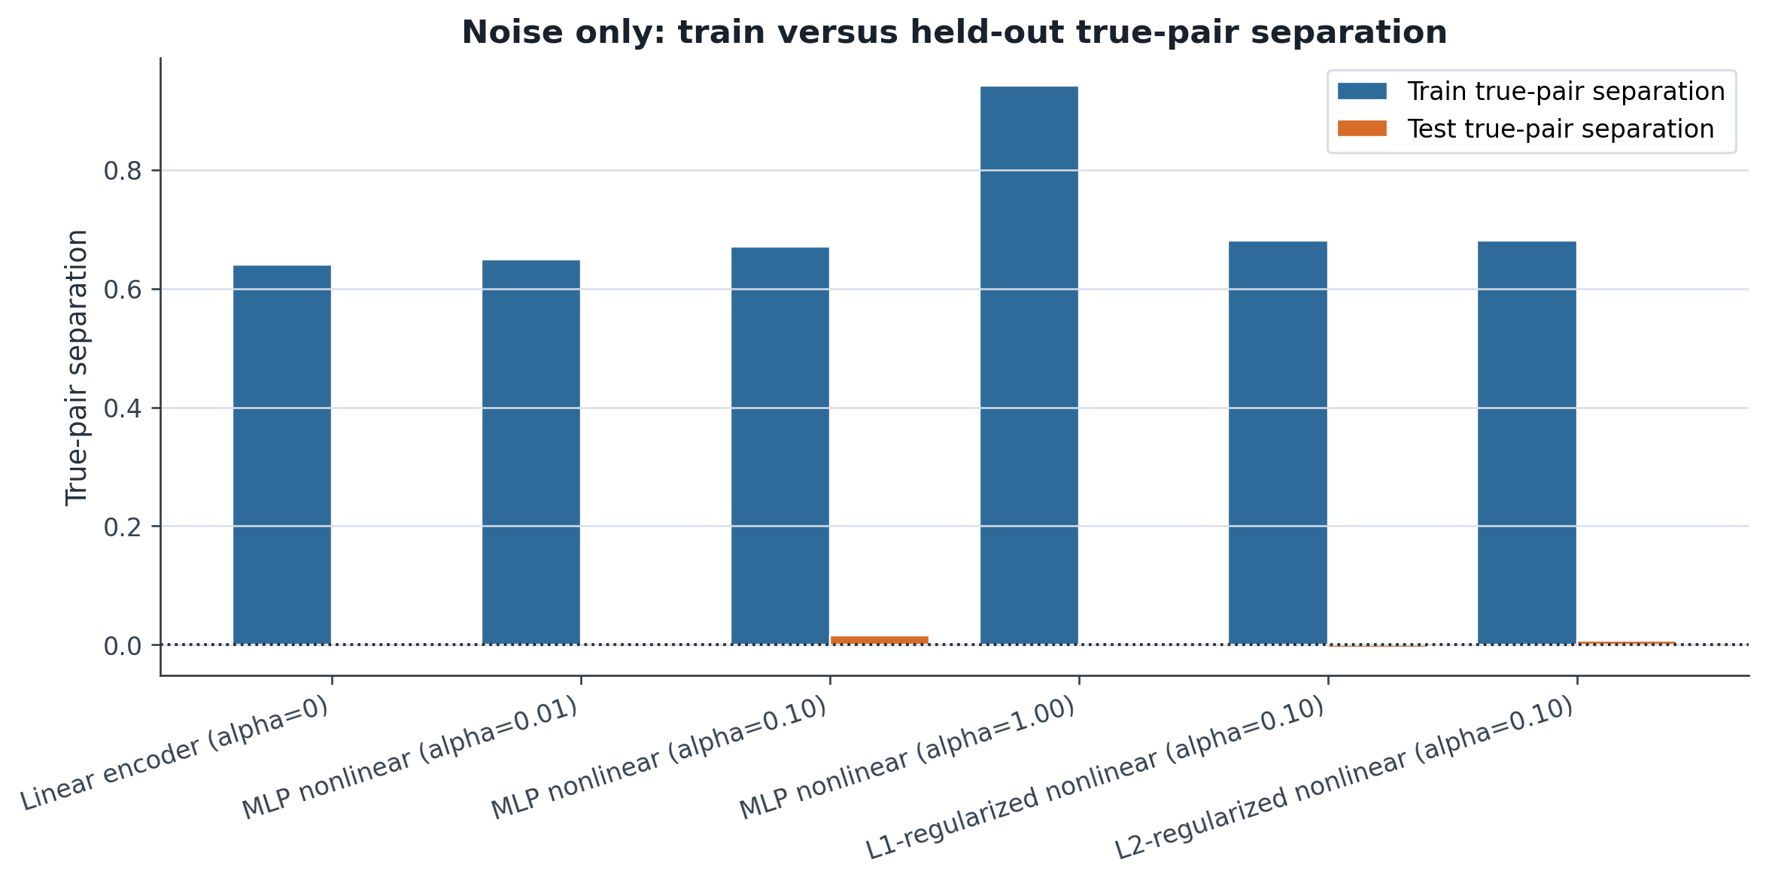
RESULT
Noise-only: train vs held-out separation
High train separation with low held-out separation indicates memorization rather than signal.
Interpretation
In noise-only data, X and Y have no real relationship. Training alignment can still grow because the model can memorize paired training samples.
Key takeaway
Held-out performance remains the sanity check: high training alignment alone is not evidence of real learning.
Contrastive encoder experiment | 5/12

Slide 6
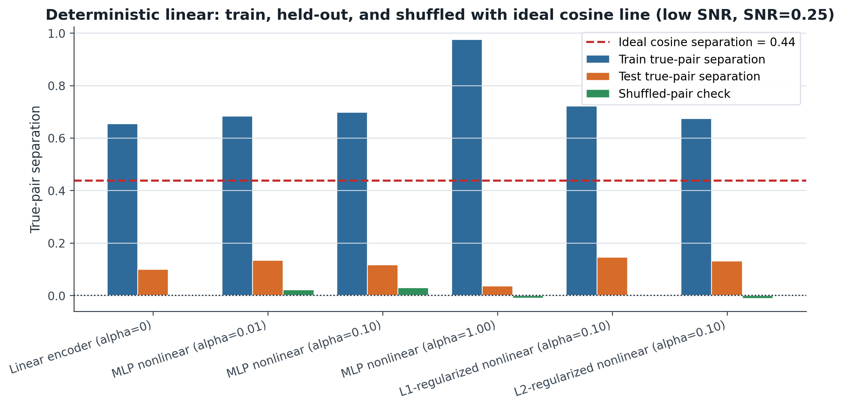
RESULT DETAIL
Deterministic linear: train, held-out, and shuffled (low SNR, SNR=0.25)
Low-SNR snapshot with the ideal cosine reference line.
Inserted SNR detail 1/6 | linear, low SNR, SNR=0.25

Slide 7
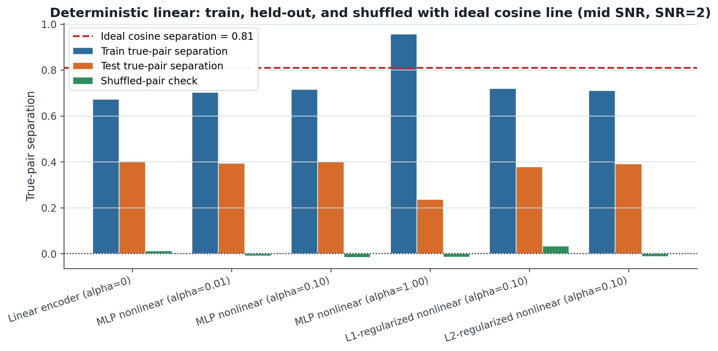
RESULT DETAIL
Deterministic linear: train, held-out, and shuffled (mid SNR, SNR=2)
Mid-SNR snapshot with the ideal cosine reference line.
Inserted SNR detail 2/6 | linear, mid SNR, SNR=2

Slide 8
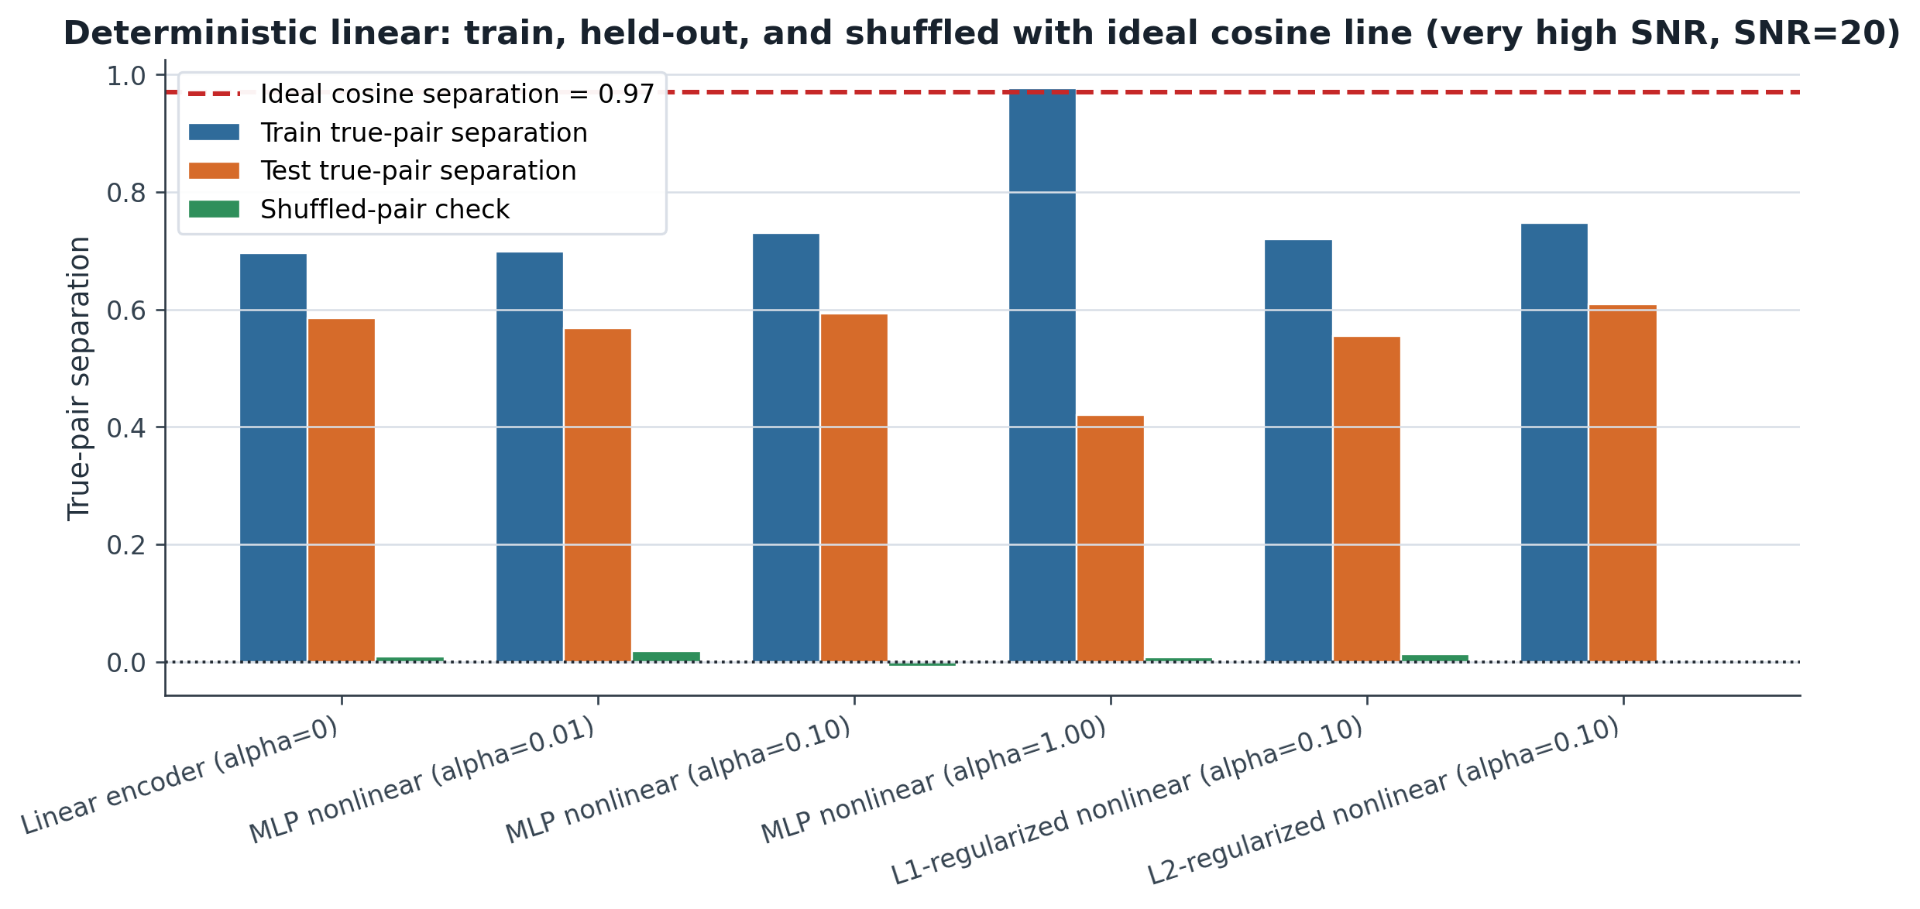
RESULT DETAIL
Deterministic linear: train, held-out, and shuffled (very high SNR, SNR=20)
Very-high-SNR snapshot with the ideal cosine reference line.
Inserted SNR detail 3/6 | linear, very high SNR, SNR=20

Slide 9
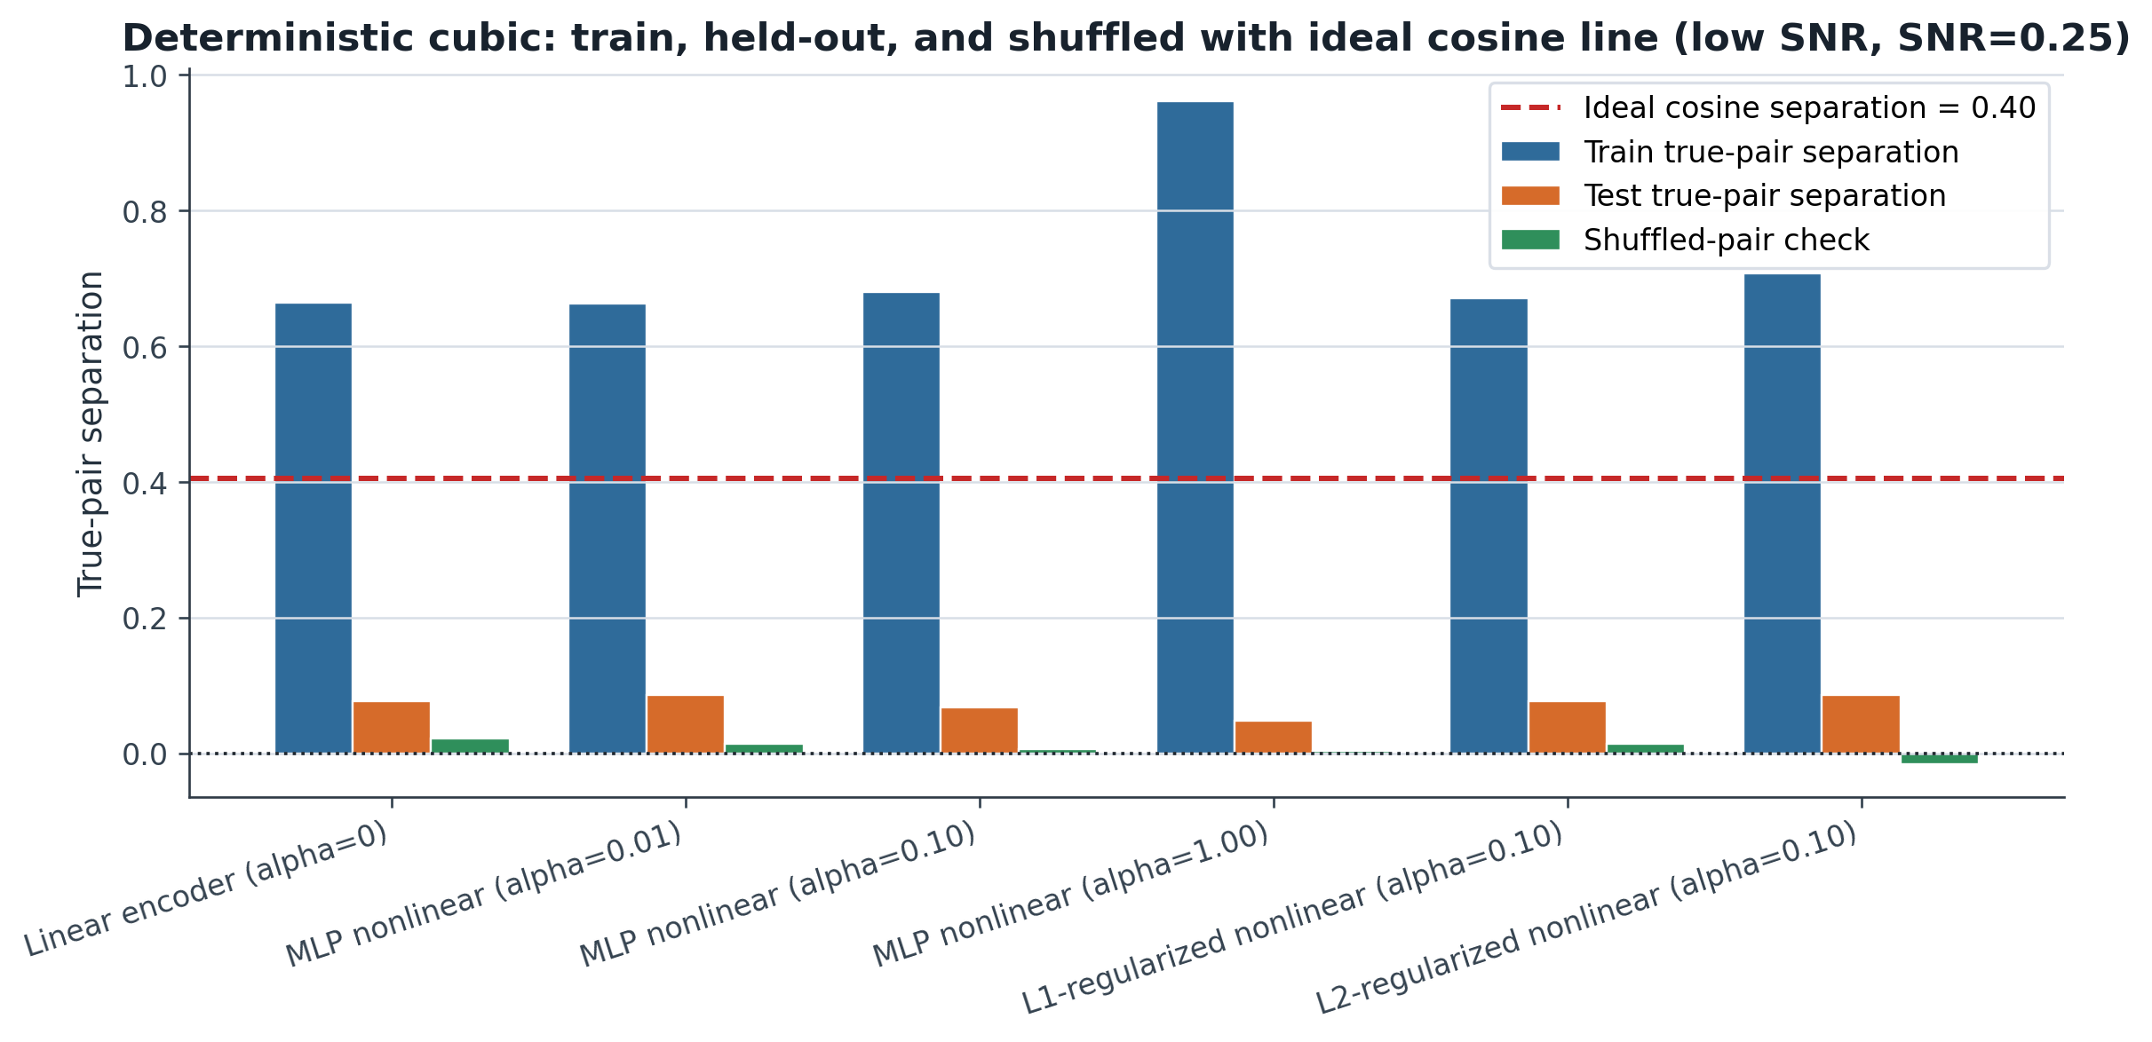
RESULT DETAIL
Deterministic cubic: train, held-out, and shuffled (low SNR, SNR=0.25)
Low-SNR snapshot with the ideal cosine reference line.
Inserted SNR detail 4/6 | cubic, low SNR, SNR=0.25

Slide 10
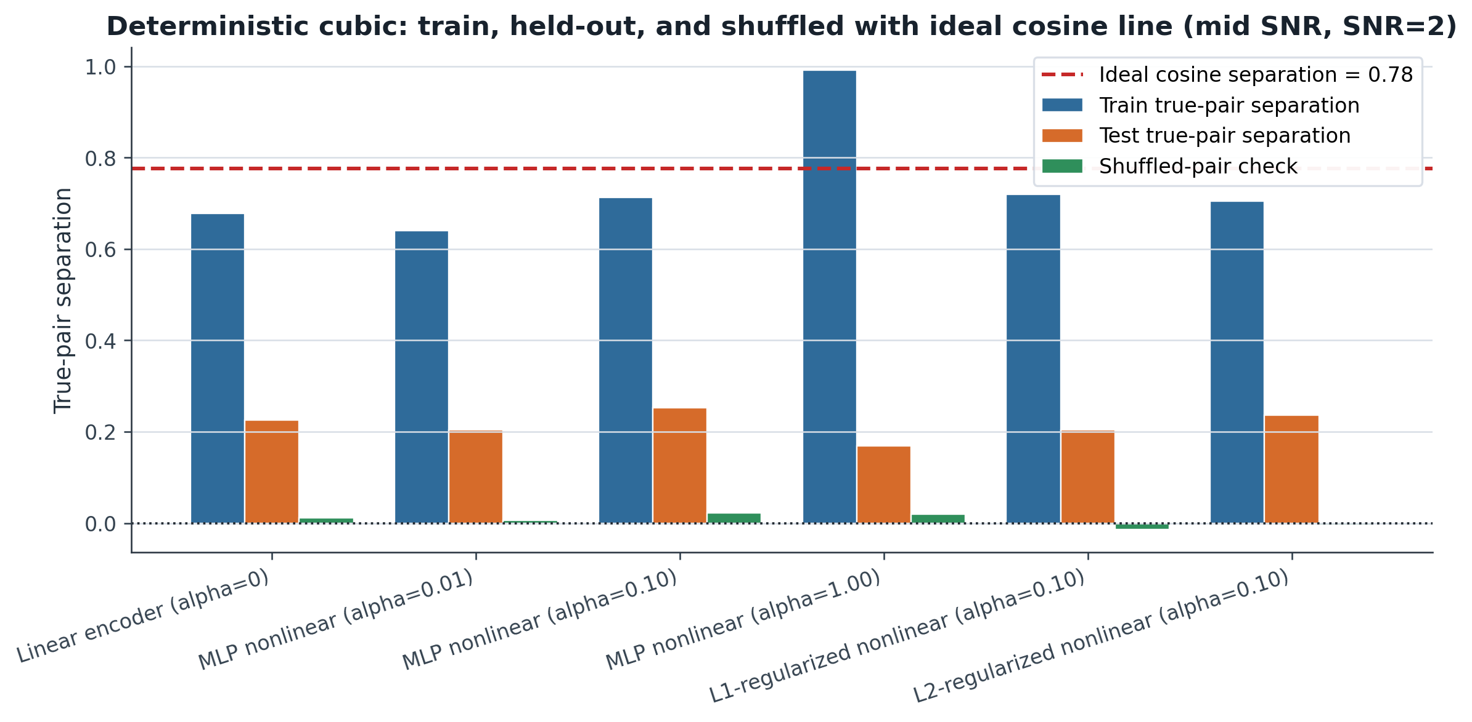
RESULT DETAIL
Deterministic cubic: train, held-out, and shuffled (mid SNR, SNR=2)
Mid-SNR snapshot with the ideal cosine reference line.
Inserted SNR detail 5/6 | cubic, mid SNR, SNR=2

Slide 11
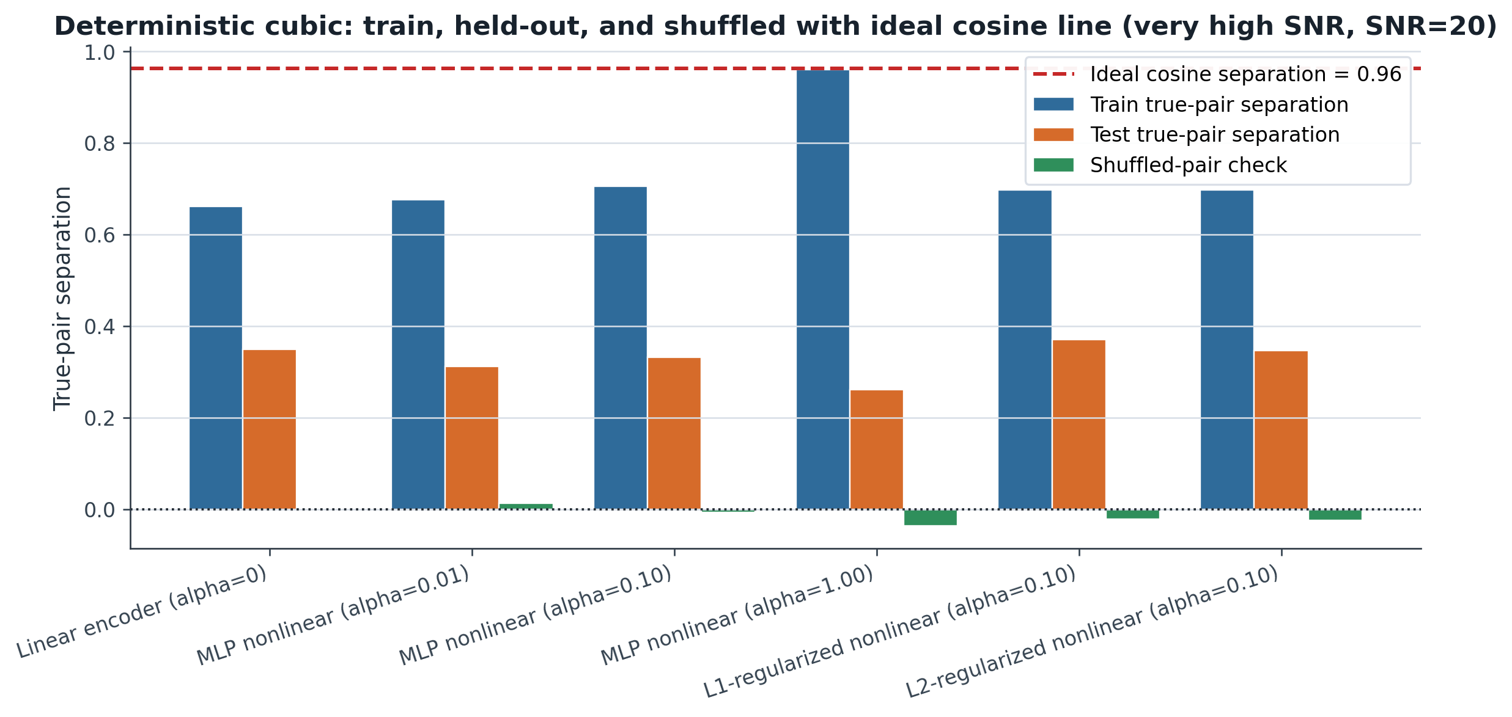
RESULT DETAIL
Deterministic cubic: train, held-out, and shuffled (very high SNR, SNR=20)
Very-high-SNR snapshot with the ideal cosine reference line.
Inserted SNR detail 6/6 | cubic, very high SNR, SNR=20

Slide 12
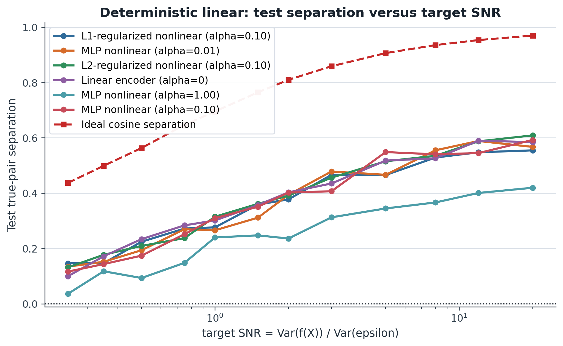
RESULT
Deterministic linear: test separation vs SNR
The many-point log-SNR sweep includes the red ideal PVE/cosine reference line.
What to read
Test separation improves as SNR rises, but all learned encoders remain well below the red ideal reference across the sweep.
Key takeaway
The linear deterministic task is not solved just by increasing SNR; model-side recovery remains limited.
Contrastive encoder experiment | 6/12

Slide 13
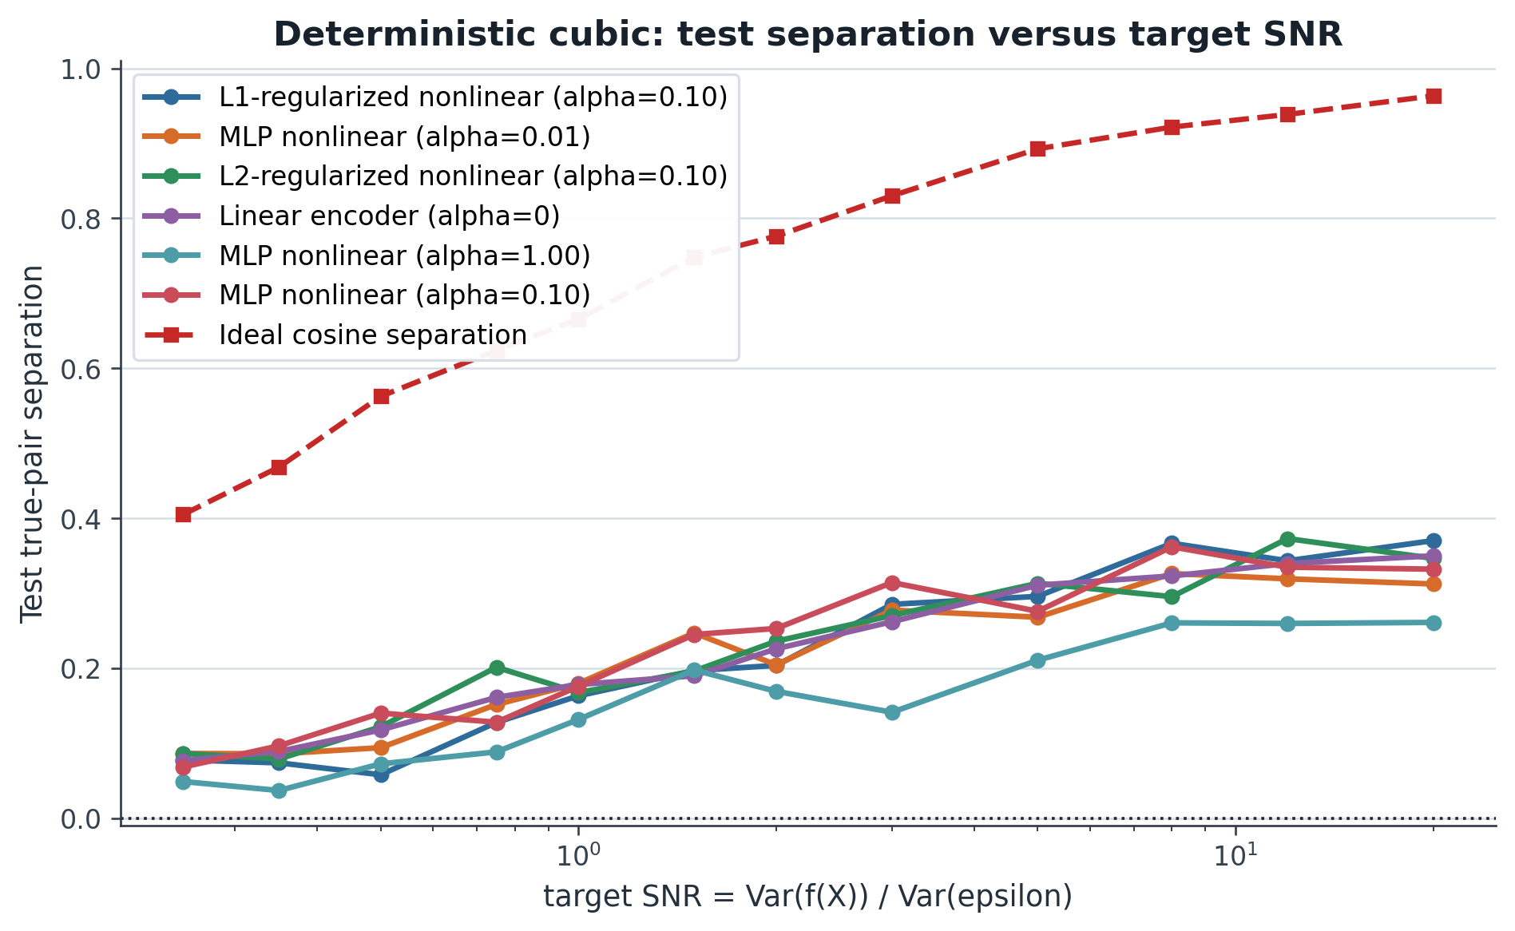
RESULT
Deterministic cubic: test separation vs SNR
The cubic relationship is harder; the same red ideal reference provides a clean upper benchmark.
What to read
The cubic test curves rise with SNR, but the gap to the ideal reference is larger than in the linear case.
Key takeaway
Controlled nonlinear corrections help somewhat, but they do not close the deterministic recovery gap.
Contrastive encoder experiment | 7/12

Slide 14
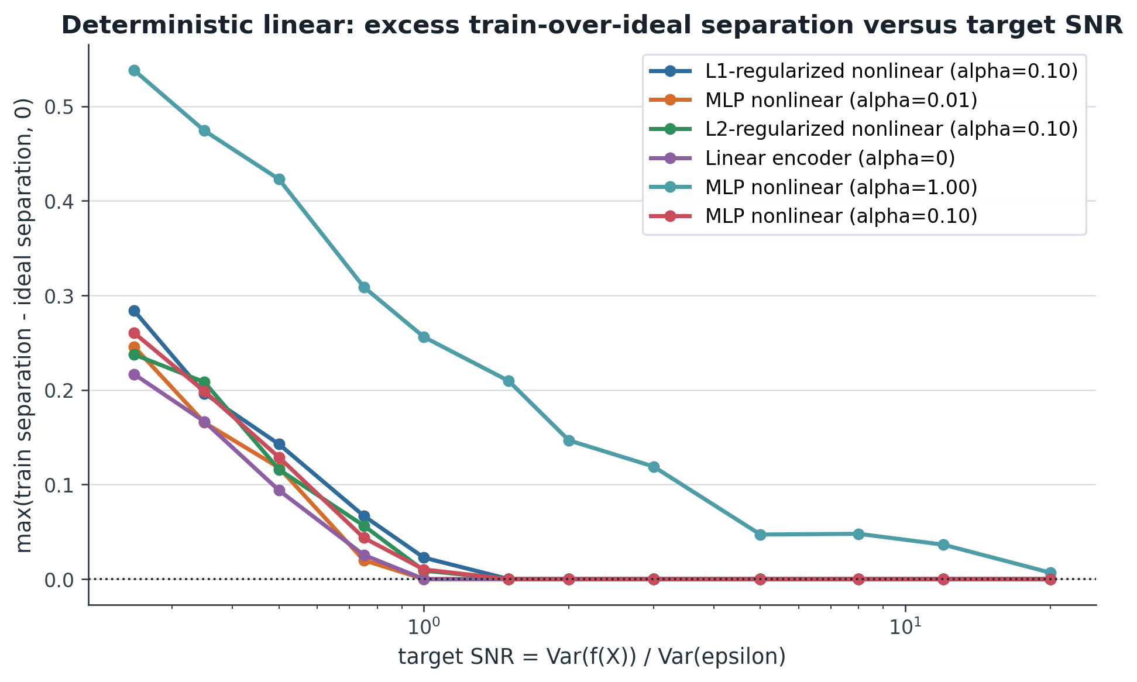
RESULT
Linear overfitting: train score above the ideal
The log-axis excess train-over-ideal plot quantifies train-side memorization beyond the PVE reference.
Overfitting measure
This plot shows max(train separation - ideal separation, 0). Low SNR leaves room for models to fit training pairs beyond the clean/noisy reference.
Key takeaway
The alpha=1 nonlinear model shows the largest excess, making it the clearest overfitting warning.
Contrastive encoder experiment | 8/12

Slide 15
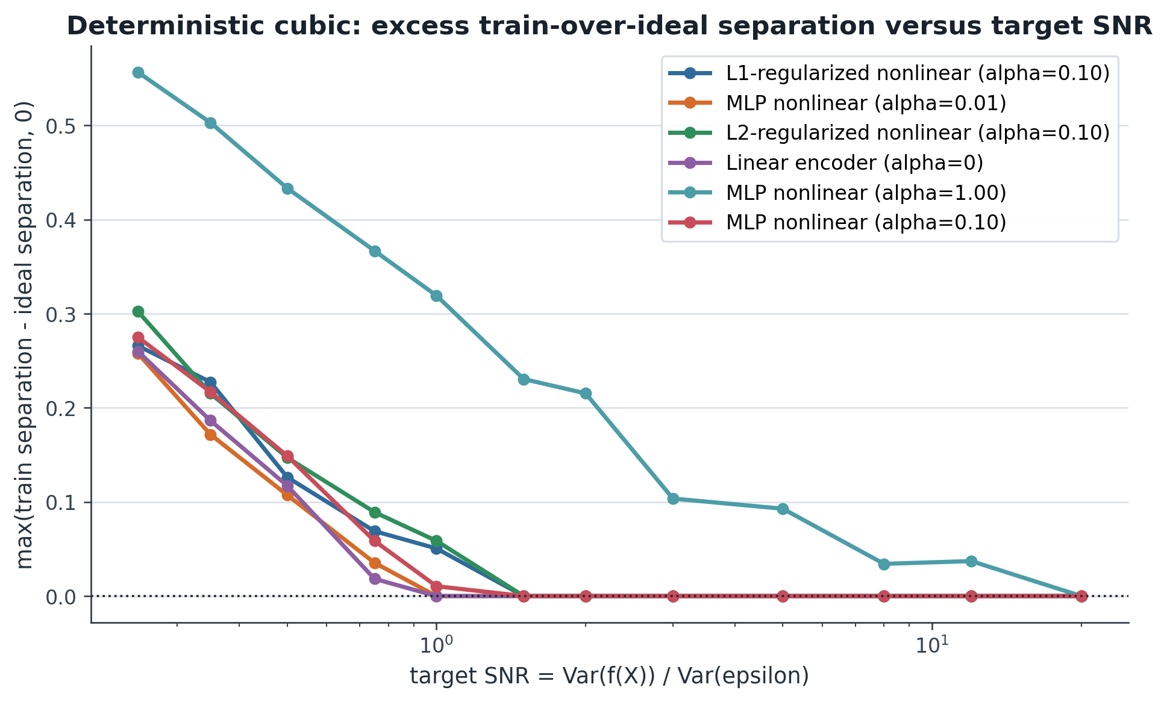
RESULT
Cubic overfitting: train score above the ideal
The same log-axis diagnostic shows how quickly excess train alignment disappears as SNR improves.
Overfitting measure
Cubic excess train-over-ideal is largest in the low-SNR regime and shrinks toward zero for most models as signal becomes easier.
Key takeaway
Again, the alpha=1 nonlinear model stays suspicious longer than controlled or regularized settings.
Contrastive encoder experiment | 9/12

Slide 16
PROBE EXPERIMENT
Pipeline for reading out learned nonlinear information
The probe is fitted after training, so it measures what the frozen encoder made linearly readable.
Generate scalar
Y=f(X)+noise
Train residual
alpha = 1
Freeze X-side
encoder
Split branches
linear / nonlinear
Fit ridge probes
to clean f(X)
Sweep raw coordinate x_j
Plot branch readout curves
against true target
Targets
Readouts
Interpretation
square: f(x)=x^2; cubic: x^3; exponential: exp(x).
linear branch only, nonlinear branch only, and combined embedding.
Curvature readable from the nonlinear branch suggests the branch is carrying nonlinear structure.
Contrastive encoder experiment | 10/12

Slide 17
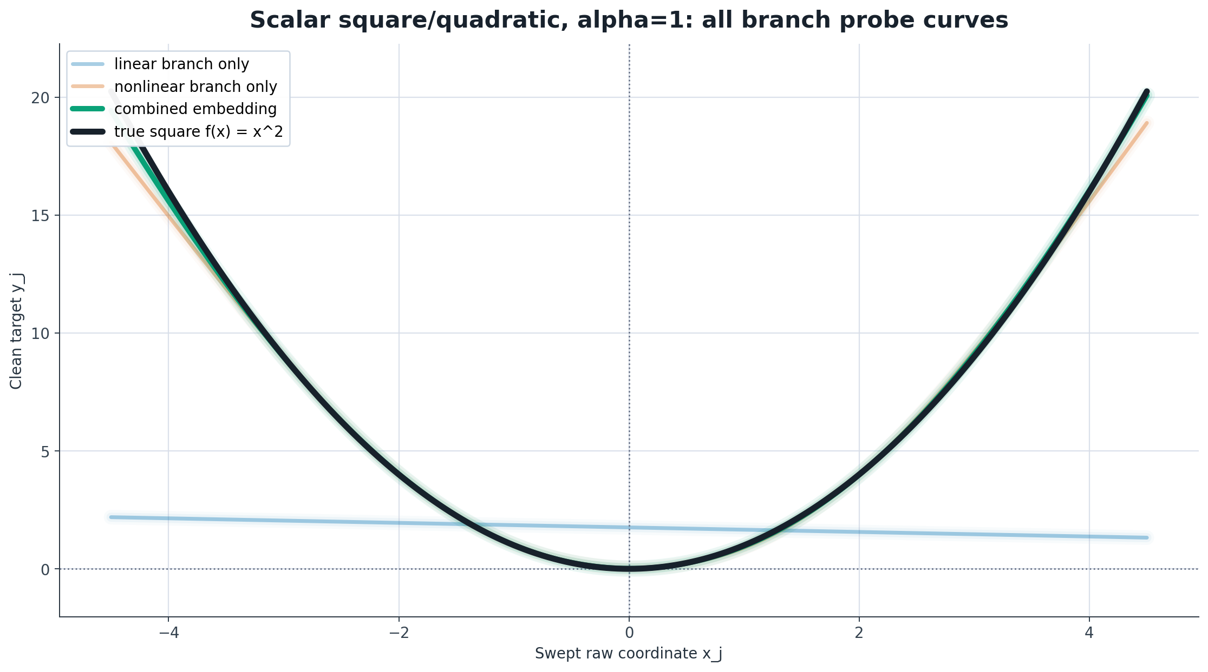
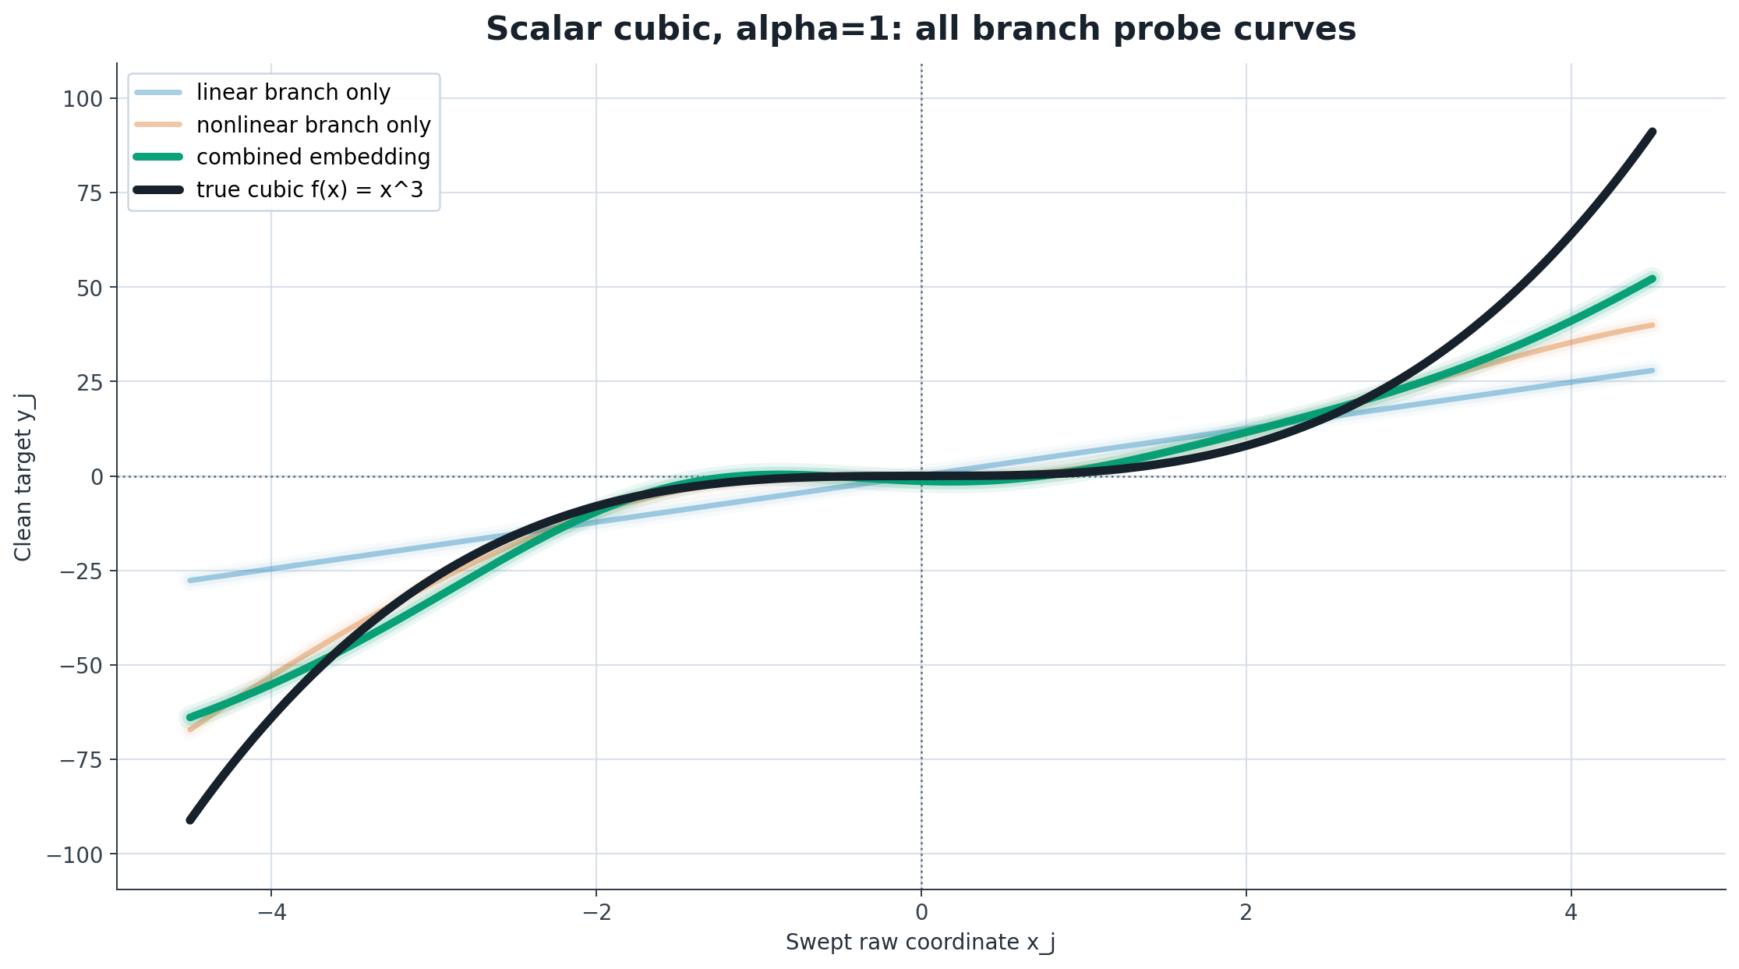
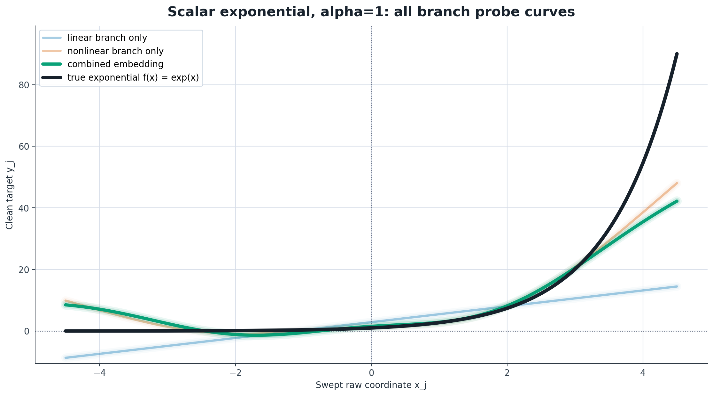
PROBE EXPERIMENT
Probe results across square, cubic, and exponential targets
Branch-probe outputs show what is linearly readable from learned embeddings across nonlinear target functions.
Square branch readout
Cubic branch readout
Exponential branch readout
For f(x)=x^2, the combined embedding closely follows the target curve; the nonlinear branch carries the curvature.
The combined embedding follows the cubic shape better than either branch alone over part of the sweep.
The combined and nonlinear-branch readouts pick up rising curvature, but still under-shoot the exponential tail.
Note: the scalar branch-probe notebook saves square/quadratic, cubic, and exponential branch-story plots, so all three panels use the same alpha=1 scalar readout format.
Contrastive encoder experiment | 11/12

Slide 18
PROBE FINDINGS
Probe finding: nonlinear branch recovers nonlinear structure
The branch probes suggest that curvature is made linearly readable by the learned nonlinear component.
Linear branch
Nonlinear branch
Combined embedding
mostly carries linear trend
carries curvature
closest readout shape
What the plots show
Interpretation
Caution
For square and cubic targets, the nonlinear branch and combined embedding follow the curved target better than the linear branch.
The residual branch is not just extra capacity: a ridge probe can read out nonlinear coordinate structure from the frozen embedding.
Recovery is partial. The exponential target still under-shoots in the tail, so the probe supports nonlinear recovery, not perfect recovery.
Takeaway: the probe results give positive evidence that the nonlinear encoder is recovering the nonlinear part of the signal, while the SNR/PVE slides quantify how far that recovery remains from the ideal reference.
Contrastive encoder experiment | probe findings

Slide 19
SUMMARY
Findings and next steps
The updated story focuses on deterministic recovery versus noise fitting.
Findings to report
Main caution
Noise-only: high train alignment with held-out near zero remains the memorization sanity check.
Linear/cubic: test separation rises with SNR, but stays below the red ideal reference.
Overfitting: excess train-over-ideal shrinks as SNR increases, except alpha=1 remains suspicious longer.
The PVE/reference line is an upper benchmark, not a model result. The gap between the red line and learned test separation is the key evidence that current encoders under-recover the deterministic signal.
Next steps
Compare the square, cubic, and exponential probe-readout shapes directly against the SNR/PVE recovery curves.
Use the overfitting plots to choose alpha/regularization settings before adding more target functions.
Repeat strongest deterministic settings across more random seeds.
Contrastive encoder experiment | 12/12

