Slide 1
MOTIVATION
Linear vs Nonlinear Contrastive Encoders
Main question
Does adding a controlled nonlinear correction recover real shared signal, or mostly increase noise fitting?
One-line setup
We compare linear and residual nonlinear encoders on noise-only, linear-signal, and cubic-signal synthetic data.
Contrastive encoder experiment | 1/12

Slide 2
EXPERIMENTAL SETUP
Synthetic data conditions
Each condition tests a different kind of X/Y relationship while keeping the training protocol fixed.
Noise only
Linear signal
Cubic signal
X and Y are independent Gaussian noise. Any training alignment here is memorization.
X has latent Z_x, Y has latent Z_y, with Z_y = Z_x.
X has latent Z_x, Y has latent Z_y, with Z_y = standardized(Z_x^3).
Data scale
Signal/noise setting
Input dimensions: X=128, Y=128
Train pairs: 160
Held-out pairs: 800
Latent dimension: 1
Signal strength: 2.0
Noise std: 1.0
Contrastive encoder experiment | 2/12

Slide 3
MODEL ARCHITECTURE
Linear backbone plus controlled nonlinear correction
Both views use matched encoder families; residual models use normalized branches so alpha has a meaningful scale.
Pure linear encoder
Residual nonlinear encoder
A2: 128 -> 16
GELU
input 128
G
embedding 4
input 128
G
A1: 16 -> 4
g(u) = Normalize(G u)
g(u) = Normalize(G u) + alpha * Normalize(A1 GELU(A2 u + b))
Current MLP size
Each nonlinear encoder uses one hidden layer: 128 -> 16 -> 4. Embedding dimension is fixed at 4.
Contrastive encoder experiment | 3/12

Slide 4
OBJECTIVE
Paper contrastive loss with optional penalties
All model families use the same objective; differences come from architecture and regularization.
Similarity scores
For a batch of paired embeddings:
sᵢⱼ = zₓ,ᵢᵀ zᵧ,ⱼ
maximize L = Σᵢ sᵢᵢ − Σᵢ log Σⱼ exp(sᵢⱼ) − Σⱼ log Σᵢ exp(sᵢⱼ)
training minimizes −L / n plus any active regularization terms
L1 penalties
L2 penalties
Output penalty
Linear: ||Gₓ||₁ + ||Gᵧ||₁
Nonlinear: ||A||₁ terms when enabled.
Linear: ||Gₓ||₂² + ||Gᵧ||₂²
Nonlinear: ||A₁||₂² + ||A₂||₂².
Available to keep the actual nonlinear correction small unless needed.
Contrastive encoder experiment | 4/12

Slide 5
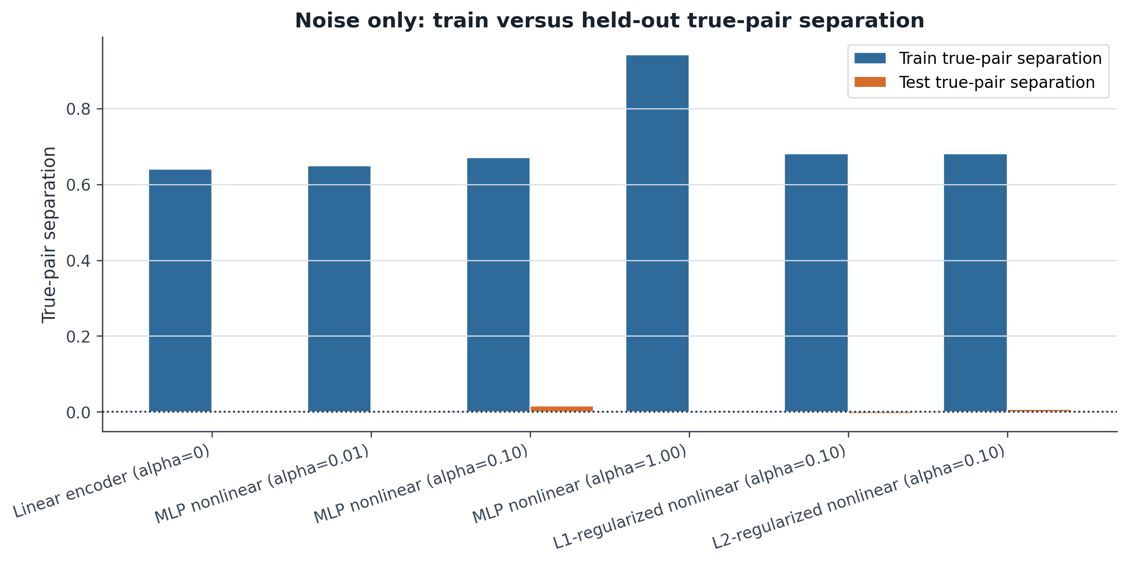
RESULT
Noise-only: train vs held-out separation
High train separation with low held-out separation indicates memorization rather than signal.
Interpretation
In noise-only data, X and Y have no real relationship. All models can still separate paired training samples, so the training alignment reflects memorized noise pairings. The alpha=1 nonlinear model shows the strongest training separation, while held-out separation stays near zero for all models.
Key takeaway
High training alignment in noise does not mean real learning; held-out performance reveals memorization.
Contrastive encoder experiment | 5/12

Slide 6
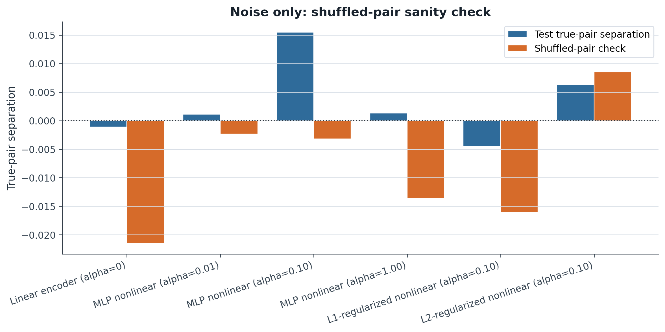
RESULT
Noise-only: shuffled-pair sanity check
Breaking the pairing should remove alignment; values near zero support the sanity check.
Interpretation
This is a sanity check for noise-only data. Since X and Y are independent, true held-out pairs should not be more meaningful than shuffled pairs. Both original held-out separation and shuffled-pair separation stay close to zero.
Key takeaway
True held-out pairs behave like shuffled random pairs, confirming that no real signal is learned.
Contrastive encoder experiment | 6/12

Slide 7
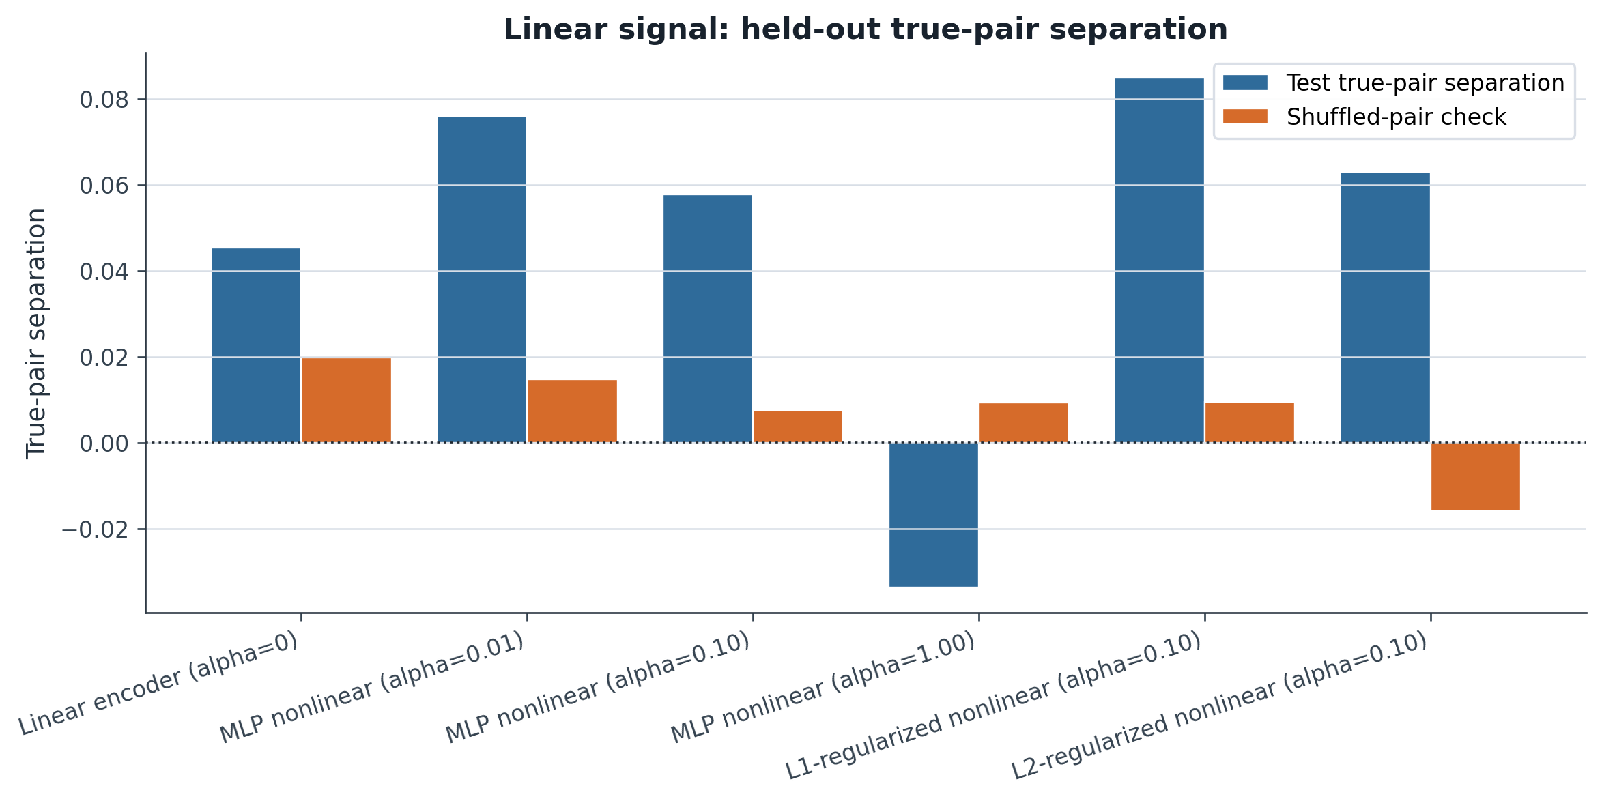
RESULT
Linear signal: held-out separation
The linear baseline should already be competitive when Z_y = Z_x.
Interpretation
With linear signal, held-out true-pair separation is positive for most models, so they capture shared structure that generalizes. The linear baseline is already competitive, shuffled values are smaller, and alpha=1 performs poorly.
Key takeaway
When the true relationship is linear, the linear baseline is strong and a dominant nonlinear branch does not necessarily help.
Contrastive encoder experiment | 7/12

Slide 8
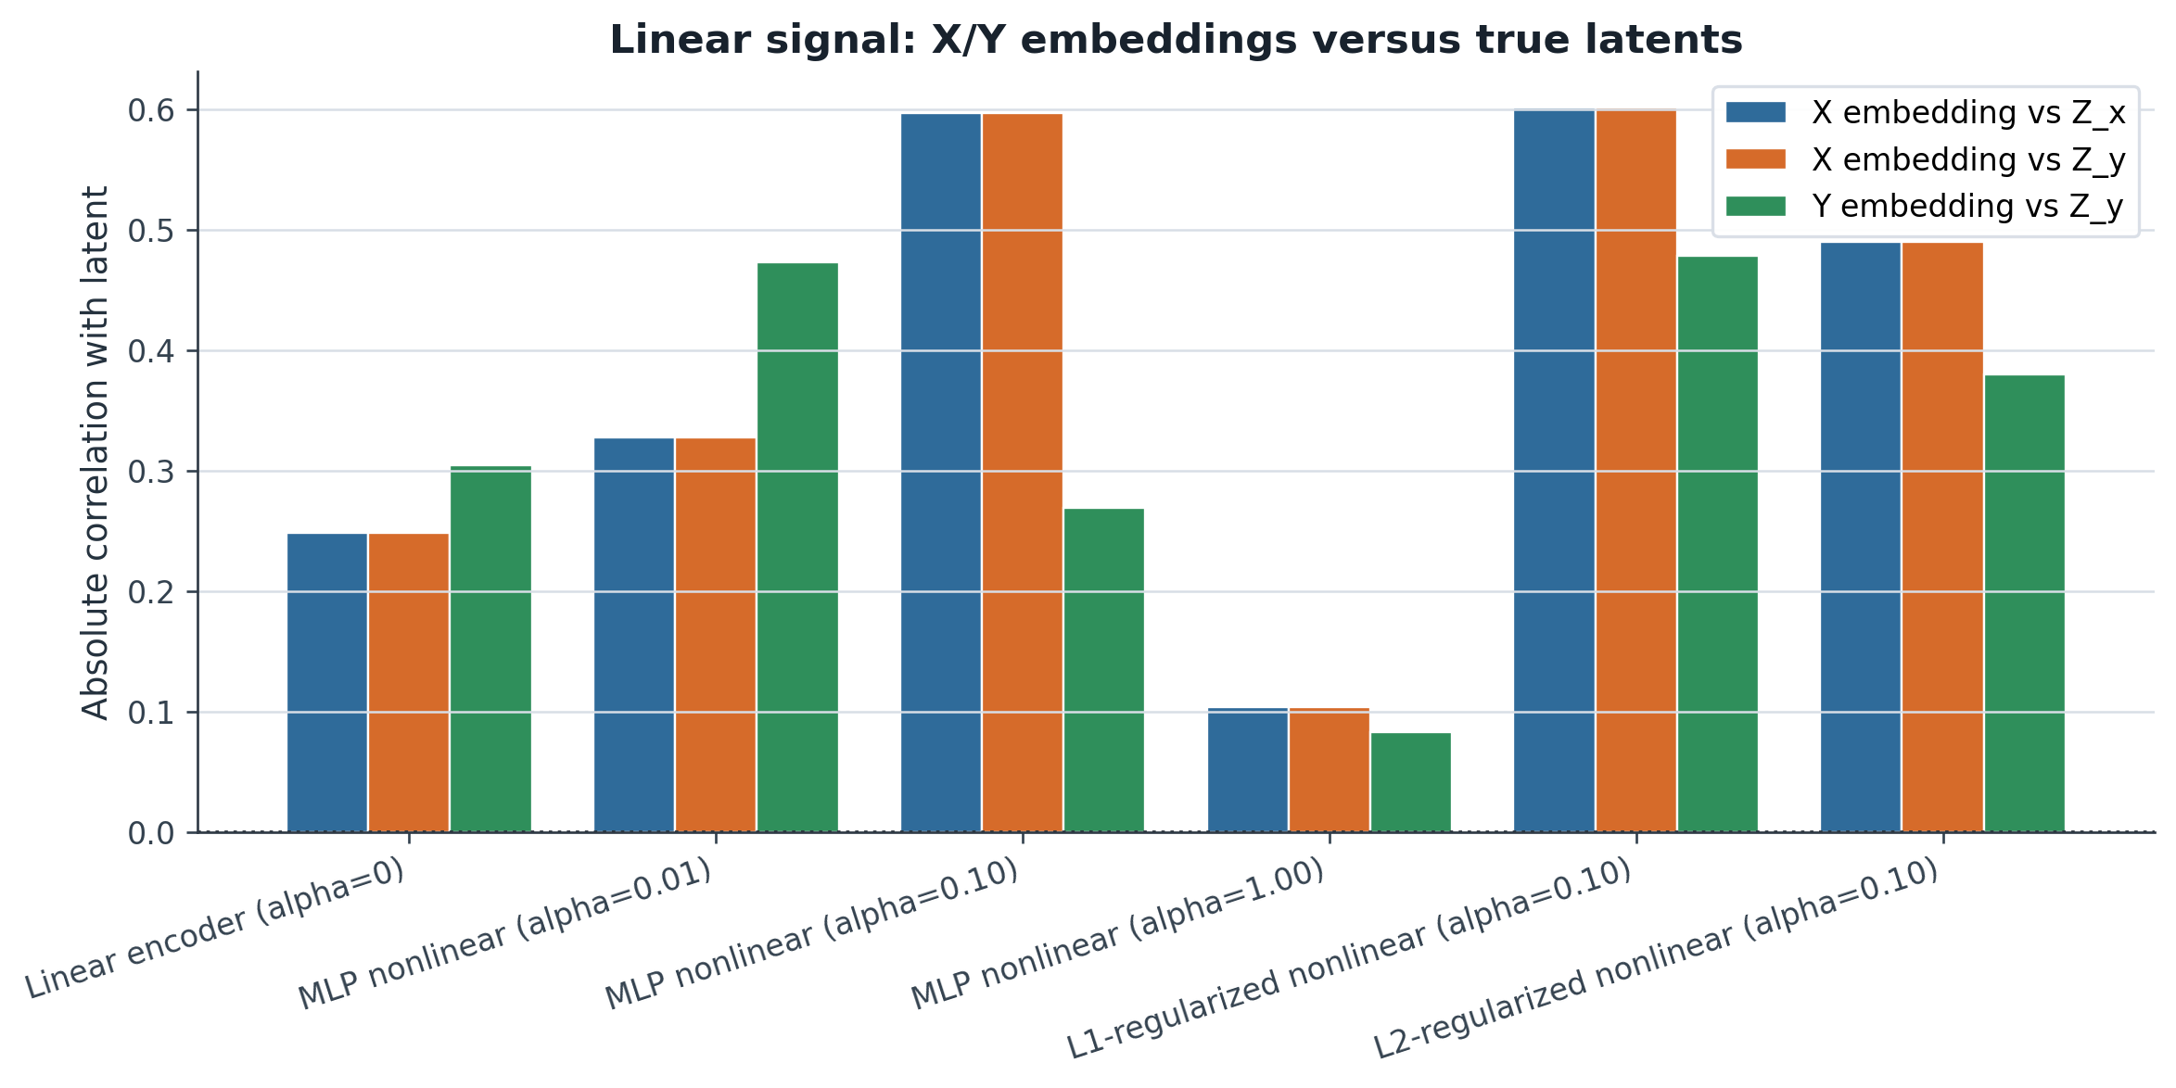
RESULT
Linear signal: latent recovery
Correlation with the true latent shows whether embeddings preserve the synthetic signal.
Interpretation
This plot measures how much true latent signal remains in the embeddings. Moderate nonlinear contribution and the L2-regularized nonlinear model improve X-side recovery, while alpha=1 hurts recovery. Y-side recovery is more uneven.
Key takeaway
Moderate nonlinear correction can improve latent recovery, but too much nonlinear influence can hurt even for linear signal.
Contrastive encoder experiment | 8/12

Slide 9
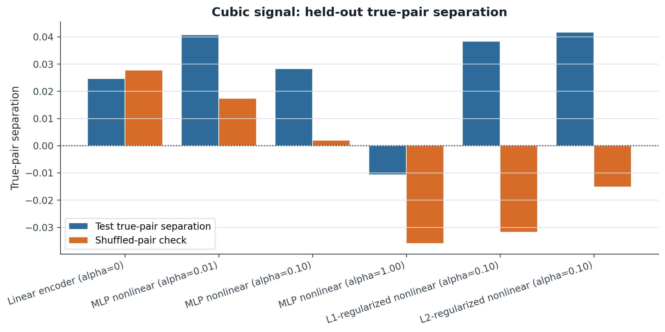
RESULT
Cubic signal: held-out separation
The cubic relationship asks whether the nonlinear correction helps beyond the linear backbone.
Interpretation
The cubic setting tests whether nonlinear correction helps beyond the linear backbone. Some controlled nonlinear or regularized models improve held-out separation over the shuffled baseline, suggesting partial nonlinear structure recovery. The alpha=1 model generalizes poorly.
Key takeaway
Controlled nonlinear corrections can help nonlinear signal, but an overly large nonlinear branch can destabilize learning.
Contrastive encoder experiment | 9/12

Slide 10
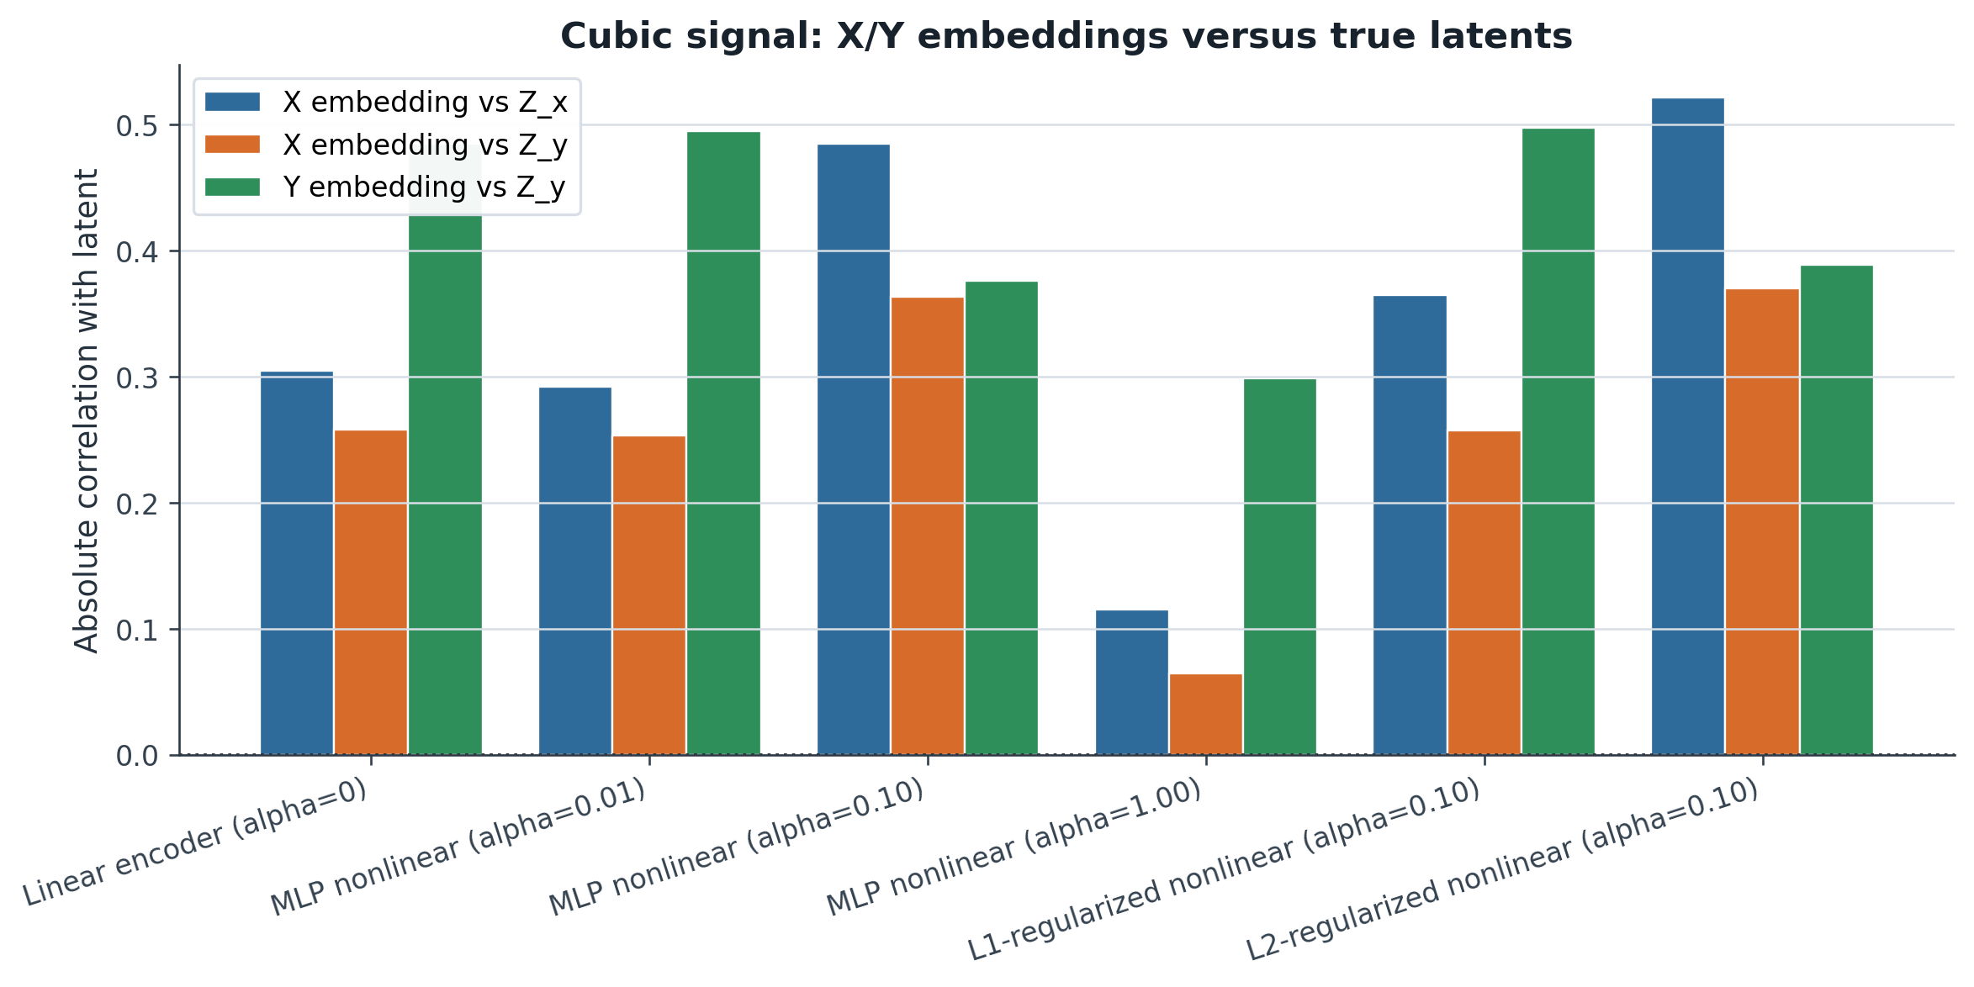
RESULT
Cubic signal: latent recovery
The recovery plot asks whether embeddings capture the true nonlinear latent relationship.
Interpretation
Latent recovery is less consistent than in the linear setting, showing the cubic relationship is harder to capture. Controlled nonlinear or regularized models preserve more latent information for some views, while alpha=1 damages the representation.
Key takeaway
Nonlinear structure is harder to recover; controlled nonlinear correction helps more than a dominant nonlinear branch.
Contrastive encoder experiment | 10/12

Slide 11
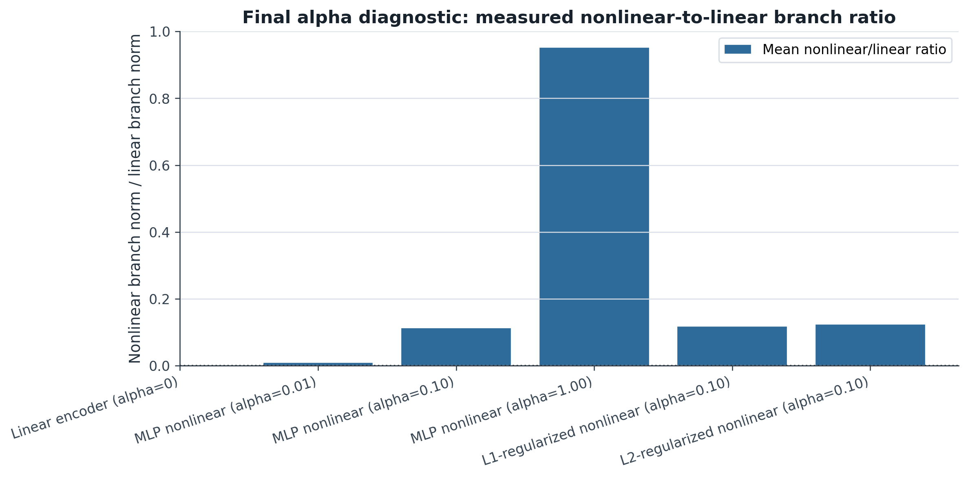
RESULT
Branch ratio diagnostic
The measured nonlinear/linear branch ratio checks whether alpha controls the correction size.
Interpretation
This diagnostic checks whether alpha controls the nonlinear correction size. Because both branches are normalized before summing, the nonlinear-to-linear ratio should track alpha: alpha=0.01 is tiny, alpha=0.10 is controlled, and alpha=1 is nearly as large as the linear branch.
Key takeaway
Branch normalization makes alpha interpretable: small alpha gives a controlled correction, while alpha=1 lets the nonlinear branch dominate.
Contrastive encoder experiment | 11/12

Slide 12
SUMMARY
Findings and next steps
The cleaned experiment separates signal recovery from noise fitting.
Findings to report
Main caution
Noise-only: high train alignment but held-out near zero means memorization.
Linear signal: the linear baseline is strong; moderate nonlinear correction can improve recovery.
Cubic signal: controlled or regularized nonlinear models help more than alpha=1.
The train/test alignment gap is still large in the linear and cubic settings. Branch normalization makes alpha interpretable, but it does not by itself solve overfitting or loss-design issues.
Next steps
Understand and reduce the train/test alignment gap for linear and cubic signals.
Try different contrastive loss functions.
Tune the early stopping mechanism and stopping criteria.
Try other signal relationships beyond linear and cubic.
Repeat the strongest settings across more random seeds.
Contrastive encoder experiment | 12/12

