Slide 1

BMD Simulation Progress
By Basma El-Mahdy
Oct.5 Meeting

Slide 2
Contents
Material Correction
Geometrical design correction

Slide 3
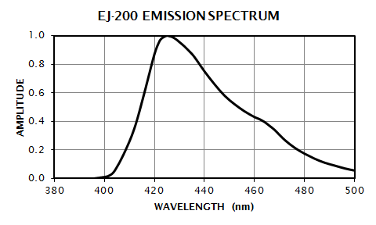
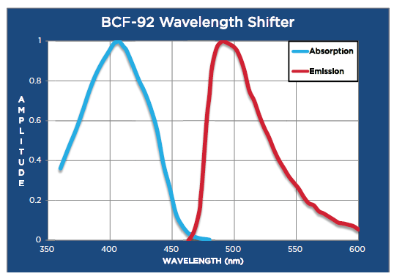

Spectra of:
$$E=\frac{ℏc}{λ}=\frac{\text{197.3269804}\text{(}\text{eV}\text{.}\text{nm}\text{)}}{λ}$$
$$I=Const. A^{2}$$
EJ200 Scintillator (Emission)
WLS (Emission and Absorption)
Wavelength (nm) -> Energy (eV)
Amplitude -> Intensity (eV)
Wavelength (nm) -> Energy (eV)
Amplitude -> Intensity (eV)

Slide 4
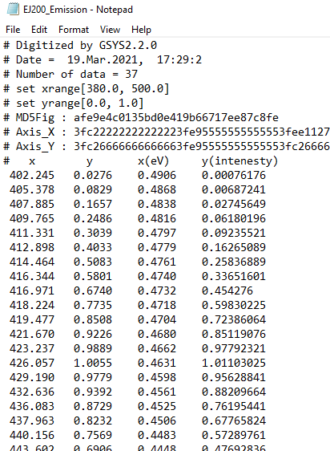
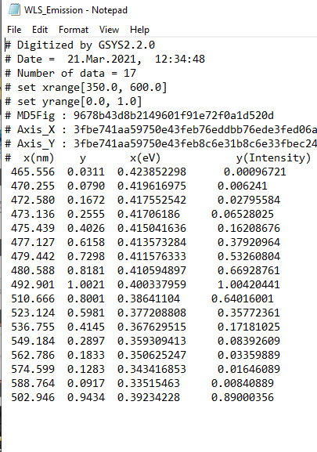
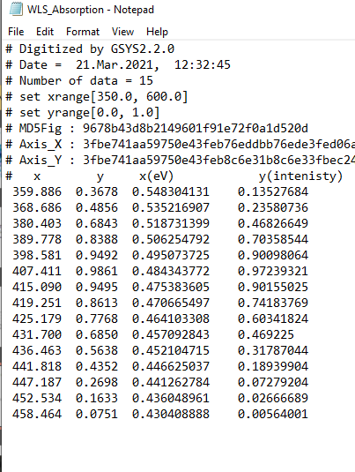
Through the use of GSYS2
EJ200 Scintillator (Emission)
BCF-92 WLS (Emission and Absorption)

Slide 5
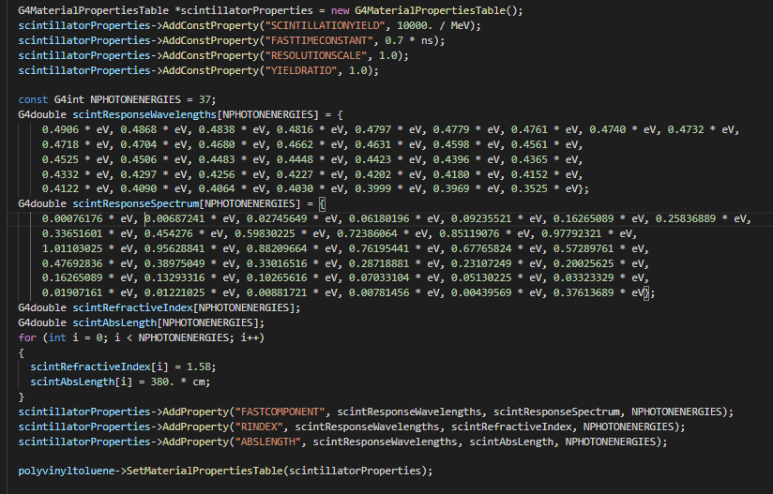
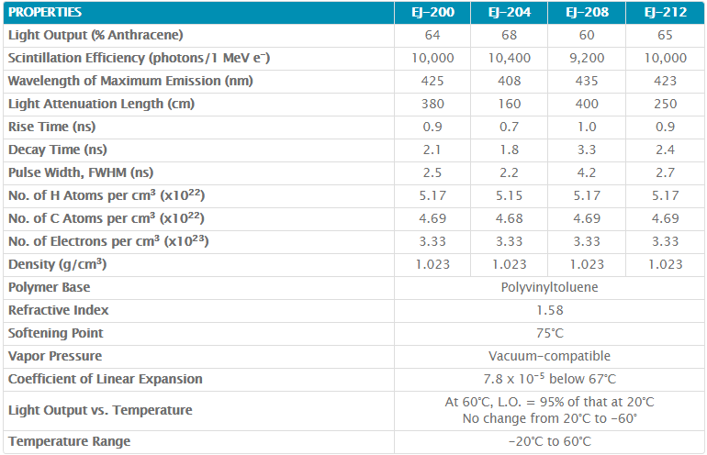
EJ200 Scintillator
Scintillator efficiency
Rise Time
Refractive index
Absorption length

Slide 6
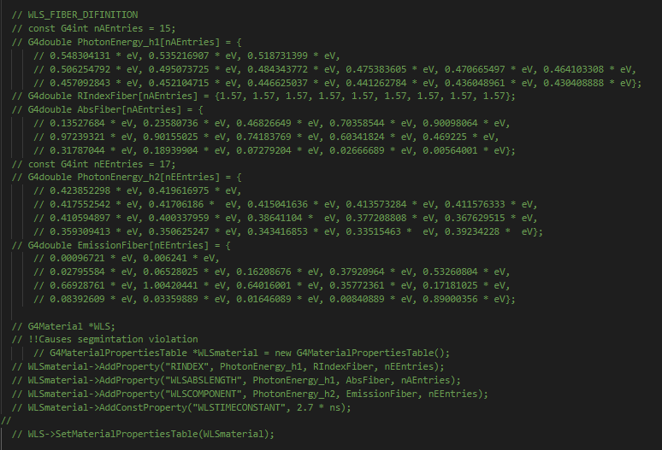
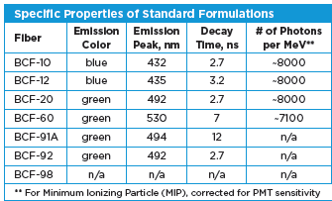
BCF-92 WLS Material
Refractive index
Decay time

Slide 7
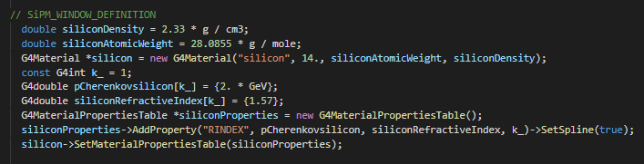
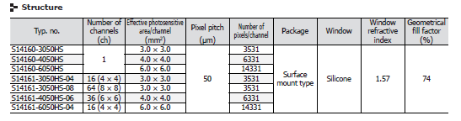
SiPM Material
Chernkov parameter
Refractive index

Slide 8
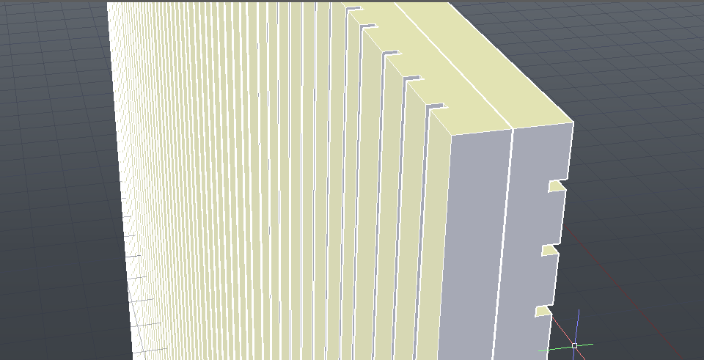
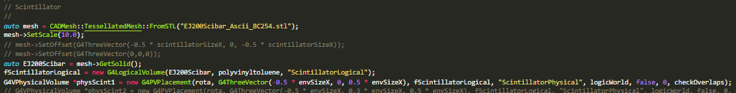
EJ200 Scintillation Bar Geometry

Slide 9
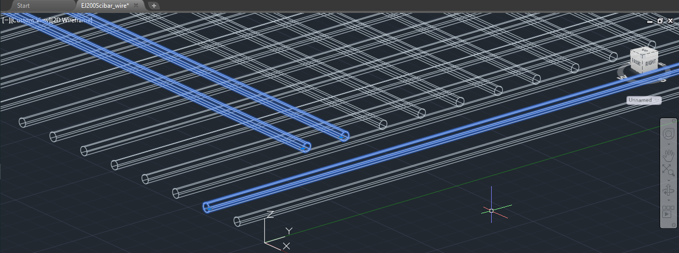
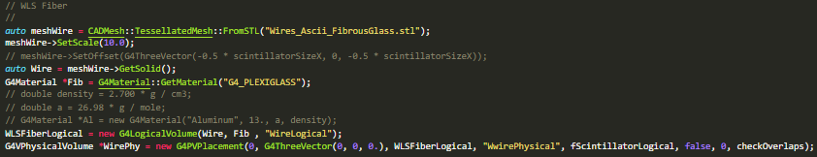
BCF-92 Wavelength Shifting Fibers Geometry

Slide 10
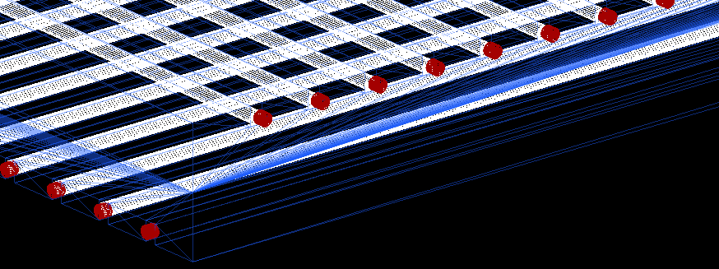
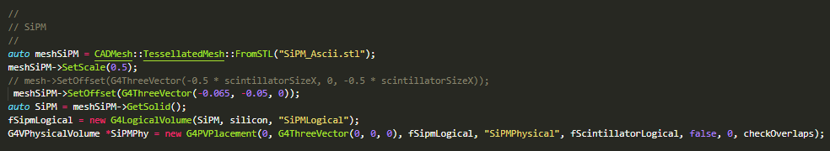
SiPM

Slide 11
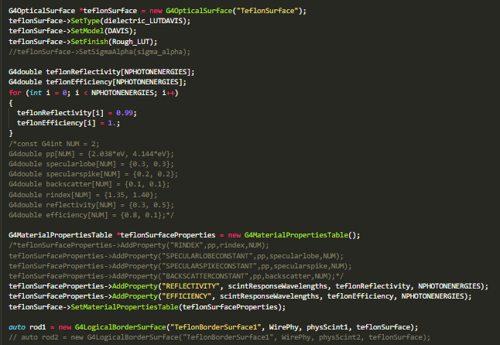
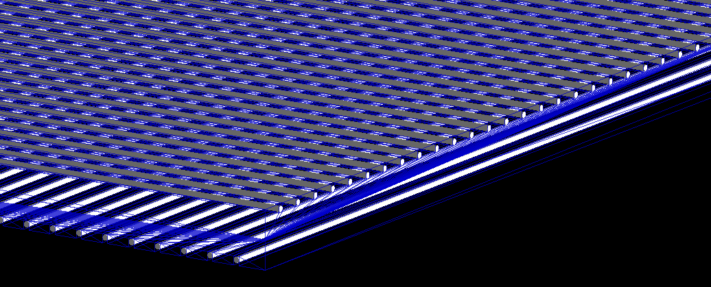
In GEANT4

Slide 12
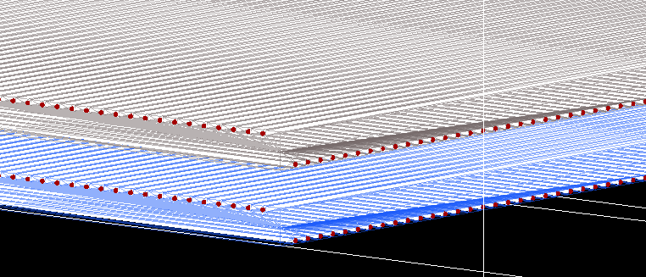
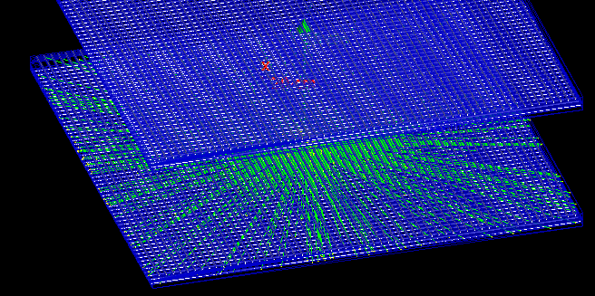

Slide 13
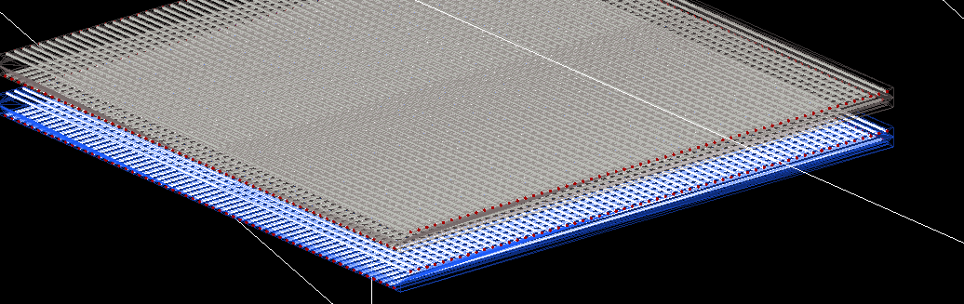
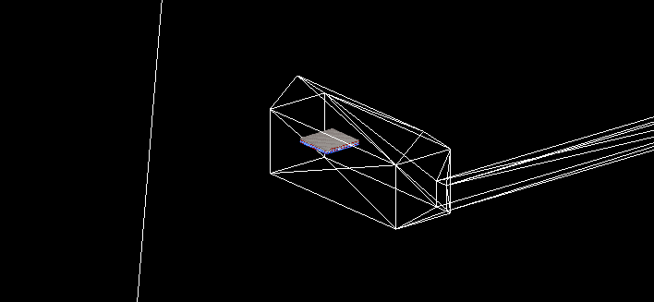
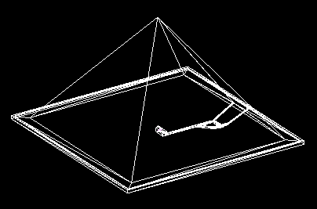
Calling the SiPM by the sdManager to collecting the hits
Running CRY (Shereen working on it)
Extracting the output histograms

