Slide 1
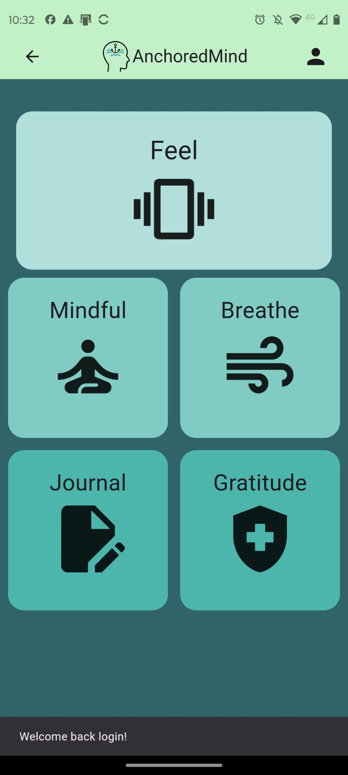








AnchoredMind
Innovating anxiety technology in psychology
Ben Hanley
BSc(hons) Computer Science 2025
benhanley321@gmail.com www.benhanley321.wixsite.com/my-site

Slide 2
The problem
301 million people suffer from anxiety in 2019 [1]
67.3% of anxiety apps lacked development with health care professionals, 3.8% of anxiety apps were tested thoroughly [2]
Majority of Anxiety apps are text and video based
[1] (World Health Organization, 2023 )
[2] (Sucala et al., 2017)
Ben Hanley
BSc(hons) Computer Science 2025

Slide 3
The task
Stakeholder with psychological expertise
Haptic feedback and visualisation
Mindfulness, breathing exercises, journal and gratitude
UX design
Architecture
Security
Statistical analysis
Ben Hanley
BSc(hons) Computer Science 2025
benhanley321@gmail.com www.benhanley321.wixsite.com/my-site

Slide 4
Stakeholder Management
Worked in an agile software development lifecycle in which I met up with 3 mental healthcare professionals who operate as stakeholders in the product
Associate Professor in Psychology
CAHMS Mental health Nurse
Chartered Educational Psychologist
They were crucial in research, requirements, ideation and evaluation of the product.
Ben Hanley
BSc(hons) Computer Science 2025
benhanley321@gmail.com www.benhanley321.wixsite.com/my-site

Slide 5
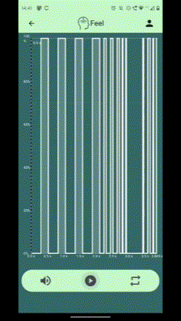
Haptic feedback
Provides sensory grounding through use of vibration building a repetitive and reliable sense of feeling for users to depend on.
This is a unique concept for anxiety management and had captivated the stakeholders in initiation.
The app vibrates to different patterns, with a dynamic graph visualising the haptic feedback, to help users anticipate the feedback. They can play, pause and loop.
Ben Hanley
BSc(hons) Computer Science 2025
benhanley321@gmail.com www.benhanley321.wixsite.com/my-site

Slide 6

App features
Mindful audio player
Gratitude journalling with randomly generated prompts
Mood tracking w
Breathing exercise visualisation of waves
Heartrate device connectivity allowing future heartrate monitoring.
Multi-lingual
Ben Hanley
BSc(hons) Computer Science 2025
benhanley321@gmail.com www.benhanley321.wixsite.com/my-site

Slide 7
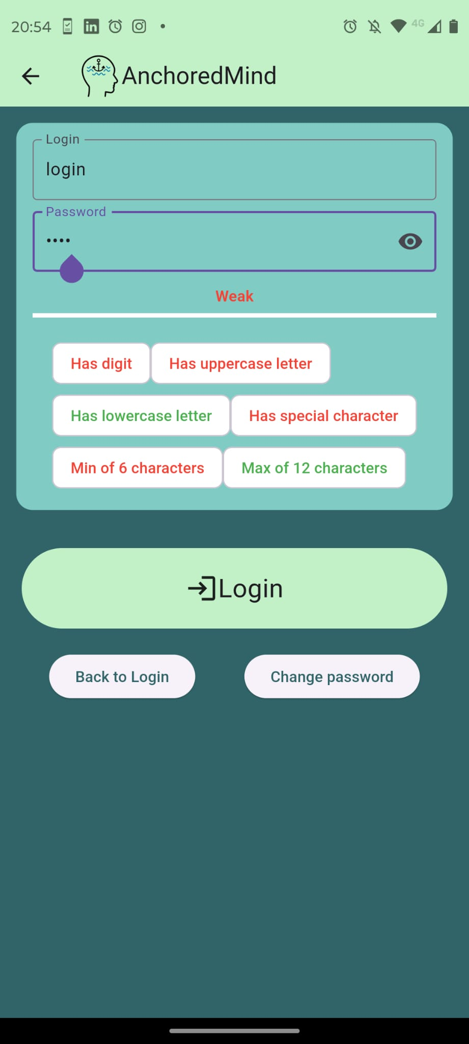
Security
Field Encryption on sensitive data
Encryption uses Advanced encryption standard with randomised IV
LoginHash uses SHA-256 which is the current industry standard
Password creation validation
Ben Hanley
BSc(hons) Computer Science 2025
benhanley321@gmail.com www.benhanley321.wixsite.com/my-site

Slide 8

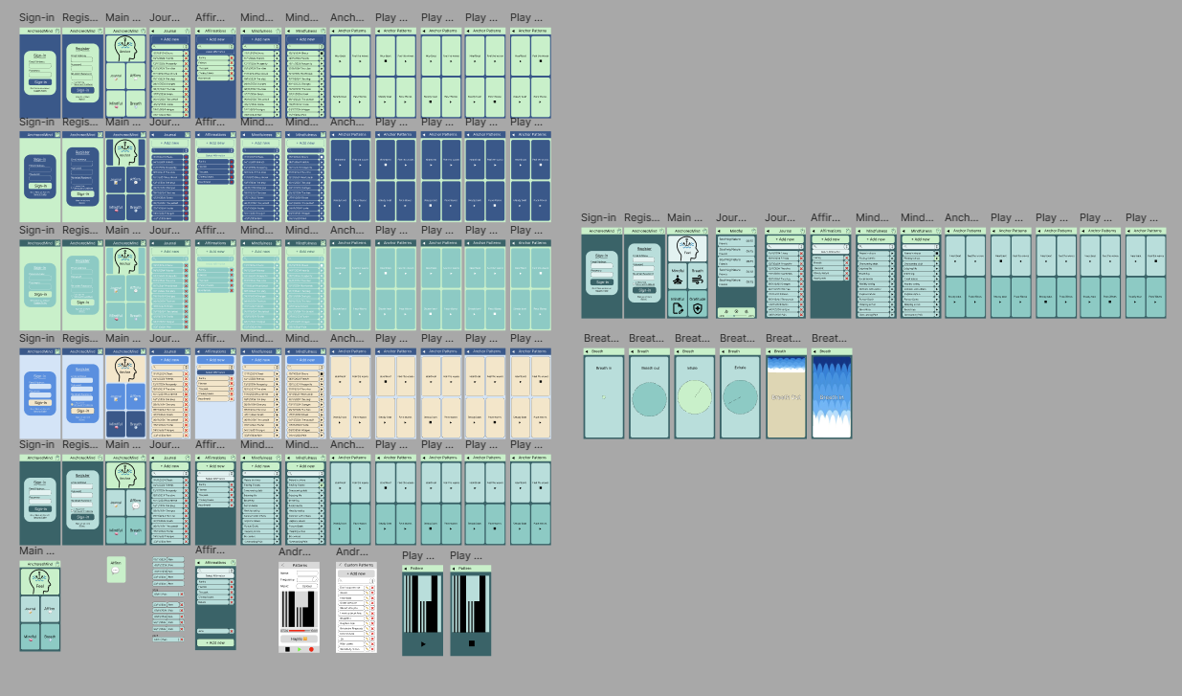
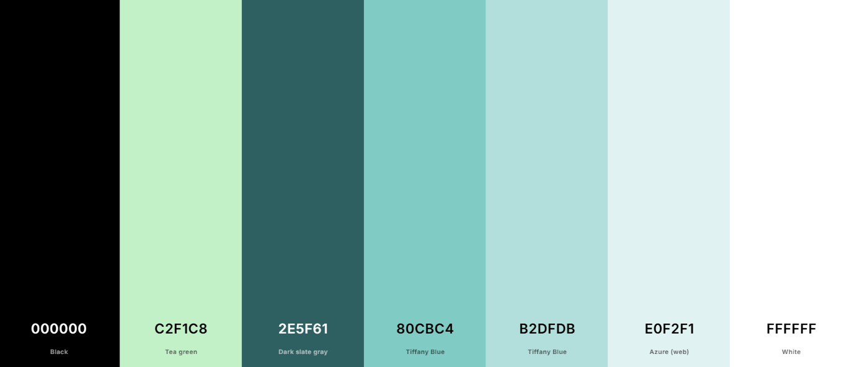
UX & Design choices
Ben Hanley
BSc(hons) Computer Science 2025
benhanley321@gmail.com www.benhanley321.wixsite.com/my-site

Slide 9

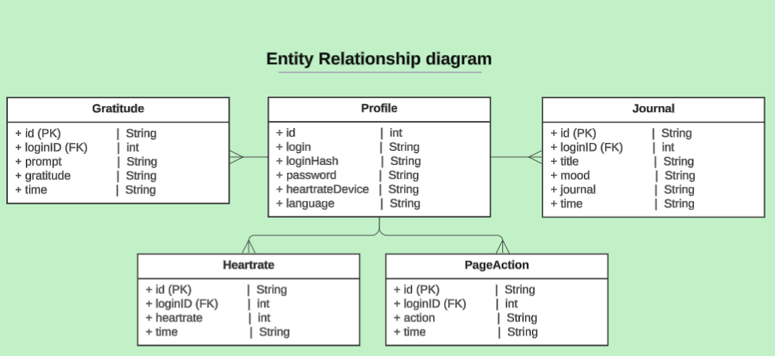


The stack
GitHub version control
Flutter framework with Dart
ObjectBox
local database
Ben Hanley
BSc(hons) Computer Science 2025
benhanley321@gmail.com www.benhanley321.wixsite.com/my-site

Slide 10
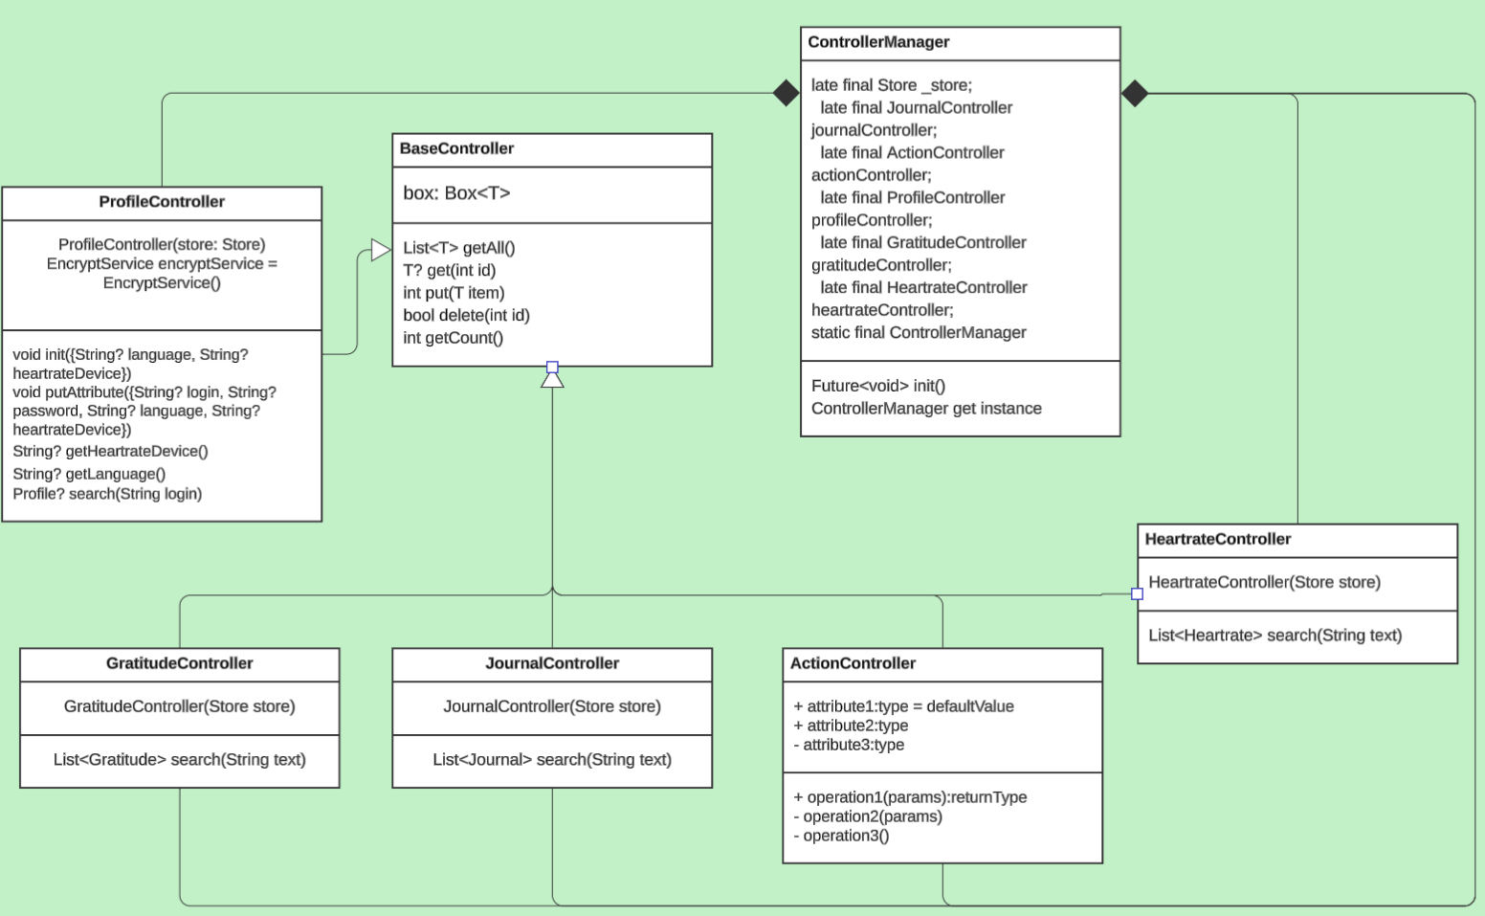
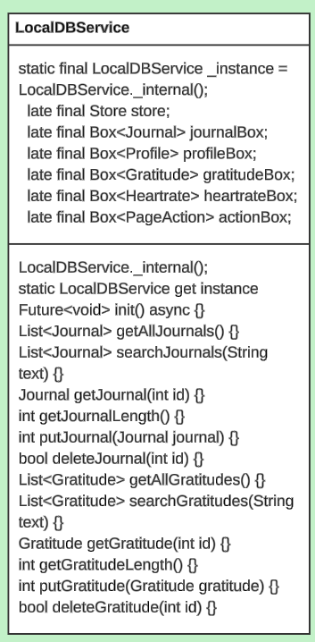
Architecture Evolution
Ben Hanley
BSc(hons) Computer Science 2025
benhanley321@gmail.com www.benhanley321.wixsite.com/my-site

Slide 11
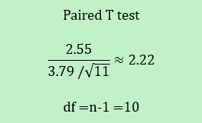
Psychological analysis
11 Participants (aged 18-62) were assessed based on their anxiety levels (GAD-7) before and after using the app over a two-week period
GAD-7 is 7 question survey to assess the severity of Anxiety symptoms. On average we saw a 2.55-point reduction on GAD-7.
A t-test was created to establish whether the result was statistically significant
p=2×(1−P(T≤2.22)) where T∼t 10
p≈ 0.0503 > 0.05 which is approaching significance
Ben Hanley
BSc(hons) Computer Science 2025
benhanley321@gmail.com www.benhanley321.wixsite.com/my-site

Slide 12


Testing
Functional Testing
Semi-Structured Design Case Study (2 participants)
Colour Scheme Survey (32 participants)
High Fidelity Prototype Testing (healthcare professional)
Initial UX design evaluation (22 participants)
3 Week Beta Testing (13 participants)
Results were positive and described a very user-friendly and highly useable.
Flutter framework with Dart
Nodejs with express
NoSQL database for online use
Ben Hanley
BSc(hons) Computer Science 2025
benhanley321@gmail.com www.benhanley321.wixsite.com/my-site

Slide 13
Conclusion
Fully functioning app with 5 modules
Worked alongside healthcare professionals,
Gained approval to work onwards.
Well designed UX processes
Beta testing describes a complete product
Psychologically assessed
App considers Legal, Ethical & Social issues
Ben Hanley
BSc(hons) Computer Science 2025
benhanley321@gmail.com www.benhanley321.wixsite.com/my-site

Slide 14
Future
Working with healthcare professionals further.
Gain funding from NHS, CAMHS and mental health charities.
Complete Heartrate monitoring.
Haptic customisation.
Pattern filtering.
Run randomised controller trials on each module.
Hire legal consultation.
Ben Hanley
BSc(hons) Computer Science 2025
benhanley321@gmail.com www.benhanley321.wixsite.com/my-site

