Slide 1

Recommendation of Books using Content Filtering
Welcome to our presentation on using content filtering to recommend books to readers. Our system aims to understand the unique interests of each user, considering their reading history, preferences, and even their emotional state. We'll explore the data processing, feature extraction, and model building techniques involved, and discuss the key metrics used to measure the effectiveness of the recommendation system.

Slide 2
Introduction to Content-Based Filtering
Content-Based Filtering
Benefits
A technique that recommends items based on the user's historical interactions with similar items. By understanding the content of books a user has liked in the past, we can predict which new books they might enjoy.
Personalizes recommendations, avoids cold-start problems, and provides explanations for the recommendations.

Slide 3
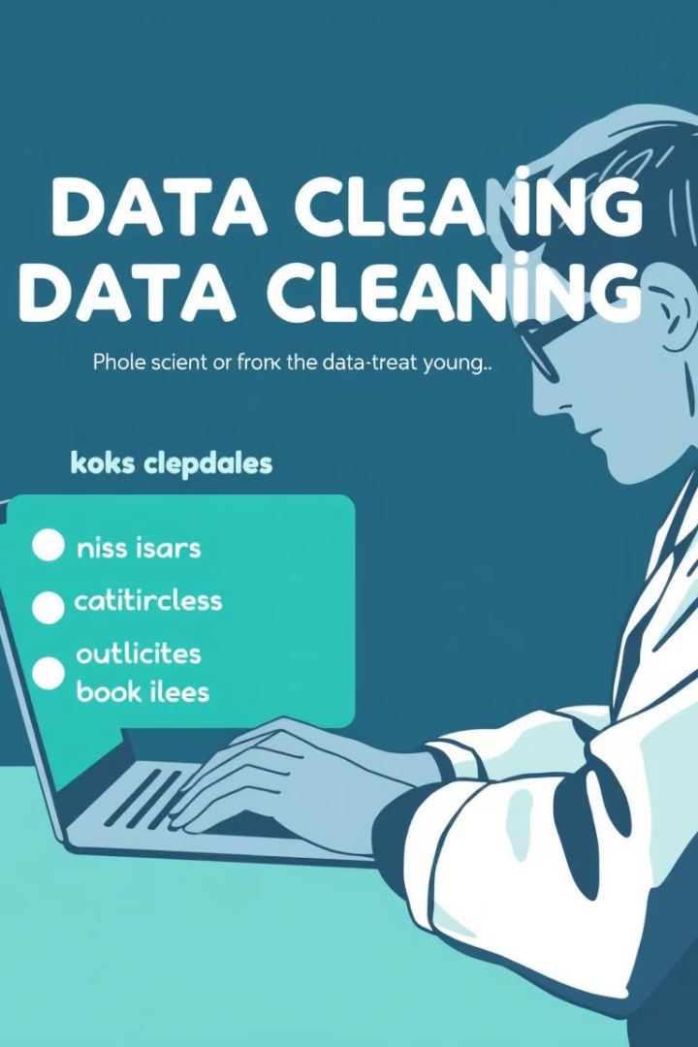
Data Preprocessing and Cleaning
Data Collection
Data Cleaning
Gathering data from various sources, such as book repositories, user reviews, and ratings.
Handling missing data, removing outliers, and correcting inconsistencies in book information.
Data Transformation
Normalizing and scaling data for consistent processing and analysis.

Slide 4





Extracting Book Features
Genre
Author
Language
Publication Date
Identifying the primary genre of each book.
Extracting information about the book's author, including their past works.
Determining the language of the book.
Extracting the date when the book was first published.

Slide 5



Building the Recommendation Model
Model Selection
1
Model Training
2
Using labeled data to train the model, including user preferences and book features.
Model Evaluation
3
Testing the model's accuracy and performance against various metrics.

Slide 6
Flowchart
Data Collection
1
2
Data Preprocessing
Feature Extraction
3
4
Model Training
User Profile
5
6
Recommendation Generation

Slide 7




Similarity Measures and Recommendations
Cosine Similarity
Measures the angle between two vectors, representing book features. A smaller angle indicates higher similarity.
Euclidean Distance
Calculates the straight-line distance between two vectors, representing book features. Smaller distances indicate greater similarity.
Recommendation Generation
Based on calculated similarity, the system recommends books that are most similar to the user's preferences.

Slide 8
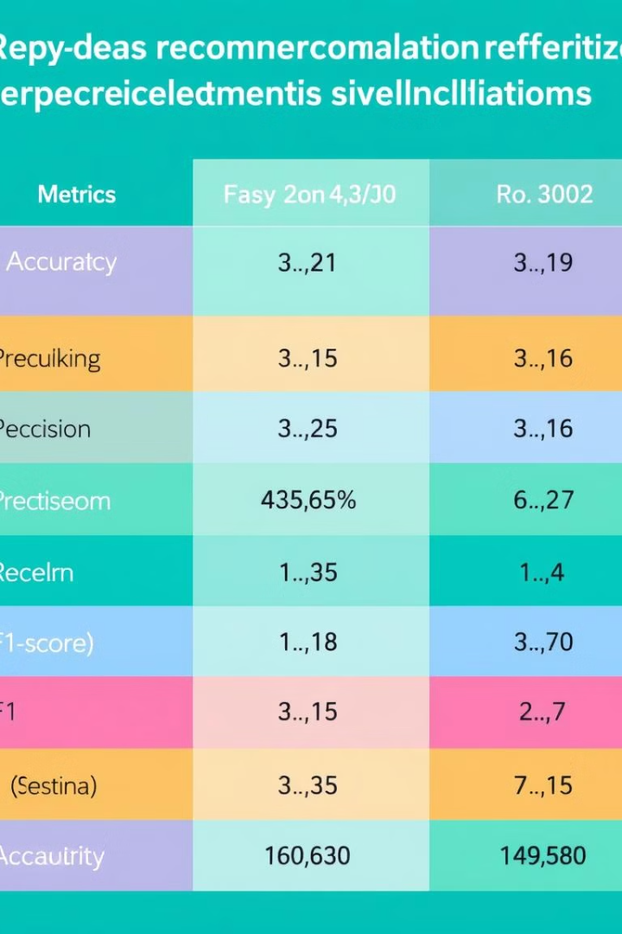
Evaluating the Recommendation System
1
2
Accuracy
Precision
Percentage of correct recommendations.
Percentage of recommended books that are actually relevant.
3
Recall
Percentage of relevant books that are actually recommended.

Slide 9

Conclusion and Future Enhancements
The system successfully leverages content filtering to generate personalized book recommendations. Future improvements include incorporating collaborative filtering, handling cold-start problems, and providing explanations for recommendations.

