Slide 1
MF < Dflow start date & SWMM start date
MF < Dflow
&
MF >= SWMM
MF >= Dflow
&
MF >= SWMM
Run MF
Couple MF + SWMM + DFLOW
Run MF and SWMM

Slide 2
Review preliminary results
Second eyes on 3-way couple timing

Slide 3
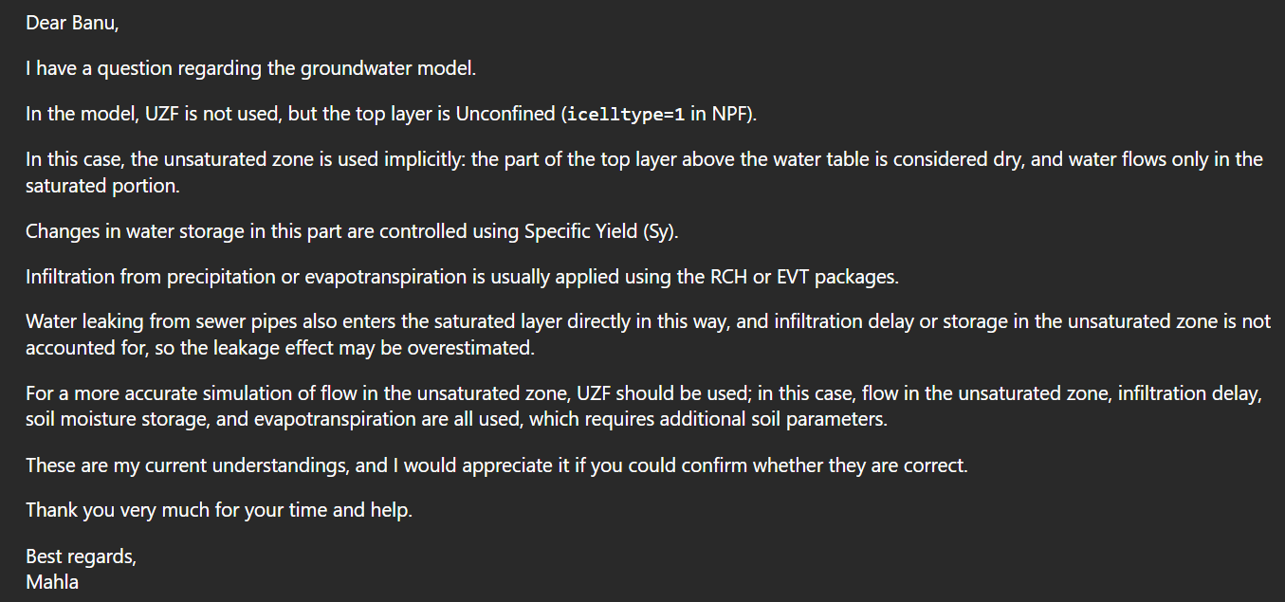
Email from Mahla about unsaturated flow...
Her assumptions are technically true.
Too many parameters … adds complexity we didn’t have time to address
This would be more of a concern in the middle of the island as opposed to the coastal setting of PJ/GP.
Sensitivity analysis by reducing leakage.
Add this info to limitations section?

Slide 4
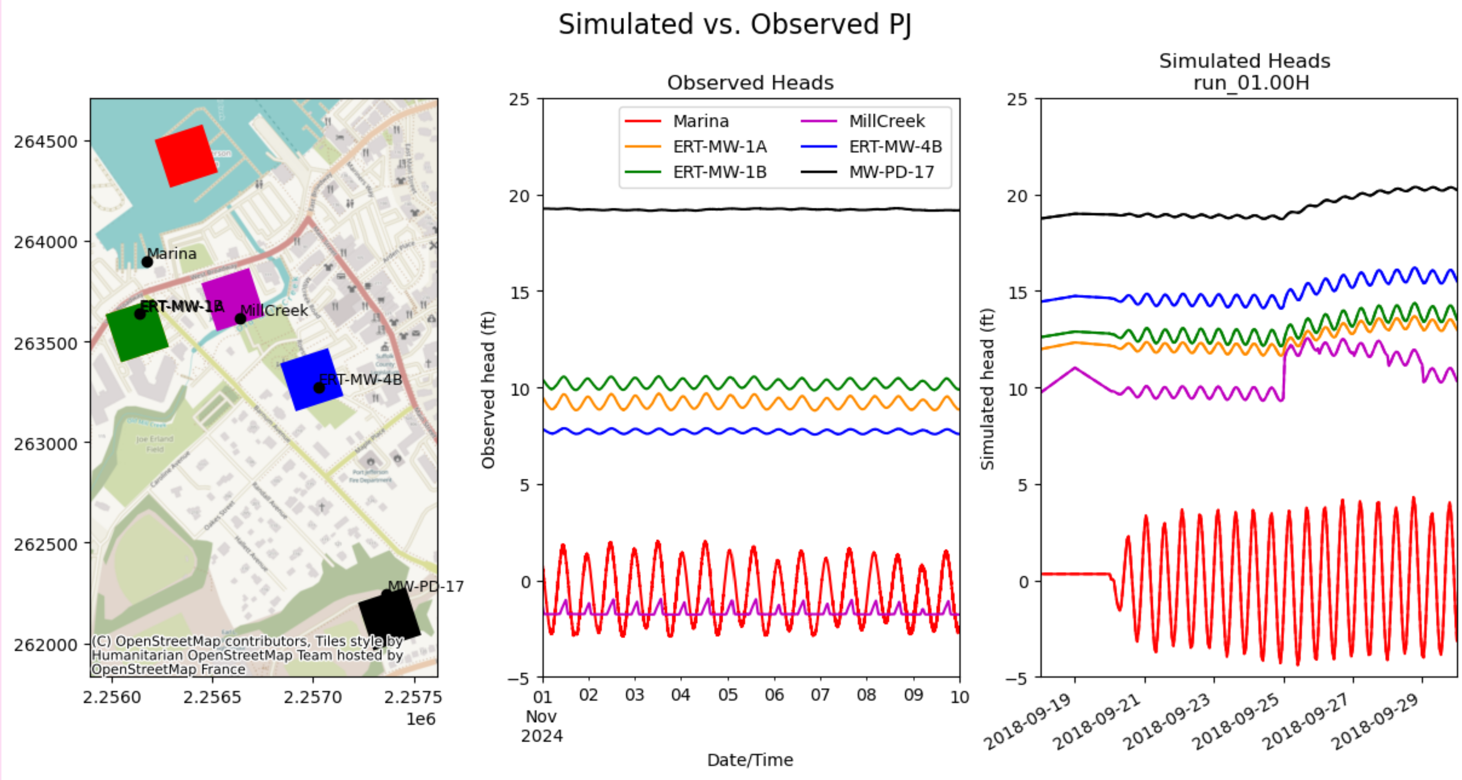
DRN
CHD
Have dflow water levels been spot checked against NOAA? (Liv)
  2010 – something about wind, Liv is looking at this.
  2018- in progress

Slide 5
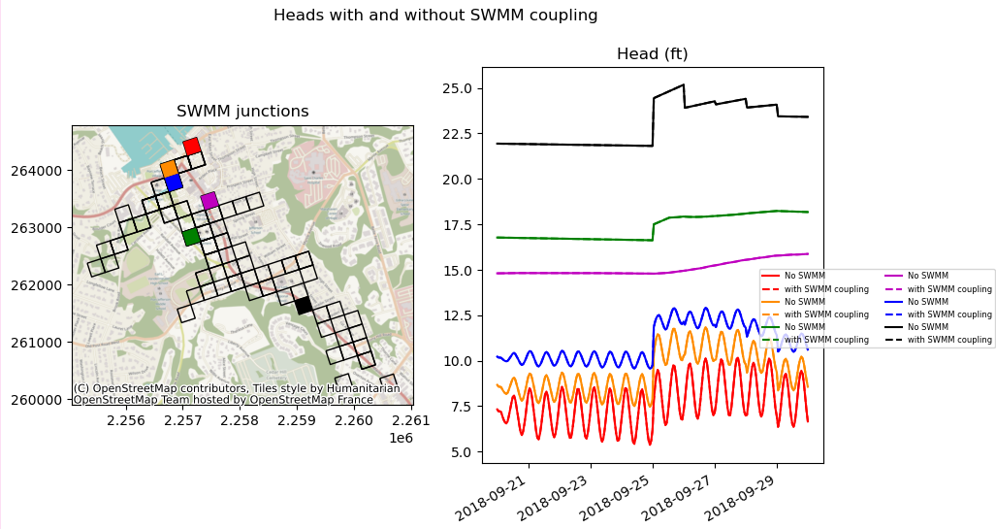
MF + D-Flow+ SWMM (daily)
Heads at select locations within the SWMM well network
SWMM coupling does not significantly change heads

Slide 6
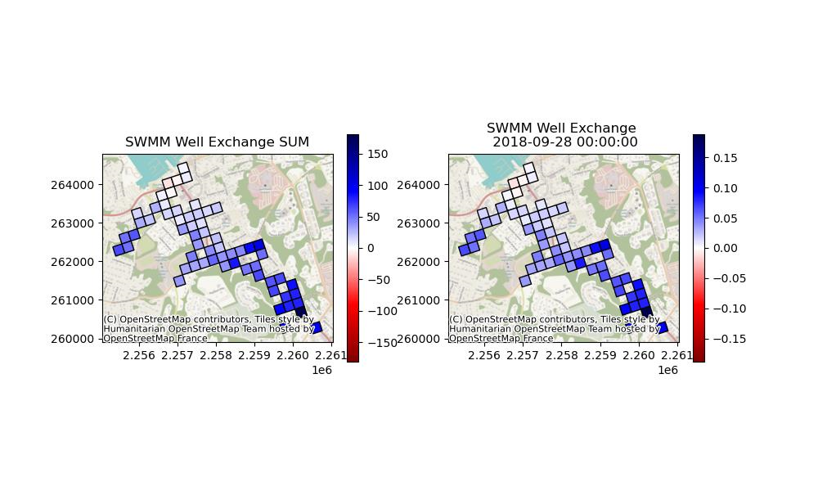
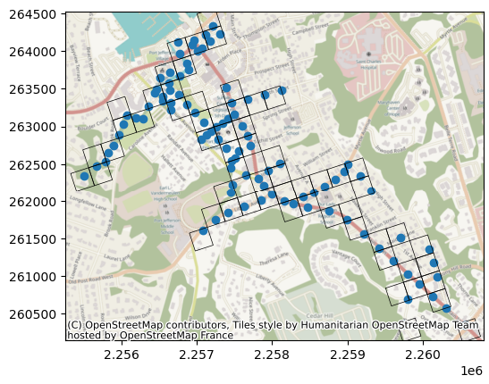
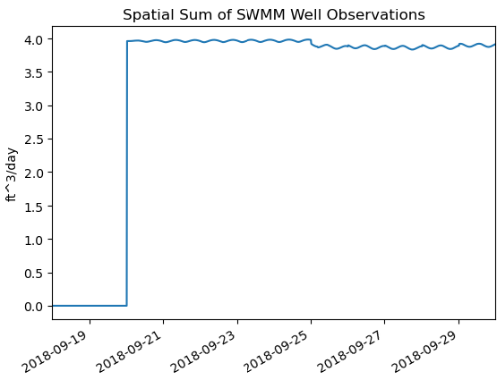
MF + D-Flow+ SWMM (daily)
Well Observations (flux)
SWMM adding water to mf
SWMM is adding the most water to MF “upstream”
Plot downsewer time series after units have been fixed

Slide 7
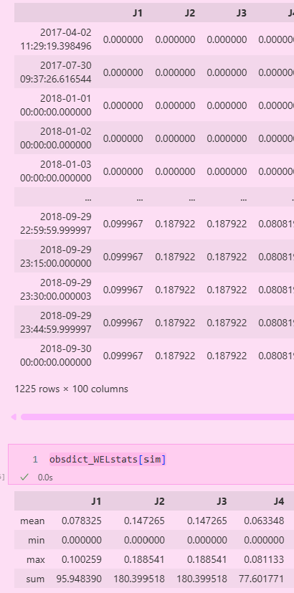
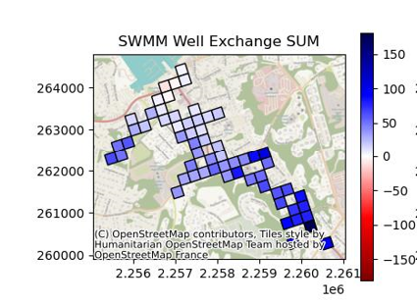
Do I need to divide sum by the coupling interval (eg. Divide by 96 for 15min coupling interval)?
Ft^3/day *
(15 [mins]/1440 [mins/day])
15-min coupling interval
?

Slide 8
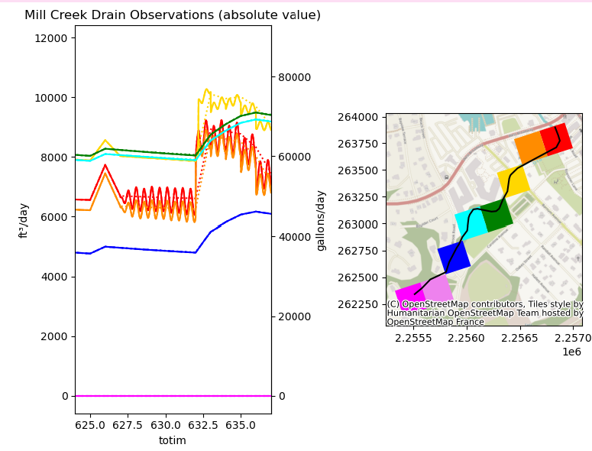
Mill Creek
Drain cells are large
Does it need to be represented in MF?
  Mill creek in SWMM is an open channel
  I send VP location of Mill Creek gage. They will return flow rates and water depth
Solid Line(s): Coupled models with and without swmm
Dotted lines: Modflow Only
Only the lower reach of Mill Creek is affected by coupling with tides.
Coupling with tides results in shorter lag time.
SWMM coupling does not impact drain discharge in a significant way
Plot the fluxes of swmm wells that represent mill creek
Check if we have cells that are defined as both wells and drains
* How can we provide DRN discharge to SWMM for routing, without double counting?

Slide 10
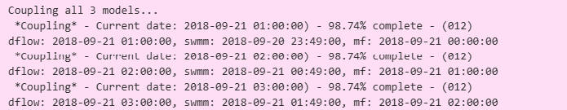
Coupling with 1-minute SWMM
VP & company share 2 SWMM simulations with 1-min timesteps
  A. Simulates all of 2018 (begins 1/1/2018)
  B. Simulates Sept-Oct 2018 (2018-09-20 23:49:00)
    This goes against the current assumption that MF > SWMM> Dflow
    I wrote a bunch of logical statements to allow flexibility for which SWMM simulation is used .But I cannot get them perfectly coupled.

Slide 11
11/14/2025 Notes after this slide
Mill creek drains are also wells for swmm. What issues can this pose?

