Slide 1
Project Proposal:
Wearable Signals for Motorcycling
Ben Buckley
ELT-2720
Spring, 2022

Slide 2

Proposed Project
Animated LED traffic signals to be embedded in a riding vest and wired directly to the motorcycle
  Left and right turn and brake lamps provide signals
    Requires voltage regulation and attention to available current
  Bike’s 12V alternator provides power via battery
    9V power to Arduino
    4V input signals
    12V power to LED pixels
  Arduino Nano responds to signals
    Produces partial animation frames in response to signals
    Assembles partials into frame, sends to array

Slide 3
Smooth Technology’s Prototype Biker Jacket

Slide 4
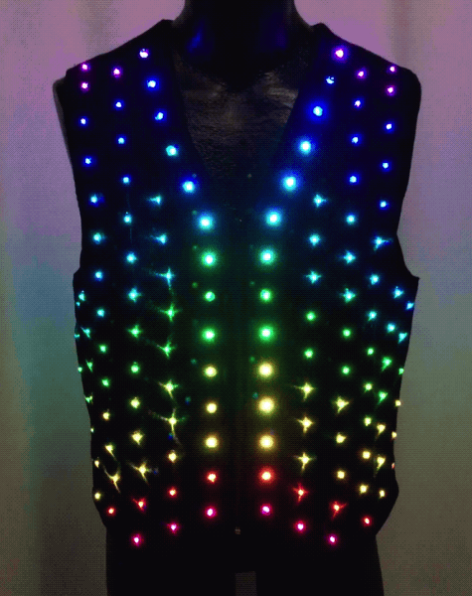
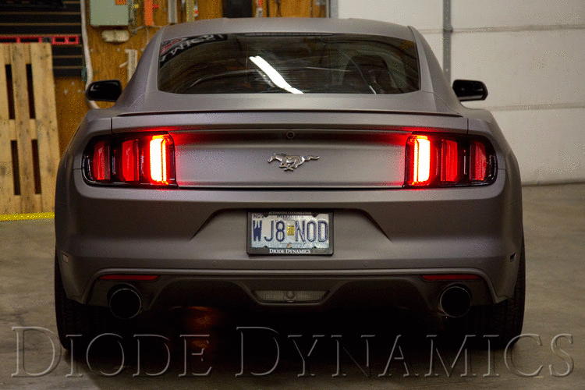
+
Combine these inspirations with the addressable LED software and protocol from ELT-2050

Slide 5
Original Contributions
Input signals:
  Voltage regulation
  Pull-down resistors
Firmware:
  Partial frames in response to inputs
  Synthesis of complete frame from partials
  Stream timing for output of frame to array
    Handled by FastLED library

Slide 6
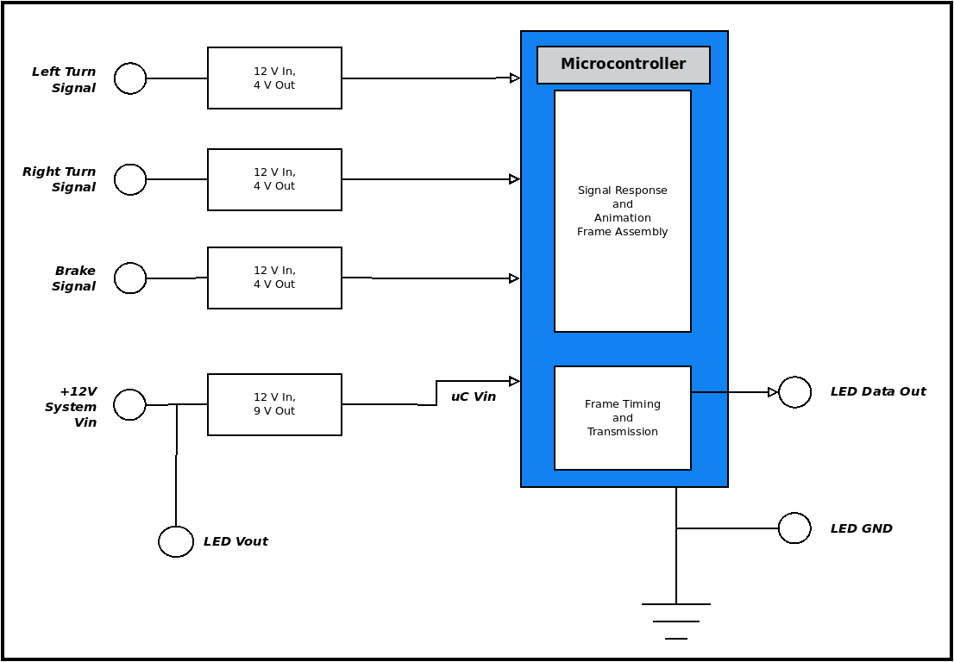
Block diagram of Wearable Signal Vest controller

Slide 7
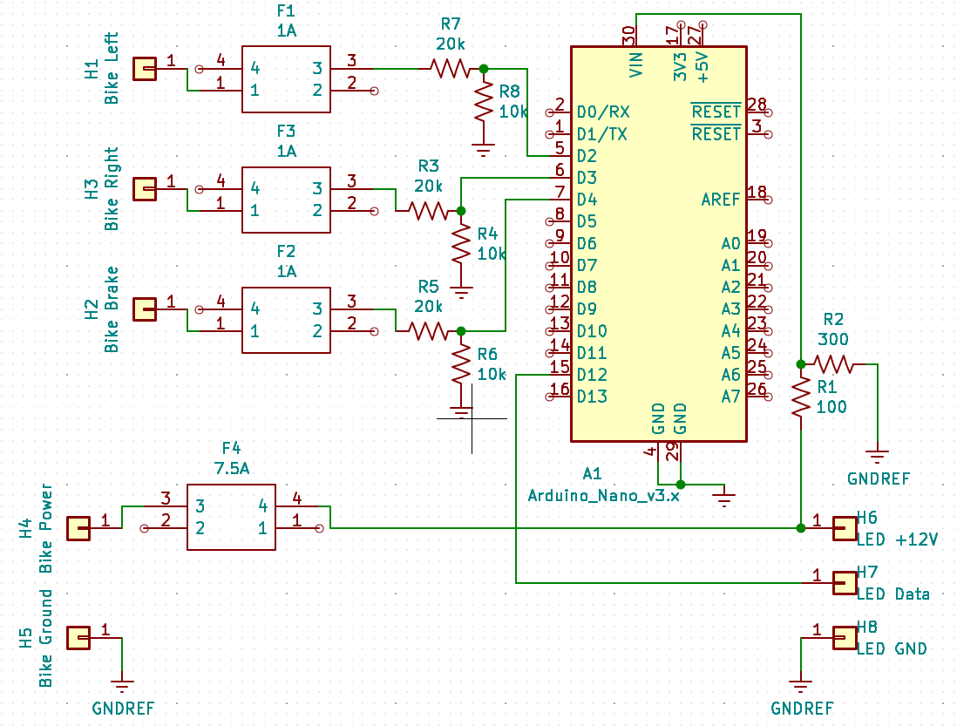
Circuit Diagram for Control Board

Slide 8
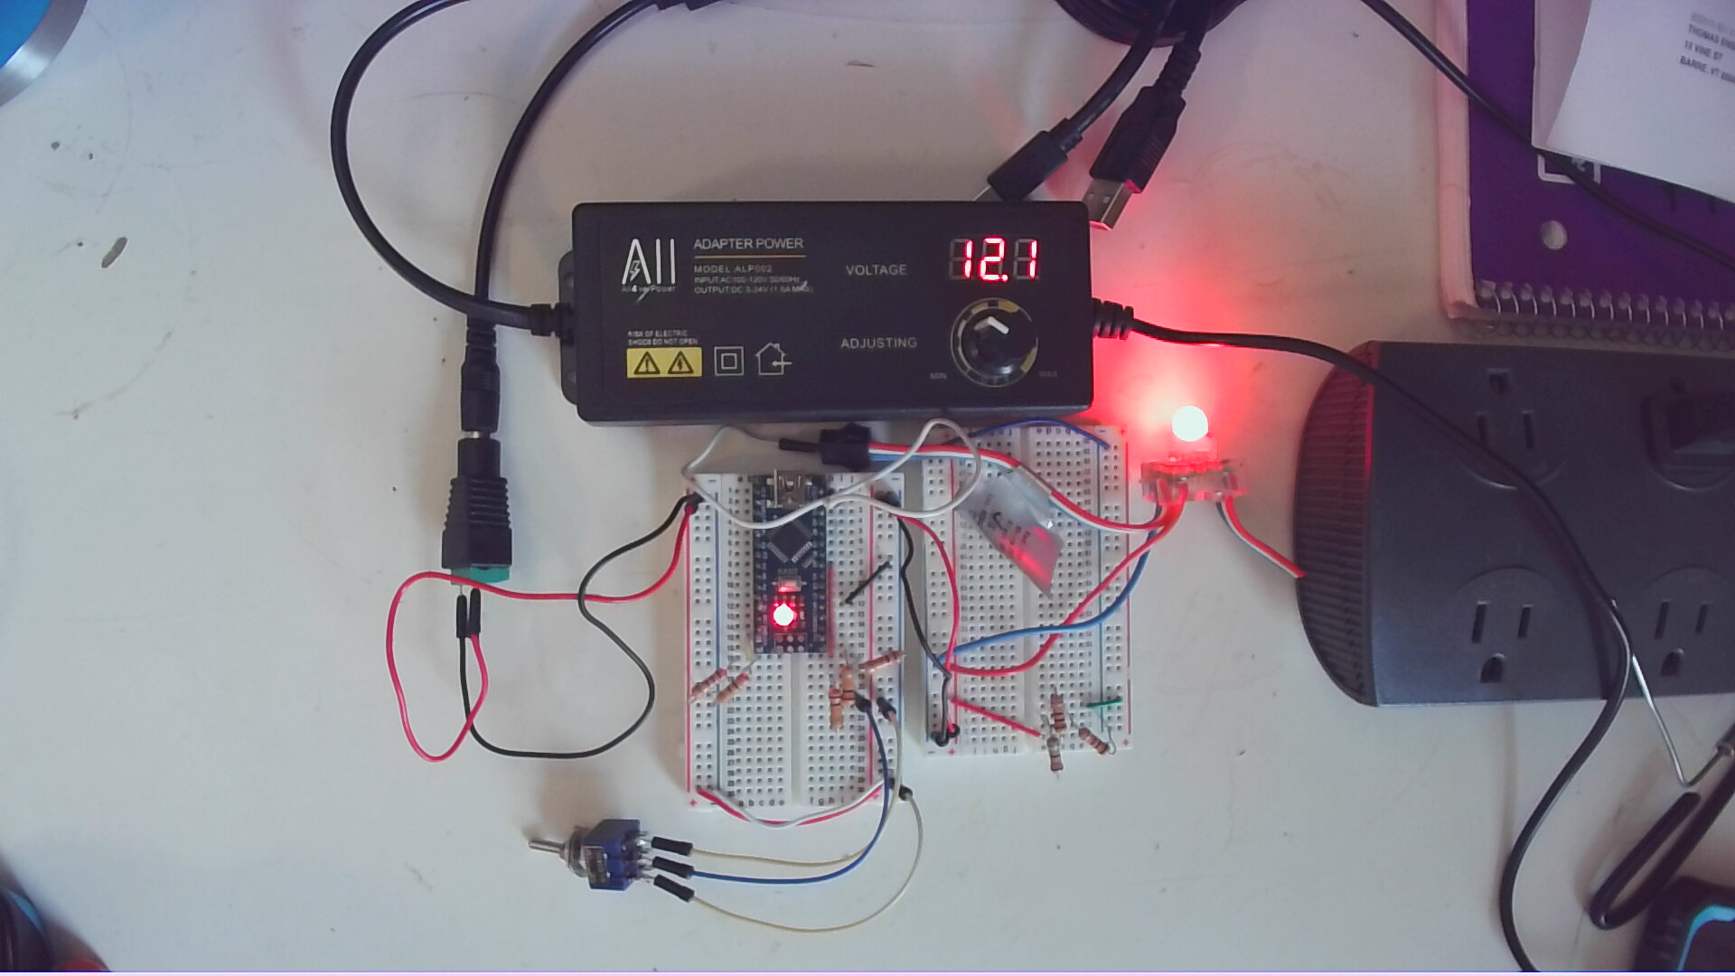
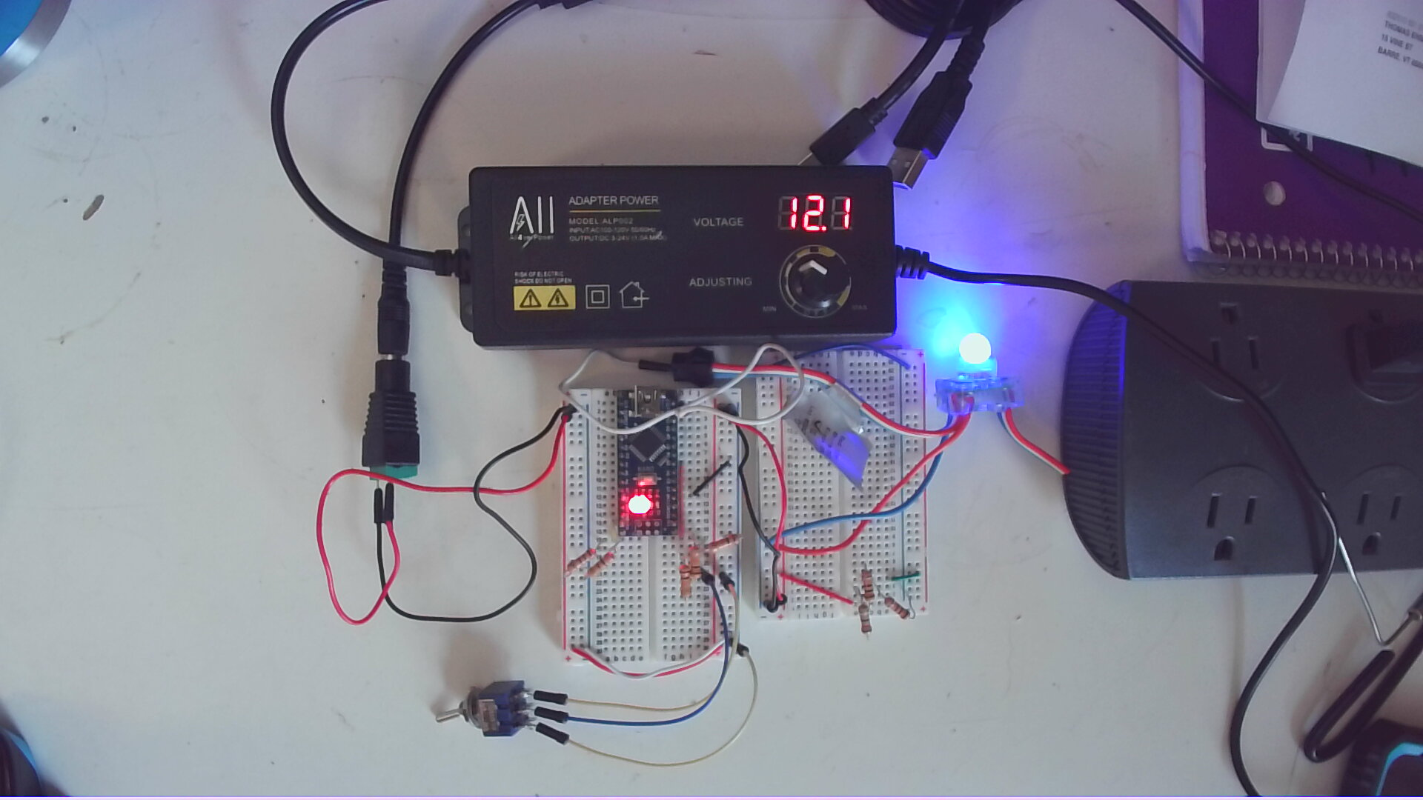
Working breadboard prototype. Red indicates 0V input signal. Blue indicates 3 – 5V input signal.

Slide 9
The final prototype demonstrating all functions of the project.

Slide 10
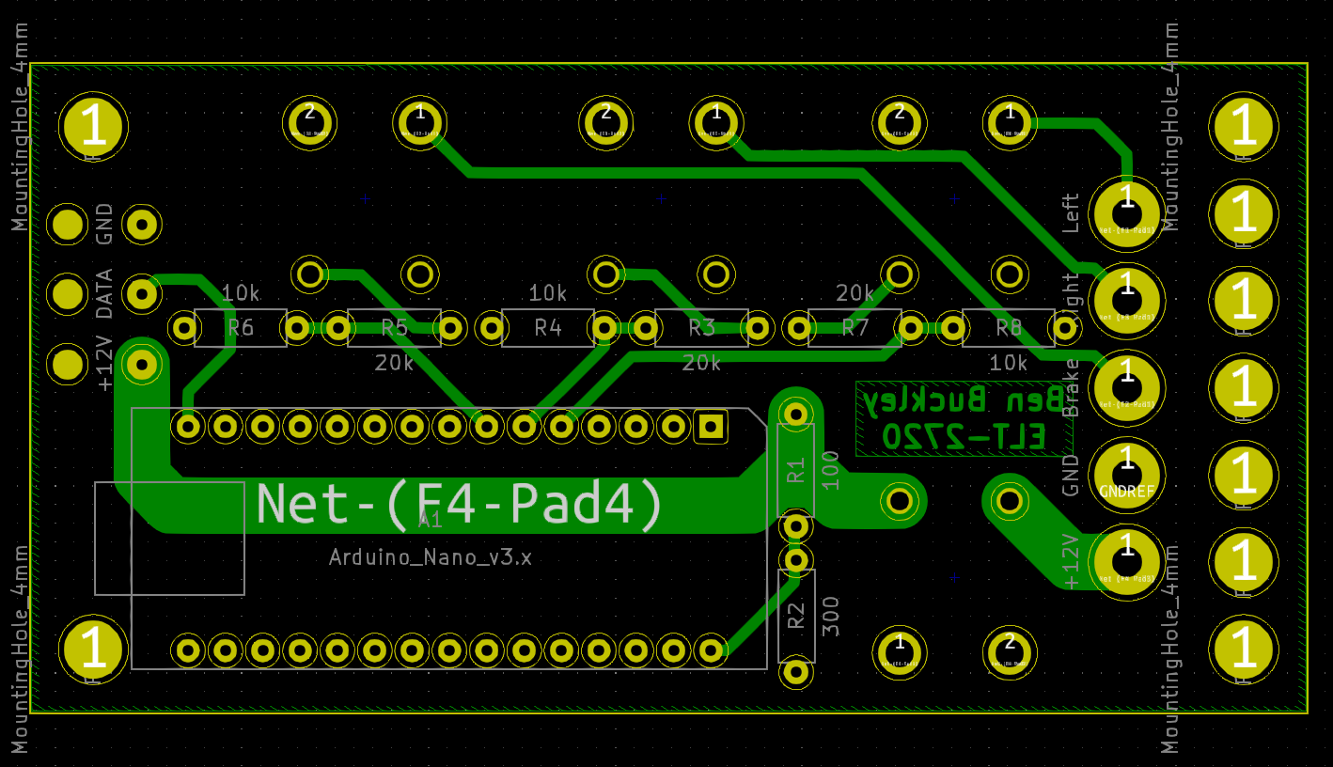
PCB Schematic for Control Board
Notes:
Design Considerations:
* USB Port Availability
* In one side, out the other:
* Fuse order follows pin order
* Strain relief holes
* Corner mount holes

Slide 11
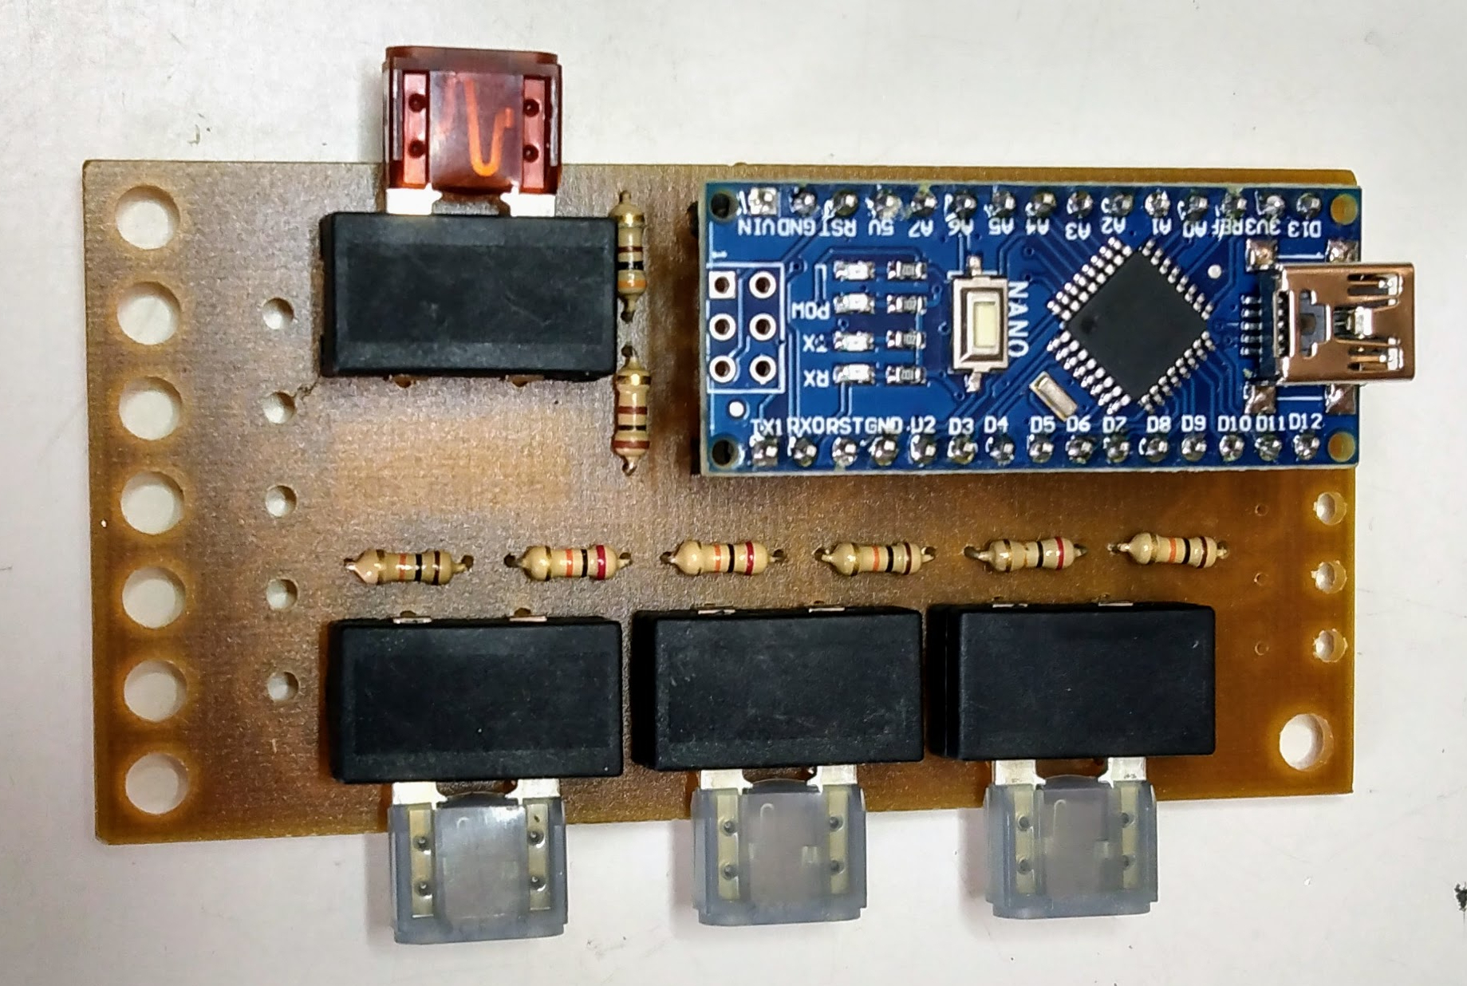
Top-side view of PCB
Notes:
Design Considerations:
* USB Port Availability
* In one side, out the other:
* Fuse order follows pin order
* Strain relief holes
* Corner mount holes

Slide 12
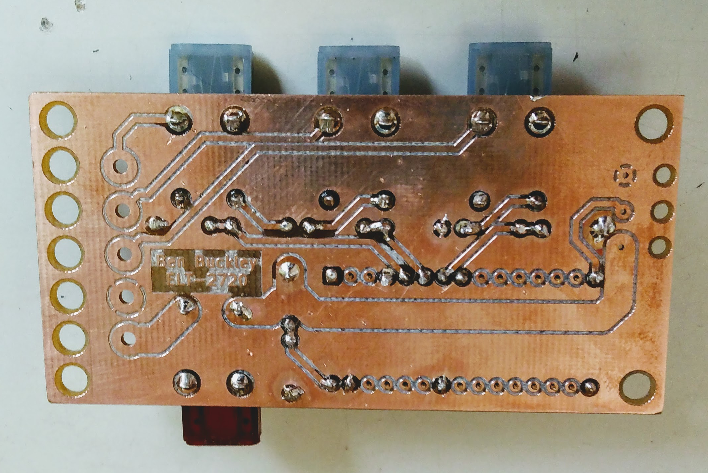
Bottom view of PCB
Notes:
Design Considerations:
* USB Port Availability
* In one side, out the other:
* Fuse order follows pin order
* Strain relief holes
* Corner mount holes

Slide 13
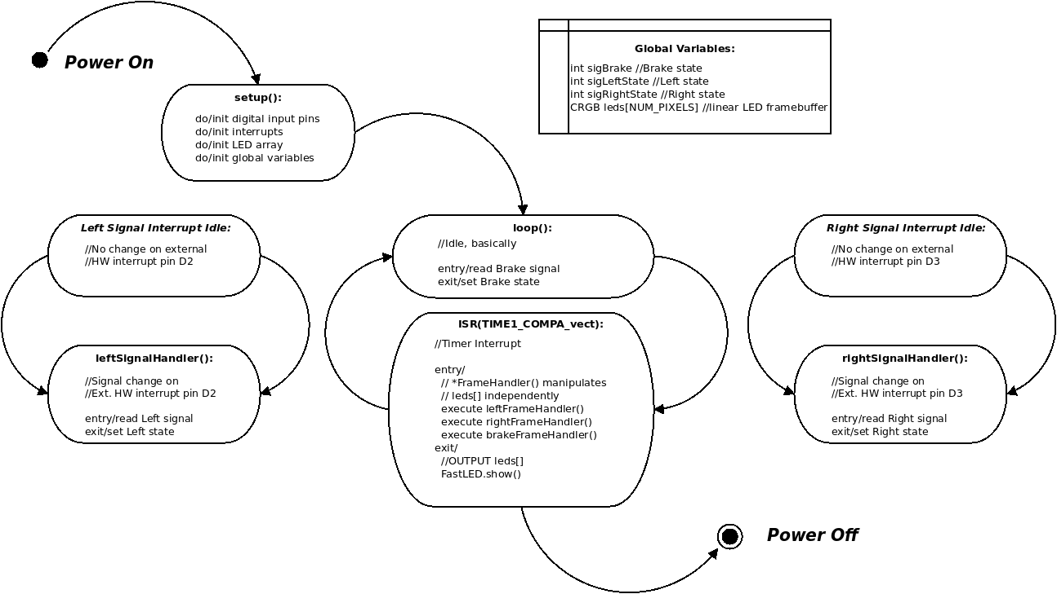
State Machine Diagram of uC Firmware

Slide 14
5 //External includes
6 #include "FastLED.h"
7
8 //Brake Timer Interrupt Macros
9 #define CLOCKSPEED 16000000
10 #define TIMER_FREQUENCY 24
11 #define CMR_RESOLUTION 1024
12
13 //Pin Definition Macros
14 #define PIN_LEFT_SIG 2
15 #define PIN_BRAKE_SIG 4
16 #define PIN_RIGHT_SIG 3
17 #define PIN_DATA 12
18
19 //LED PIXEL Macros
20 #define LED_COLS 17
21 #define LED_ROWS 4
22 #define LEFT_OUT 0
23 #define BRAKE_OUT 1
24
25 //State Macros
26 #define OFF 0
27 #define ON 1
28
29 //Timing Macros
30 #define DELAY 750
Using lots of macros for flexibility and readability

Slide 15
181 void setup() {
182 signal = 0;
183 NUM_PIXELS = LED_ROWS * LED_COLS;
184
185 //pinMode(PIN_LED,OUTPUT);
186 pinMode(PIN_LEFT_SIG,INPUT);
187 pinMode(PIN_BRAKE_SIG,INPUT);
188 pinMode(PIN_RIGHT_SIG,INPUT);
189 //digitalWrite(PIN_LED,LOW);
190
191 cli(); //Disable all interrupts while setting up interrupts
192 setupInterrupt_Timer();
193 //Enable hardware interrupt on D2 for left turn signal
194 attachInterrupt(digitalPinToInterrupt(PIN_LEFT_SIG),leftSignalHandler,CHANGE);
195 //Enable hardware interrupt on D3 for right turn signal
196 attachInterrupt(digitalPinToInterrupt(PIN_RIGHT_SIG),rightSignalHandler,CHANGE); 197 sei(); //Re-enable interrupts
198
199 FastLED.addLeds<WS2811, PIN_DATA>(leds, NUM_PIXELS);
200 }
All the initializations in setup()...

Slide 16
52 void setupInterrupt_Timer(){
54
55 //This timer interrupt setup code borrowed from
56 // https://www.instructables.com/Arduino-Timer-Interrupts/
57
58 //set timer1 interrupt at 15Hz
59 TCCR1A = 0;// set entire TCCR1A register to 0
60 TCCR1B = 0;// same for TCCR1B
61 TCNT1 = 0;//initialize counter value to 0
62 // set compare match register for 15hz increments
63 //OCR1A = 1041;// = (16*10^6) / (15*1024) - 1 (must be <65536)
64 OCR1A = (CLOCKSPEED / (TIMER_FREQUENCY * CMR_RESOLUTION)) - 1;
65 // turn on CTC mode
66 TCCR1B |= (1 << WGM12);
67 // Set CS10 and CS12 bits for 1024 prescaler
68 TCCR1B |= (1 << CS12) | (1 << CS10);
69 // enable timer compare interrupt
70 TIMSK1 |= (1 << OCIE1A);
Borrowed Code to Initialize Timer Interrupt

Slide 17
146 void leftSignalHandler(){
147
148 int sigLeft;
149
150 sigLeft = digitalRead(PIN_LEFT_SIG);
151 sigLeftStatePrev = sigLeftState;
152 if (sigLeft) { //If left turn signal is on now, it was off previously
153 // Do all the WAS-OFF stuff
154 sigLeftState = ON;
155 leftFrameCount = 0;
156 }
157 else {
158 // Do all the WAS_ON stuff
159 sigLeftState = OFF;
160 }
161 }
201 void loop() {
202
203 //One var for each signal... replace with ext. interrupts?
204 sigBrake = digitalRead(PIN_BRAKE_SIG);
205
206 }
Ultra-minimalist loop()… the beauty of interrupts!

Slide 18
119 ISR(TIMER1_COMPA_vect){
120
121 //Handle left signal
122 leftFrameHandler();
123 //Right turn handling
124 rightFrameHandler();
125
126 //##### The block between these comments should be extracted to a handler function
127 //##### ... but because it's the brake, it should always go last before FastLED.show()
128
129 #define BRAKE_OFFSET 6
130 #define BRAKE_WIDTH 5
131
132 //Quick-n-dirty brake signal handling
133 if (sigBrake) {
134 frameFill(BRAKE_OFFSET,BRAKE_WIDTH,0,255,255);
135 }
136 else {
137 frameFill(BRAKE_OFFSET, BRAKE_WIDTH,0,255,100);
138 }
139
140 //##### That's the end of the brake handler.
141
142 //Send the resulting frame to LED data out
143 FastLED.show();
144 }
Timer ISR: Executes once every 1/24 secs.

Slide 19
89 void leftFrameHandler() {
90
91 #define LEFT_OFFSET 0
92 #define LEFT_WIDTH 6
93 #define DUTY_CYCLE (TIMER_FREQUENCY/2)
94
95 if (sigLeftState) {
96 if (leftFrameCount == TIMER_FREQUENCY) leftFrameCount = 0;
97 if (leftFrameCount == 0) frameFill(LEFT_OFFSET,LEFT_WIDTH,0,0,0);
98 if (leftFrameCount > DUTY_CYCLE) frameFill(LEFT_OFFSET,LEFT_WIDTH,40,255,255);
99 leftFrameCount++;
100 }
101 else frameFill(LEFT_OFFSET,LEFT_WIDTH,40,255,100);
102 }
The model frameHandler()

Slide 20
72 void frameFill(int offset, int width, int hue, int sat, int bright) {
73
74 int startCell,
75 endCell;
76
77 for (int row = 0; row < LED_ROWS; row++) {
78 if (!(row % 2)) startCell = (row * LED_COLS) + offset;
79 else startCell = (((row + 1) * LED_COLS) - 1) - (offset + (width -1));
80
81 endCell = startCell + width;
82
83 for (int cell = startCell; cell < endCell; cell++) {
84 leds[cell] = CHSV(hue,sat,bright);
85 }
86 }
87 }
The model frameHandler()

Slide 21
Challenges
Soldering small pads, relatively wide ground contact traces, and weird shaped posts in wrong-shaped holes
Self-teaching non-standard software…
Customizing footprints
Exporting my own Gerber files
Keeping it simple
Setting up the website

Slide 22
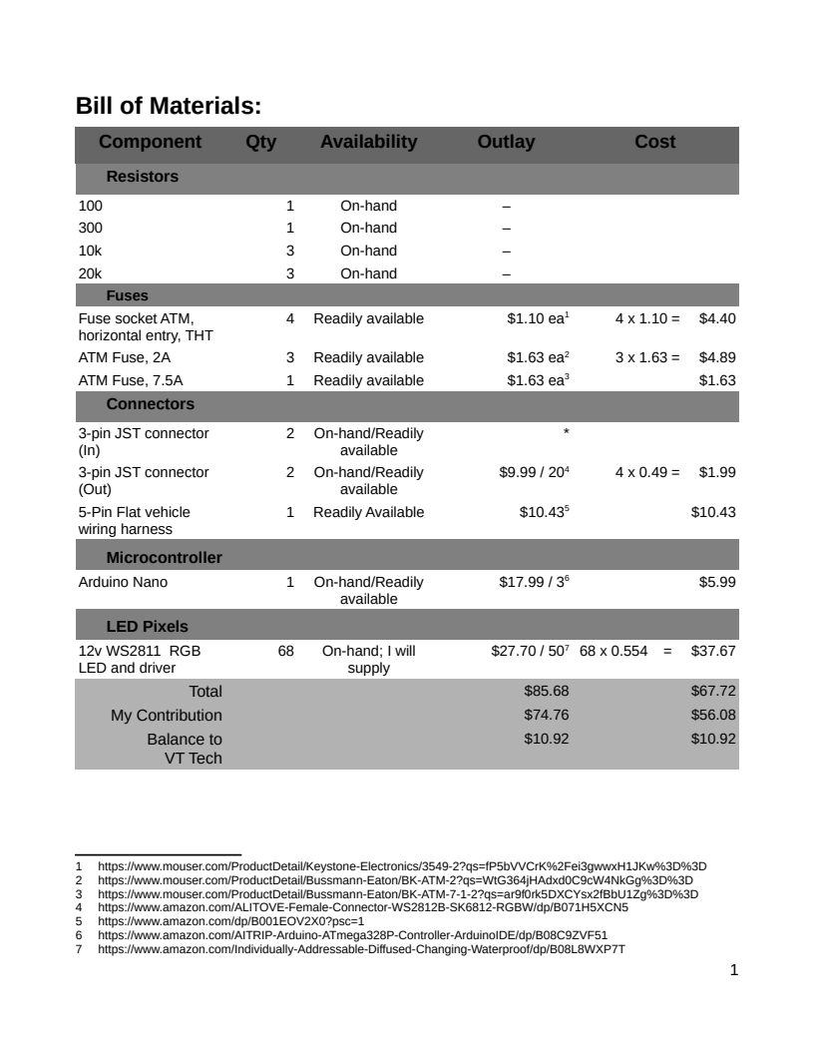
Bill of Materials: Outlay and Expense

Slide 23
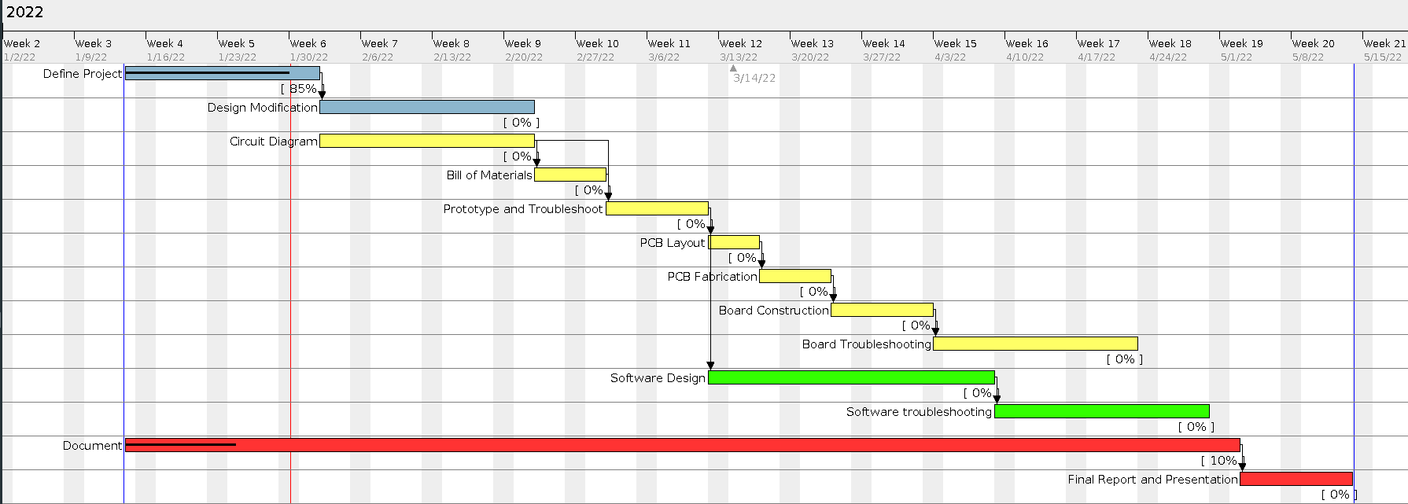
Proposed Project Timeline

