Slide 1
Project Proposal:
Wearable Signals for Motorcycling
Ben Buckley
ELT-2720
Spring, 2022

Slide 2

Proposed Project
Animated LED traffic signals to be embedded in a riding vest and wired directly to the motorcycle
  Left and right turn and brake lamps provide signals
    Requires voltage regulation and current limitation
  Bike’s 12V stator and provides power via battery
    Requires branching for board and array
    Requires regulation
  Arduino Nano responds to signals
    Produces partial animation frames in response to signals
    Assembles partials into frame, sends to array

Slide 3
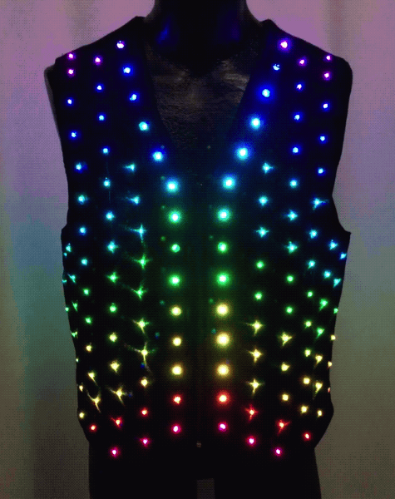
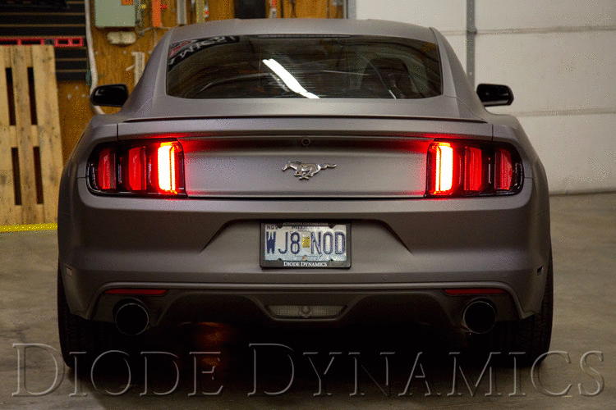
+
Combine these inspirations with the addressable LED software and protocol from ELT-2050

Slide 4
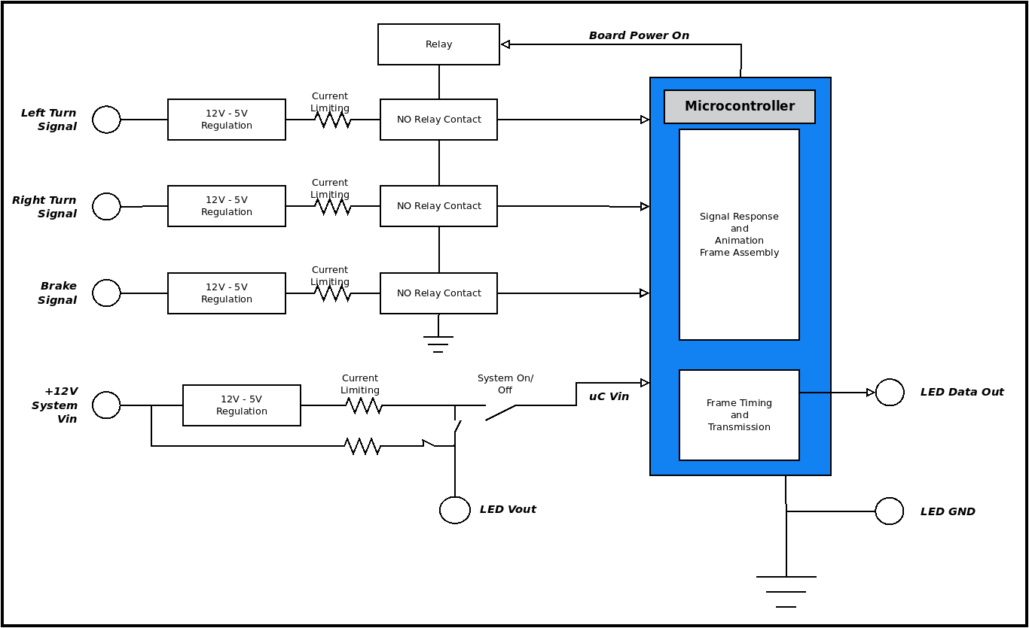
Block diagram of Wearable Signal Vest controller

Slide 5
Original Contributions
Input signals:
  Voltage regulation and current limiting
  Power conditioning
    Prevent spikes
    Regulate for Arduino uC
Firmware:
  Partial frames in response to inputs
  Synthesis of complete frame from partials
  Stream timing for output of frame to array

Slide 6
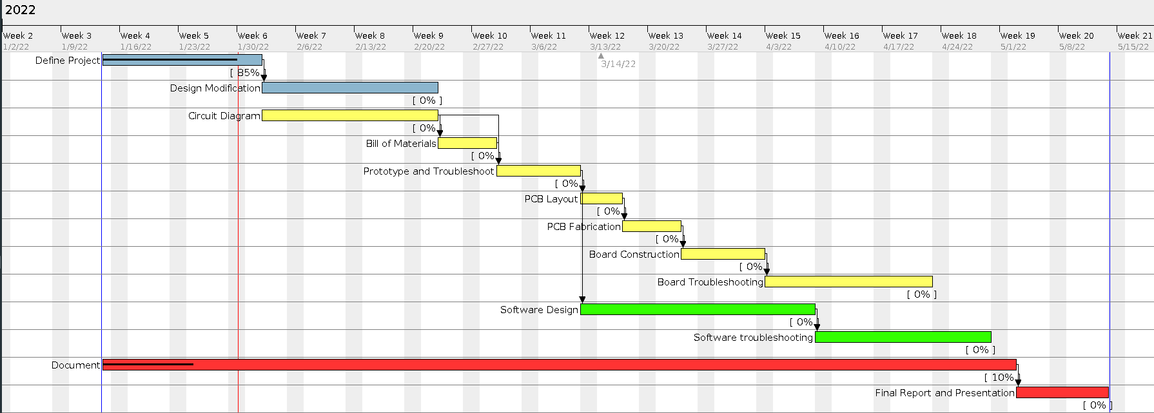
Proposed Project Timeline

Slide 7
Anticipated Challenges
* Decouple auto-cutoff logic circuitry from charging voltage.
* Calculating parameters based on nominal outputs moves the burden of safety from the user to the programmer/designer. I will need to add/program safety features that ensure “sane” operational values and detect and correct fault conditions.
* Decoupling three-stage charging logic from the voltage of the battery-under-charge will require significant modification of the reference design.
* Much of the work of the microcontroller will be performed through transistors, and transistor circuit analysis and design is one of my weak points.

