Slide 1
Project Proposal:
Wearable Signals for Motorcycling
Ben Buckley
ELT-2720
Spring, 2022

Slide 2

Proposed Project
Animated LED traffic signals to be embedded in a riding vest and wired directly to the motorcycle
  Left and right turn and brake lamps provide signals
    Requires voltage regulation and attention to available current
  Bike’s 12V alternator provides power via battery
    9V power to Arduino
    4V input signals
    12V power to LED pixels
  Arduino Nano responds to signals
    Produces partial animation frames in response to signals
    Assembles partials into frame, sends to array

Slide 3
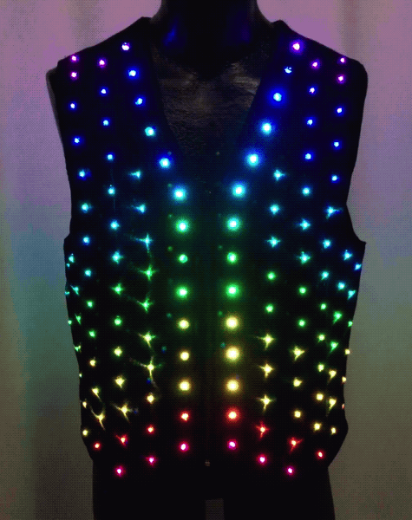
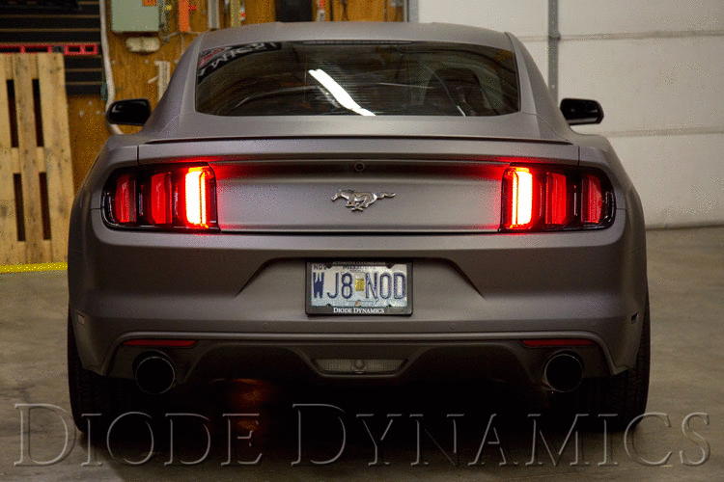
+
Combine these inspirations with the addressable LED software and protocol from ELT-2050

Slide 4
Original Contributions
Input signals:
  Voltage regulation
  Pull-down resistors
Firmware:
  Partial frames in response to inputs
  Synthesis of complete frame from partials
  Stream timing for output of frame to array
    Handled by FastLED library

Slide 5
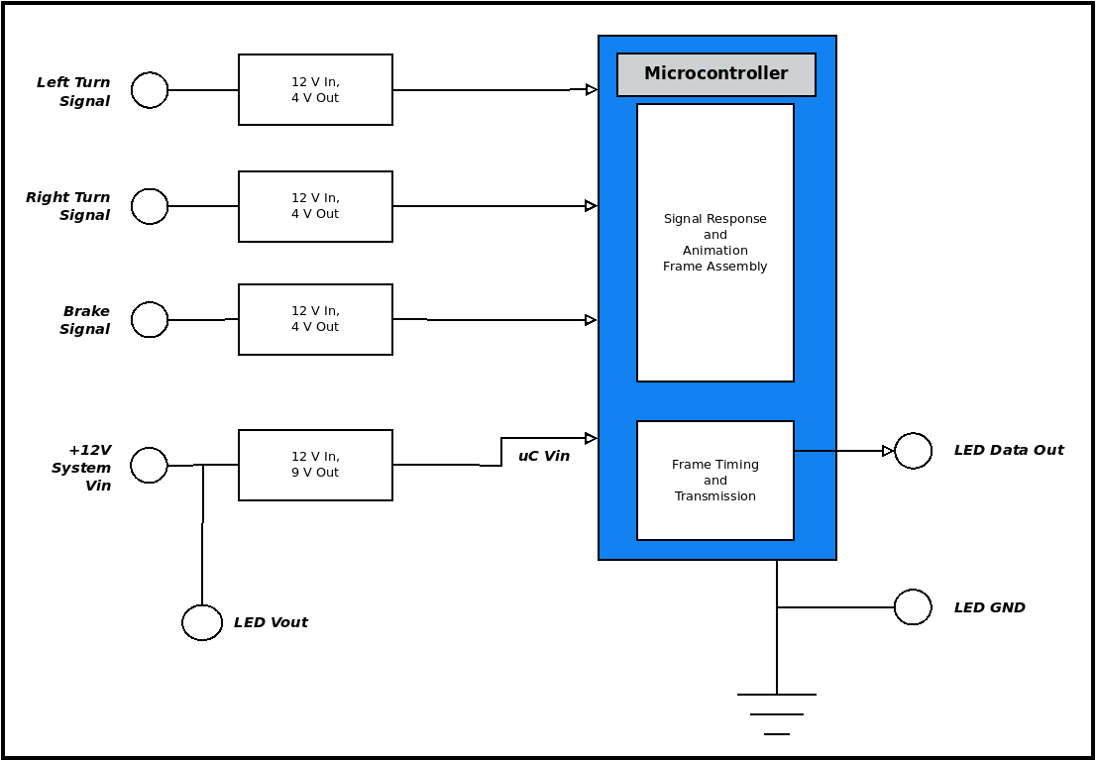
Block diagram of Wearable Signal Vest controller

Slide 6
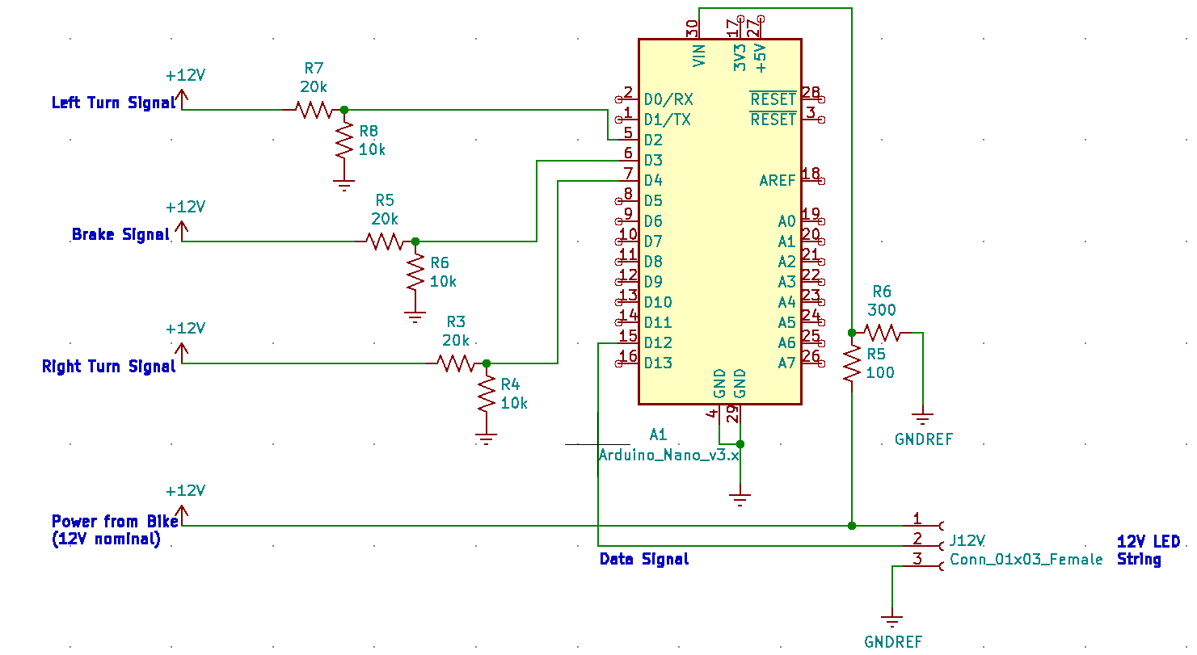
Circuit Diagram for Control Board

Slide 7
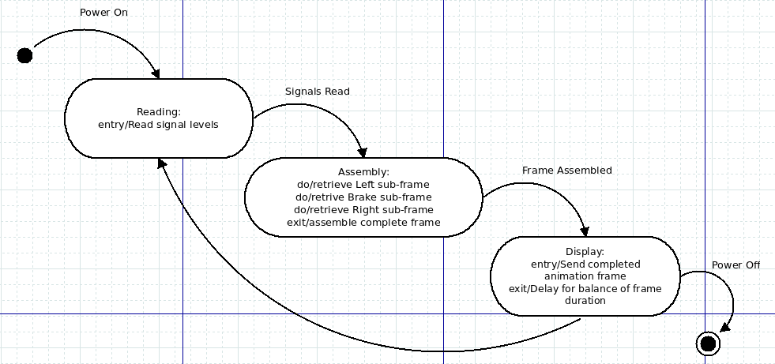
State Machine Diagram of uC Firmware

Slide 8
// A simple sketch to proof the use of FastLED and my power supply circuit
// to drive a single WS2811 led pixel
//
// The base for this sketch is signalDetect.ino.
#include "FastLED.h"
#define PIN_LED 13
#define PIN_SIGNAL 5
#define PIN_DATA 12
#define NUM_PIXELS 1
int signal_high;
CRGB leds[NUM_PIXELS];
void setup() {
signal_high = 0;
pinMode(PIN_LED,OUTPUT);
pinMode(PIN_SIGNAL,INPUT);
digitalWrite(PIN_LED,LOW);
FastLED.addLeds<WS2811, PIN_DATA>(leds, NUM_PIXELS);
}
void loop() {
signal = digitalRead(PIN_SIGNAL);
if (signal) {
leds[0] = CRGB::Blue;
}
else {
leds[0] = CRGB::Red;
}
digitalWrite(PIN_LED,signal);
FastLED.show();
}
Arduino sketch for the prototype build

Slide 9
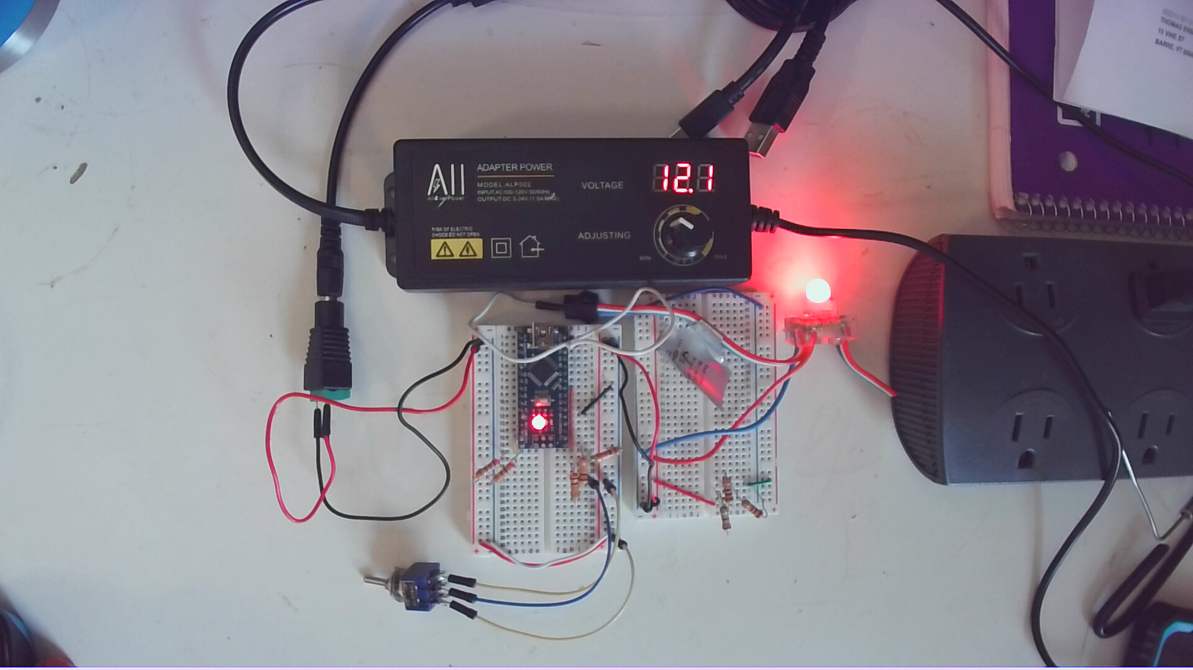
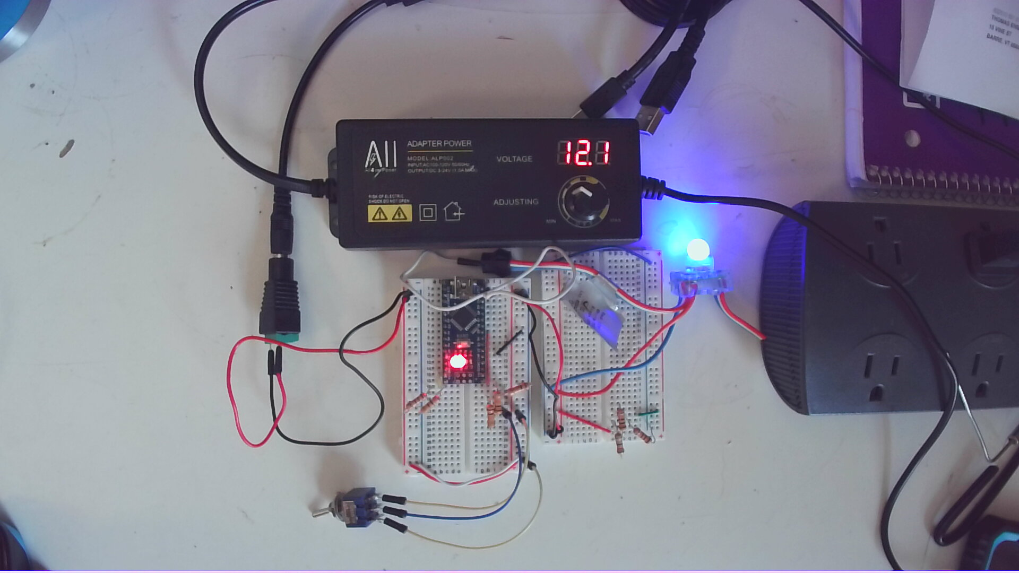
Working breadboard prototype. Red indicates 0V input signal. Blue indicates 3 – 5V input signal.

Slide 10
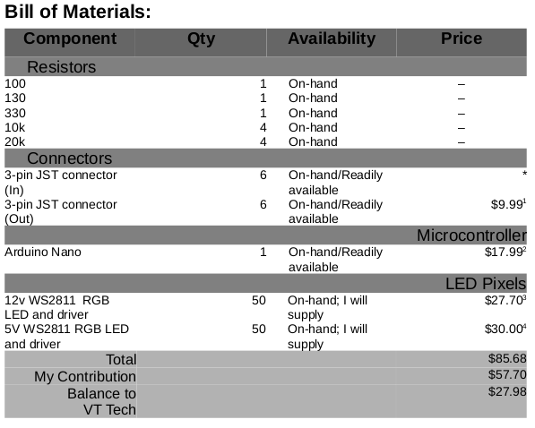

Slide 11
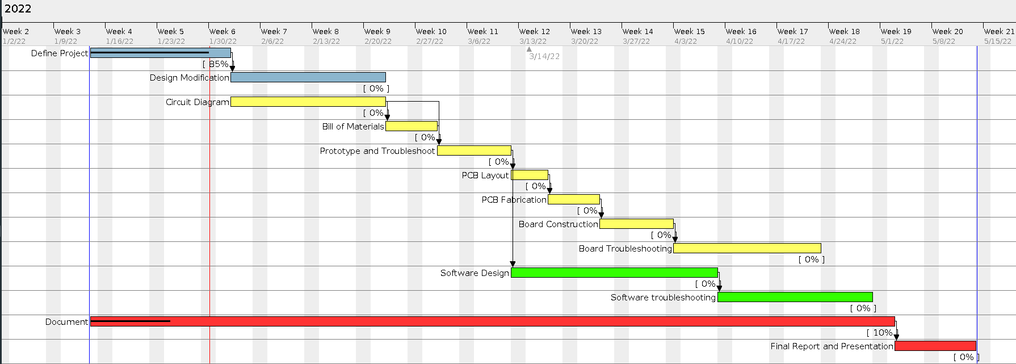
Proposed Project Timeline

