Slide 1



Open Minds Club
IT School: AI - Epoch 1
Python Fundamentals Iteration 1

Slide 2

Open Minds Club
Agenda
01. Why Python?
02. Setup
03. Variables & Data Types
04. Operators
05. Control Flow
06. Data Structures
07. Functions
08. Built-in functions

Slide 3
Open Minds Club
01. Why Python?
Easy & Readable:
👉 Clean syntax that reads like English
👉 Less time fighting with code, more time solving problems
👉 Fast to learn, fast to prototype

Slide 4
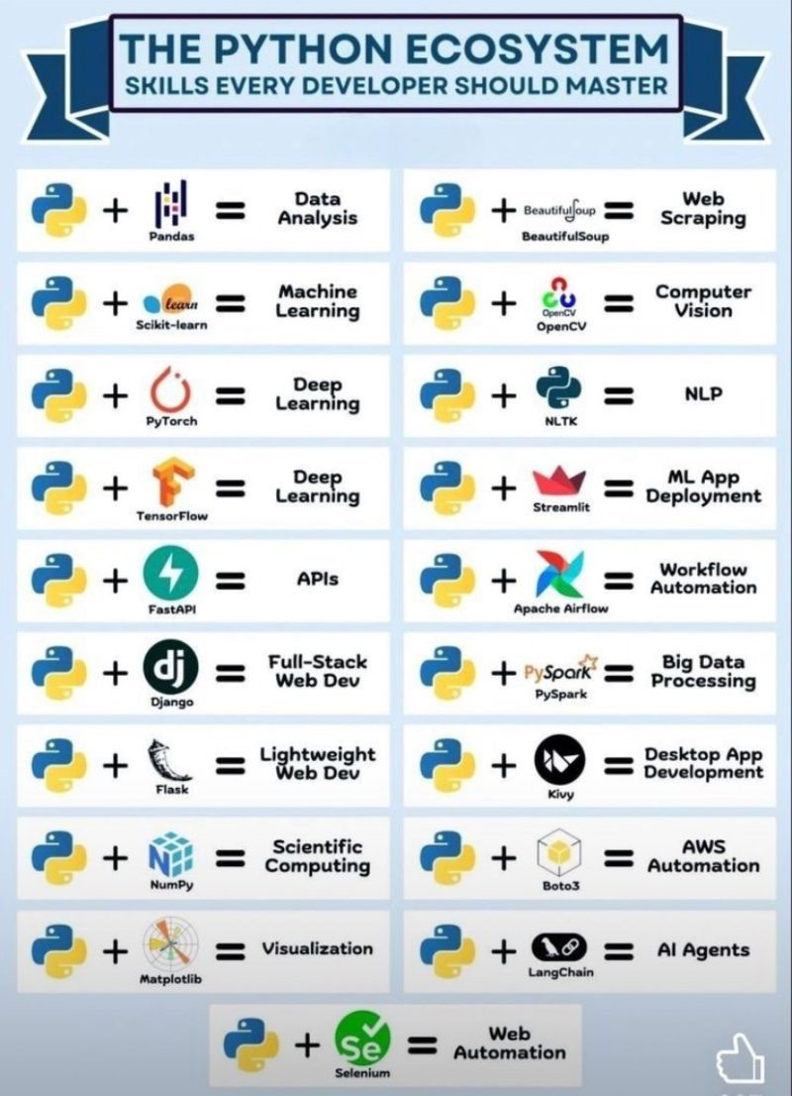
Open Minds Club
01. Why Python?
Powerful Ecosystem:
  NumPy, Pandas -> data manipulation
  Matplotlib, Seaborn -> visualization
  TensorFlow, PyTorch -> deep learning
  scikit-learn -> machine learning

Slide 5
Open Minds Club
02. Setup
  Install Python: https://realpython.com/installing-python/
  Install VS Code (or your preferred IDE): https://code.visualstudio.com/docs/setup/setup-overview
  Install Jupyter Notebook extension in VS Code: https://code.visualstudio.com/docs/datascience/jupyter-notebooks
  Alternatives (no installation needed):
    Google Colab: https://colab.research.google.com
    Kaggle Notebooks: https://www.kaggle.com/code

Slide 6

Open Minds Club
Coding Section

Slide 7
Open Minds Club
Additional Resources
📌 HackerRank’s Python Challenges: https://www.hackerrank.com/domains/python
📌 Harvard’s Introduction to Programming with Python: https://cs50.harvard.edu/python/
📌 And always ✨ read the docs ✨: https://docs.python.org/3/

Slide 8
Open Minds Club
Any Questions ?

Slide 9
Open Minds Club
Thank you for your attention ✨

