Slide 1



Open Minds Club
AI School: Iteration 1.5
Statistics
By BOULGHERAIF F.Z
A little bit of stats
<h4>
</h4>

Slide 2

Open Minds Club
Agenda
01. Stats & ML
02. Basics
03. Measures of Central Tendency
04. Measures of Dispersion
05. Outliers
06. Distributions
07. Correlation
08. Stats → ML

Slide 3
Open Minds Club
01. Stats & ML
Statistics and machine learning are deeply intertwined in two major ways:
1- Stats is the language of many ML models
Many ML algorithms are built on statistical foundations. Linear regression, Naive Bayes, logistic regression, PCA
2- Stats is how we explore data before training
Before feeding data to any algorithm, we need to understand it. No good model was ever built on poorly understood data.

Slide 4
Open Minds Club
02. Basics

Slide 5
Open Minds Club
02. Basics: Types of Data
Numerical (Quantitative):
Data that represents measurable quantities.
Can be:
  continuous (height, temperature, salary);
  or discrete (number of items, count of events).
Categorical (Nominal | Qualitative):
Data that represents categories with no natural order.
Examples: gender, country, color, type of animal.
Ordinal:
Data with categories that have a meaningful order
Examples: rating (1-5), shirt size (s < m < l)

Slide 6
Open Minds Club
02. Basics: Population vs Sample
Population
The entire group you want to draw conclusions about.
Example: all students in Algeria
Sample
A subset of the population that we actually collect and analyze. Example: 500 randomly selected students
A good sample is representative: it reflects the population without bias.
👉 Most real-world datasets are samples, not populations.

Slide 7
Open Minds Club
02. Basics: Descriptive vs Inferential Stats
Descriptive Stats:
Summarizes and describes the data you have.
Answers: What does my data look like?
Examples: mean, median, standard deviation, histograms, frequency tables.
Inferential Stats:
Uses a sample to make conclusions about a larger population.
Answers: What can I conclude beyond my data?
Examples: hypothesis testing, confidence intervals, p-values.

Slide 8
Open Minds Club
03. Measures of Central Tendency

Slide 9

Open Minds Club
03. Measures of Central Tendency: Mean
The mean is the arithmetic average of all values in a dataset.
Mean = Sum of all values / Number of values
Example: [2, 4, 6, 8, 10] → Mean = 30 / 5 = 6
+ Easy to understand and to compute
_ Highly sensitive to outliers. One extreme value can pull the mean far from the "center" of most data points.
[2, 4, 6, 8, 1000] → Mean = 204 (not representative at all)
+
📌

Slide 10
Open Minds Club
03. Measures of Central Tendency: Median
The median is the middle value when data is sorted in order.
  If the count is odd: take the middle value.
  If the count is even: take the average of the two middle values.
Example: [2, 4, 6, 8, 10] → Median = 6
[2, 4, 6, 8] → Median = (4+6)/2 = 5
+ Robust to outliers.
👉 Use when outliers are present, data is skewed.
+

Slide 11
Open Minds Club
03. Measures of Central Tendency: Mode
The mode is the most frequently occurring value in a dataset.
A dataset can have:
    No mode — all values appear once
    One mode — unimodal
    Two modes — bimodal
    Multiple modes — multimodal
👉 The only measure that works for categorical data.

Slide 12
Open Minds Club
04. Measures of Dispersion

Slide 13
Open Minds Club
04. Measures of Dispersion: Range
The range is the simplest measure of dispersion.
Range = Maximum value − Minimum value
Example: [3, 7, 2, 9, 1] → Range = 9 − 1 = 8
+

Slide 14

Open Minds Club
04. Measures of Dispersion: Variance
The average of the squared differences from the mean. Measures how spread out the values are.
  Low variance → values cluster tightly around the mean
  High variance → values are scattered widely
Problem: Variance is in squared units (e.g., meters² for height data), making it hard to interpret directly.
+

Slide 15
Open Minds Club
04. Measures of Dispersion: Standard Deviation
The square root of variance. Brings the measure back to the original unit of the data.
  Low std dev → values cluster tightly around the mean
  High std dev → values are scattered widely
Example: Heights with mean = 170cm, Std Dev = 10cm → most people are within 160–180cm.
👉 Std Dev tells you: on average, how far is each value from the mean?
+

Slide 16
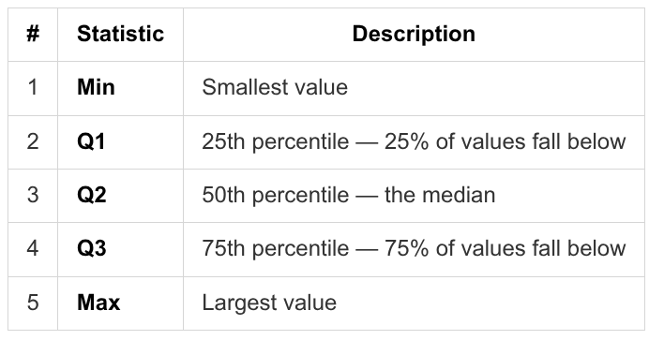
Open Minds Club
04. Measures of Dispersion: 5 number summary
The five number summary gives a compact picture of a dataset's spread:
(min, Q1, Q2, Q3, max)
+
The five number summary is the foundation of the box plot

Slide 17
Open Minds Club
04. Measures of Dispersion: IQR
Represents the spread of the middle 50% of the data.
IQR (Interquartile Range) = Q3 − Q1
👉 IQR focuses on the middle 50% — robust to outliers unlike range.
+

Slide 18
Open Minds Club
05. Outliers

Slide 19
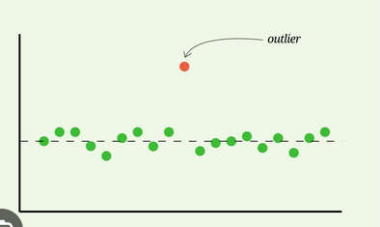
Open Minds Club
05. Outlier Detection: IQR method
An outlier is a data point that lies abnormally far from the rest of the dataset.
IQR Method:
  Compute Q1 and Q3
  Compute IQR = Q3 − Q1
  Lower bound = Q1 − 1.5 × IQR
  Upper bound = Q3 + 1.5 × IQR
  Any value outside [Lower, Upper] is flagged as an outlier
+

Slide 20
Open Minds Club
05. Spurious vs Non-Spurious Outliers
Not all outliers are equal. Before removing them, you need to understand why they exist.
Spurious Outliers (Noise)
Caused by errors: data entry mistakes, sensor malfunctions, corrupted records.
→ These should usually be removed or corrected.
Example: A patient's age recorded as 320. Clearly an error.
Non-Spurious Outliers (Real signal)
Genuine extreme values that reflect reality.
→ These should be kept and investigated.
Example: A transaction of $1,000,000 in a fraud detection dataset: this could be the fraud you're looking for.
👉 Blindly removing outliers can destroy the most interesting part of your data.

Slide 21
Open Minds Club
06. Distributions

Slide 22
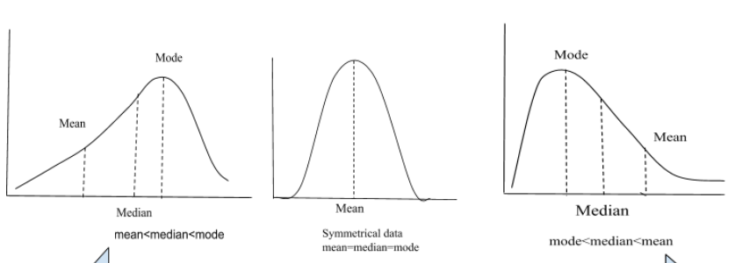
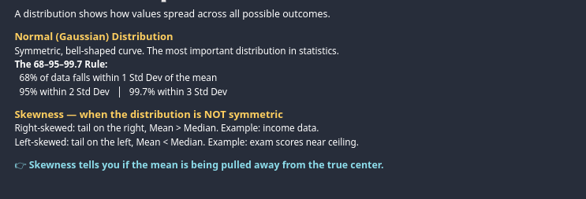
Open Minds Club
06. Distributions

Slide 23
Open Minds Club
07. Correlation

Slide 24
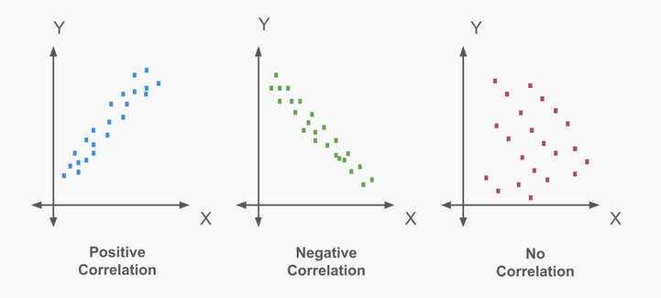
Open Minds Club
07. Correlation

Slide 25
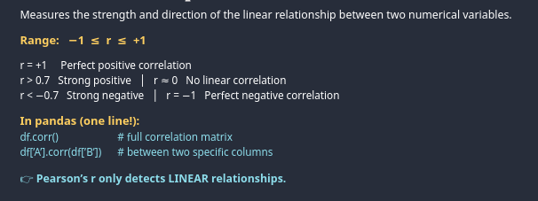
Open Minds Club
07. Correlation: Pearson’s R

Slide 26
Open Minds Club
08. Stats → ML
📌 Everything we covered is the backbone of ML
Mean and std dev → Feature scaling
Correlation → Feature selection
Distributions → Model assumptions
Outlier detection → Data cleaning

Slide 27

Open Minds Club
Any Questions ?

Slide 28
Open Minds Club
Thank you for your attention ✨

