Slide 1

Airline Costs and Incidents
Brett Foster
DSC640-T301
Project Task 2
July 2, 2021

Slide 2
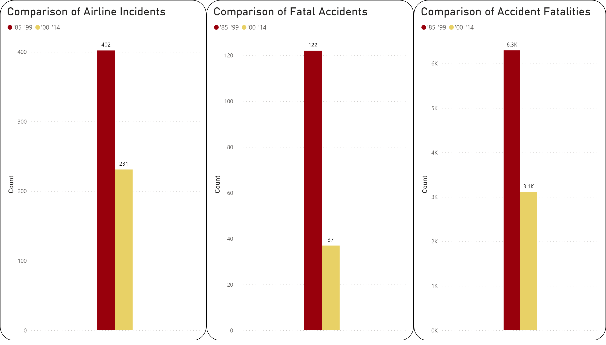
Changes in Airline Travel Incidents, Fatal Accidents, and Fatalities from 1985-1999 vs 2000-2014

Slide 3
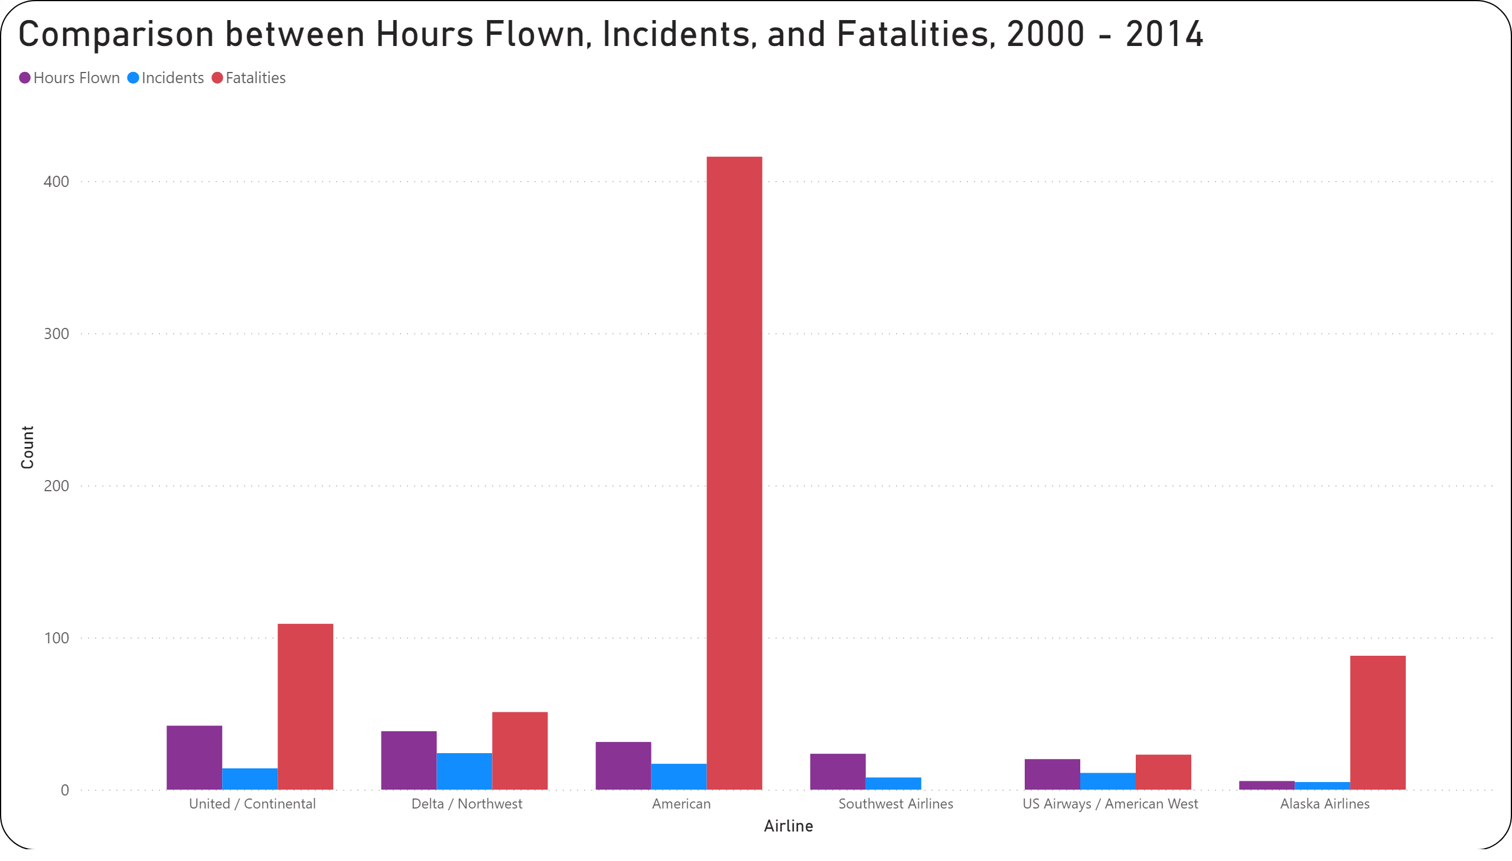
Understanding Flight Hours Flown’s Effect on Incidents and Fatalities

Slide 4
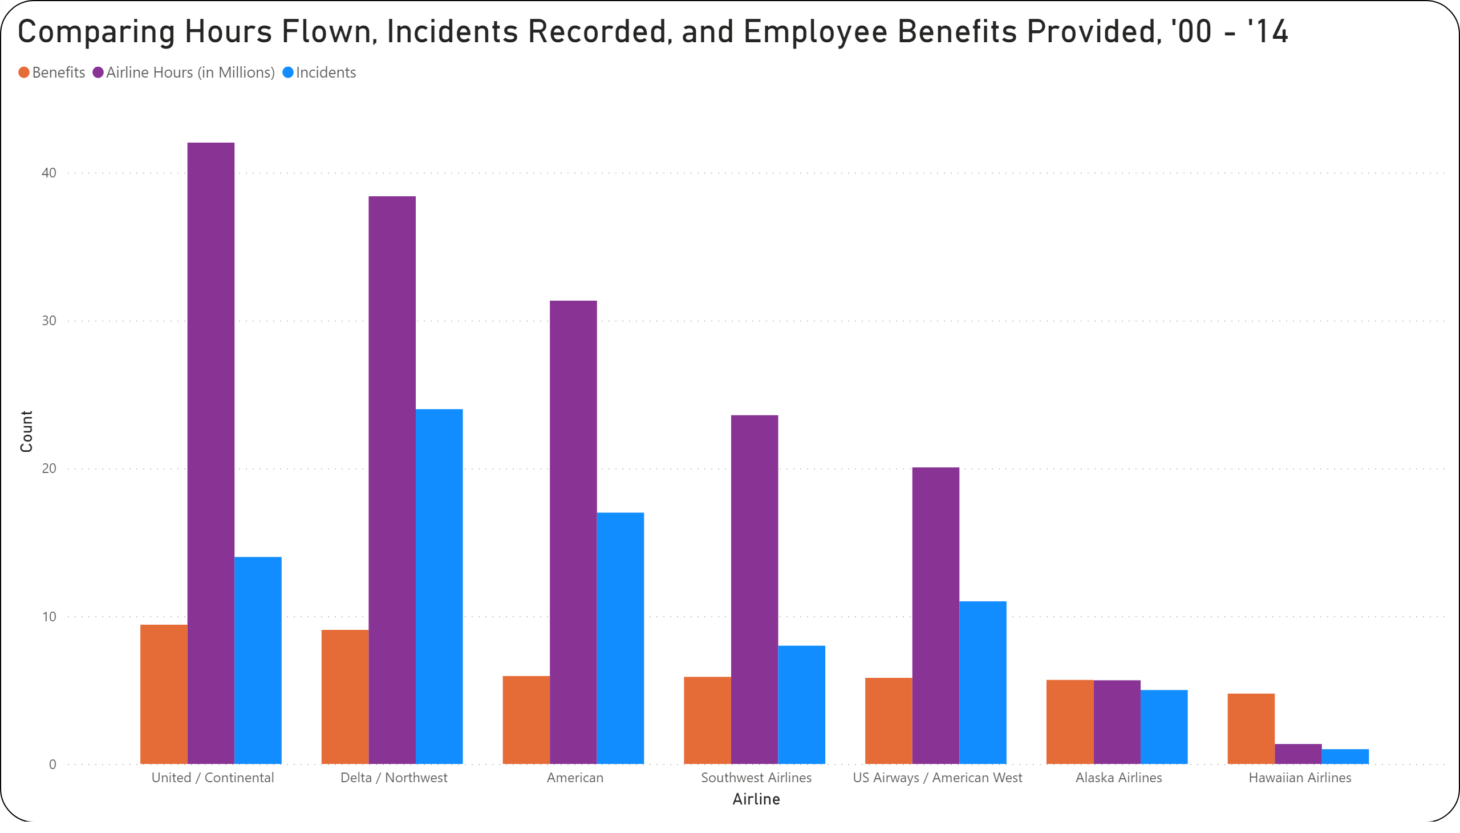
Deciphering Whether or Not Employee Benefits Correlates to Hours Flown and How if it Helps Decrease Flight Incidents

Slide 5
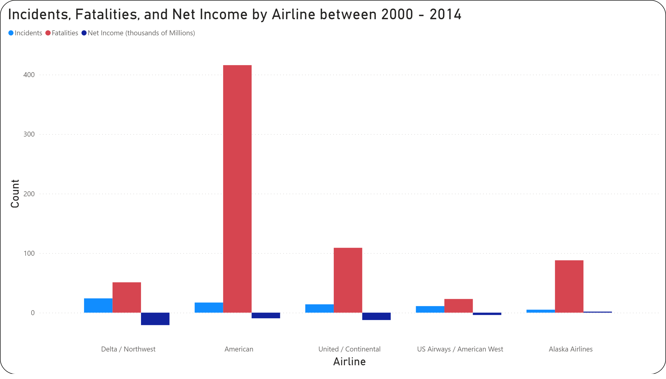
Comparison of Incidents & Fatalities and the Potential Impact on Net Income for Large US Airlines between 2000 and 2014

Slide 6
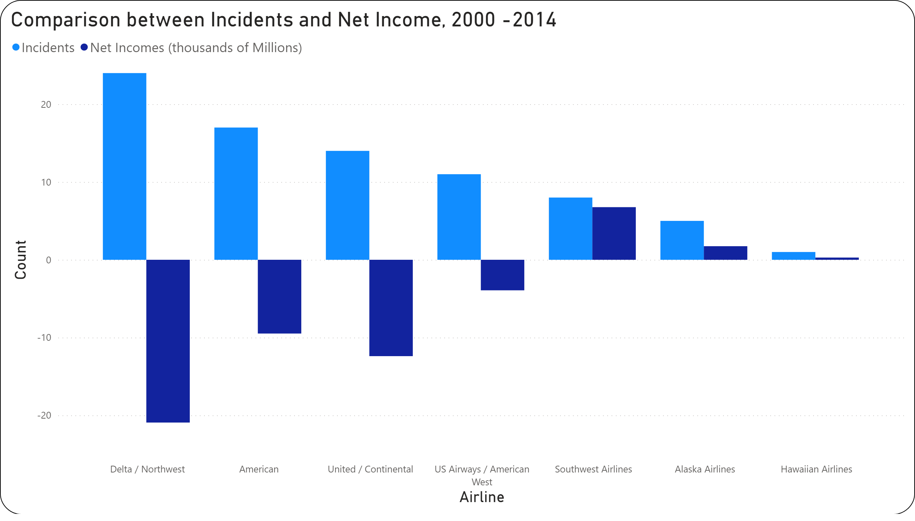
Clear Depiction of the Impact Travel Incidents have on Airline Income

Slide 7
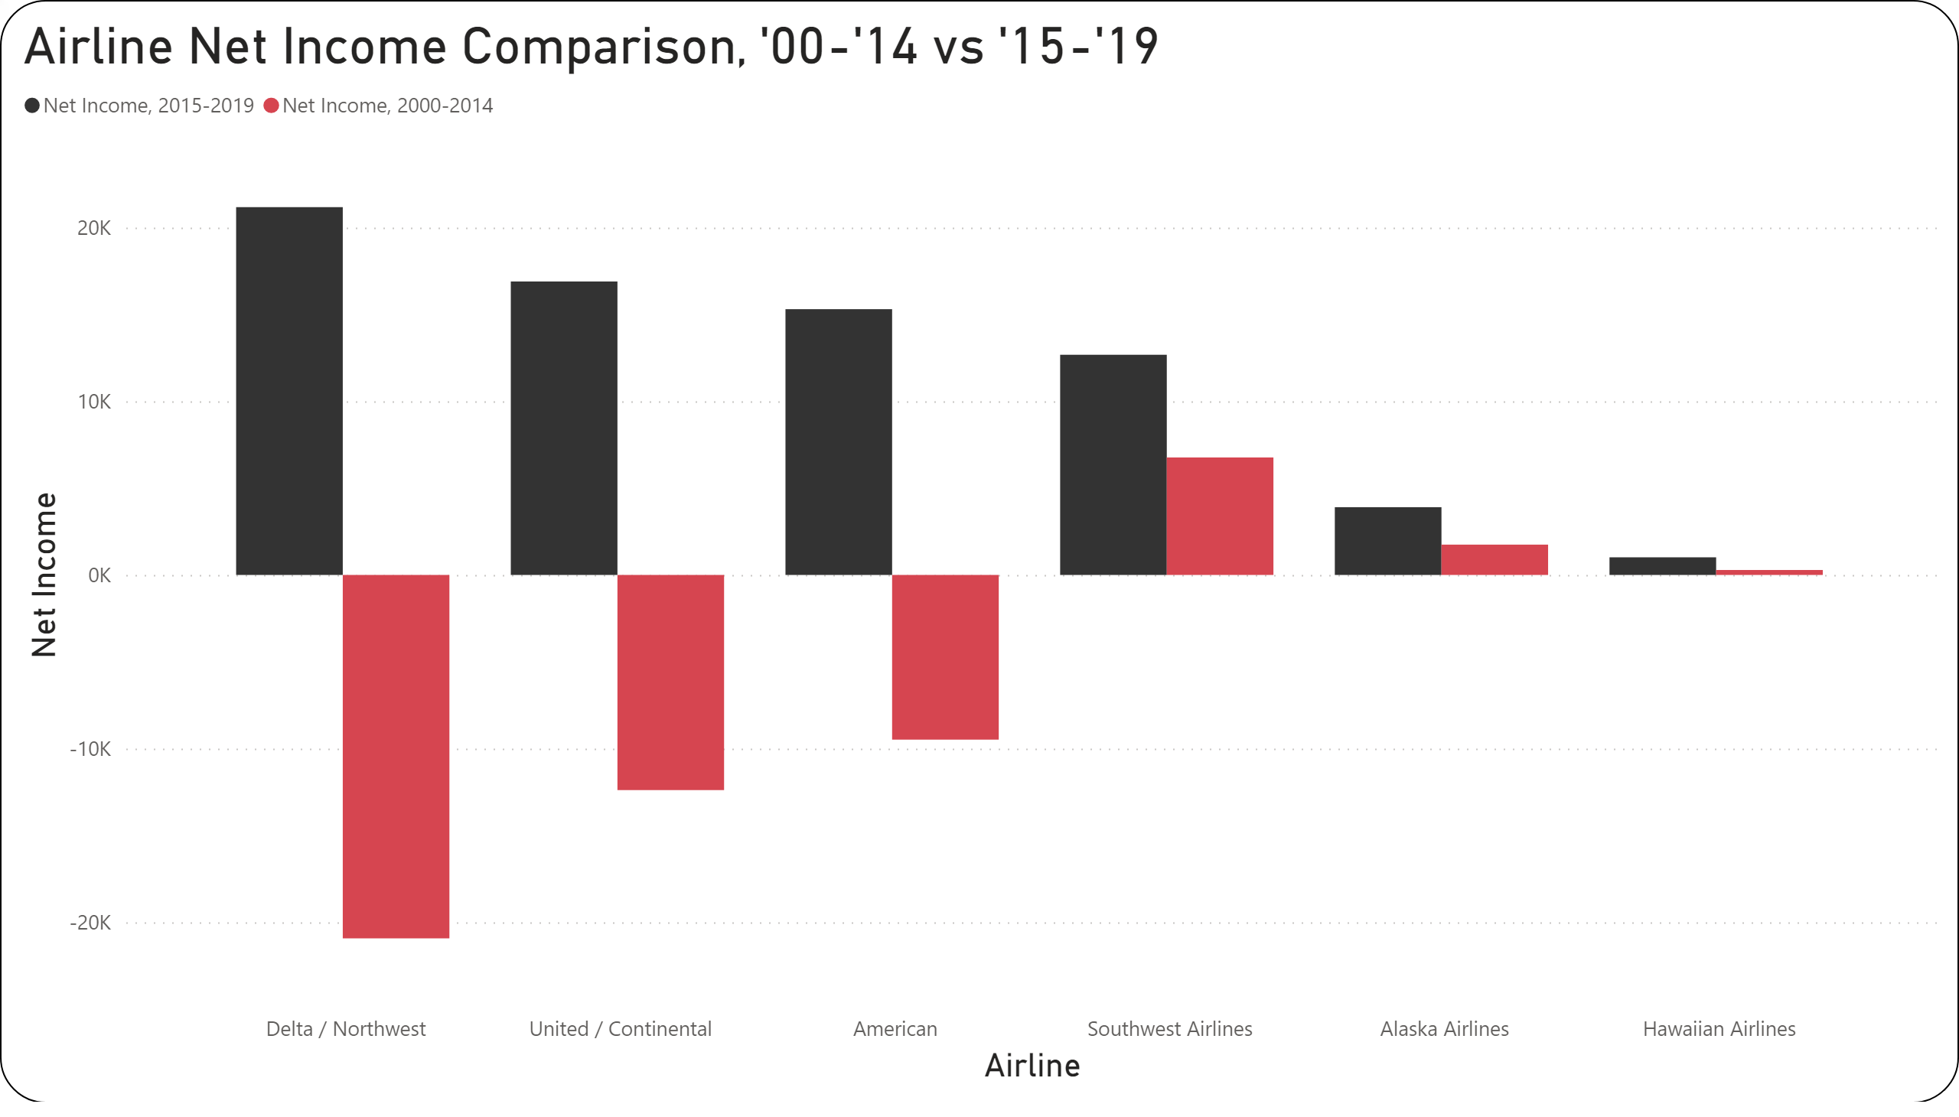
Progression of Net Income from ‘00-’14 to ‘15-’19

