Slide 1
Using Social Media for Disaster Prediction and Warnings
By Benjamin Haile
March 13, 2020

Slide 2
Problem Statement
While traditional methods for alerting on events such as hurricanes and tornadoes rely on information derived from official sources (e.g. USGS), this project aims to utilize Twitter activity to identify such an event. In practice, once the event is predicted, an alert can then be sent out across social media. The outcome of this project will be a binary classification model that can analyze tweets and use them to predict whether a disaster is present and a warning must be sent. As a proof of concept, this project will use archived tweets collected during the most dangerous days of Hurricane Sandy in 2012. The project's terminology will center around that of hurricanes specifically. In this situation, predicting no emergency while a hurricane approaches (false negative) is a much more dangerous outcome than predicting a hurricane when there is none (false positive). Models will therefore be evaluated on recall as well as accuracy.

Slide 3
Data Source
CrisisLex
Over 10,000 rows
October 28-30, 2012
Coastal New York and New Jersey
Next: using Twitter API to collect live data or location and time

Slide 4
Methodology
Off-topic = 0, on-topic = 1
Observe most common words, add to stop words if necessary
Cluster the classes
Run models with different versions of the stop words lists
Experiment with two vectorizers

Slide 5
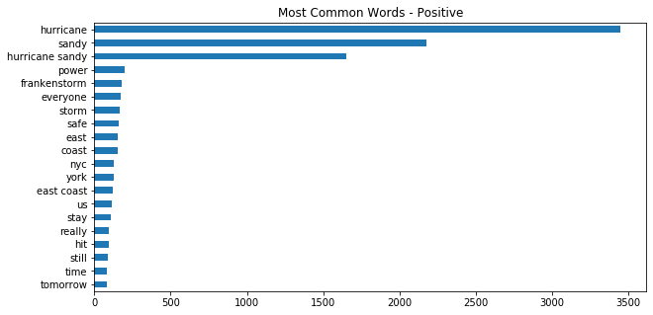
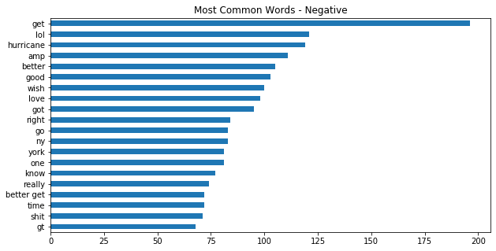
Comparing Common Words

Slide 6
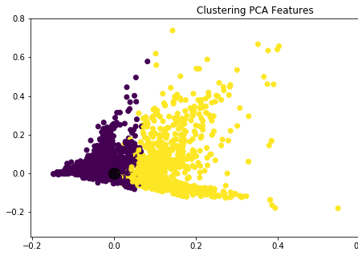
Kmeans Clustering
Silhouette score = 0.0026
Corpus transformed with TFIDFVectorizer
PCA to view in 2D

Slide 7
Modeling
Logistic Regression with CountVectorizer
Logistic Regression with TFIDFVectorizer
Random Forest with CountVectorizer
Random Forest with TFIDFVectorizer

Slide 8
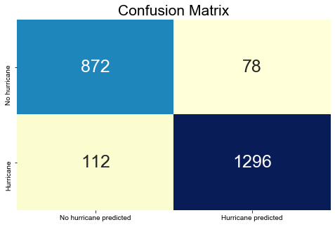
Model Selection
Logistic Regression with CountVectorizer
Recall = 92%
Accuracy = 92%
Baseline accuracy = 60% for positive
Increasing stop words had a lesser effect on model performance
Positive class was more numerous

Slide 9
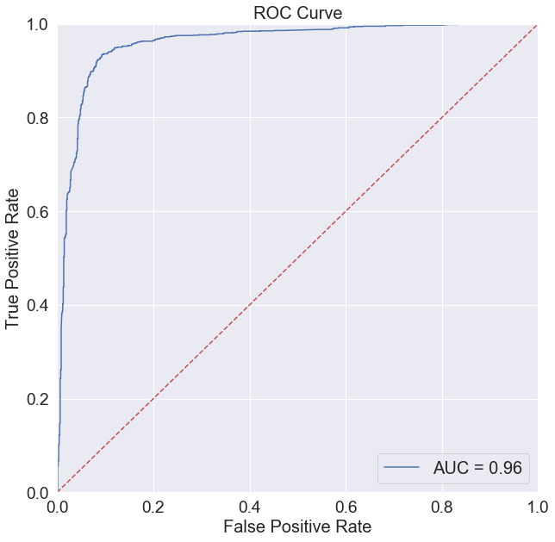
ROC Curve
AUC = 0.96

Slide 10
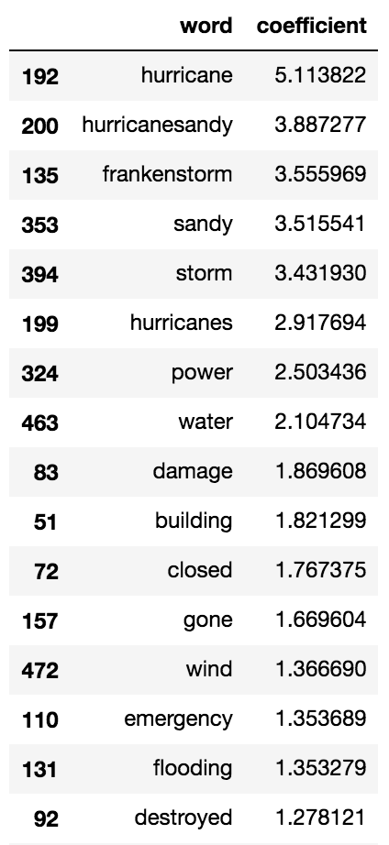
Feature Coefficients
The most relevant words have strong coefficients

Slide 11
Conclusion and Next Steps
This model successfully predicts the presence of a hurricane
Use as the catalyst for an alert system
Use Twitter API for live data
Experiment with weights for retweets, handles, hashtags
Generalize to different types of disaster
Start predicting based on time, NHC: mid-August – late October

