Slide 1
Targeted podcast-based marketing on reddit
Benjamin Haile, January 31, 2020

Slide 2
Problem statement
Hardwire is a marketing firm specializing in gaming and online media. We want to tailor digital marketing to social media users based on the interests they express online. One avenue we’re pursuing is designing an algorithm for understanding a user’s interests based on Reddit posts. We’re testing our algorithm on the audiences of two podcasts we’ve worked with before: the Rooster Teeth Podcast and Castle Super Beast. To complete the algorithm, we need a classification model that will predict which podcast’s subreddit a user posts in based on the post’s title. The algorithm can then show a user relevant ads based on key words associated with that podcast.

Slide 3
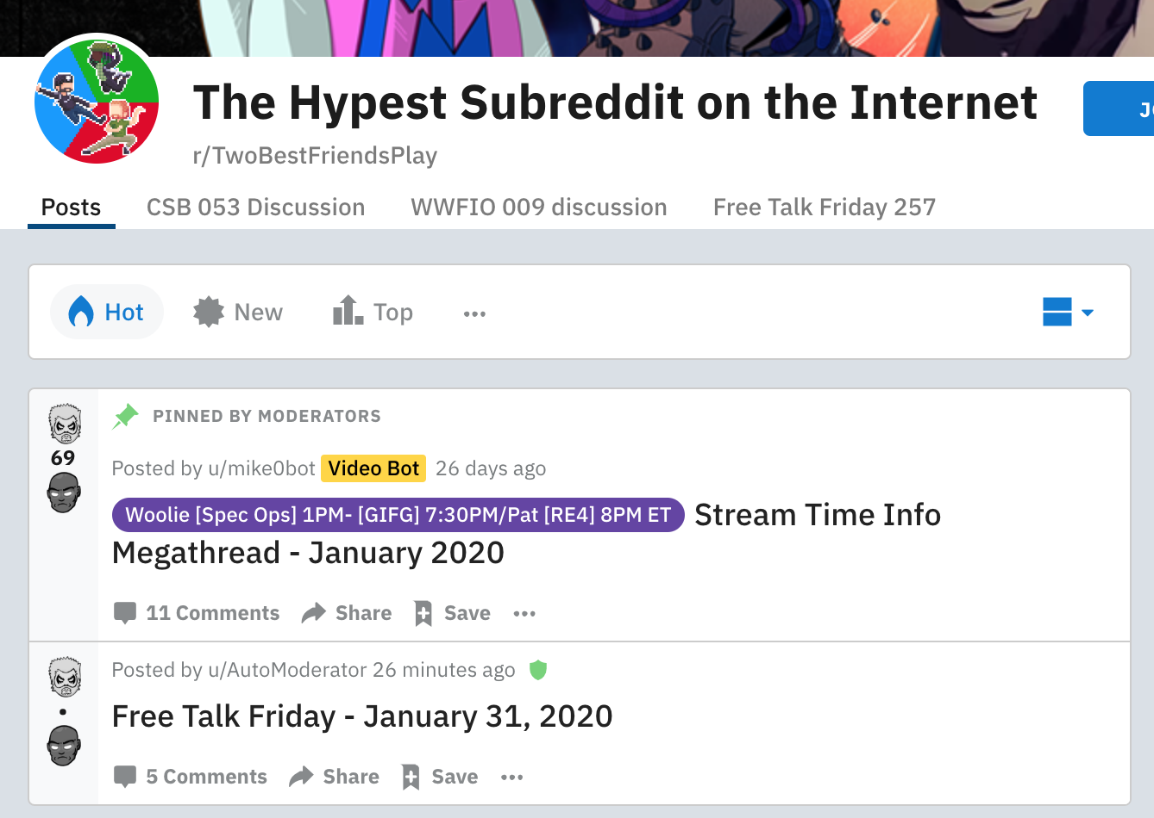
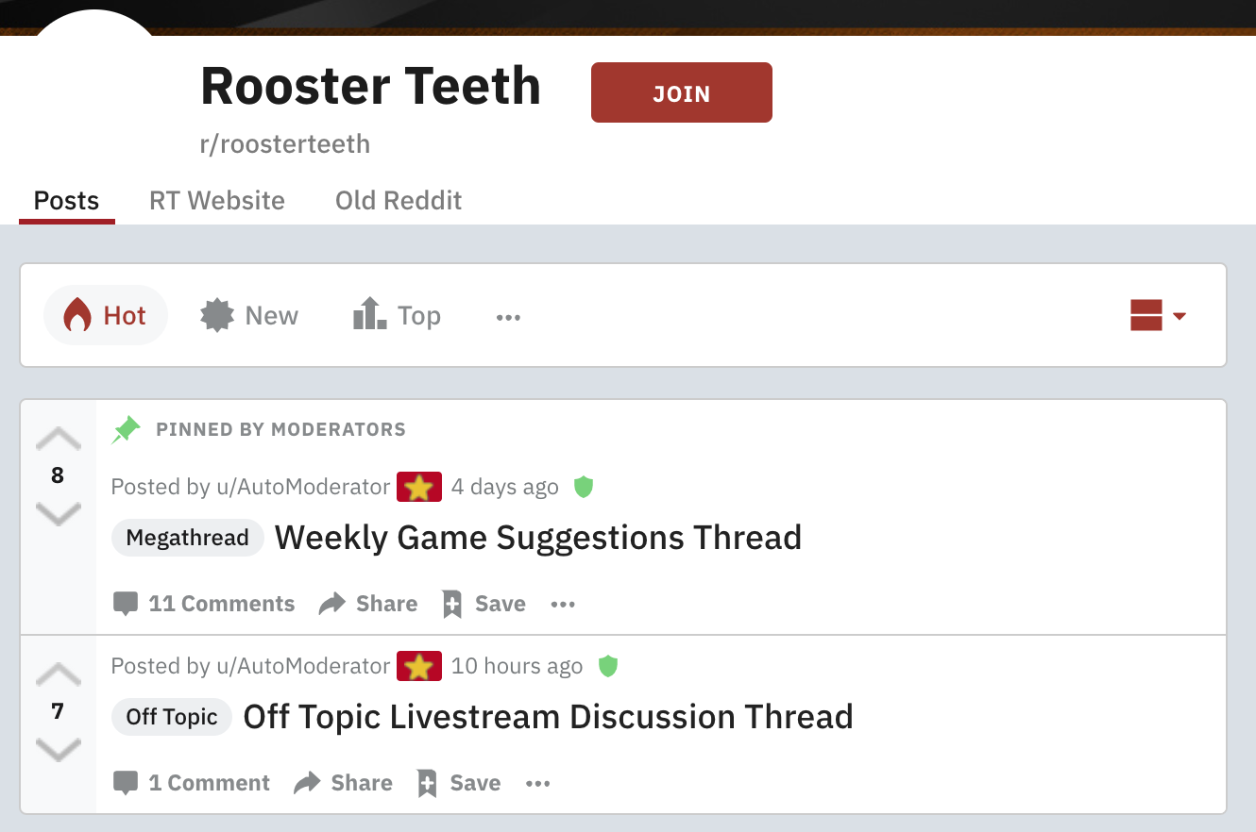
background
r/twobestfriendsplay
-castle super beast
-70.9K members
r/roosterteeth
-244k members

Slide 4
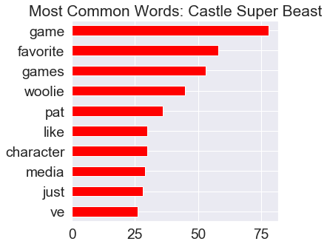
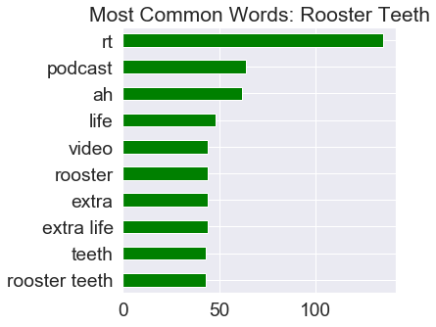
Different interests

Slide 5
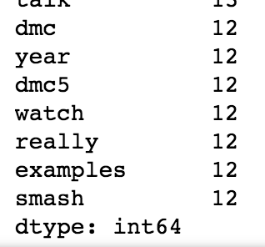
Game discussion
Devil May Cry 5
Super Smash Bros. Ultimate

Slide 6
process
Collecting via Pushshift API
RT = 0, CSB = 1
Removing stopwords
Determining differences in language
Fitting logistic regression, multinomial naïve Bayes, Gaussian naïve Bayes, with CountVectorizer
Multinomial NB returned best results

Slide 7
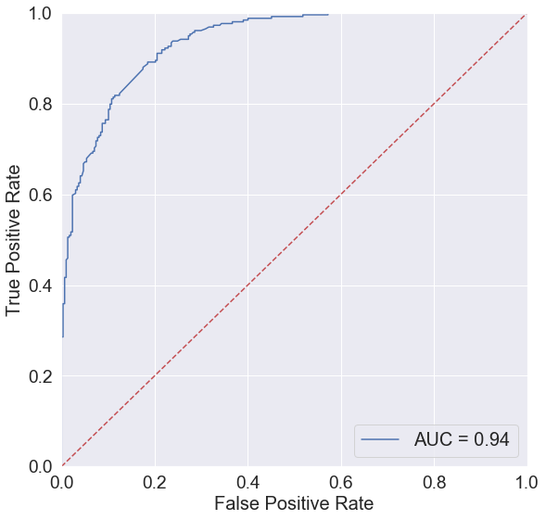
Multinomial naïve bayes model
Baseline score: 53% for class 0
Training score: 93%
Testing score: 85%
Cross validation score: 86%
Best parameters:
max_df = 0.1
min_df = 2
max_features = None
ngram_range = (1, 2)
stop_words = ‘english’

Slide 8
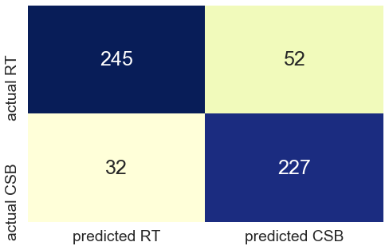
Confusion matrix

Slide 9
Conclusion and next steps
Prepared to use predictive model in our algorithm
Similar podcasts
Going beyond podcasts

