Slide 1
SMART FARMER
Team ID: TSH2024
Branch & Year: CSE -3rd year
Institution: Sreenidhi Institute of Science and Technology
Location: Ghatkesar, Hyderabad
Domain: Agrotech
Problem Statement: Crop prediction, Fertilizer Utilization, Disease Prediction and Solution Recommendation

Slide 2
About our Idea
Our project aims to provide the best model for crop prediction, which can help farmers decide the type of crop to grow based on the climatic conditions and nutrients present in the soil.
Our project also involves providing them with the info about the appropriate type, quantity, and timing of fertilizer application based on soil nutrient levels, crop requirements, and environmental conditions. If they are not sure about the utilization of any particular fertilizer.
One of our major goals is to enable early detection and accurate diagnosis of crop diseases.
We made use of ML and DL techniques in plant disease detection is a rapidly evolving field with promising results

Slide 3
Use Cases
Tech Stack
In the model we have developed, we prioritize user accessibility and inclusivity. Our platform offers farmers the option to gain a lot information which can help them decide the type of crop to grow, how to apply a particular fertilizer on a specific crop and majorly identifies the disease and recommends best pesticides available in the market.
1). Text Downloads:
Users can download textual information regarding specific crop diseases and recommended fertilizers directly from our platform.
2). Audio Downloads:
In addition to textual information, our platform facilitates audio downloads in various languages.
This feature is particularly beneficial for farmers who may face challenges with reading or literacy.
1).CNN Algorithm for Image Classification: Utilized for precise classification of images depicting various diseases. Known for its capability to handle large datasets effectively, simplifying the training process.
2).Dataset Source: Acquired from Kaggle, a renowned platform offering diverse datasets. The dataset comprises a vast collection of images representing different diseases, facilitating robust model training.
Model Enhancement:
3).Integration of Web Technologies:
HTML, CSS, and JavaScript integration aimed at enhancing the model's aesthetics and interactivity. Enhances user experience by creating an appealing and user-friendly interface for farmers.

Slide 4
Unique Value Proposition
Our developed model encompasses a multitude of distinctive features unparalleled by existing models.
1).Crop Prediction:
-Predicts the ideal crop to be cultivated based on comprehensive analysis of soil and weather conditions.
-Utilizes advanced algorithms to generate dynamic crop predictions, enhancing agricultural productivity.
2).Fertilizer Recommendation:
-Provides tailored recommendations on the selection of fertilizers suitable for specific crops.
-Offers insights into the optimal quantity of fertilizer to be applied to enhance soil nutrient levels and prevent crop diseases.
3). Crop disease detection and Pesticide Management:
-Offers detailed information on the recommended quantity of pesticide required for disease treatment.
-Recommends the most suitable pesticide for effective disease management.
The incorporation of these innovative features sets our model apart, offering a holistic solution for agricultural management. By integrating aforementioned features, our model empowers farmers with dynamic and data-driven insights to optimize crop yield and mitigate disease risks effectively.

Slide 5

Video Explanation

Slide 6
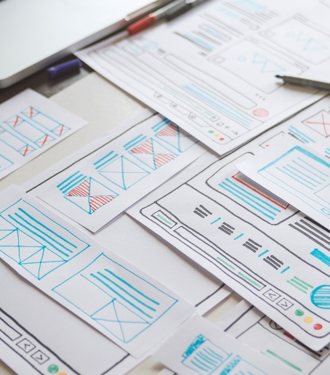
Team Details
Team Leader:
Branch: CSE Year: 3rd
Team Member 1:
Branch: CSE Year: 3rd
Team Member 2:
Branch: CSE Year: 3rd
Team Member 3:
Branch: CSE Year: 3rd
Team Member 4:
Branch: CSE Year: 3rd

