Slide 1
Release The Hounds
Will you survive or will you be torn to shreds...

Slide 2
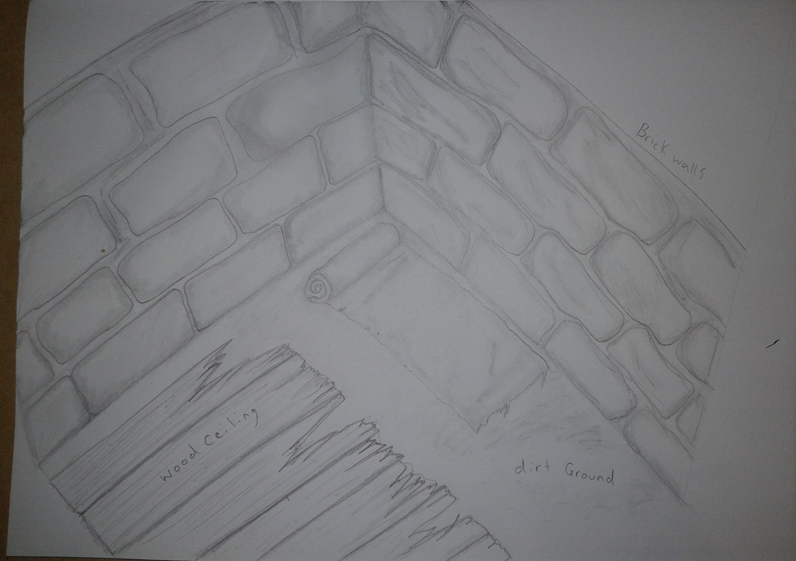
Starting Dungeon Cell
Starting Area
Dungeon Cell
Dead Guard and Hound
Note about experiments on body

Slide 3
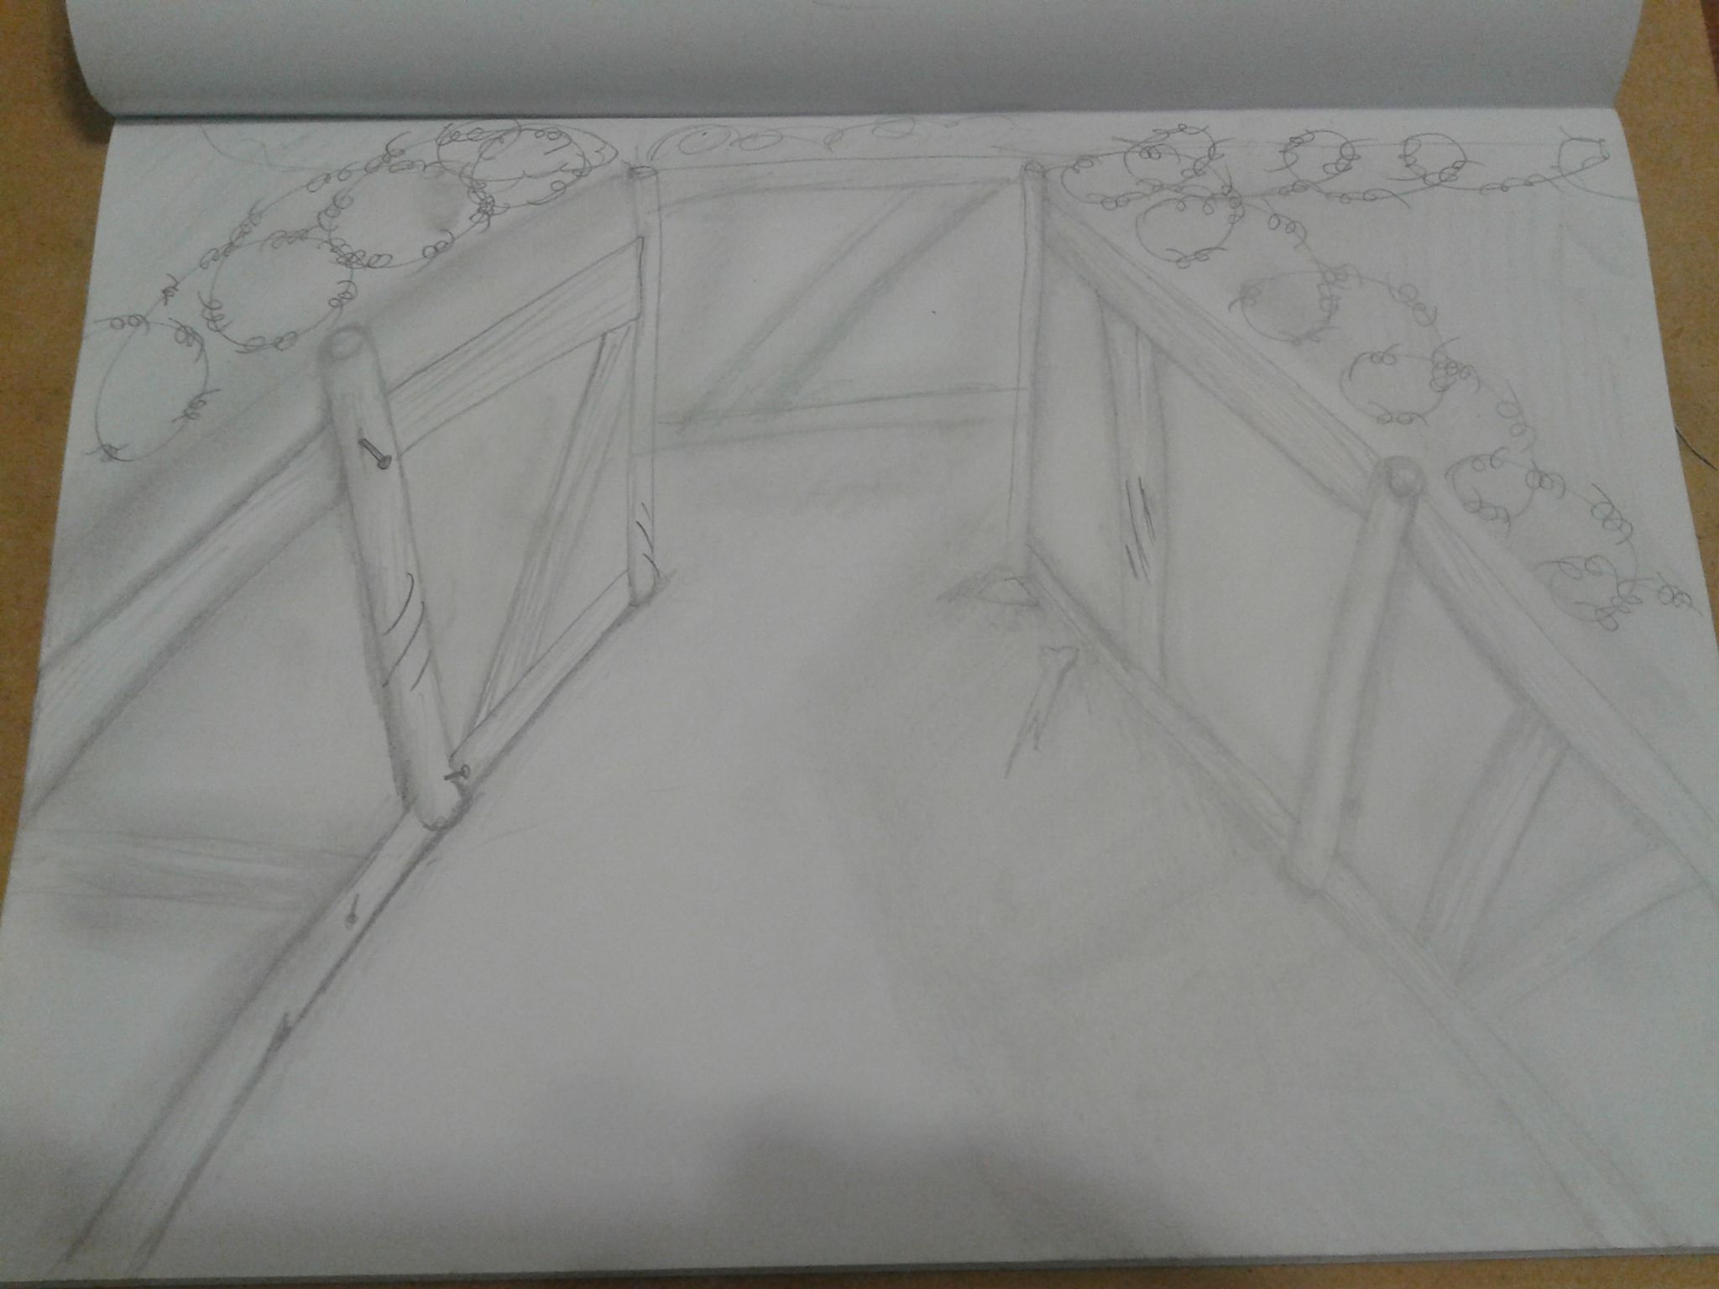
Trench Maze
Environmental weapons
Jagged Bones
Rocks
Land Mines
Maze
Dark Night, Clouds
Mist/fog
Chased...

Slide 4
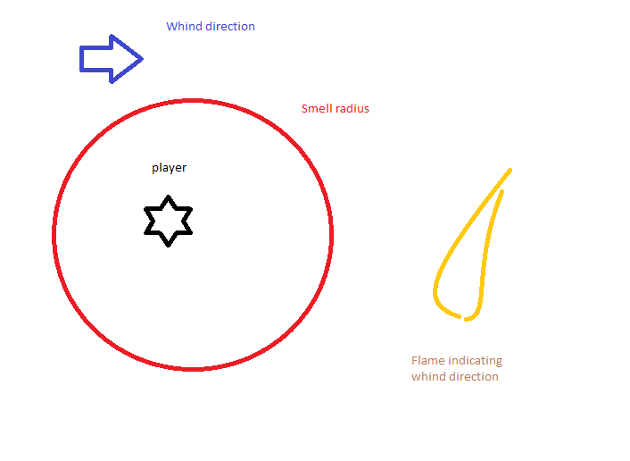
Player mechanics
Hounds navigate at random until they pick up the players scent.
Player can stay downwind and move past a dog that hasn’t seen him.
Items that can enable shortcuts.
Stamina and adrenalin.

Slide 5
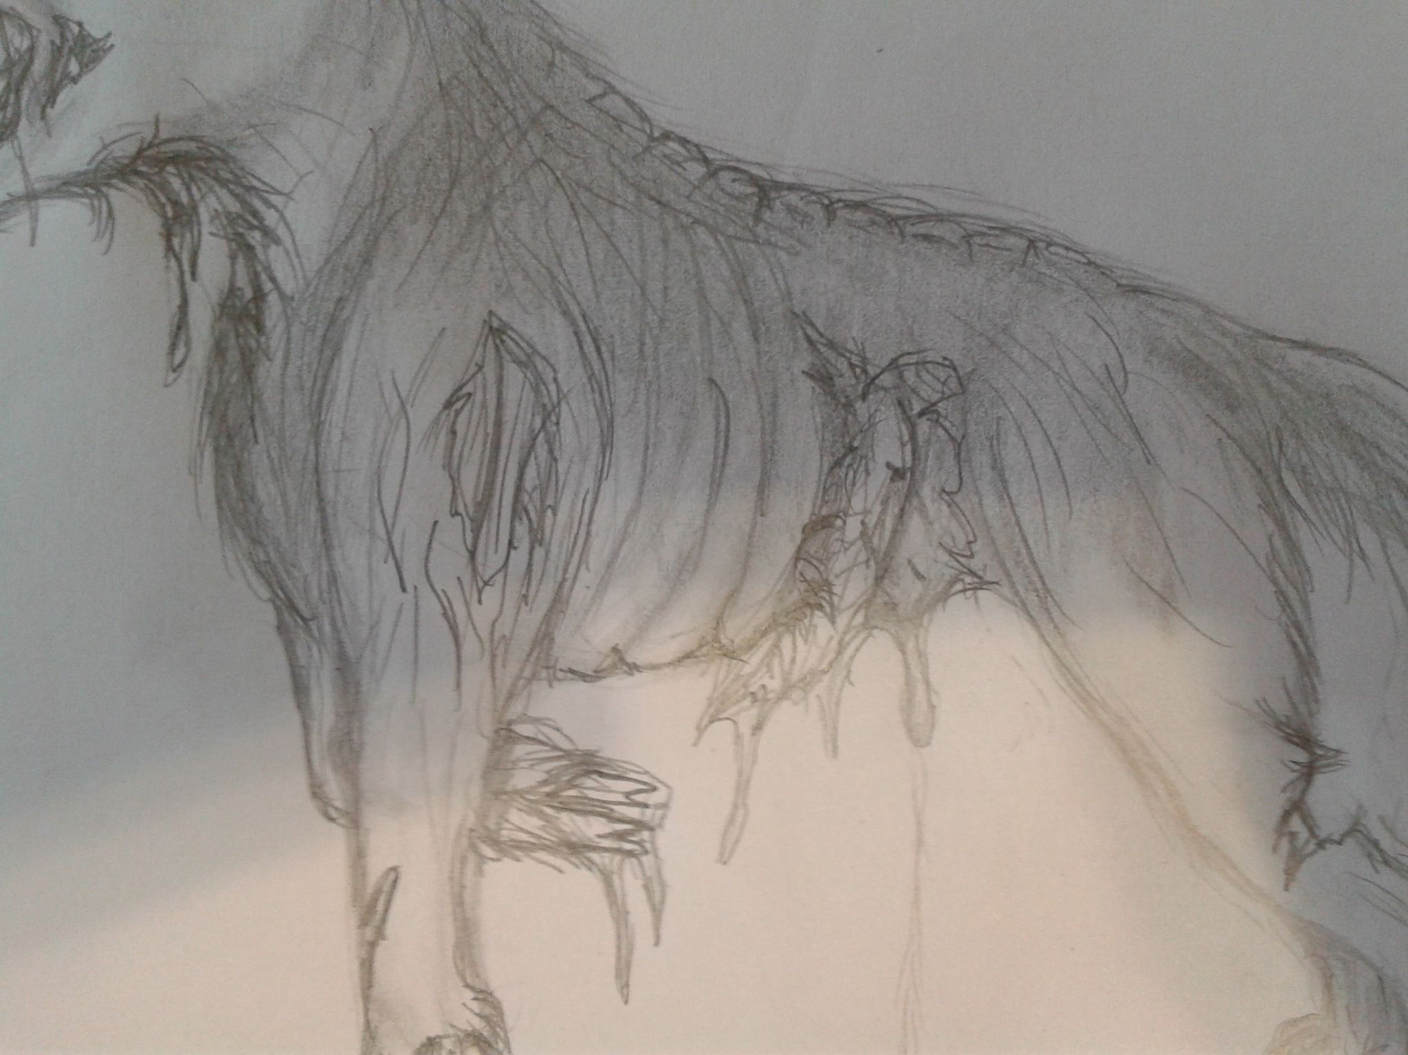
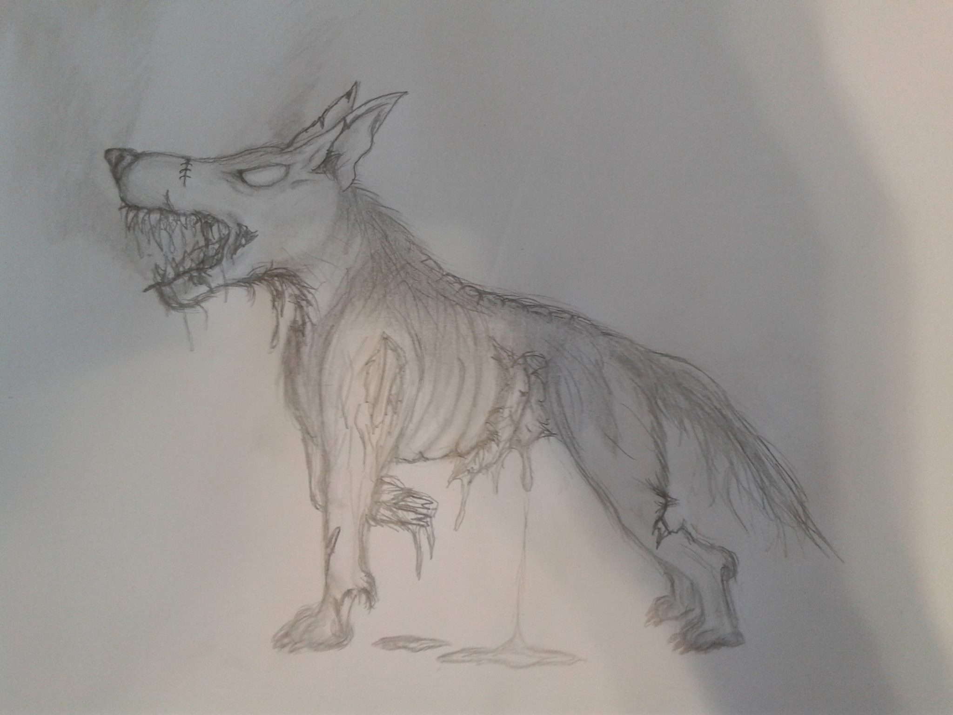
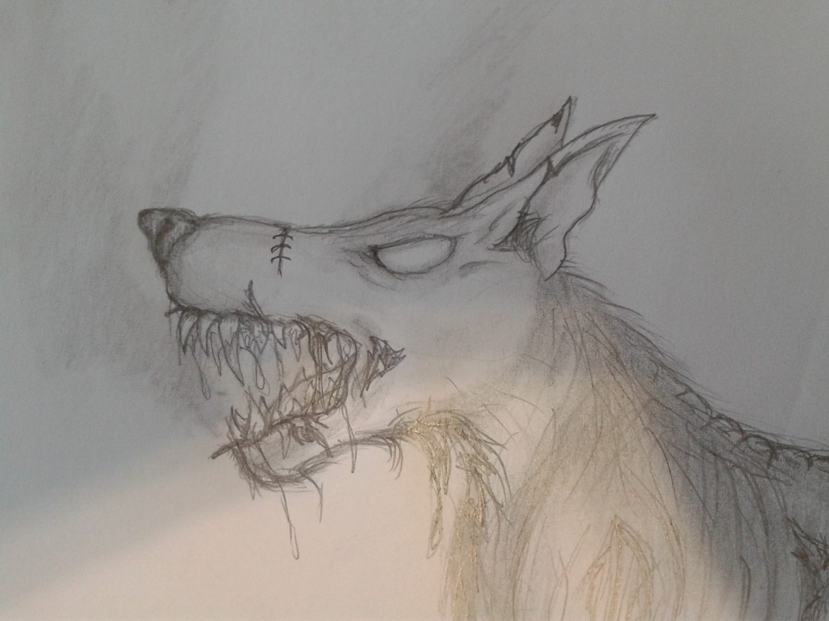
The Hounds
Experimental Abominations

Slide 6
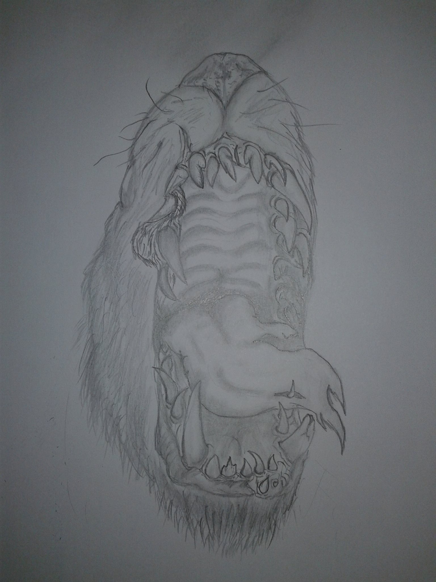
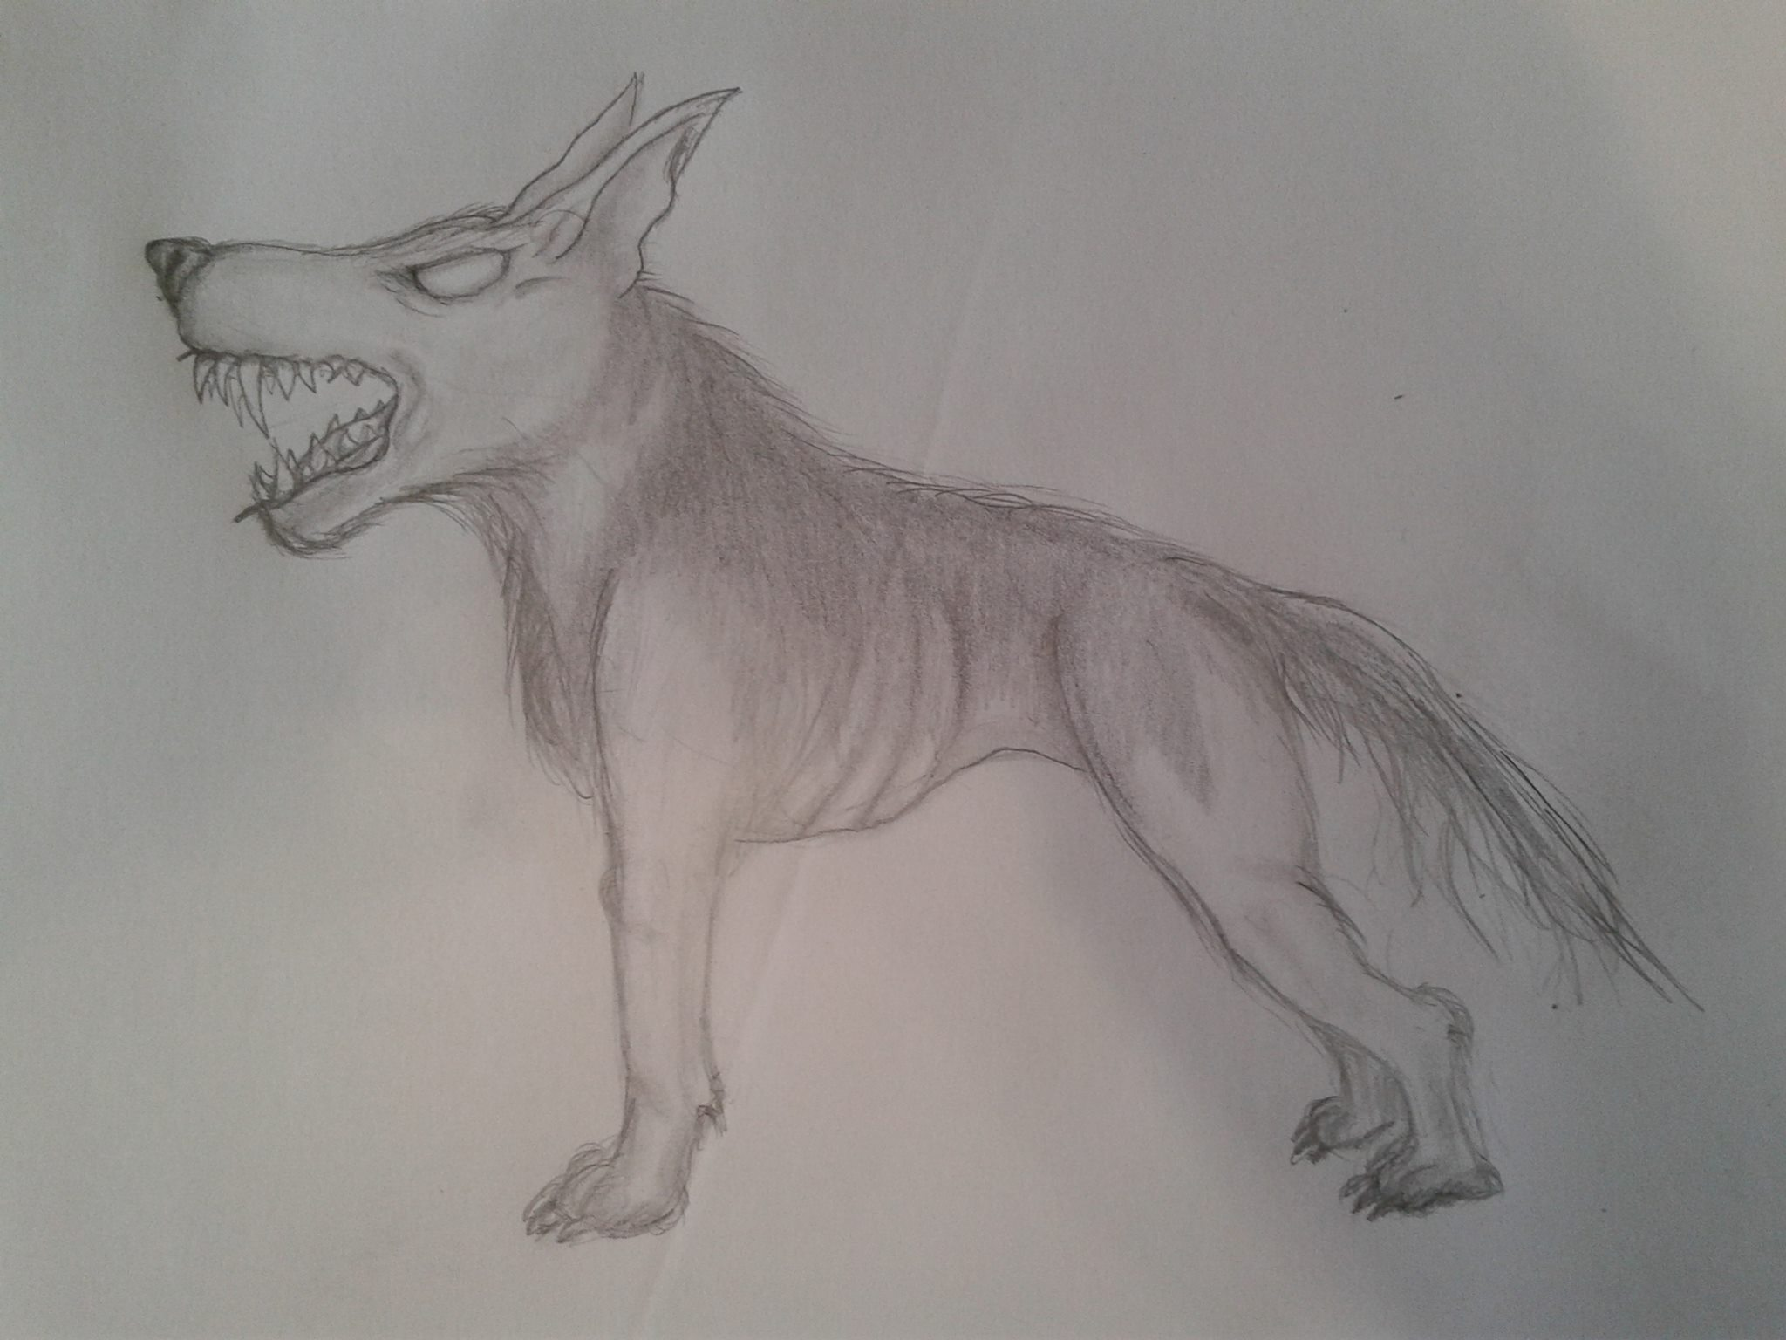

Slide 7
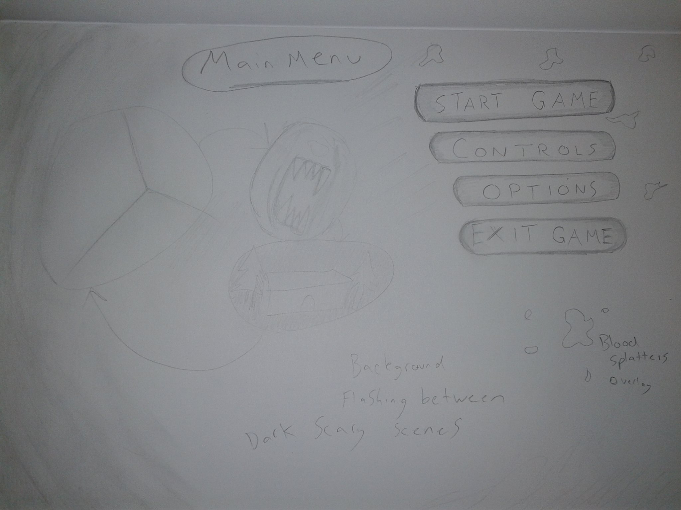
User interface
Start menu
Background flashing images of game scenes
Start area
Hounds
Trench Scene
Dead Bodies
Dark grunge look
Blood Splatters

Slide 8
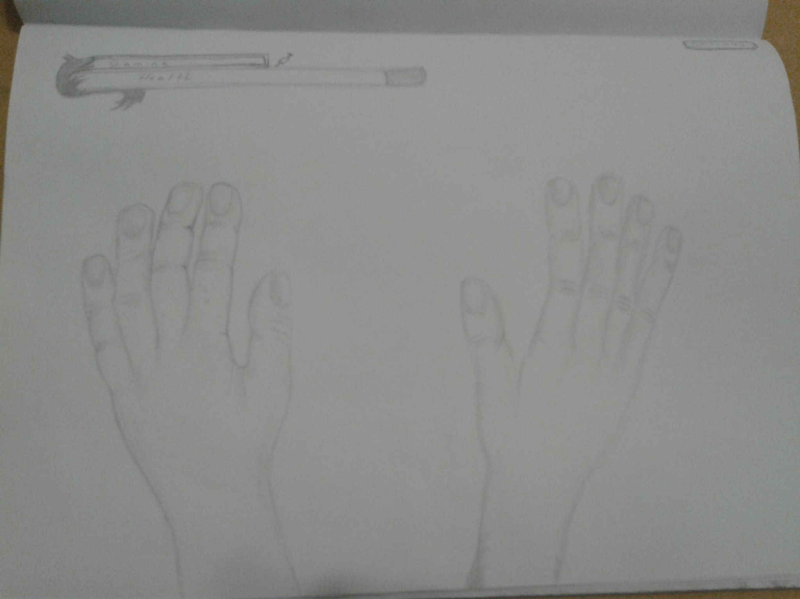
First Person View with avatars Hands
Health bar
Stamina Bar
Adrenaline Syringes
Player Controls
WASD movement
Jump
Crouch
Interact
Use Item/object/environment weapon in hand

Slide 9
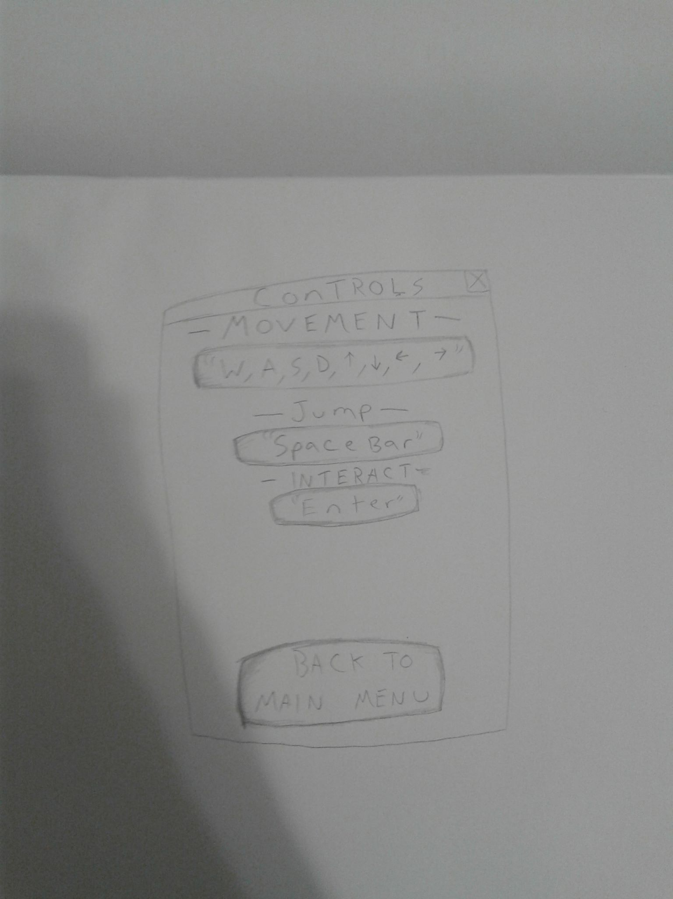
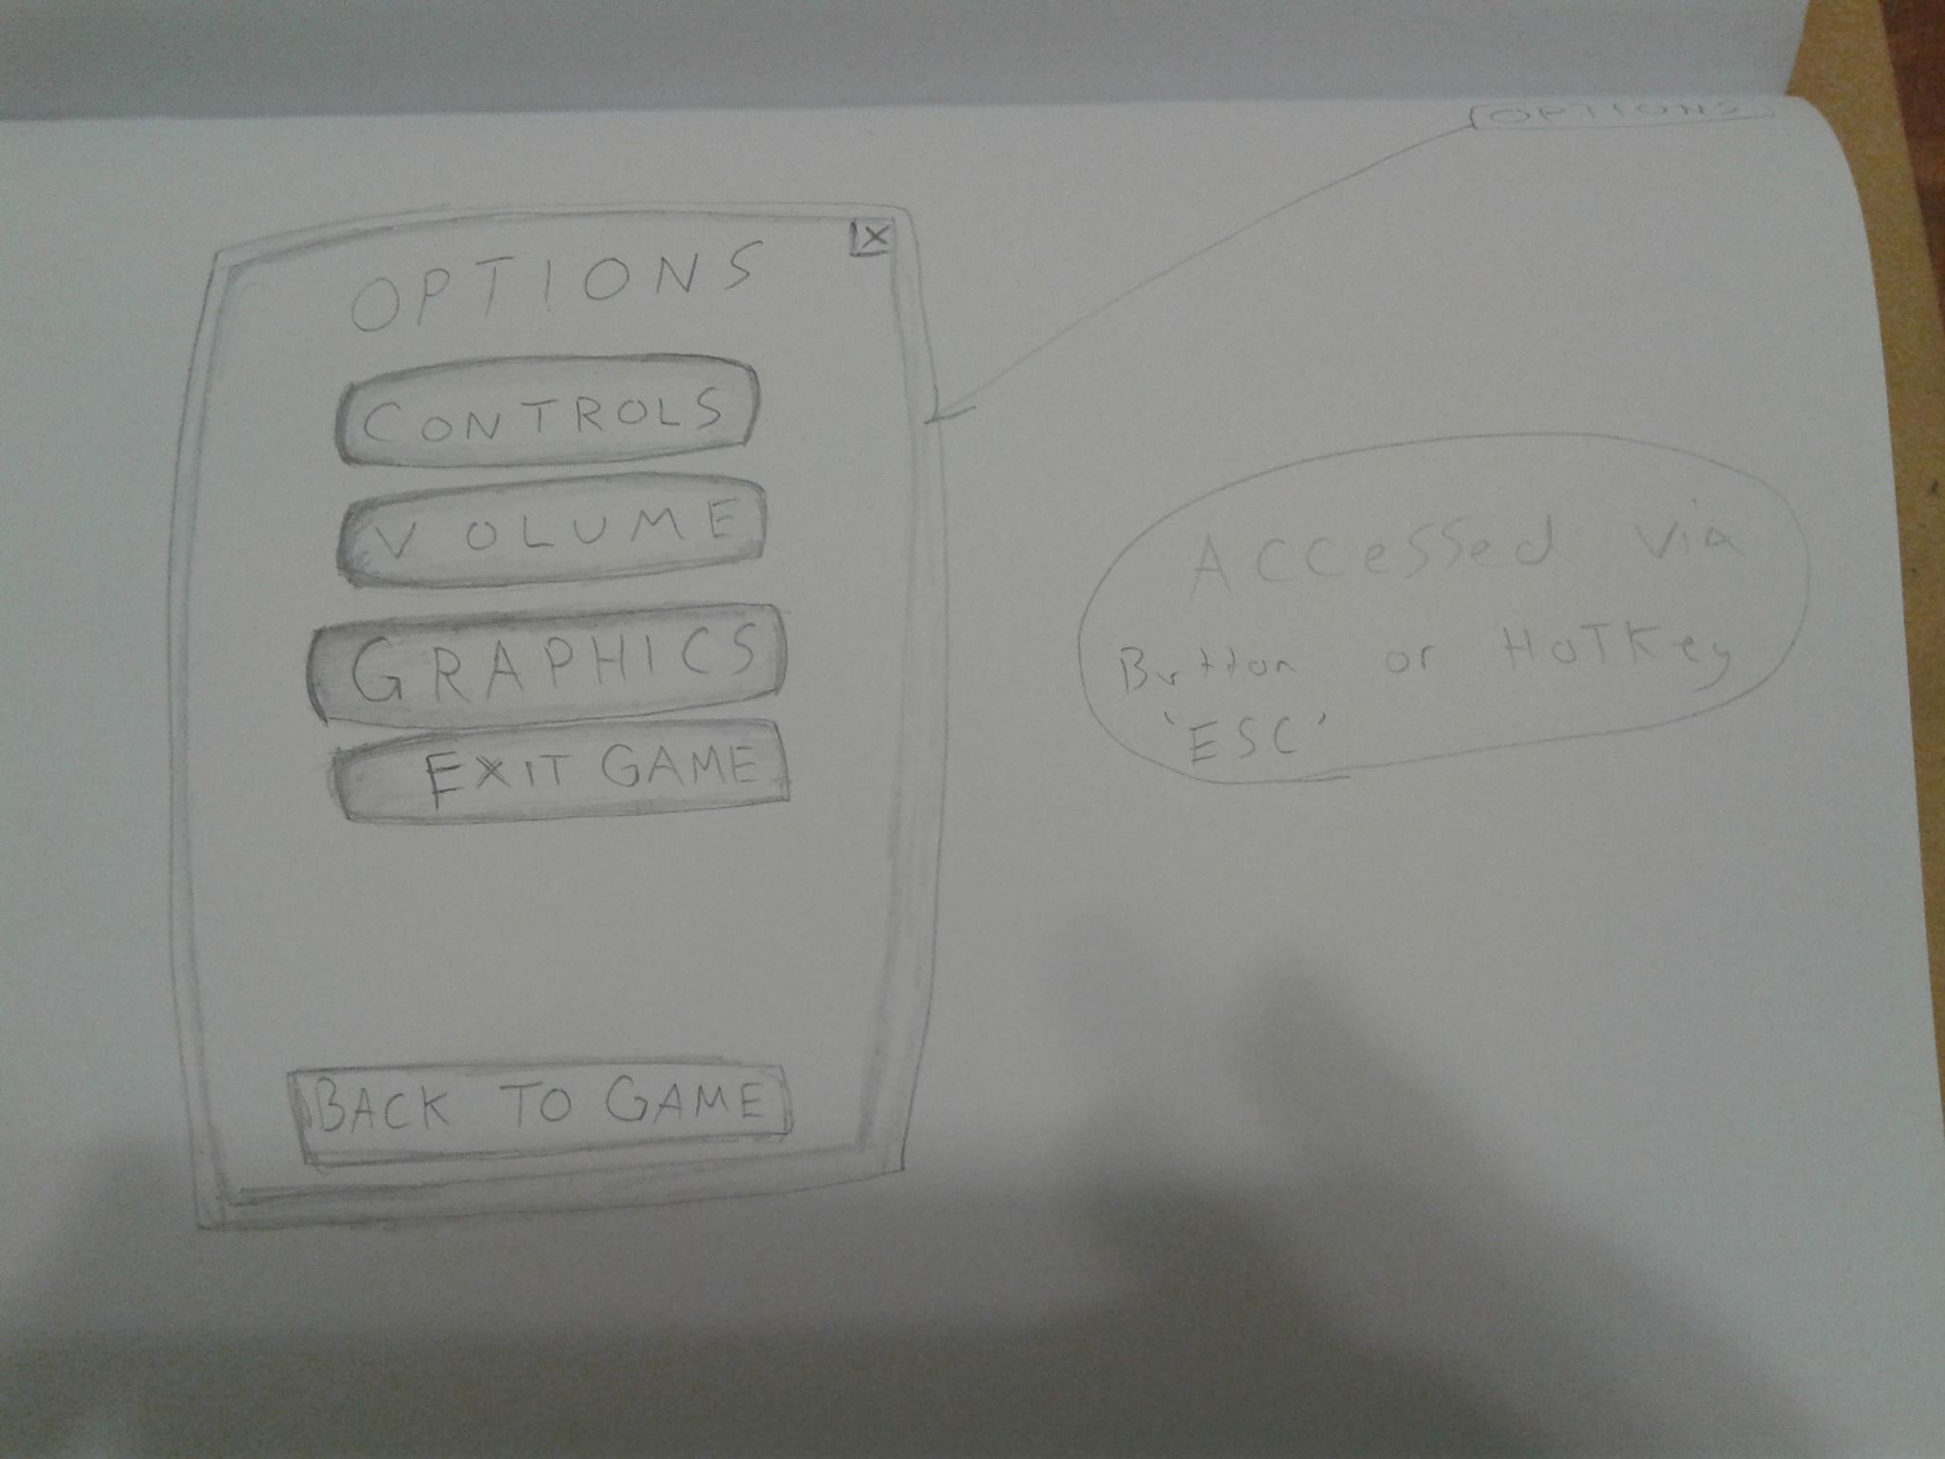
In Game Options Menu

