Slide 1
Reflect AI
Privacy-First AI Journaling Companion
Building Consistent Journaling Habits with Intelligent AI Assistance
By
Jatin Bhandari
Palo Alto Networks NetSec Hackathon 2026

Slide 2
The Journaling Challenge
Blank Page Anxiety
Users don't know what to write
Event Logs, Not Insights
Entries lack depth and reflection
Users need intelligent assistance that respects their privacy
No Pattern Recognition
Can't identify emotional patterns over time
Lack of Continuity
Each entry feels disconnected from the last
Privacy Concerns
Users hesitate to share personal thoughts with AI

Slide 3
MVP Features
1
Daily AI Prompts: Context-aware prompts generated by Claude AI
2
Real-Time Sentiment Indicator: Local AFINN analysis shows sentiment as you type
3
AI Writing Companion: Debounced suggestions appear after 2-second typing pause
4
Theme Extraction: Automatic identification of topics (work, family, health, etc.)
5
Sentiment Trends: Visual charts showing emotional patterns over time
6
Weekly Summaries: AI-generated insights from aggregated data
7
Privacy Controls: User can disable AI features, export data, delete account

Slide 4
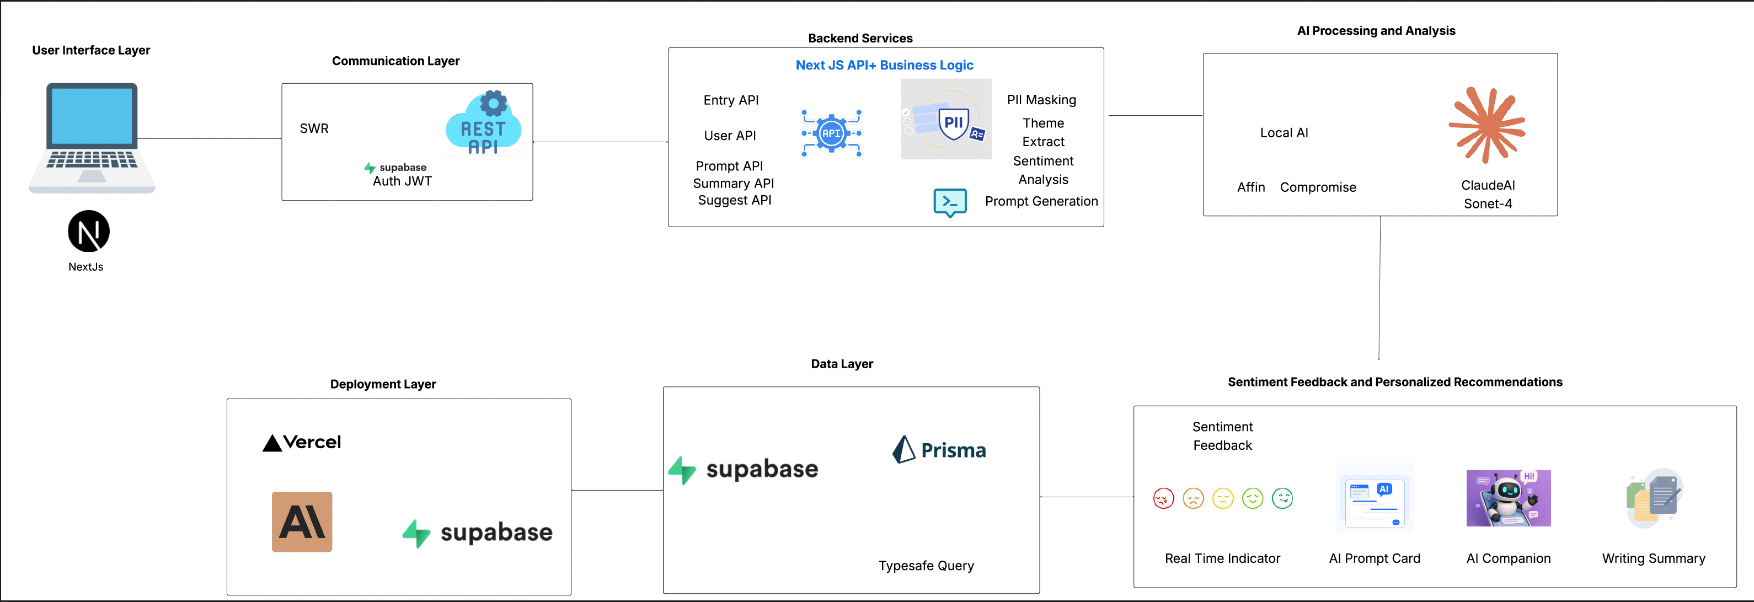
High-level System Architecture

Slide 5
Technology Stack
Frontend
UI Components
Backend
• Next.js 14 (App Router)
• shadcn/ui (Radix UI)
• Next.js API Routes
• React 18
• Recharts
• Prisma 5
• TypeScript 5
• Supabase Auth
• Tailwind CSS
Database
AI
Deployment
• Supabase
• Anthropic Claude API
• Vercel
• AFINN (local)
• Compromise NLP

Slide 6
Key Learnings
🔒
Privacy Matters
Users are more willing to use AI features when privacy is prioritized
⚡
Local Processing
Instant feedback improves user experience significantly
🎯
Context is King
Context-aware prompts dramatically improve engagement
🤝
Hybrid Approach
Combining local and cloud AI provides best of both worlds
🎛️
User Control
Giving users control over AI features builds trust
✨
Prompt Engineering
Careful prompt design makes AI responses more helpful

Slide 7
Challenges & Solutions
⚠️ Challenge:
✅ Solution:
Balancing privacy with AI functionality
Hybrid approach with local processing + PII masking
⚠️ Challenge:
✅ Solution:
Generating context-aware prompts
Historical pattern analysis + careful prompt engineering
⚠️ Challenge:
✅ Solution:
Real-time sentiment without API delays
Local AFINN sentiment analysis
⚠️ Challenge:
✅ Solution:
Debouncing AI suggestions effectively
2-second delay + >100 character threshold

Slide 8
Thank You
🌐 Demo: https://youtu.be/UxRMG4uT6XY
📁 GitHub: https://github.com/b-jatin/FY26-NetSec
Palo Alto Networks NetSec Hackathon 2026

