Slide 1
Characterizing Mean and Standard Deviation of the Strong Earth Gravity Prior
Björn Jörges & Joan López-Moliner

Slide 2
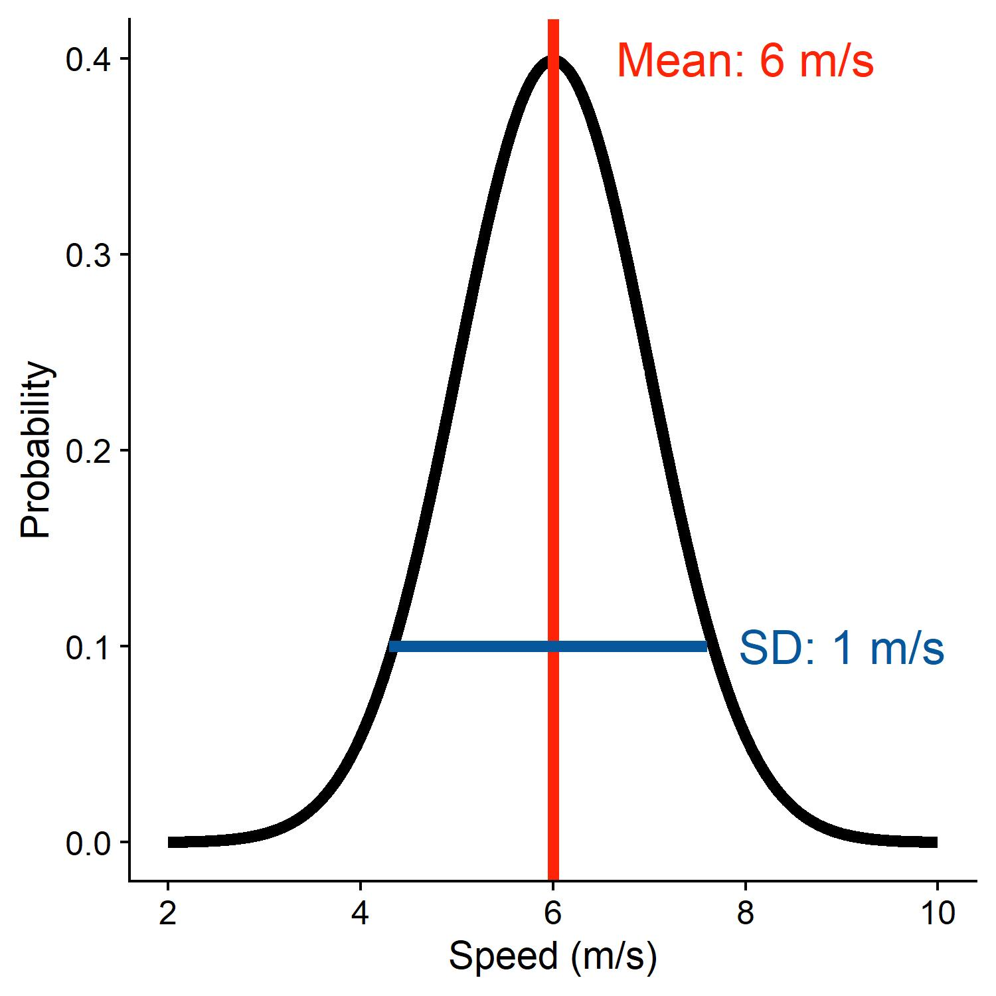
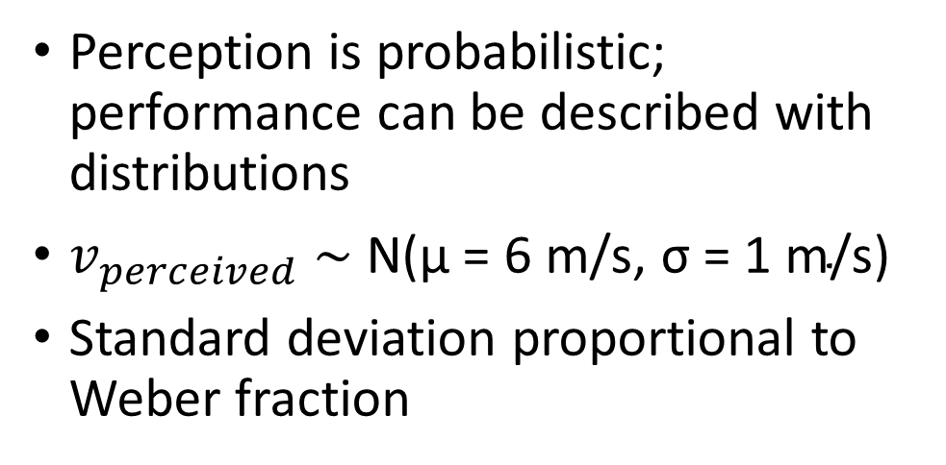
Background #1
Perception is probabilistic; performance can be described with distributions
$v_{perceived} \sim \text{N}\text{(}\text{μ} \text{=}\text{ 6 }\text{m}\text{/}\text{s}\text{,} \text{σ} \text{=}\text{ 1 }\text{m}\text{/}\text{s}\text{)}$
Standard deviation proportional to Weber fraction

Slide 3

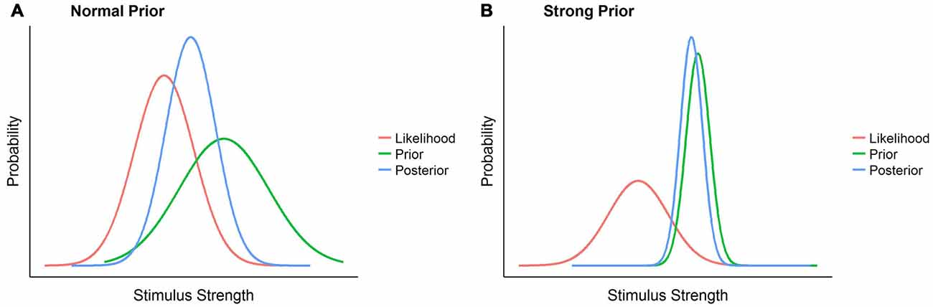
Background #2
Earth Gravity expectation used to extrapolate motion (e.g., to catch objects)
Recently envisioned as „Strong Prior“

Slide 4
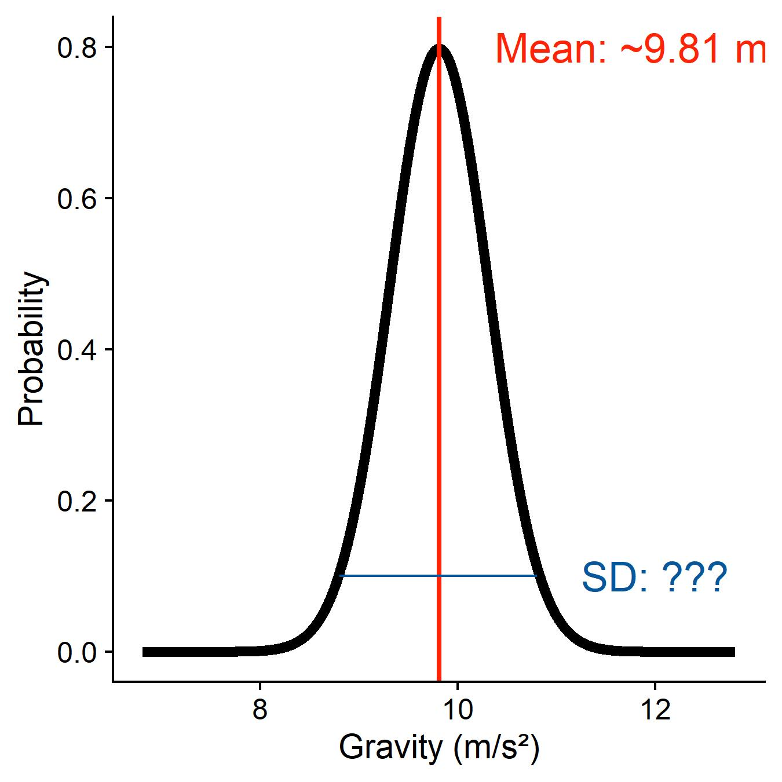
Research question
The mean is *very* likely at 9.81 m/s², but what is the standard deviation?

Slide 5
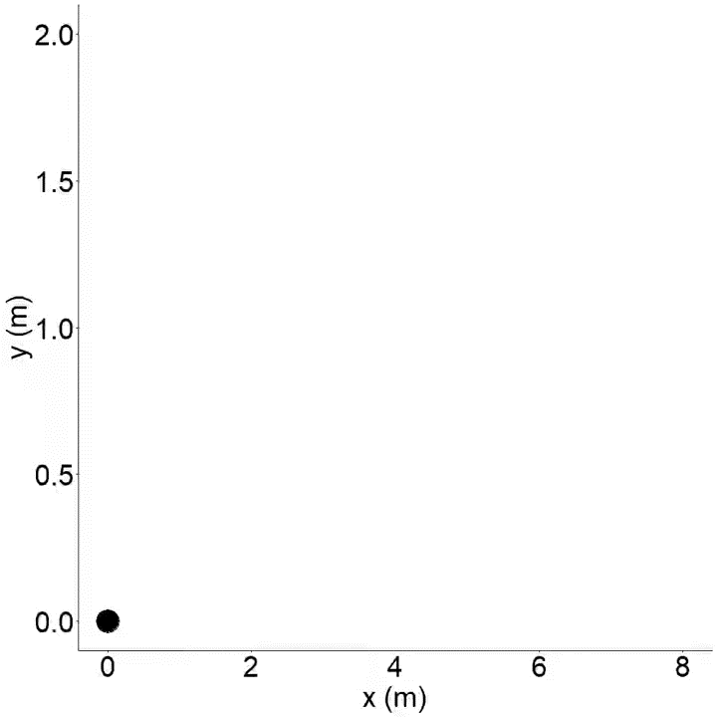
How to get at the Standard Deviation?
Timing errors in motion extrapolation can have different sources:
Estimating the distance to be convered by the object
Estimating the tangential speed before disappearance
Extracting estimate of vertical speed from tangential speed
Motor response
Gravity prior
Identify all other sources of error remaining error is due to gravity prior

Slide 6
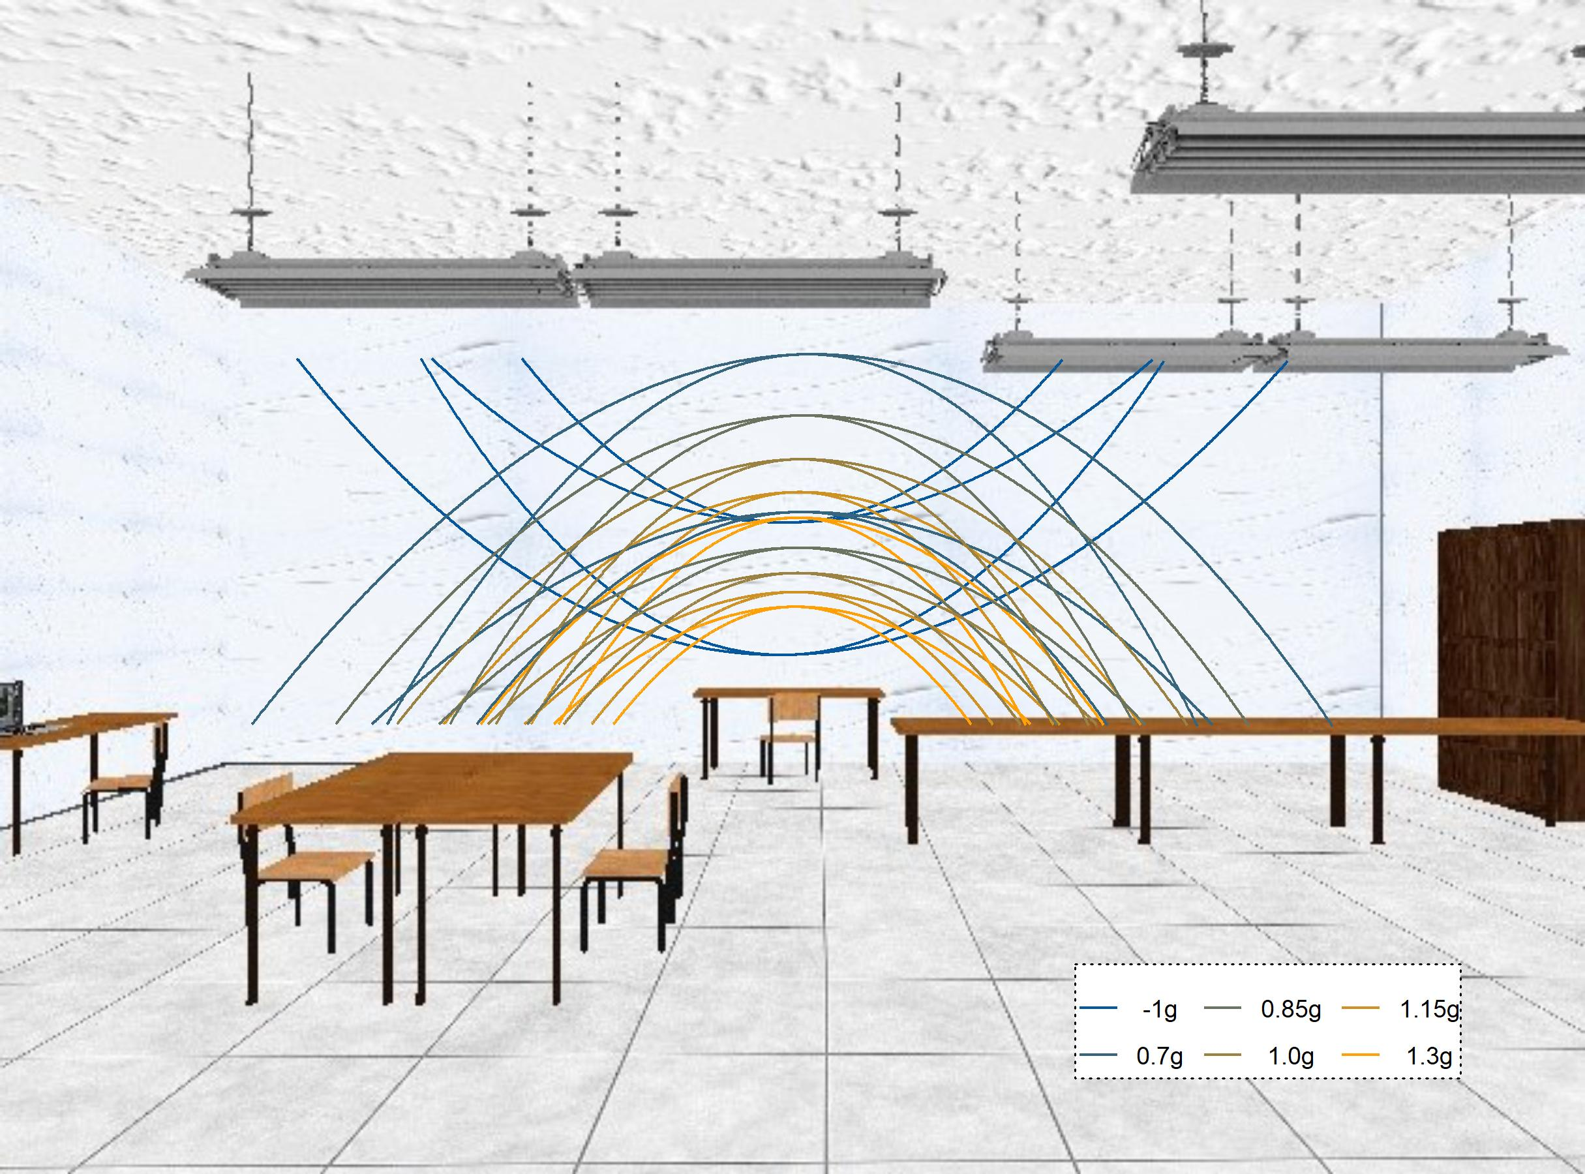
The Experiment
Timing Task for parabolic motion in fronto-parallel plane
Ball disappears some way through the trajectory: early or late
Two initial vertical velocities, two initial horizontal velocities, 6 gravities (0.7g, 0.85g, 1g, 1.15g, 1.3g, -1g)

Slide 7
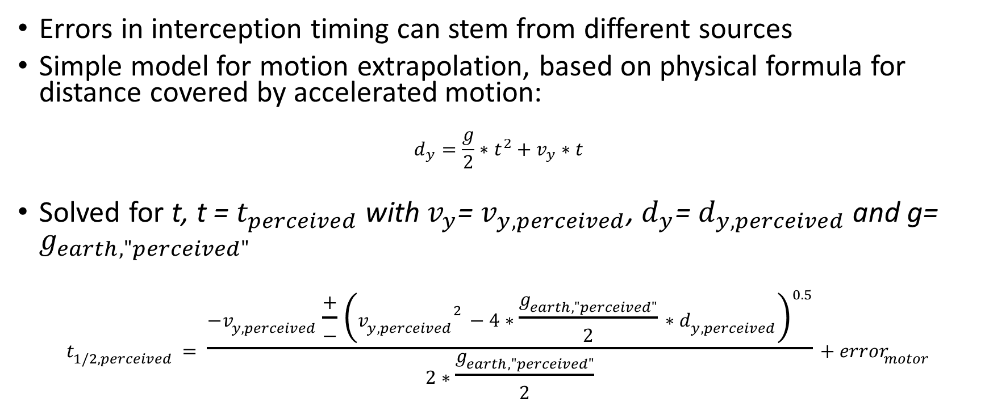
The Plan
Errors in interception timing can stem from different sources
Simple model for motion extrapolation, based on physical formula for distance covered by accelerated motion:
$$d_{y}=\frac{g}{2}∗t^{2}+v_{y}∗t$$
Solved for t, t = $t_{perceived}$ with $v_{y}$= $v_{y, perceived}$, $d_{y}$= $d_{y, perceived}$ and g= $g_{earth,"perceived"}$
$$t_{1/2,perceived}= \frac{−v_{y, perceived}\frac{+}{−}{\left({v_{y, perceived}}^{2}−4∗\frac{g_{earth,"perceived"}}{2}∗d_{y, perceived}\right)}^{0.5}}{2∗\frac{g_{earth,"perceived"}}{2}}+{error}_{motor}$$

Slide 8

Sources of error
 | Mean | SD
Distance to be convered by the object | Presented distance | Weber fraction of 5-7%
Tangential speed before disappearance | 80% of presented speed | Weber fraction of 5-10%
Angle between tangential speed vector and vertical
Motor response: to be estimated from -1g/1g block
Abitrary Accelerations | Presented acceleration | 20% of presented acceleration
Remaining error | TBD | TBD
Gravity prior

Slide 9
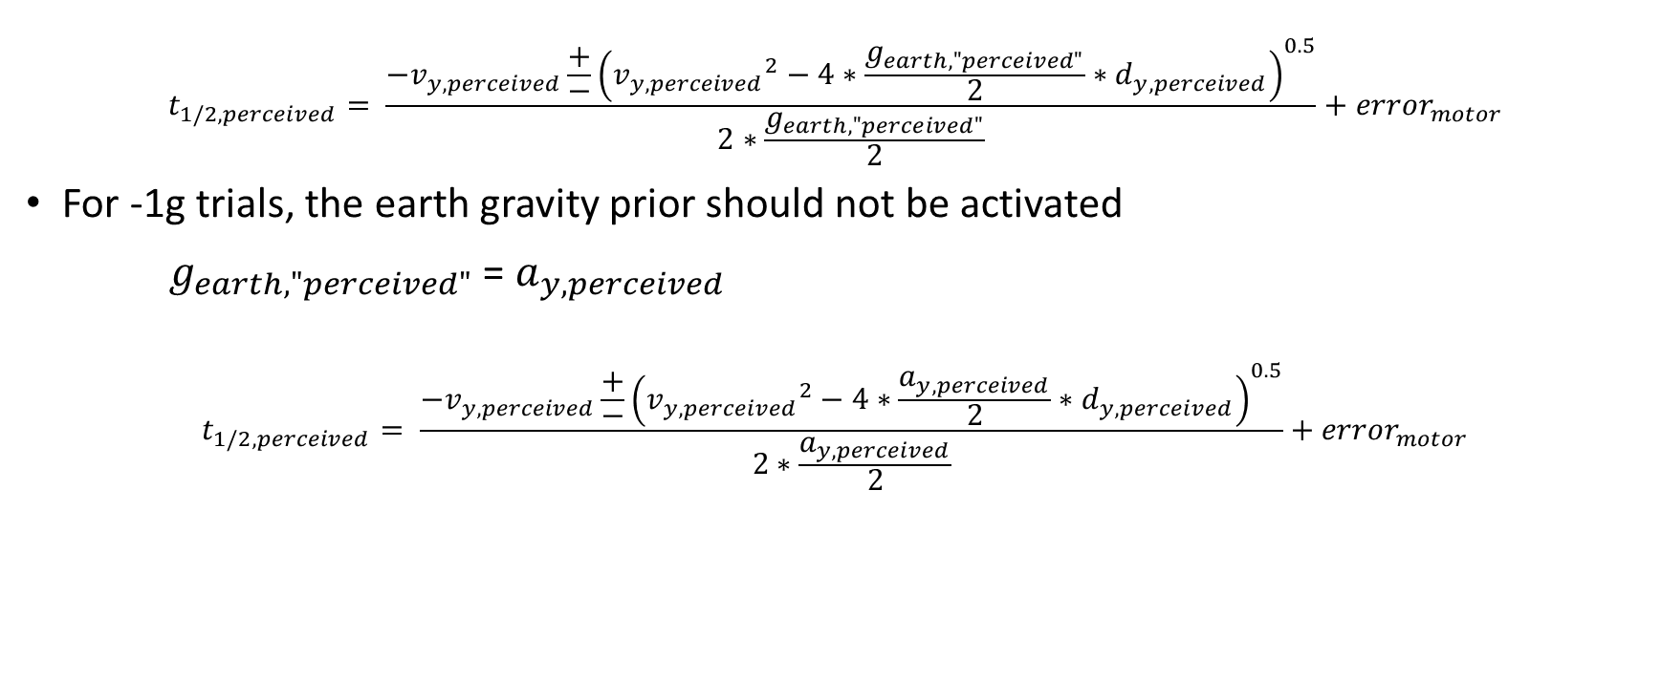
Motor Error
$$t_{1/2,perceived}= \frac{−v_{y, perceived}\frac{+}{−}{\left({v_{y, perceived}}^{2}−4∗\frac{g_{earth,"perceived"}}{2}∗d_{y, perceived}\right)}^{0.5}}{2∗\frac{g_{earth,"perceived"}}{2}}+{error}_{motor}$$
For -1g trials, the earth gravity prior should not be activated
$g_{earth,"perceived"}$ = $a_{y,perceived}$
$$t_{1/2,perceived}= \frac{−v_{y, perceived}\frac{+}{−}{\left({v_{y, perceived}}^{2}−4∗\frac{a_{y,perceived}}{2}∗d_{y, perceived}\right)}^{0.5}}{2∗\frac{a_{y,perceived}}{2}}+{error}_{motor}$$

Slide 10
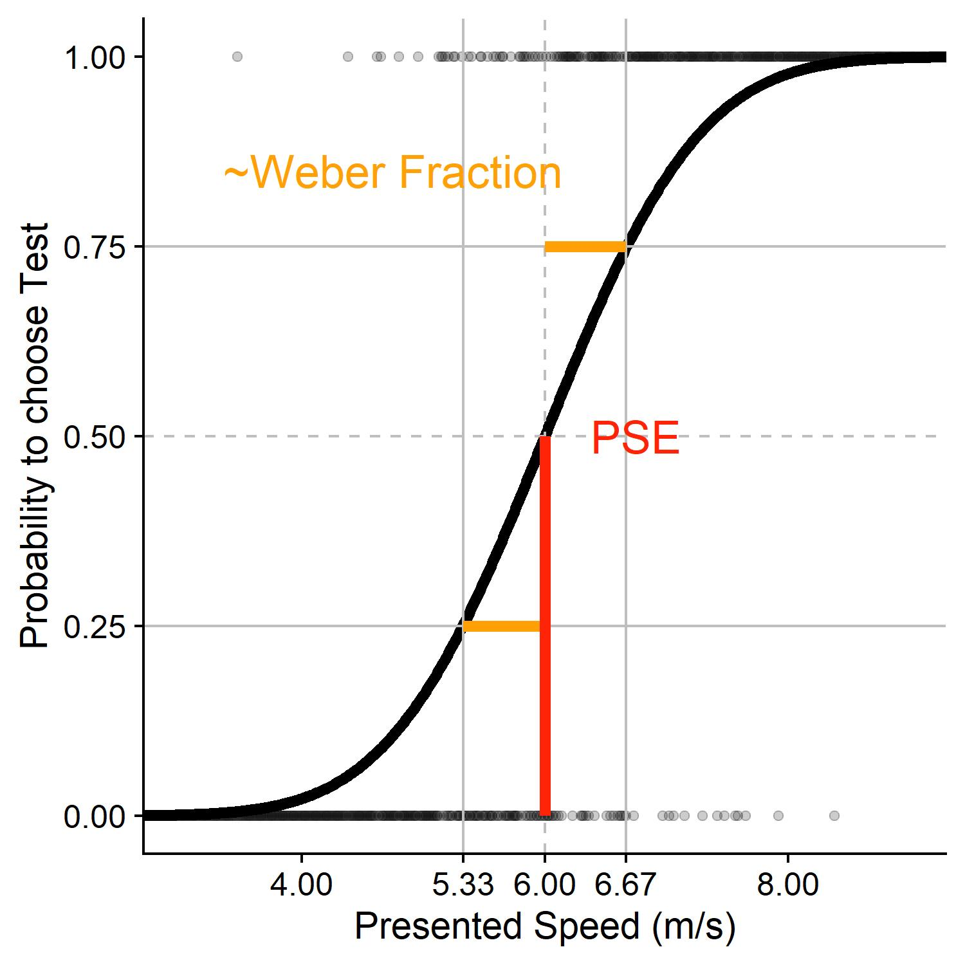
Standard Deviation vs. Weber Fraction
PSE:
6 m/s
Weber Fraction:
(6.67-6)/6 = 11%
Standard deviation:
That standard deviation that produces 25/75% probability at a presented speed difference of 11% from PSE
16% of PSE in this case

