Slide 1

























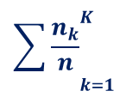




Swap
Sort $↓$
Average
(3)
(2)
Assign weights to clients according to sorting order
Sort loss in ascending order
Model weights are averaged
(2)
$$C^{1}$$
$$C^{2}$$
Or
Server Side
$$Δω^{3}$$
$$Δω^{k}$$
$${ loss}^{3}$$
$${\sum{\frac{n_{k}}{n}}}_{k=1}^{K}$$
$${ loss}^{2}$$
$$w_{t+1}^{k}$$
$${ loss}^{k}$$
$${loss}^{1}$$
$$Δω^{2}$$
$$Δω^{1}$$
$$C^{k}$$
$$C^{3}$$
(4)
(3)
Send weights back to clients
Send weights back to clients
Clients send their local models
(1)
${loss}^{1}$
$${ loss}^{k}$$
$$Δω^{1}$$
$$Δω^{2}$$
$${ loss}^{2}$$
$${ loss}^{3}$$
$$Δω^{k}$$
$$Δω^{3}$$
Client Side
$$C^{1}$$
$$C^{2}$$
$$C^{3}$$
$$C^{k}$$

Slide 2





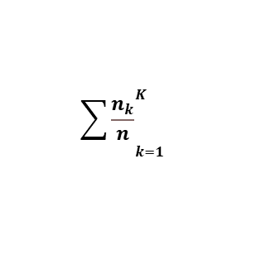








Swapping
Or
Averaging
Best:${ loss}^{3}$
$$Δω^{3}$$
Worst: ${loss}^{1}$
$${\sum{\frac{n_{k}}{n}}}_{k=1}^{K}$$
$$Δω^{1}$$
$$w_{t+1}^{k}$$
Best:${ loss}^{2}$
$$Δω^{2}$$
Worst: ${ loss}^{k}$
$$Δω^{k}$$

Slide 3
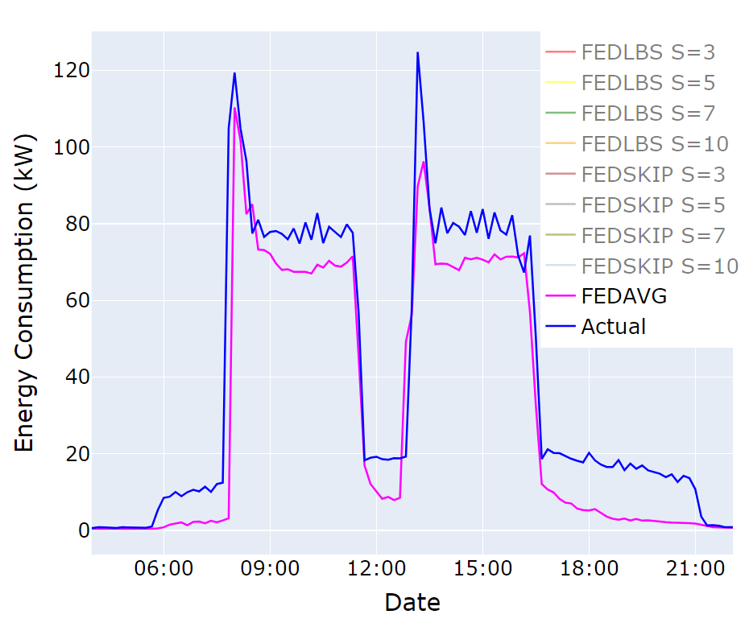

Slide 4
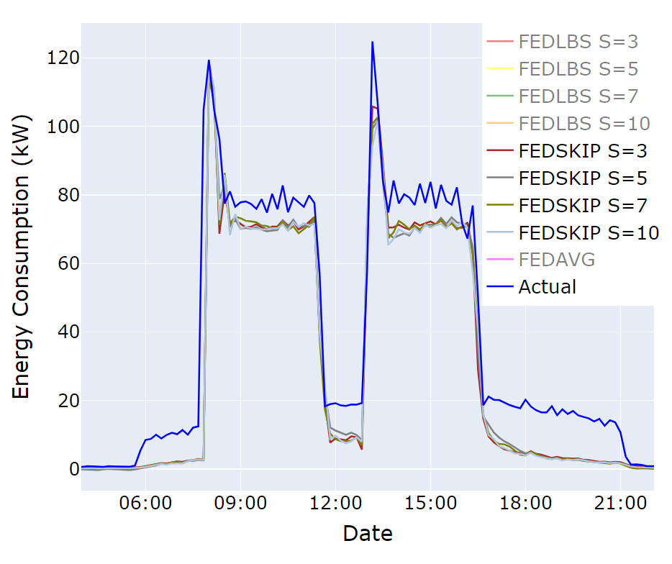

Slide 5
