Slide 1
L.A.S.E.R.
Los Angeles Strategic Extraction and Restoration

Slide 2
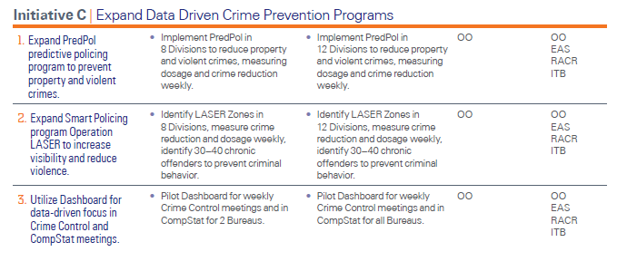
Strategic Goal 1 | Reduce Crime and Victimization

Slide 3
Operation LASER+
Core Principles:
Use laser-like, non-invasive techniques to rid areas of crime and criminals
Use appropriate data and analysis to drive decision making
Measure what matters
Focus on results and outcomes
Continue to follow Constitutional Policing

Slide 4
Winning Elements
Use of Crime Intelligence Details (CID)
Identify hot spot corridors and maintain them for 9-12 months
Create Chronic Offender bulletins and assign them to patrol and special units
Collect and analyze data throughout the intervention period
Direct regular patrol, bikes, and foot patrol into the hot spot corridors

Slide 5
Dosage
Dosage refers to the amount of visible police presence spent in a LASER zone. Early in the LASER program, many believed that just spending time in a zone would reduce crime. Although there is a correlation between visible police presence and crime, we found that presence alone was not enough.
The time spent in a LASER zone should match the time and day of when the analysis showed crime occurring. LASER zones are based on a historical pattern of crime.

Slide 6
Chronic Offender Bulletins
A chronic offender bulletin is the result of work done by crime intelligence analysts. Based on a daily review of dozens of field interview cards, arrests, and incident reports, analysts identify a person who has been active and could be engaged in violent criminal behavior. The analyst conducts a 'work up' to determine whether the person has been involved in a violent crime, has any prior arrests for a handgun, is a gang member, or is on probation or parole. Further, the analyst determines the number of 'quality' police contacts in the last two years. These contacts are based on FIs, arrests, and other reports.

Slide 7
Chronic Offender Criteria
In Los Angeles a crime intelligence analyst at each Division creates a minimum of 12 chronic offender bulletins. (More bulletins are created to serve as substitutes for offenders who are arrested, in custody, or left the area).
For the 12 chronic offender bulletins, individuals are rank-ordered based on the following point system:
5 points if the individual is a gang member
5 points if the individual is on Parole or Probation
5 points if the individual had any prior arrests with a handgun
5 points if the individual had any violent crimes in his rap sheet
1 point for every “quality” police contact in the last two years (FIs, arrests, etc.)

Slide 8
Actions on Chronic Offender
Captains at each Division determine which units or persons are responsible for a chronic offender. Usually a special unit (gangs, narcotics, or Parole Compliance units) is assigned a group of offenders and must report on their progress in handling offenders.
These special units have done the following types of activities:
1. Letters to the offenders.
2. Within the LASER Zones do door knocks - talk with whoever is there. Let them know we are aware of them and offer services.
3. Warrant checks.
5. Parole/probation checks.
6. Updates every two weeks to discuss what was done with each chronic offender.
-How many chronic offenders have been arrested in the last two weeks?
-How many chronic offenders has your group made contact with?
-What is the status for each offender?
-What are your strategies for your outstanding offenders?

Slide 9
Anchor Points
An “Anchor Point” is a location in a LASER Zone that officers identified as possibly being responsible for the crime. An “Anchor Point” can be a business, residence or gathering place.
Areas are being asked to identify their Top Five “Anchor Points” and prepare strategies to address the issues. Strategies can include;
      Abatements/evictions
      Licensing/Conditional Use Permits
      Changes to environmental design

Slide 10
QUESTIONS?

