Slide 1
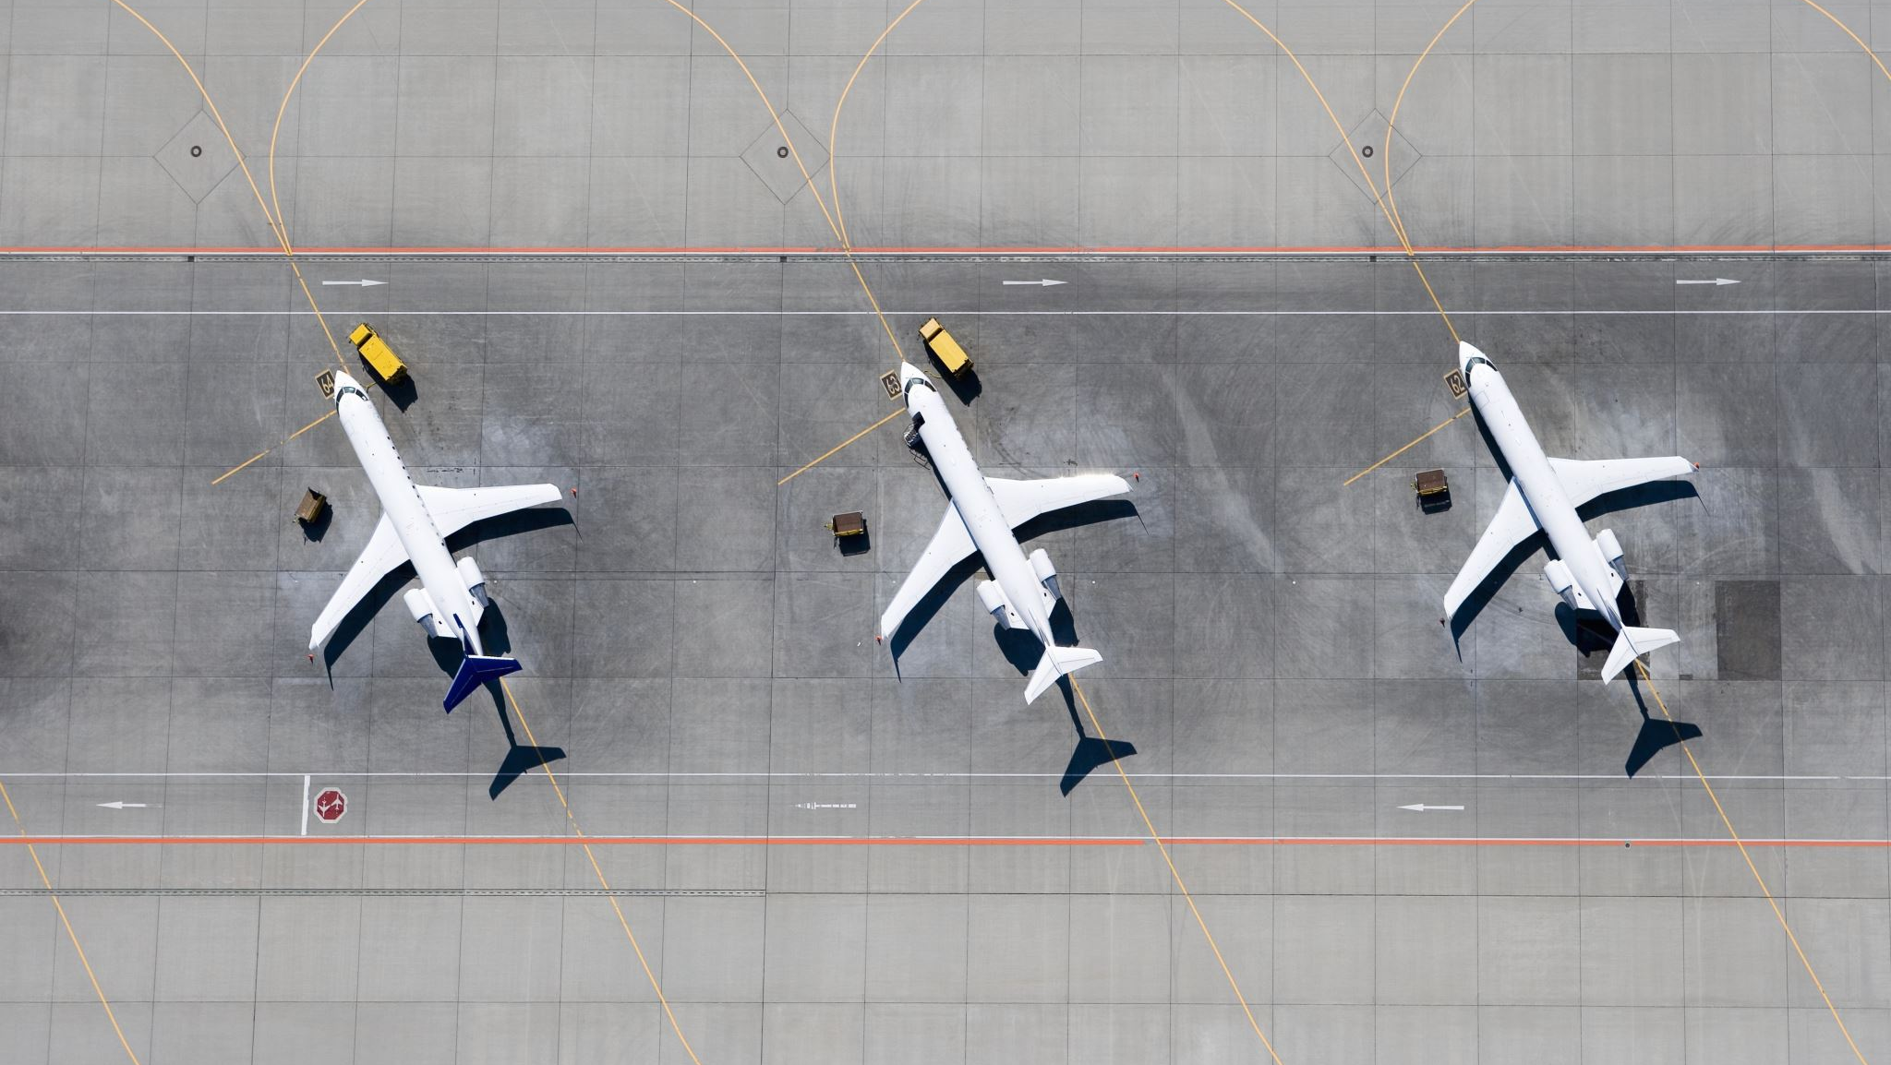
Air Traffic Incidents 2000-2022
Ben MacDonald, CW2

Slide 2
Intro
Individual aircraft incidents and associated factors
2000 to 2022
Primarily categorical data that required significant cleaning to be useable
Ground casualty figures were excluded as most were purely coincidental
Includes military, private, passenger, and cargo flights

Slide 3
Air Traffic Incidents by the numbers
Average flights per year (2000-2022): 28.3 million
Average incidents per year: 215
Non-fatal incidents: 73.6%
Fatal incidents: 26.4%
Total occupant loss: 67.3%
Partial loss: 32.7%

Slide 4
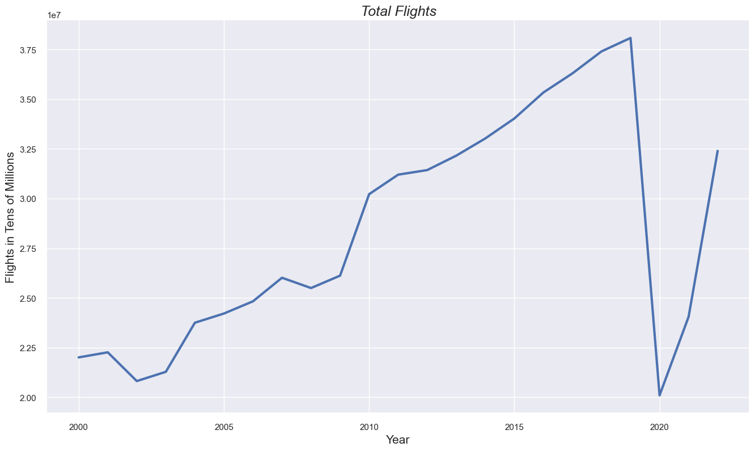
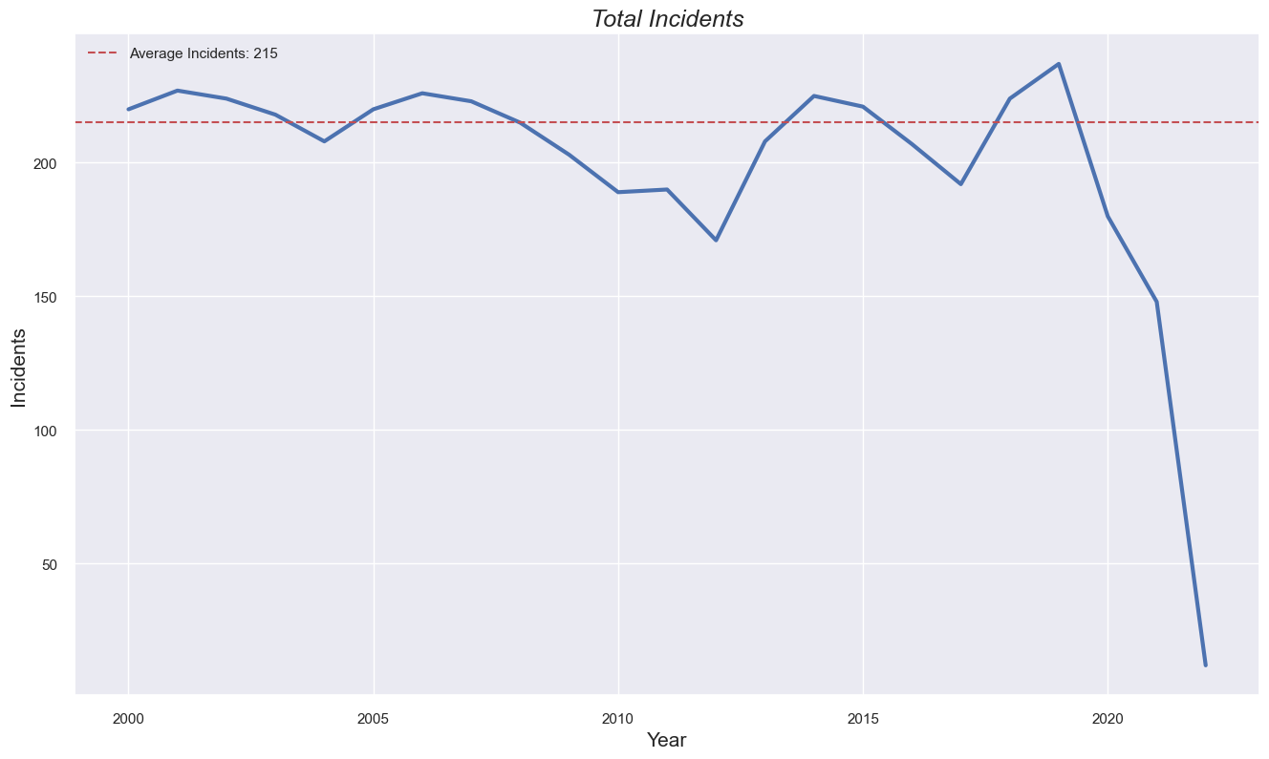
Air Traffic Incidents by the numbers
Covid-19
Covid-19

Slide 5
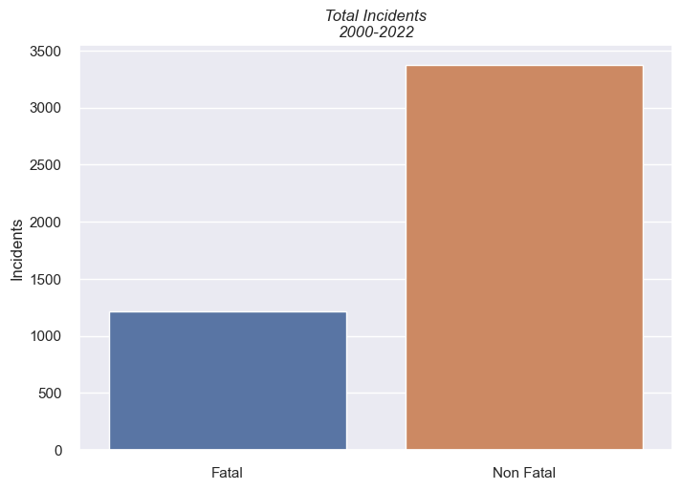
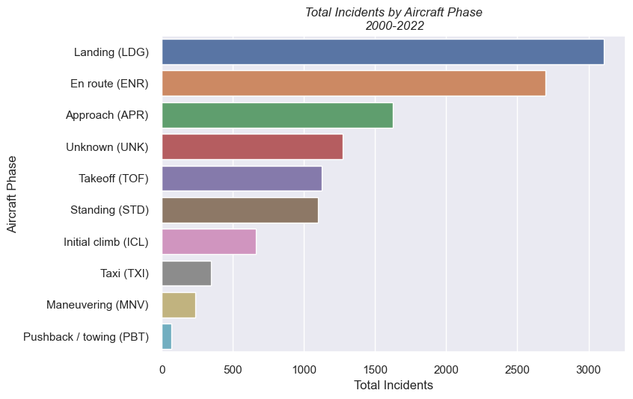
Air Traffic Incidents by the numbers
73.6% of incidents were not fatal
26.4% were fatal
Most incidents occur during flight and landing phases

Slide 6
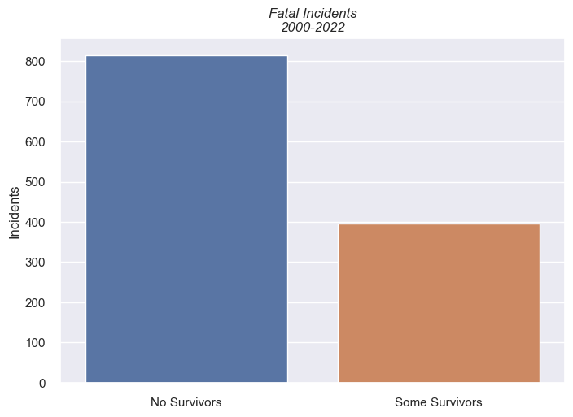
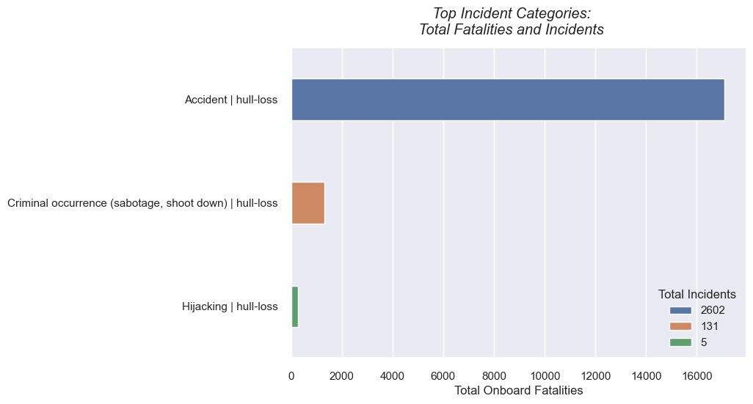
Air Traffic Incidents by the numbers
67.3% of fatal incidents had no survivors
32.7% had some

Slide 7
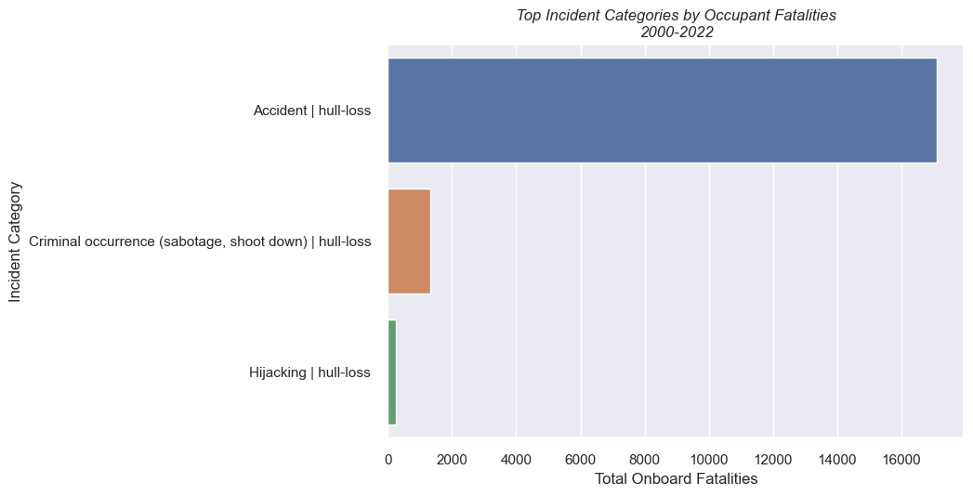
Air Traffic Incidents by the numbers

Slide 8
Hypotheses
Null:
Incident causes have no influence on fatal occurrences
Alternate:
Incident causes have a significant influence on fatal occurrences

Slide 9
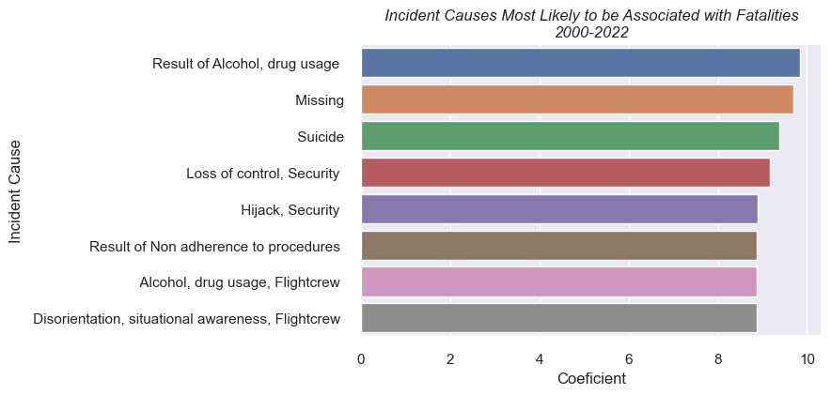
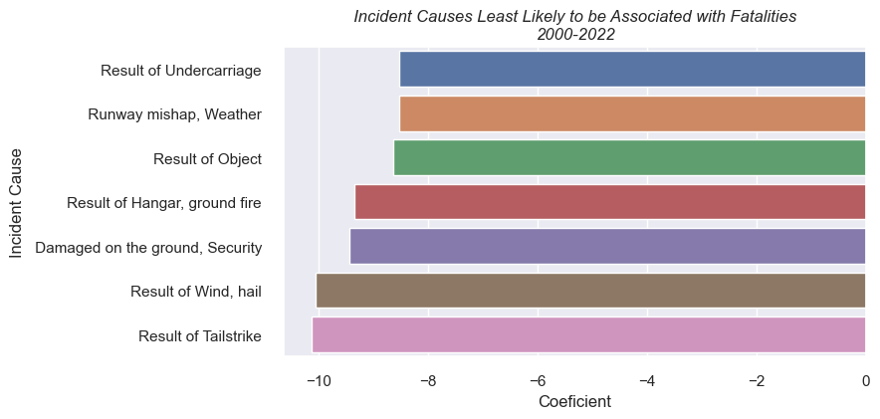

Hypothesis revisited
Null:
Incident causes have no influence on fatal occurrences
Alternate:
Incident causes have a significant influence on fatal occurrences
x

Slide 10
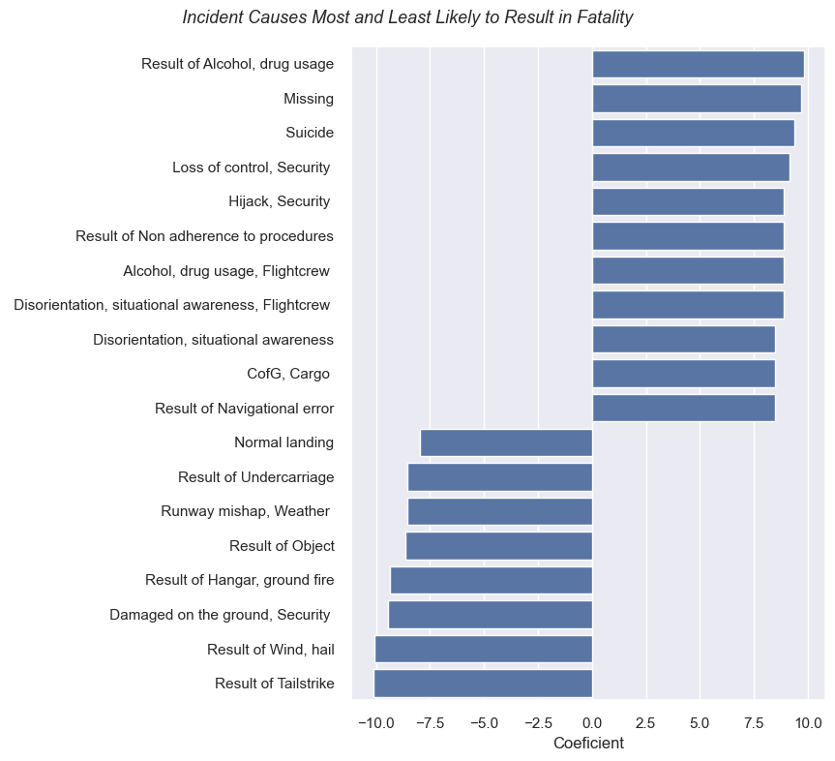
Hypothesis revisited
Most Likely
Null:
Incident causes have no influence on fatal occurrences
Alternate:
Incident causes have a significant influence on fatal occurrences
x
Least Likely

Slide 11
Key Findings
Air travel is very safe
Most accidents do not result in fatalities
When there are fatalities, there tends to be a total loss of occupants
Incident causes are a statistically strong predictor of whether an incident will result in fatalities or not

Slide 12
Information
GitHub Repository:
https://github.com/b-macd/Air_Travel_Safety_Analysis
Datasets:
https://www.kaggle.com/datasets/deepcontractor/aircraft-accidents-failures-hijacks-dataset
https://data.worldbank.org/indicator/IS.AIR.DPRT
Contact:
benjamin.t.macdonald.mil@army.mil

Slide 13
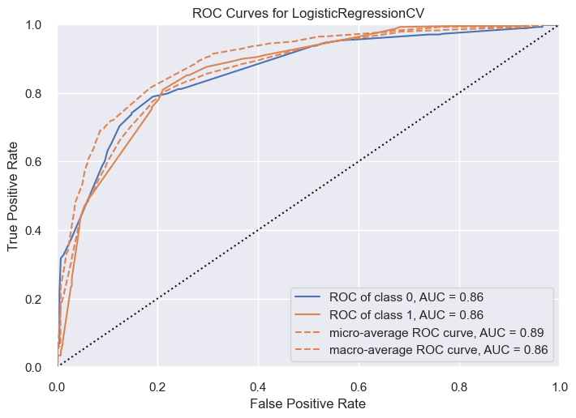
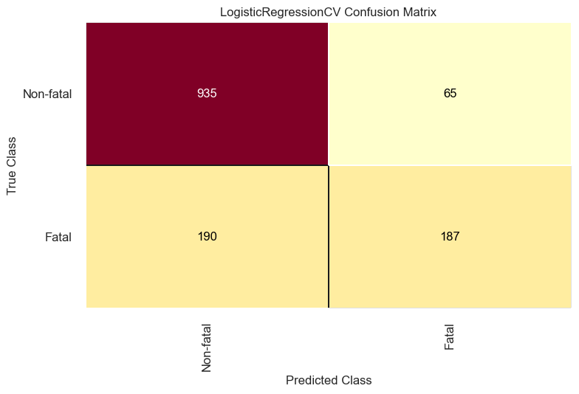
Appendix

Slide 14
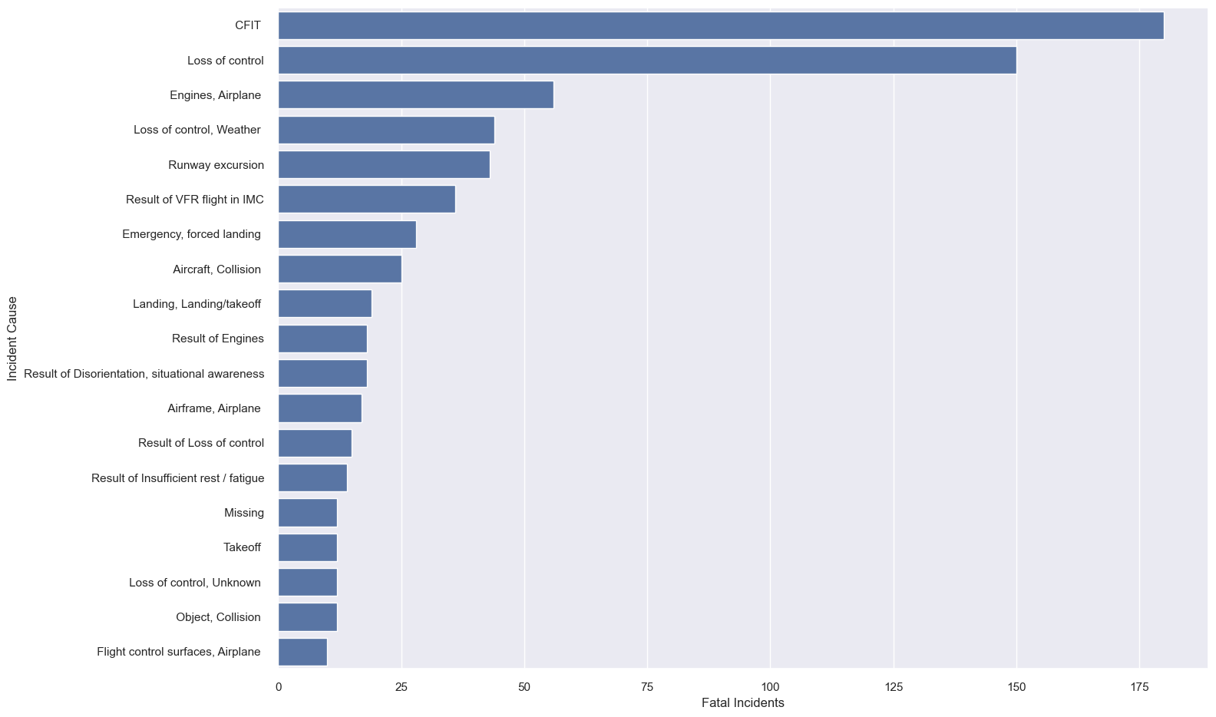
Appendix

