Slide 1
Air Traffic Incidents 2000-2022
Ben MacDonald, CW2

Slide 2
Intro
Data covers time period from 2000 to 2022
Data was primarily categorical and required significant cleaning to be useable
Chose not to use ground casualty figures as most were purely coincidental

Slide 3
Hypothesis
Null: Incident causes have no influence on fatal occurrences
Alternate: Incident causes have a significant influence on fatal occurrences

Slide 4
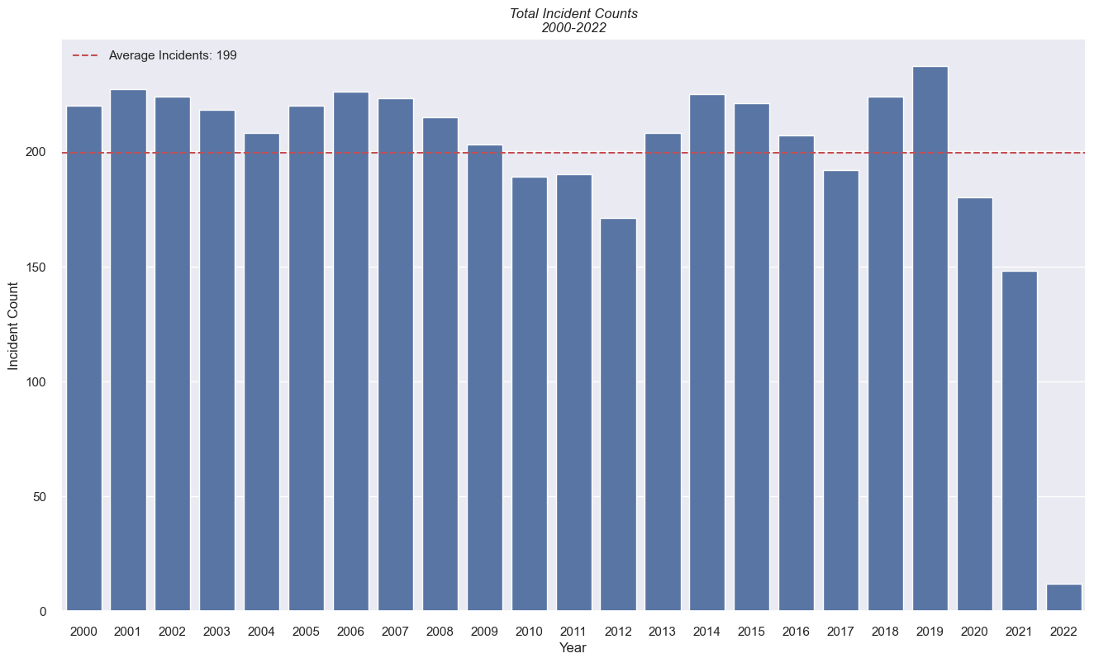
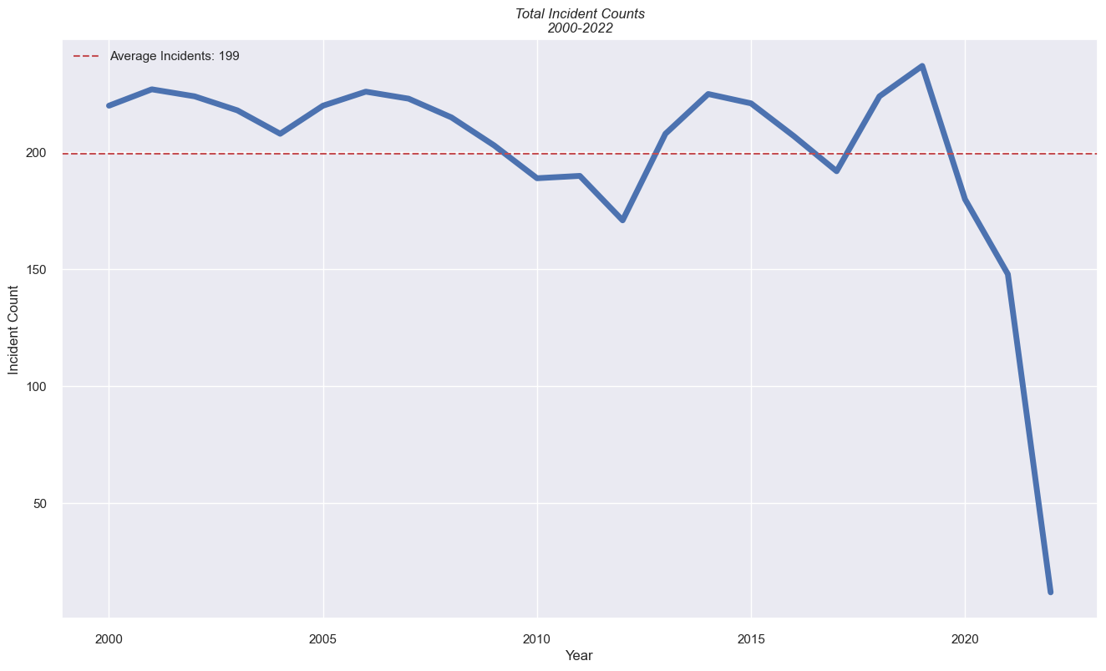
1st graph

Slide 5
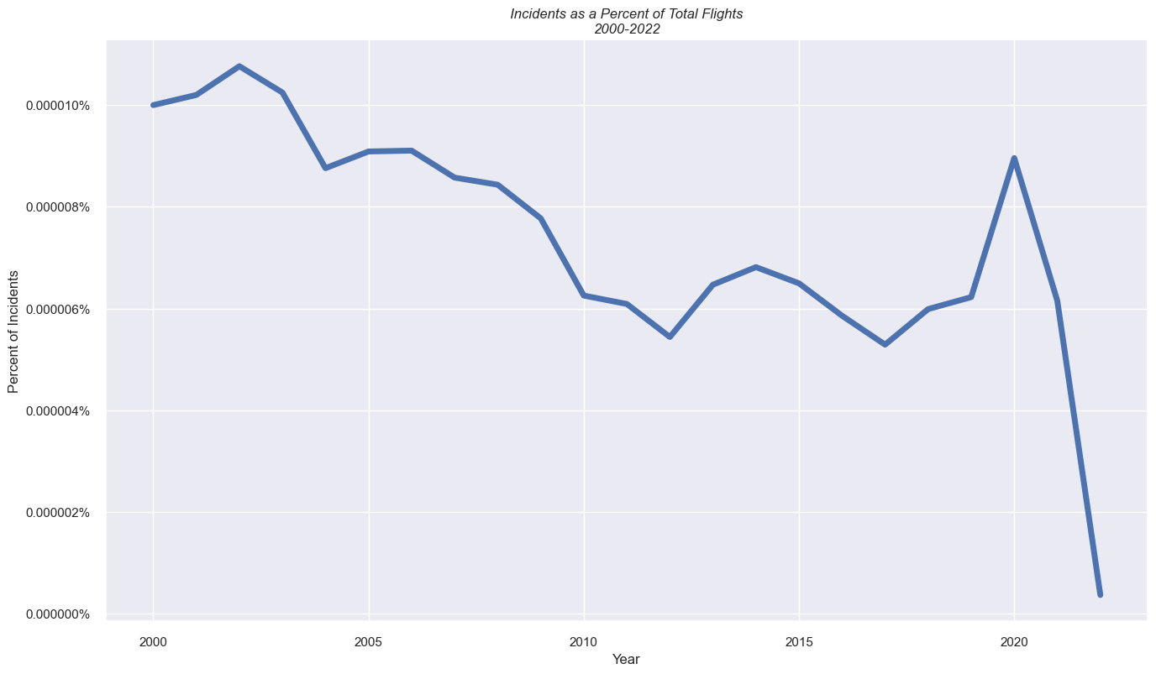
2nd graph

Slide 6
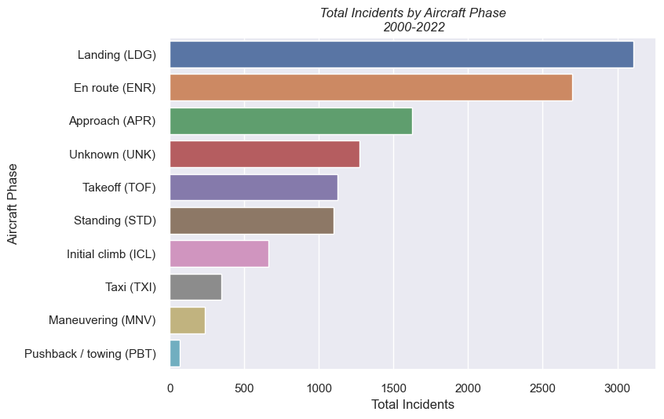
Conclusion slide

Slide 7
