Slide 1

Customer
Customer called and disputed the transaction to Credit Union
Send the response with Case Details to Track Further
Start
Darwin System
Enter Dispute details/ Create Case
Receive Disputes through Emil/ Fax
Co-Ops
(Financial Services)
FIS/ FDR
Login to FIS/ FDR and find the transaction
Acquirer Bank
Submit the CB representment
Co-Op Analyst
Login to Mastercam
MasterCom to validate the received CB representments
Submit CB details
Co-Op Analyst Decision
Co-Op Analyst
Login to Visa Reserve
VISAReserve to validate the received CB representments
File the 1st CB to Acquirer from FIS/ FDR.
Received CB representment is satisficed
Co-Op Analyst
Decision
Yes
Claim Loss to Credit Union
No
Updates in Darwin on case updates regarding CU claims
Arbitrator will decide on claim in Visa Reserve/ Master Com
Dispute the CB Representment
and Submit for Pre-Arbitation
Pre-Arbitration
End

Slide 2
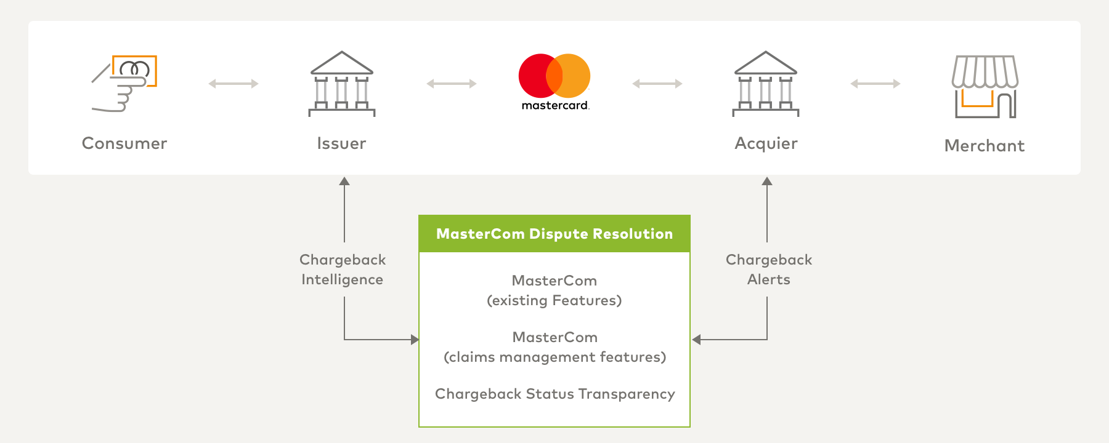
MasterCom workflow

