Slide 1
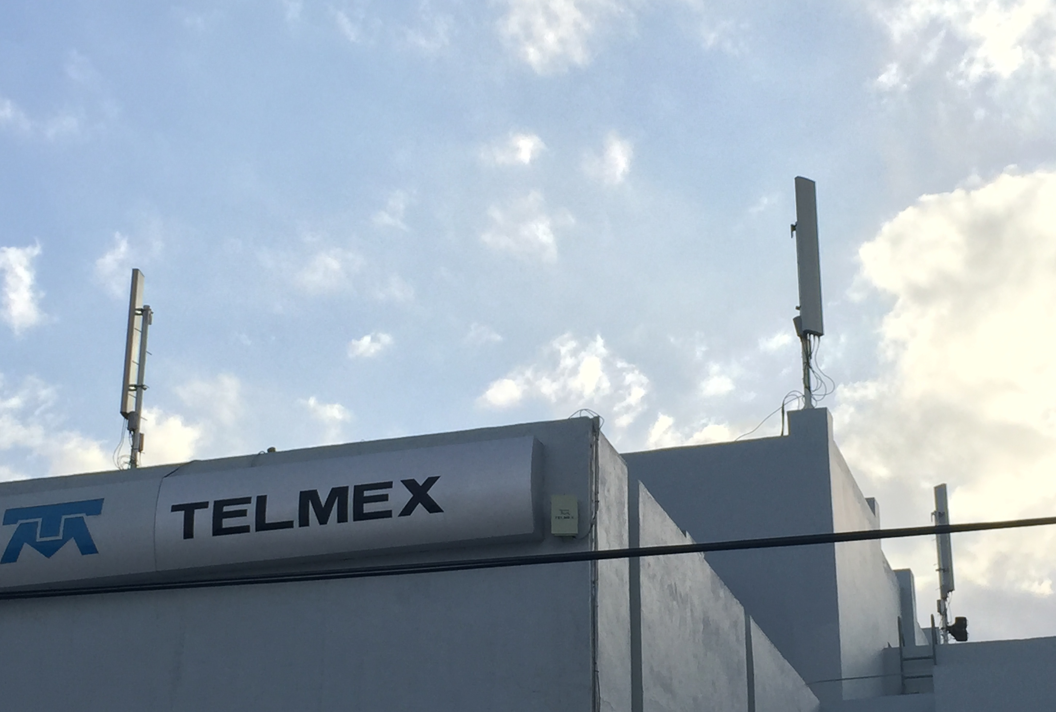
Active Cellphone Site Simulators
Freddy Martinez
4554 DB89 B856 F6E7 487D 59BF F319 5C29 2A82 2EF5
@B_meson

Slide 2
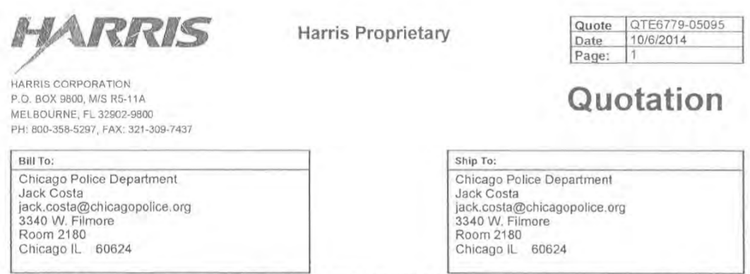

Slide 3
Overview
Our FOIA work
Stingrays / IMSI Catchers
Physical Stack
Electronic Signature of GSM
Detecting GSM disruptions
  Software
  Hardware
Notes:
This talk was motivated by a conversation I had at THOTCON last year about IMSI catchers “Is there a way to detect them?”
I just continued to drink my beer and thought about it
Assuming we are seeing active / hybrid attack with stationary targets.

Slide 4
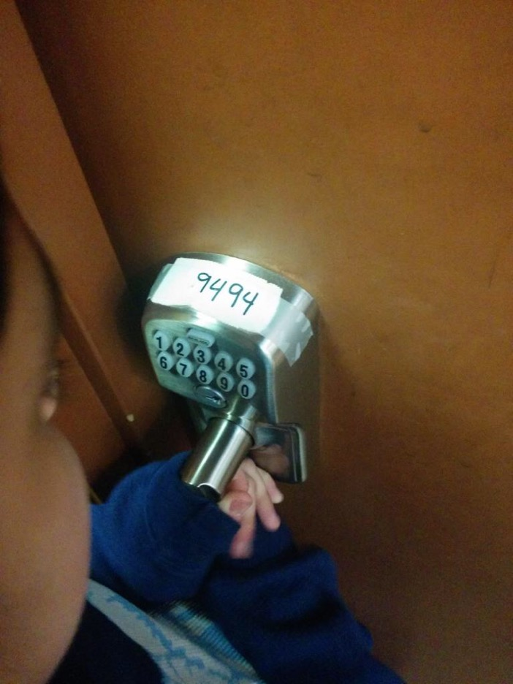
Biography
Physicist
Linux System Admin by night
“A skinny fidgety twenty-seven year old” – VICE
Notes:
Physicist
Privacy, Open Source, and digital rights by day

Slide 5
IMSI: Who you are
Uniquely identify your phone
Example IMSI: 3104108154071743
  MCC 310 USA
  MNC 410 AT&T GSM 850 / GSM 1900 / UMTS 850 / UMTS 1900
  MSIN 8154071743
Notes:
International Mobile Subscriber ID → phone number on the SIM card.
IMSI for unknown person with physical surveillance three times will deanonymize a user 80% of the time
Country Code, Carrier, Capabilities (for example AT&Ts 2G was shutdown a few years ago) and the phone number for routing via SMS

Slide 6
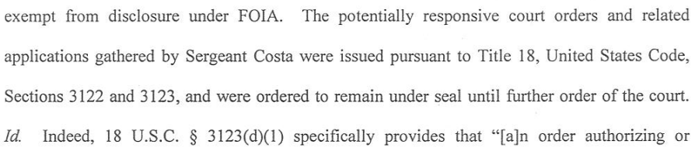
Chicago FOIA Work
After previous denials, lawsuit uncovered at least 2-3 Stingrays
  Funding came from asset forfeiture
Hailstorm upgrade purchased in Oct 2014
CPD obtains PR/TT see IL SB2828
Notes:
Lied to the press but you have to sue.
NDA agreement FBI, Harris and CPD. (2nd or 3rd call after our lawsuit files was CPD & FBI0)
Early Adopters
200K spend on defending a basic public records request

Slide 7
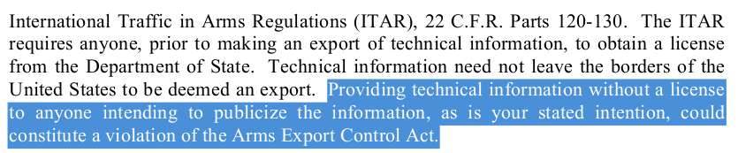
FOIA Work (Cont)
Contract btw CPD and Harris state they can't disclose to courts they own HailStorm
CPD claims no records of anyone checking IMSI catchers in / out.
Notes:
Court orders are sealed until whenever
Publishing FOIA documents online same as exporting munitions. “International Arms Exporter via the Internet” is hilarious
See Bernstein vs State Department.
IL law requires a warrant for GPS tracking with exception to “organized crime”, huge carve out.

Slide 8


Slide 9
Pen Register/Trap and Trace
Lower legal standard than search warrants. Requires only that information be “relevant and material to an ongoing investigation”
After 2001, PR/TT began being used for cell tracking
See also: No “reasonable expectation of privacy” after handing off data to 3rd party (Smith v. Maryland)
Notes:
Anyone know what happened in 2001?
PR/TT under US PATRIOT ACT and SCA
Discussion of Smith v Maryland in 2007 with WITT team
Police are third parties

Slide 10
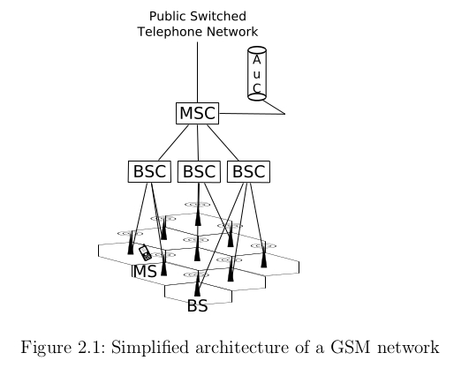
GSM Simplified
[6]
Notes:
MS – Mobile Subscriber – Cell Phone.
BS or BTS Base Transceiver Station
BSC – MSC = LAC

Slide 11
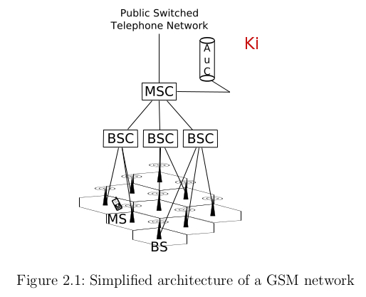
GSM Simplified
[6]
Notes:
MS – Mobile Subscriber – Cell Phone.
BS or BTS Base Transceiver Station
BSC – MSC = LAC

Slide 12
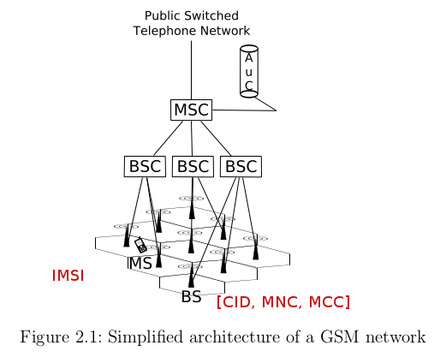
GSM Simplified
[6]
Notes:
MS – Mobile Subscriber – Cell Phone.
BS or BTS Base Transceiver Station
BSC – MSC = LAC

Slide 13
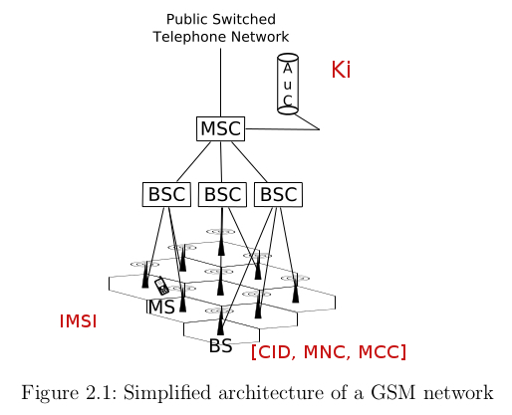
GSM Simplified
[6]
Notes:
MS – Mobile Subscriber – Cell Phone.
BS or BTS Base Transceiver Station
BSC – MSC = LAC

Slide 14
GSM Simplified
BTS (identified by Cell ID)
LAC (wider area multiple BTS operate on)
ARFCN: Absolute Radio-Frequency Channel Number
Authenticate to network via IMSI
  IMSI (International Mobile Subscriber Identity)
    TMSI (Temporary Mobile Subscriber Identity)
  Kc (Short-Term Encryption Key)
Notes:
Actual frequency tower operate on i.e. 900MhZ +/- an offset.
Ki (SIM card) → generate Kc hourly

Slide 15
Problems with GSM
Downgrade attacks (i.e. 3G jammers)
Many known weaknesses in encryption
Lack of Forward Secrecy
BTS decides encryption
BTS can say your TMSI is invalid
  So you had over your IMSI
Notes:
Fundamental Problem: No Authentication
in 2G. Similar to rouge AP
IMSI Catchers will be sold + 3G jammers
300,00K DTRBox – 80% of phones broken in >1 minute
Key theft → NSA means breaking of previously recorded comms
Base Transmission Station decides which cipher suits to use or can silently disable encryption completely
3G/4G there is an additional authentication mechanism.

Slide 16
Authentication
1. MS transmit IMSI
2. AuC generates RAND (128 random)
  A3(RAND,Ki) → SRES → BSC(RAND) → MS
  A8(RAND,Ki) → Kc → BSC
3. MS gets RAND
  A3(RAND,Ki) → SRES → BSC
  A8(RAND,Ki) → Kc → BSC

Slide 17
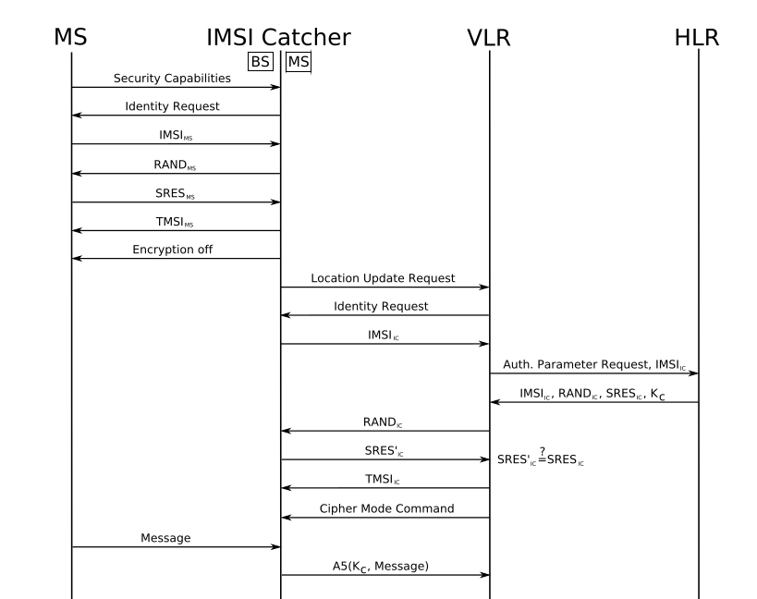
MiTM Attack

Slide 18
Motivations for Hostile BTS
Send Spam SMS messages
Pull IMSI without warrant
Gather routing metadata and/or content
  Stingrays can but no evidence police have the “upgrade”)
IMSI Catchers used by CIA / JSOC for SIGINT
Notes:
Raid on IMSI Catcher factory in China arrested 1000+ people.
Can get content but local cops probably get the shitty stuff.
IBIS II → Modify messages in real team Send message

Slide 19
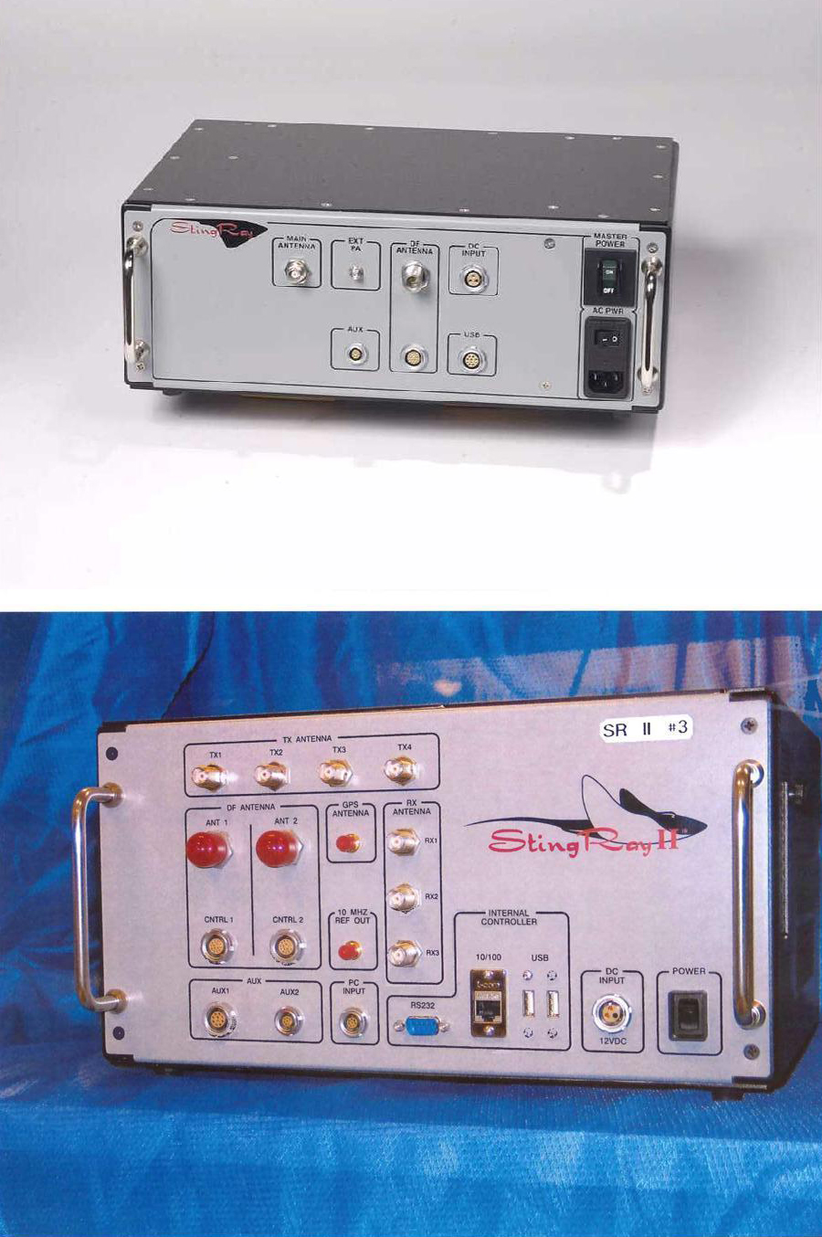
Stingray / Hailstorm
Notes:
Lots of upgrades available
Antennas, 4G upgrades, etc. Only as useful as the upgrade packages you buy...
Body-worn IMSI catchers
IBIS II, DRTbox, a lot of different manufacturers

Slide 20
Capabilities
Catch dialed numbers, IMSI, etc after a call is placed (passive)
Force registration on phones (active)
  CELL_RESELECT_HYSTERESIS dB of fake BTS exceeds value defined in BCCH
Force phones to transmit at full output
  C2 = C1 + CELL_RESELECT_OFFSET - TEMPORARY OFFSET * H(PENALTY_TIME - T) for PENALTY_TIME <> 11111
  TEMPORARY_OFFSET applies a negative value for PENALTY_TIME
Notes:
At minimum two modes for Stingrays.
IBIS II (different models) can do this.
Every 5s the phone calculates the value of C1 (path loss criterion parameter)
and C2 for the serving and non serving cells.
The value of C2 is defined as follows.

Slide 21
Other capabilities
Capture / modify content in real-time
Initiate calls from target without consent
Force phone to ring (?)
Malware (?)
Notes:
IB II
Hailstorm – Reported briefly in Baltimore.
OTA updates from tower. DEF CON talk about pushing binaries to SIM cars (ToorCamp).

Slide 22
Detecting a Disruption
New LAC appears
New CID or CID = (empty)
Broadcast on new ARFCN
GetNeighboringCell changes
  [<MCC>,<MNC>,<LAC>,<CI>,<BSIC>,<BCCH Freq>,<RxLev>... ]
Weighed averages to various events
Notes:
Parameters of “normal” values in Snoopsnitch
Long Delays in ACK from BTS
Problem: getting commands to/from the baseband
Baseband is proprietary and reverse engineered by Karsten Nohl / Tobias Engle in Qualcomm chipset

Slide 23
Software Countersurveillance
SnoopSnitch: Reverse engineering of low-level baseband.
  Bonus: Detects SS7 events
AIMSICD: Like SnoopSnitch an “IMSI catcher” catcher application for Android
Notes:
Requires root and / or sideloading a phone.
Access a lot low-level phone data your OS shouldn't really need (see all of Android application dev).
Buy a cheap burner phone. 80 bucks. Prepaid SIM card.

Slide 24
Hardware Countersurveillance
Adafruit 2G microcontroller wired to a Beagle Bone
Bunyan
  Logger of AT commands
Github → freddymartinez9
Notes:
SRD and GNURadio is awesome

Slide 25
Pseudo Code
PySerial.open(/dev/ttyS0,115200)
#Read Neighboring Cell
Pyserial.open(AT+CCED=1 \n)
time.sleep(waitTime)
# Signal Stregth shouldn't fluctuate drastically
if(RSSI_current-5 < RSSI_previous || RSSI_current+15 > RSSU_previous)
f.write('UNUSUAL RSSI FLUCTUATION \n')
f.write(localtime = time.asctime( time.localtime(time.time()) ))
RSSI_current=RSSI_previous
else
time.sleep(waitTime)

Slide 26
Miscellaneous / Future Work
Finding attacks "in the wild" remains elusive
  We are looking now
Dialing 911 forces de-registration
Need micro-controllers in 3G/LTE bands
Notes:
Reverse engineering blackboxes
SnoopSnitch #Nice
DoS them back

Slide 27
References
[0] Snoop Snitch.
https:// opensource. srlabs .de/projects/ snoopsnitch
[1] AIMSICD https://github.com/SecUpwN/Android-IMSI-Catcher-Detector
[2] “Mobile Self-Defense”. #31c3 Karsten Nohl
[3] “SS7: Locate. Track. Manipulate”. #31c3 Tobias Engel

Slide 28
References
[4] “Stingrays: The Most Common Surveillance Tool the Government Won't Tell You About” ACLU. https://www.aclunc.org/publications/stingrays-most-common-surveillance-tool-government-wont-tell-you-about
[5] “IMSI Catcher” Daehyun Strobel. Jul 2007 Ruhr-Universität Bochum
[6] “Introduction to GSM”
[7] “IMSI-Catcher and Man-in-the-Middle attacks” Dammann. 2011

Slide 29
References
[8] OsmocomBB http:// bb.oscom.org/trac
[9] “Stingray Talk” AACJ Winter Seminar. Daniel Rigmaiden
[10] “Your Secret StingRay’s No Secret Anymore”. 2014 Stephanie K. Pell & Christopher Soghoian

Slide 30
References
[11] “Cellular Dragnet: Active Cell Site Simulators and the Fourth Amendment”, Jan 2015. Aimee Thomson
[12] “Fake BTS Attacks of GSM System on Software Radio Platform”. Journal of Networks, Feb 2012 Song, Zhou, Chen

Slide 31
Thanks
THOTCON organizers
Drew Fustini
SSHc: Southside Hacker Space Chicago
Wally Valters & Matasano
Matt Topic (attorney Loevy & Loevy)

Slide 32
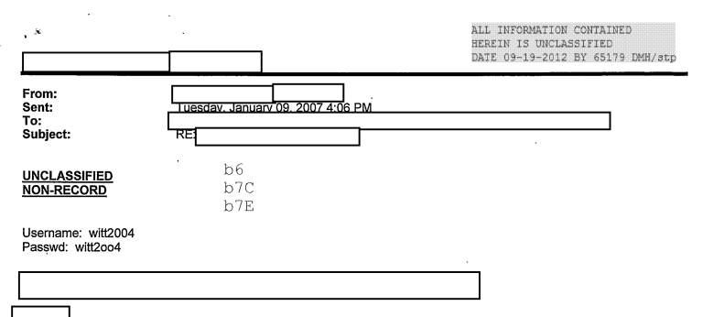
Questions?

