Slide 1
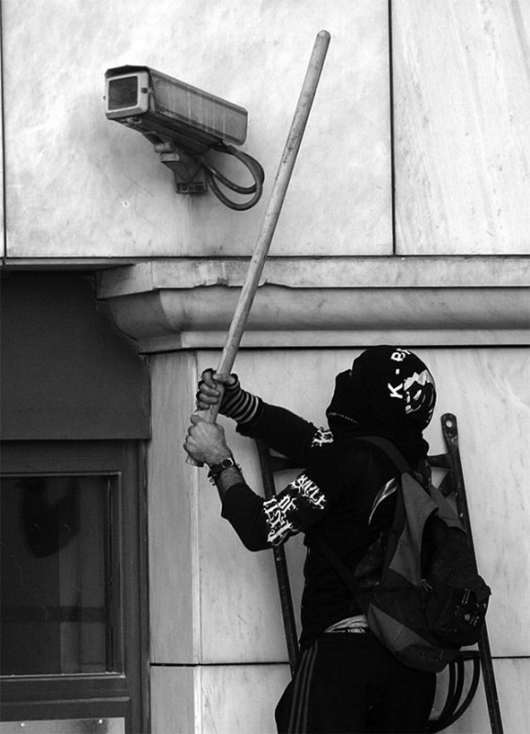
Security Culture
Chicago Cypherpunks Club
Freddy Martinez
Notes:
About me:
27 year old who works with in software industry
Interested in a variety of topics but lately focus has been GSM / telephony and security
Involved in Cryptoparty, Chicago LUG, etc.
Support journalists, activists, and other “dissent” groups to stay safe.

Slide 2
Why?
Going to jail sucks
Keeps you or your people out of jail
We don't have the backing of security state
Opening question: The best way for an adversary to gain sensitive information?
Notes:
Training Day Quote
Do you wanna go to jail or do you wanna go home.

Slide 3
Zero^{th} Rule

Slide 4
Zero^{th} Rule
Don't get caught

Slide 5
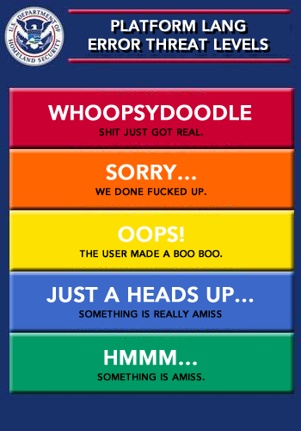
Threat Level: Midnight
Notes:
Threat modeling
What sensitive information do you have?
Who wants to access it? (Who is your adversary)
What are their capabilities?
How much can they hurt you with that information?

Slide 6
Operation Model
What are we trying to do?
How are going to try to do it?
How do we communicate?
Considerations:
When do we switch it up?
How do we clean up?
Consequences of your actions
Notes:
Next meeting time / location is at the top of the agenda.
Talk in person as much as possible.
Sanitizing after the fact is critical

Slide 7
Compartmentalize
Idea: Separate information into discrete and independent cells
Critical: Don't Cross Contaminate
See also: Ross Ulbricht / a.k.a. DPR / a.k.a. fr0sty / a.k.a. altoid
Notes:
R.Ulbricht got caught because he first registered on StackOverflow then changed his name to fr0sty.
Used fr0sty as his SSH key into the Silk Road servers
Google+ profile had same political / economics that DPR did
Strong beliefs can unmask users

Slide 8
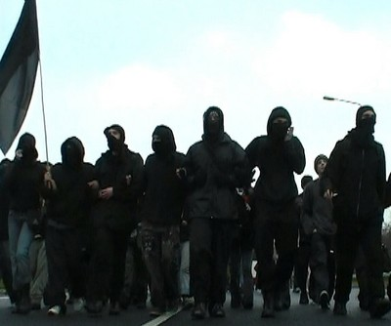
Identity Management
Anonymity is not enough
Change identities and unlink them
Notes:
”

Slide 9
Tactics Matter
Change them
  That's why they are tactics...
Never reveal your internal tactics (how...)
Never reveal your intended target(s) (who, where, when...)

Slide 10
The Wire: S03 E11
"Stinger's phone isn't on the same network as everybody below him."
"And Shamrock has a separate phone for calling [Stringer] Bell. We can't hear those calls because the system is compartmentalized"
Notes:
To catch Stinger Bell, BPD used a TriggerFish, the predecessor to the Stingray. Using an IMSI catcher, they quickly found his MIN.
With a Stingray, the IMEI would be the same, switching SIM cars wouldn't have worked.
Switch number and phone.

Slide 11
Cell phones
Idea: Your phone will burn you
Notes:
A joint CPD and DEA investigation using a Stingray ID'ed a phone number using “three points of physical surveillance an digital analysis”
Used that number to identify the whole cell.
Critical failure; Open Codes used to communicate.

Slide 12
Cell phones
Idea: Your phone will burn you
Lesson: Use a burner
Notes:
Don't:
Turn your burner on near your house, place of business, or that cafe you go to every Tuesday.
Mirror your clandestine cell phone
Do:
Pay cash at a small mom/pop store or pawn shop
Take the battery out

Slide 13
Cell phones
Idea: Your phone will burn you
Lesson: Use a burner
OpSec for telephony is very hard – you're doing it wrong
Critical: The dumber the phone, the smarter your security
Notes:
Real World Examples:
Bragging about illegal activities to impress a new partner.
P-IRA would sing songs in crowded pubs
Recently cartel members got arrested in Mexico because of bragging on Facebook and IG

Slide 14
Cell phones
“There's no pattern. Sometimes he calls every two weeks, sometime every three weeks. There's no consistency. I can't predict when he's going to make another call because the guy's erratic”
Zero Dark Thirty

Slide 15
STFU
Keep all information on a need to know basis
  Unless someone is sharing the risk (i.e. jail time) they don't need to know
Avon Barksdale: "Yo, y'all talk too damn much man" (S01E11)

Slide 16
STFU (Pt 2)
Lesson: Listen to Avon
Security failures happen all the time
Critical: You (or one of your people) only have to mess up once
Notes:
When you mess up, this is where compartmentalization helps contain fallout.
Keeps the amount of damage an adversary can do to manageable levels.

Slide 17
Logs
Idea: Don't Keep Them
Critical: No Logs, No Crime
Notes:
I've seen conversation via OTR logged.
I've seen DMs shared weeks or months later
Logs are great materials for lulz in jail.

Slide 18
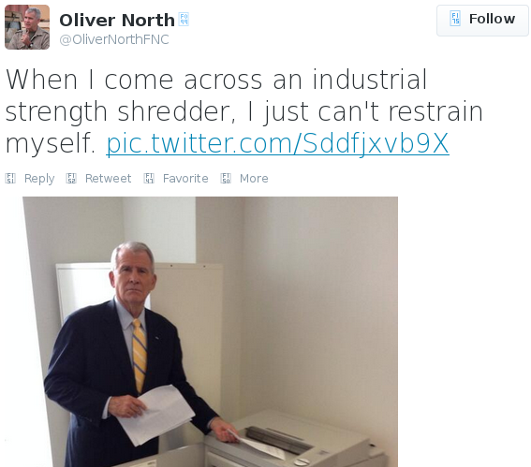
LOL rite?

Slide 19
Security Culture Cont.
Be cautious but not paranoid
Keep your personal life personal
Never talk to the police
It's your lawyer's job to talk to the police
It's your job to shut up
Notes:
Suspect had four encrypted hard drives and indicated to the police he knew the passphrases but did not give them the keys.
Mass. Sup Court ruled he had to give keys up because he indicated he knew keys.
Legal nuance he didn't know. It's for his attorney to use. He should shut up.
Use FDE and anti-forensics :-)

Slide 20
Final Thoughts
Fear leads to poor decision making
Trust your gut
You can't turn this shit on retroactively
Shut up

Slide 21
Links / Sources
Indymedia (Photos)
http://www.slideshare.net/grugq/opsec-for-hackers
http://grugq.github.io
“Rats! Your guide to protecting yourself against snitches, informers, informants, agents provocateurs, narcs, finks, and similar vermin” rats-nosnitch.com/rats/#ch3

Slide 22
Links / Sources
“Choosing Your Friends Wisely for Illegal Activities”
http://shawnewald.info/aia/sec_friends.html
The Back Door (Story about Hacker OpSec)
http://www.cjr.org/feature/the_back_door.php?page=all

Slide 23
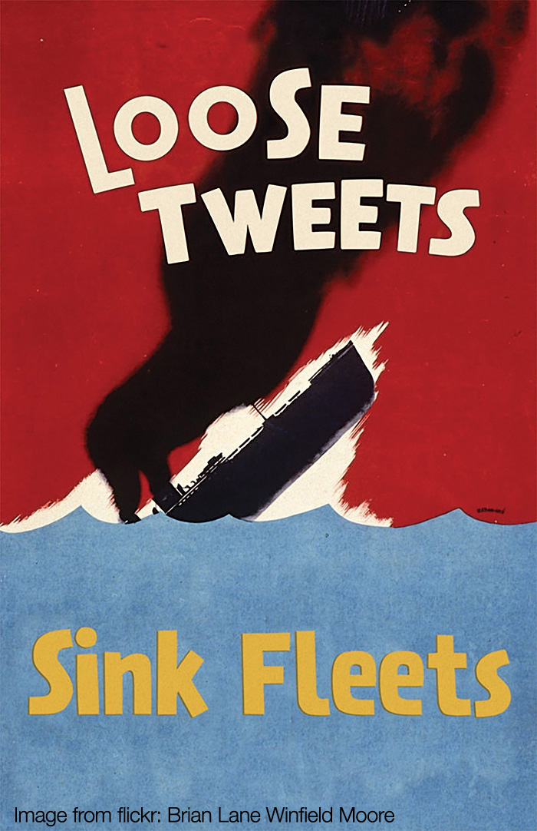
Questions?

