Slide 1
TextSecure:
Encrypting phone calls / messages
“I've been telling you your whole life, don't talk on the phone. Now you understand huh?”
Goodfellas
Freddy Martinez
Cryptoparty Chicago

Slide 2
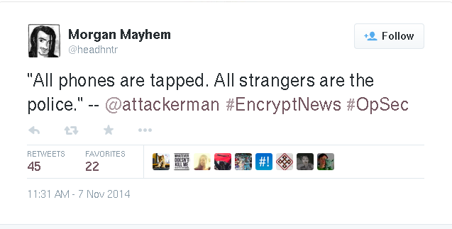
Reminder

Slide 3
Phones are not secure
A note about cell phones. Their principal function is location tracking. All other "features" are dependent on function
Never forget this fact
Seriously

Slide 4
Why do you need to encrypt?
MetaData Leaks (SMS)
    Carrier Choice
    Language
Lack of Forward Secrecy (Ki)
GSM is so badly broken
SMS spoofing attacks
Cryptanalysis
    DRTbox
    Rainbox Tables (Schneider 2008) A5/1

Slide 5
Surveillance Capabilities
NSA
    Ki Theft
    WOLFMARITE
FBI / LEOs
    CellBrite
    IMSI Catcher
    DRTBox
Google
    HangOuts
Apple
    iMessage Key Escrow or signed RAMdisk ?

Slide 6
Smartphone Store
TextSecure
    Encrypted Text Messages
Redphone (Android)
    Encrypted Phone Calls
Signal 2.0 (iOS 8)
    Encrypted Phone and Text

Slide 7
How Does 'It' Work?
Data channel between you and your recipient
Generate encryption keys for asynchronous delivery
Encrypted Database for message storing
Every next message is encrypted with a new encryption key (PFS)

Slide 8
Axolotol Ratchet
Public / Private Key pair doesn't work asynchronously
    Just add more keys!
    Root, Headers, Chain, Identity, Message Number
When keys don't match, ratchet forward
Establish next keys on read()
Jen: https://github.com/trevp/axolotl/wikicurs

Slide 9
What Does 'It' Support?
Encrypted messages
Unencrypted messages
Group Messaging
MMS (audio, video, images)
Can use any number for registration (i.e. burner)

Slide 10
How Does TextSecure Look
Interactive Part of the Talk
Padlock in message→ Encrypted

Slide 11
Signal
UI is so god damn dead simple it's not worth wasting time discussing it
Note: Long-Term Identity Keys are in the contact user name (open the chat, hover over their name)
Conversations can be put into history
No encrypted database ATM.

Slide 12
COMSEC
Caller reads the first word of the Short Authentication String
Call recipient reads the second word of the SAS
PFS is preserved so not possible to MiTM future calls
Do it anyways to establish duress

Slide 13
RedPhone / Signal
Use the regular dialer on your phone.
Application will prompt you if the caller is using Redphone / Signal

Slide 14
TroubleShooting
Group MMS gets broken in TextSecure
    Settings → Advanced → MMSC → URL
Switch between encryption modes
    SMS messages, long hold Press key
Quick Close Database
    Drag Down from the top

Slide 15
Future Work
Remove encrypted SMS
Merge TS / Redphone
PR welcome
Translations Welcome
WhatsApp Integration
TS servers (federated?)

Slide 16
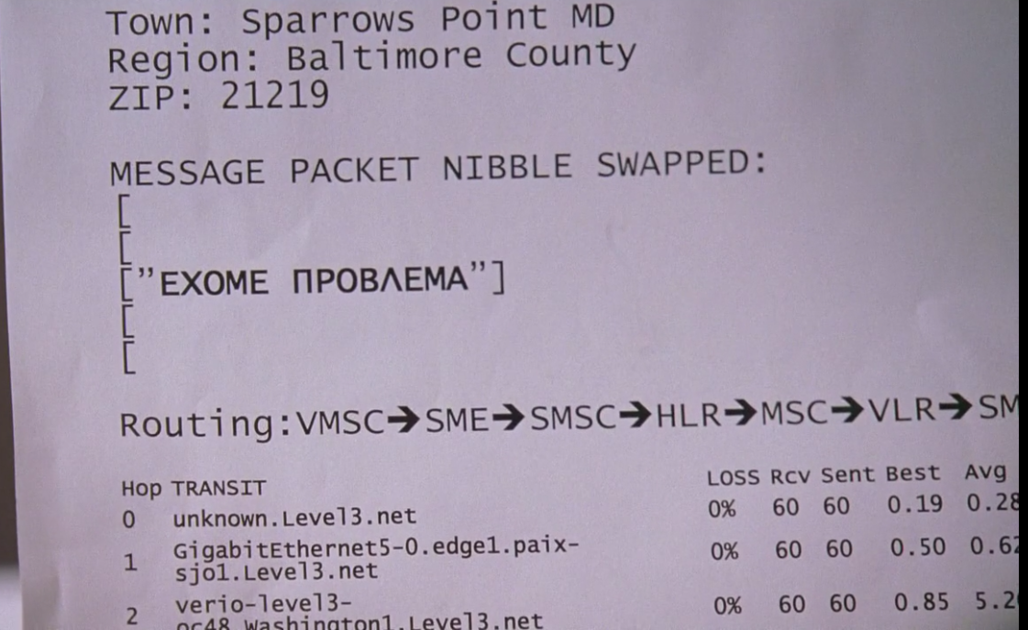
Questions?

