Slide 1
Tor
Common Non-Exit Configuration
Freddy Martinez

Slide 3
Tor: What it is
“Still the king of high secure (sic), low-latency Internet Anonymity”
Three Hop Network (Entry Guard, Middle Relay, Exit Node)
Great tool for people whom need strong anonymity

Slide 4
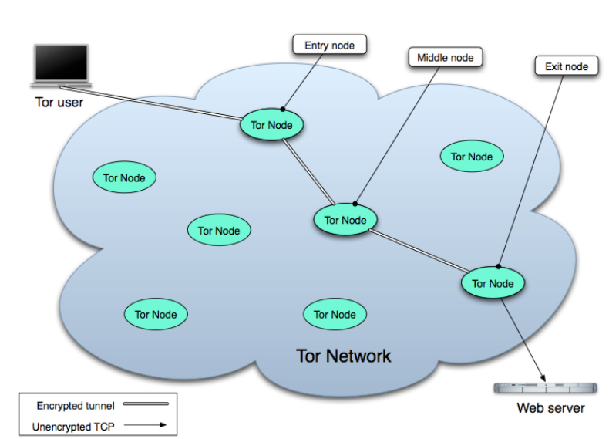
Tor

Slide 5
Tor: What It Isn't
Magic
Protect you from EPICFAIL
Remember
  OpSec
  OpSec
  OpSec

Slide 6
Tor

Slide 7
Vocabulary
Bridges – Relays that aren't listed in main Tor directory
Exit Relay – (aka exit node) the last hop out of network that visits end point (URL, IM service, forums)
Middle Relay – Intermediate relay(s) between user and exit relay
Hidden Service – “Non-public” address that is reachable only through Tor network (i.e. bczjr6ciiblco5ti.onion)
Tor Browser Bundle – suite of tools to make it easy to browse the “Dark Web”

Slide 8
Tor

Slide 9
Handshakes
Diffie-Hellman Key Exchange between nodes
Forward Secrecy
Relay connections self-destruct
Network grows as Nth to number of Nodes (n)

Slide 10
We'll cover
Basic Tor packages on a Debian Server
Quick and dirty server configurations
Basic Tor configurations
Ansible / Tor configurations
(Time permitting) Tor Browser Bundle

Slide 11
Configuring Tor on Debian
Security Advice: Don't run the Tor packages out of the repositories, they are out of date
Use Tor repository provided by Tor Project
Instructions are found on torproject.org or in the Notes to this slide.
Notes:
Edit sources to add packages
Add GPG keys for packages
gpg --keyserver keys.gnupg.net --recv 886DDD89
gpg --export A3C4F0F979CAA22CDBA8F512EE8CBC9E886DDD89 | sudo apt-key add
Update
Install repository to manage gpg keys
apt-get install deb.torproject.org-keyring
Install tor
apt-get install tor arm-cli

Slide 12
Server Configuration
Very basic (10 minutes) configuration
You can go wild with
  Chroot
  encrypted volumes
  /etc/shadow
It's highly recommended you use the server configuration to disable block certain ports like BitTorrent (it will demask you and overload the network)
Notes:
/etc/ssh.d/config
Visudo
Iptables -L
ufw

Slide 13
Configuring /etc/tor/torrc
Default file for configuration /etc/tor/torrc
Default Data Directory stored in $HOME/.tor
  Secret keys, relay fingerprints, statistics etc
Tor will run as a service out of /etc/init.d/tor
For our purposes we will rename torrc to tor{0-X}.cfg
  After talk note: don't do this unless you want to fight a bunch of user permission
Notes:
Chicago LUG has a Tor middle relay on our VPS:
ssh ubuntu-tor@166.78.248.26
Vim ~/torrc

Slide 14
Tor Weather
https://weather.torproject.org/subscribe
Email you alerts if your node goes down
Scan through the known and valid nodes
As your node gets added by Directory Authorities your bandwidth should increase

Slide 15
ARM
CLI tool for monitoring Tor relay
sudo apt-get install tor-arm
Managed by ControlPort in /etc/tor/torrc and HashedPassword
Try it: sudo arm

Slide 16
What's It Look Like?

Slide 17
Tor / Ansible
Ansible is an automated configuration management system
Possible to use Ansible to configure multiple Tor instances
Socks Proxy port binding (just bind Socks Proxy ports to 0)
User permissions
  Huge PITA
Notes:
/etc/init.d/tor stop;
Cd ~/;
Wget https://gist.githubusercontent.com/7adietri/9122199/raw/tor
Sudo chmod +x ~/tor
Sudo mv ~/tor /etc/init.d/tor
Socks Proxy
Chmod 555 /var/lib/tor/{,0-1}.cfg

Slide 18
Tor / Ansible
Replace the /etc/init.d/tor with this script:
https://gist.github.com/7adietri/9122199
It'll look for files with the following naming convention tor$.cfg in /etc/tor/ where $ is a number

Slide 19
Limitations
Bandwidth
AccountingMax
Directory Authority will ignore more than two relays from the same IP

Slide 20
Kernel Tweaks
sudo vim /etc/sysctl.conf
net.core.rmem_max = 16777216
net.core.wmem_max = 16777216
net.ipv4.tcp_rmem = 4096 87380 16777216
net.ipv4.tcp_wmem = 4096 65536 16777216
net.ipv4.tcp_no_metrics_save = 1\
sudo sysctl -p

Slide 21
Tor Browser Bundle
Lets you connect to Tor Network
Not the only way [IM, forums, IRC]
Check the developers sig
Uses NoScript and other add-ons for security (like HTTPS Everywhere)
Flash sucks, don't use it
Notes:
gpg --keyserver x-hkp://pool.sks-keyservers.net --recv-keys 0x416F061063FEE659
gpg --fingerprint 0x416F061063FEE659
gpg --keyid-format long --verify tails-i386-0.23.iso.sig tails-i386-0.23.iso

Slide 22

Heartbleed

Slide 23
Recovering the Network
Update those openSSL libraries
Remove that Data Directory
Move hidden services to new .onion
Vulnerable Directory Authorities are all banished
Relays that are vulnerable are blacklisted

Slide 24
Resources
https://www.torservers.net/wiki/setup/server#multiple_tor_processes
https://www.TorProject.org
https://gist.github.com/7adietri/9122199

