Slide 1

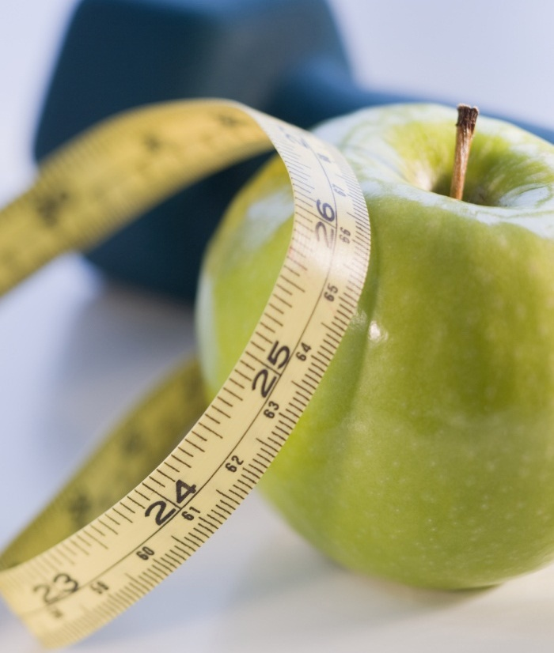

Work-life balance analysis
Group: Mohammadreza Bahmanpour, Lakshmi Korivi, Diksha Celene Kolabathula
Instructor: Hemant Purohit
CIS 5400 Final Project 04/20/2023

Slide 2
Contents
Objective
Motivation
Project RoadMap
Current Research Work
Existing Research Work
Conclusion

Slide 3
OBJECTIVE and Motivation
Objective - analyze how work-life balance can affect mental health.
identify the patterns and explore the potential impact of work-life balance on mental health.
Motivation – contribute to the creation of a healthier and more productive community

Slide 4
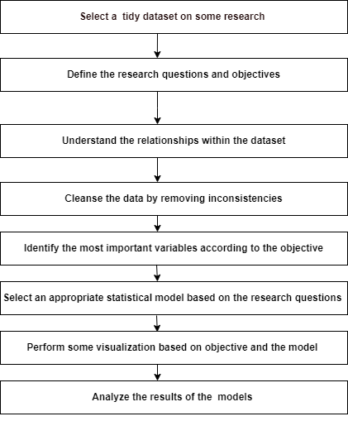
PROJECT ROADMAP

Slide 5
BUSINESS AND DATA UNDERSTANDING
Choose lifestyle and well-being dataset.
Conduct an initial exploration to understand the variables and their relations.
Define the business objectives - gaining insights into the lifestyle and well-being of individuals.
Define the research questions according to the objective.
Check for data inconsistencies.

Slide 6
CLEANSING
Search for any NA’s or inconsistent entry within the dataset
Develop a function to verify the Timestamp variable
Develop a function to verify all the numeric variables

Slide 7
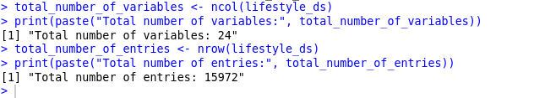
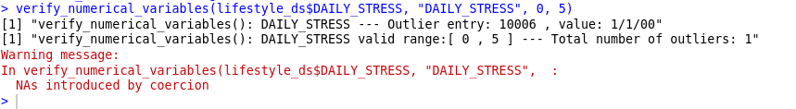
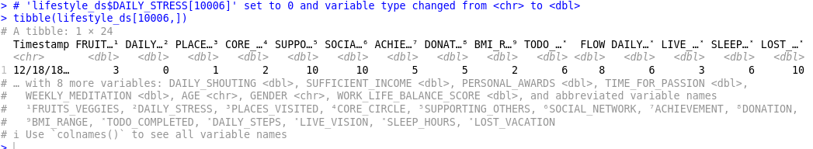
CLEANSING OUTPUT

Slide 8
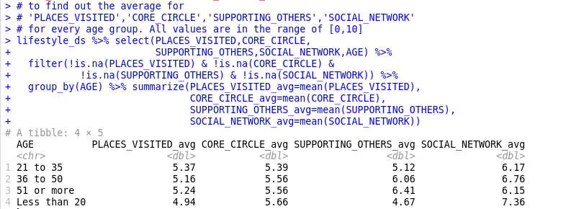
average for 'PLACES_VISITED’, 'CORE_CIRCLE’, 'SUPPORTING_OTHERS’, 'SOCIAL_NETWORK' for every age group. All values are in the range of [0,10]

Slide 9
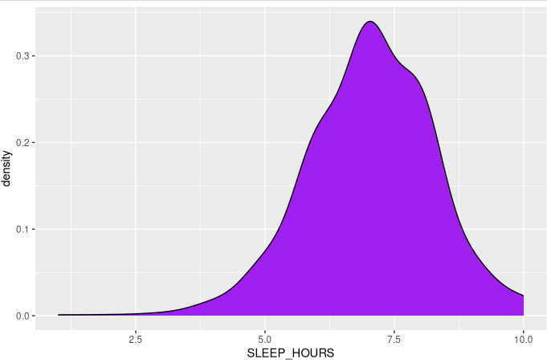
density for SLEEP_HOURS (range: [1,10])

Slide 10
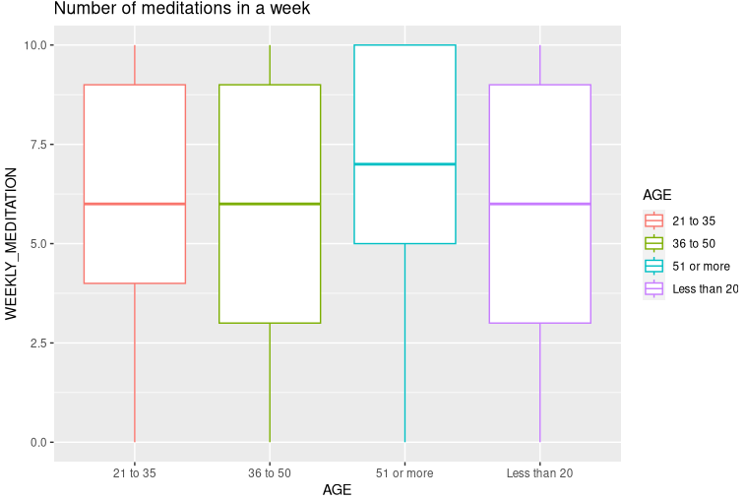
WEEKLY_MEDITATION (range: [0,10]) per AGE

Slide 11
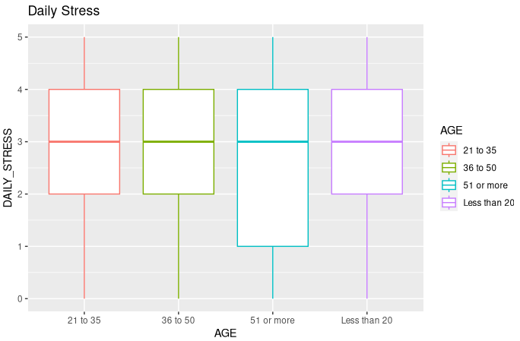
DAILY_STRESS (range: [0,10]) per AGE

Slide 12
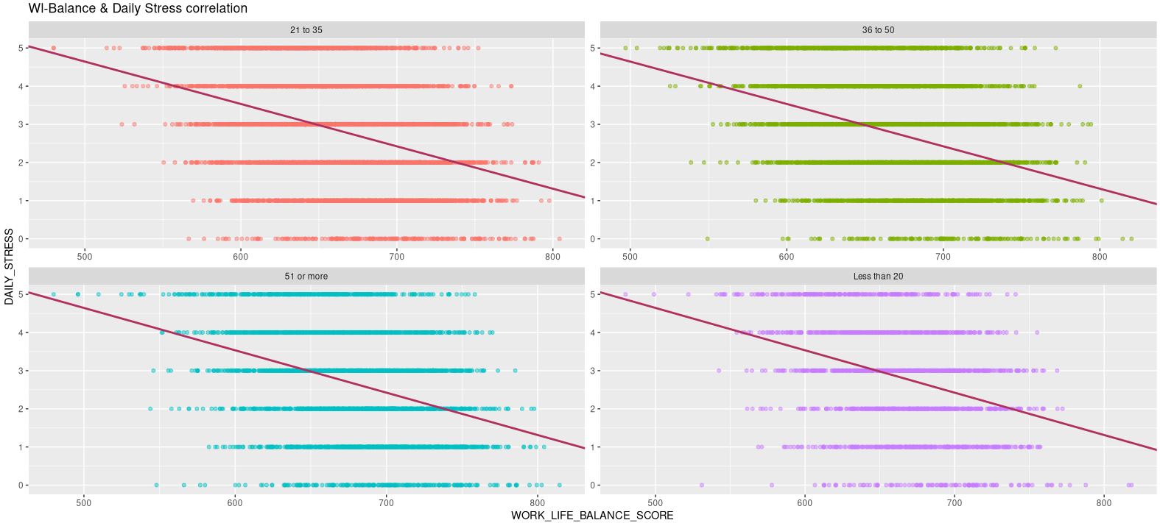
'WORK_LIFE_BALANCE_SCORE’, 'DAILY_STRESS' correlation

Slide 13
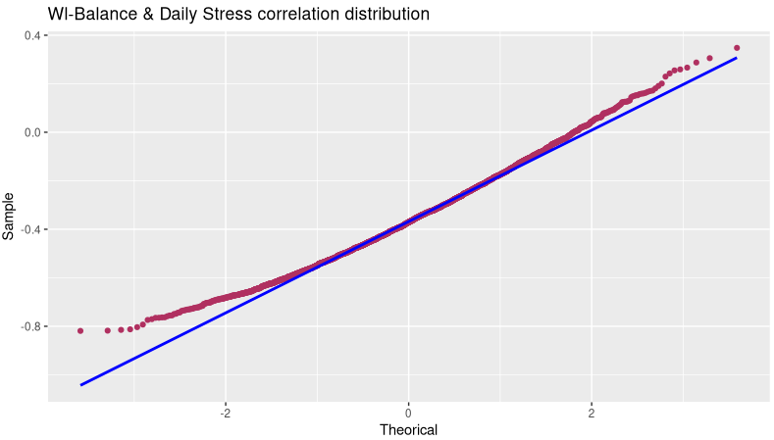
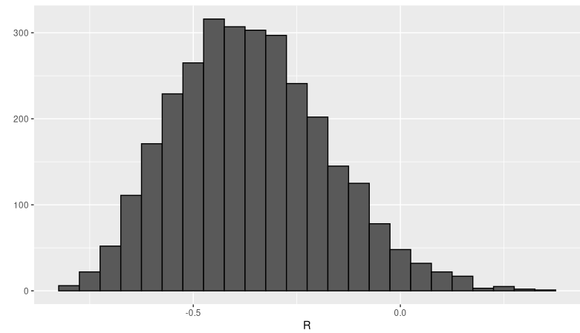
compute 'WORK_LIFE_BALANCE_SCORE', 'DAILY_STRESS' correlation using Monte Carlo simulation. Visualize the result using a histogram and normal distribution plot

Slide 14
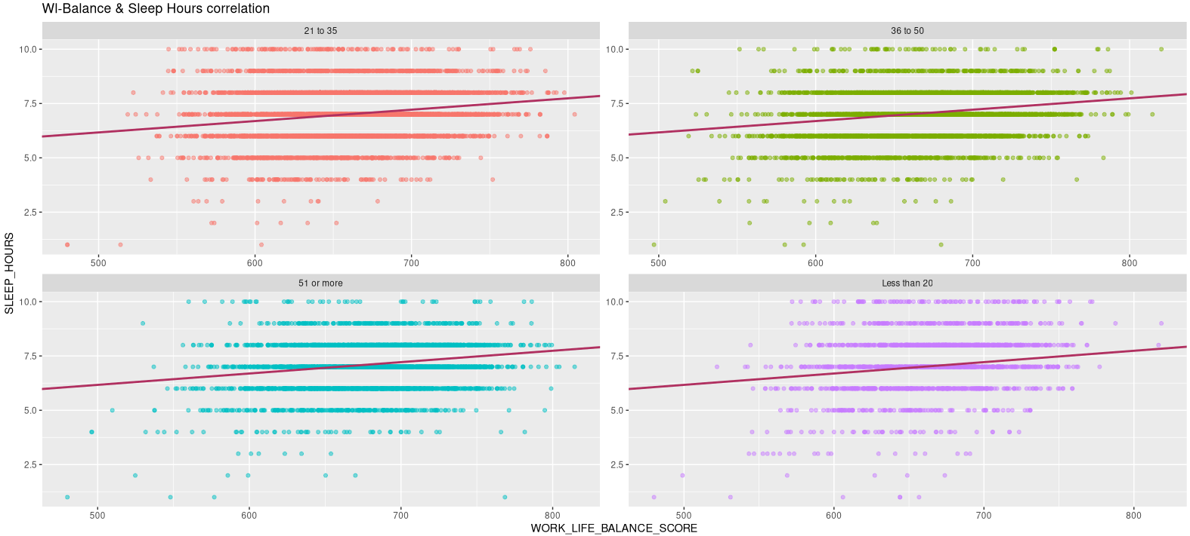
'WORK_LIFE_BALANCE_SCORE', 'SLEEP_HOURS' correlation

Slide 15
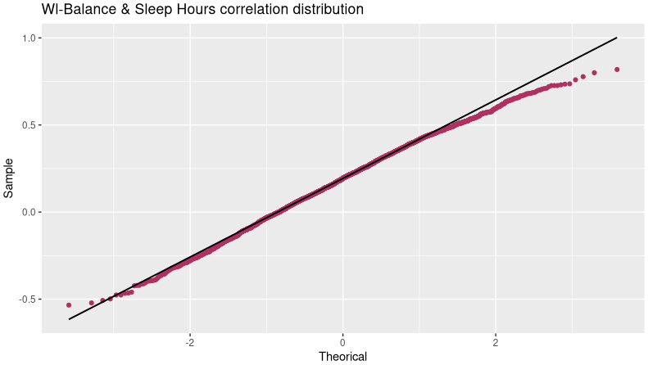
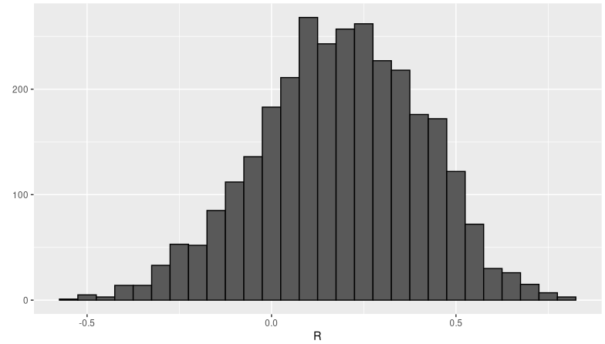
COMPUTE 'WORK_LIFE_BALANCE_SCORE', 'SLEEP_HOURS’ CORRELATION USING MONTE CARLO SIMULATION. VISUALIZE THE RESULT USING A HISTOGRAM AND NORMAL DISTRIBUTION PLOT

Slide 16
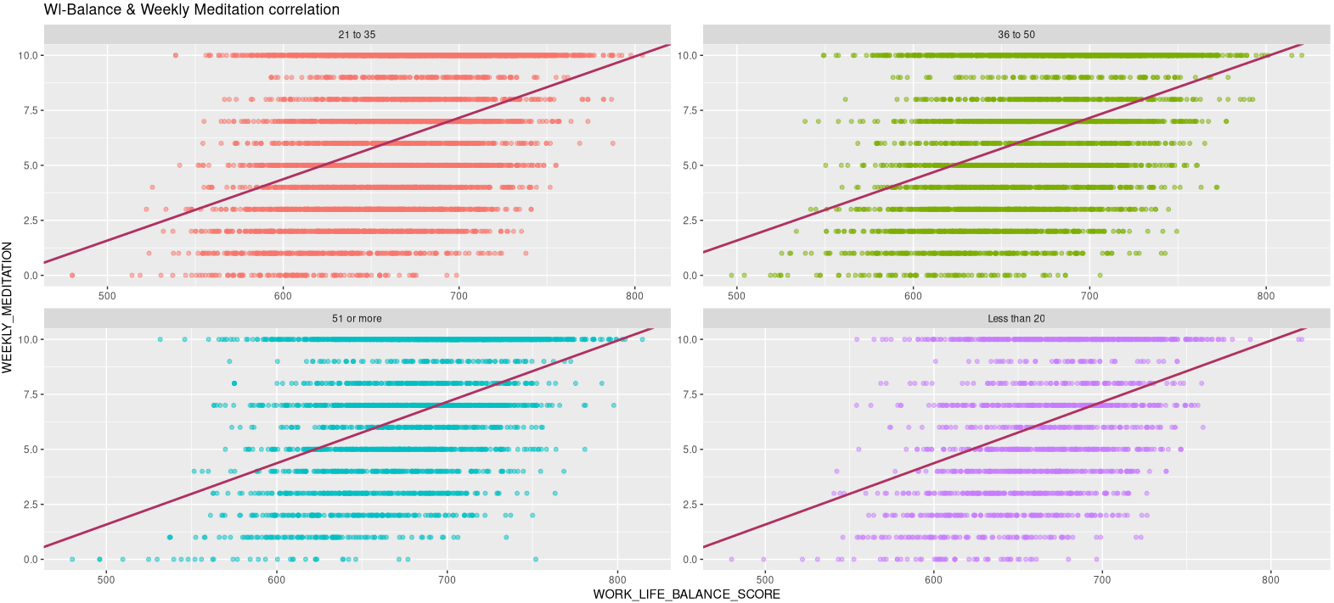
'WORK_LIFE_BALANCE_SCORE', 'WEEKLY_MEDITATION' correlation

Slide 17
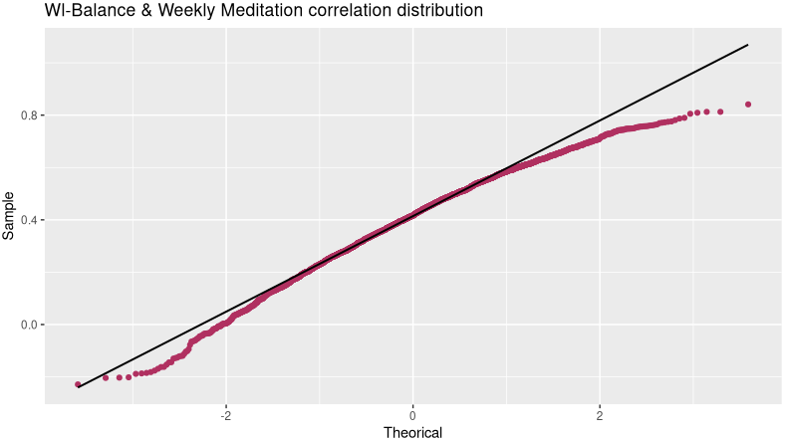
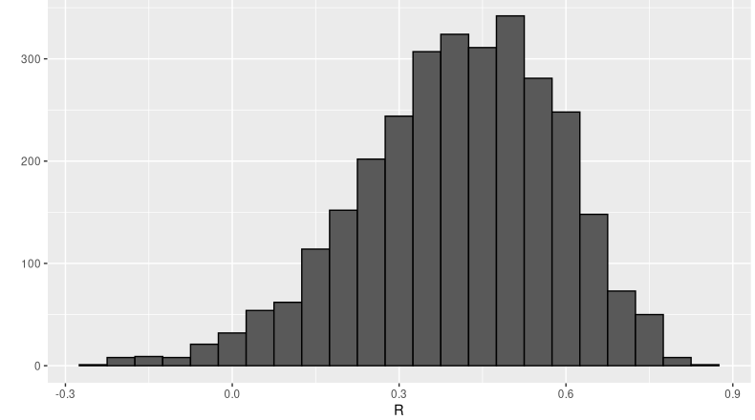
compute 'WORK_LIFE_BALANCE_SCORE', 'WEEKLY_MEDITATION' correlation using Monte Carlo simulation. Visualize the result using a histogram and normal distribution plot

Slide 18
EXISTING RESEARCH WORK
Work-Life Balance survey, an Exploratory Data Analysis of global best practices to re-balance our lives
Reference - https://www.kaggle.com/code/ydalat/work-life-balance-survey-eda/notebook

Slide 19

CONCLUSION
In conclusion, the analysis of the dataset provides insights into how work-life balance can affect daily stress and how other lifestyle factors such as sleep hours, and weekly meditation can affect an individual’s overall well-being. We observed increasing daily stress leads to a decreased work-life balance and whenever sleep hours increase the work-life balance also increases. A higher amount of weekly mediation sessions also can increase work-life balance. The findings of this study can be used to promote healthy lifestyle choices and improve overall well-being.

