Slide 1
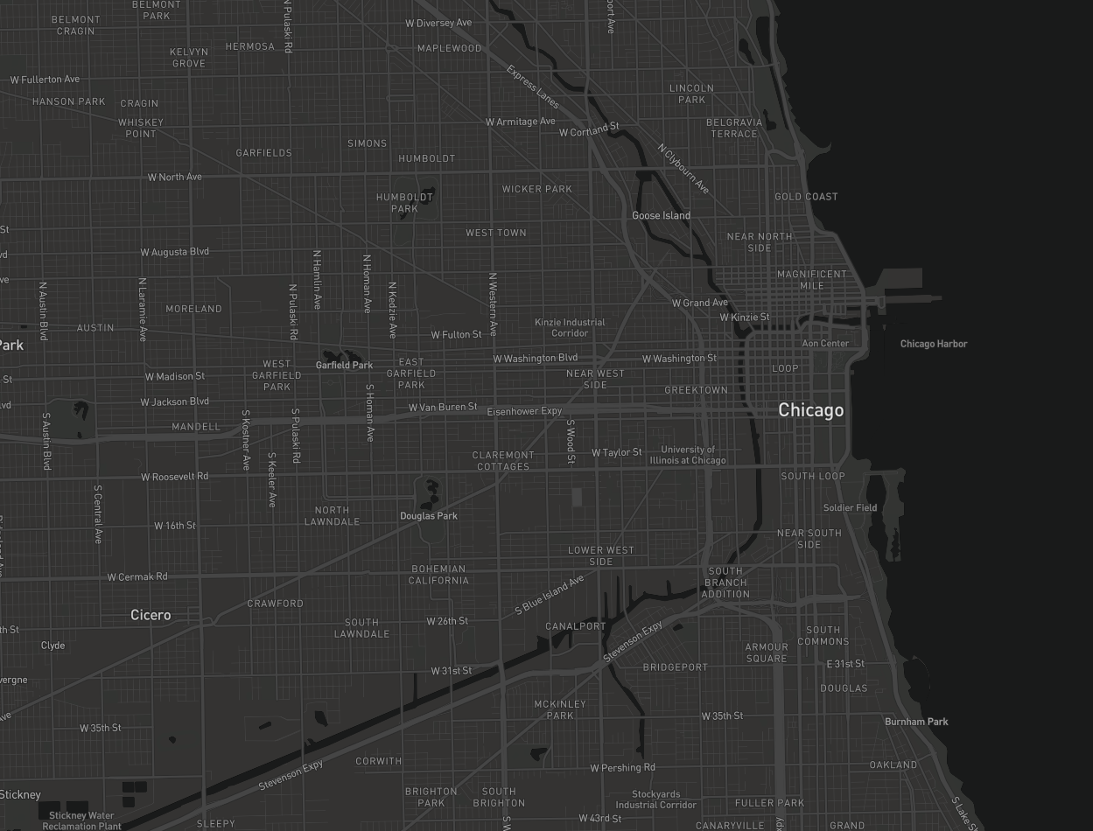
MA CSS Research Topic Benjamin Rothschild

Slide 2
Research Question
How accurate can I create a model to predict locations
of homicides in Chicago?

Slide 3
Background
Predictive Policing – the concentration of police resources in stable crime hotspots has proven effective in reducing crime, but the extent to which police can monitor changing crime hotspots is unknown.
In Los Angeles a model was 1.4 - 2.2 times better at predicting crime compared to a dedicated crime analyst and with this improved performance 7.4% of crime was reduced in a controlled experiment that used a model to predict hotspots.
In this study the prediction algorithm used historical crime data to predict future crime hotspots (did not rely on census or demographic data)
Randomized Controlled Field Trails for Predictive Policing
G. O. Mohler, M.B. Short, Sean Malinowski, Mark Johnson, et al.
Notes:
1. Focused on burglary-theft & car theft (55% of crime in LA)

Slide 4
Background
Recent social science research has taken advantage of ”Big Data” sources to achieve more accurate predictions and measurements of real-life phenomena.
For example Google Street View images were successfully used to measure income in New York City and Boston.
Big Data and Big Cities: The Promises and Limitations of Improved Measures of Urban Life
Edward L. Glaeser, Scott Duke Kominers, Michael Luca, Mikhil Naik
Notes:
1. Focused on burglary-theft & car theft (55% of crime in LA)

Slide 5
Datasets

Slide 6
Datasets
Census Tracts
5 Year estimates
Data on Age, Income, Housing, etc
Community Input Data (311 Calls)
Updated Daily
Service Requests like abandoned buildings, disturbances
Location, time, request type
Chicago Crime Data
Monthly Data
Crime type, location, time
Lower-level crime data
Zillow
Rental Price Data
Twitter
Real-time or can query tweets by place

Slide 7
Methods
Neural Network
Decision Trees
Support Vector Machines
Logit/Probit Regression

Slide 8
Evaluation Methods
I expect the output of my model to give a score for specific areas (blocks/radius/census tracts, etc) and I will try to correlate these scores with the data from the Chicago Crime Dataset.
Evaluation Criteria:
Error Rate
Proportional Reduction in Error (PRE)
Area Under the Curve (AUC)

Slide 9
Consideration and Goals
I want to try to make my geographic units of analysis as small as possible
How does my error rate changes with different boundary sizes
Similarly I want to make my unit of time analysis as small as possible
How often can I make a prediction? How does this affect the error rate?
What datasets are most informative in helping my prediction?
How does adding datasets affect the Error rate?

Slide 10
Possible Conclusions
I can predict there will be a crime on a .5 mile radius and 5 hour timespan with at 15% success rate
I can predict there will be a crime on a 2 block radius and 10 hour timespan at 30% success rate
I can predict nothing ☹

Slide 11
Why?
A model like this could help with resource allocation with police department or with community investment initiatives
Analysis like this can lead to further questions about what environments lead to crime
By seeing how the model improves or not when data sources are added I can hypothesize about what other datasets would be helpful in improving my model

Slide 12
References and Resources?
Datasets
https://censusreporter.org/profiles/86000US60657-60657/
https://data.cityofchicago.org/Service-Requests/311-Service-Requests-Vacant-and-Abandoned-Building/7nii-7srd/data
https://data.cityofchicago.org/view/5cd6-ry5g
https://www.zillow.com/research/zillow-rent-index-methodology-2393/
https://dev.twitter.com/rest/public/search-by-place
Articles
Glaeser, Edward L., Scott Duke Kominers, Michael Luca, and Nikhil Naik. "Big Data and Big Cities: The Promises and Limitations of Improved Measures of Urban Life." (pdf)Economic Inquiry (forthcoming). View Details
Websites
https://www.civicscape.com

Slide 13
Questions?

