Slide 1
OnTheMap and LODES Data
Heath Hayward
Geographer
LEHD Program
Center for Economic Studies

Slide 2
Outline
What is OnTheMap?
What is the LODES Data?
Sources
Processing
Confidentiality Protection
Releasing LODES Data
OnTheMap Application
Downloadable Data
Questions...

Slide 3
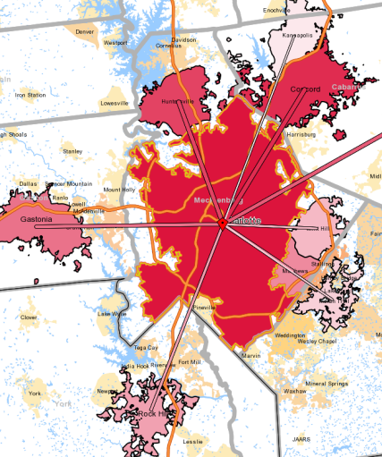
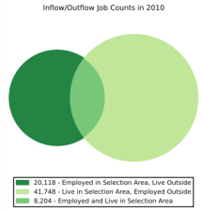
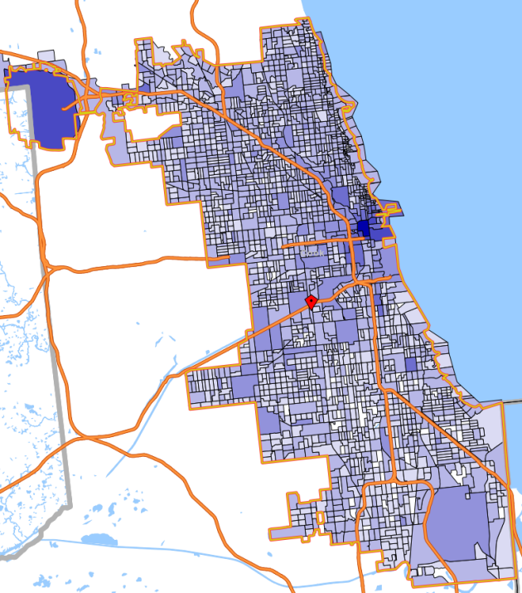
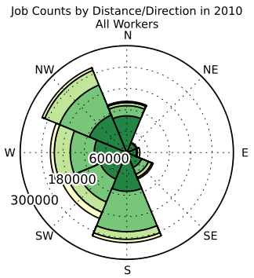
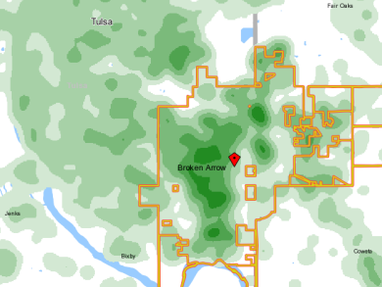
OnTheMap
Interactive mapping and reporting tool
2002-2010 annual data
User-selected areas
Based on Census Blocks
Disclosure protection
Flexible Inputs/Outputs
Where do workers live?
Where do residents work?
Analyze/report by age, earnings, or industry segments
Data for 50 states (DC, not MA)
Notes:
3

Slide 4
Uses for OnTheMap
Economic Planning & Time Series
Where is the labor supply located?
Which industries are growing or declining over time?
Transportation Planning & Analysis
Between which areas do workers commute?
How far and from what direction do workers commute?
What are the worker flows in, out, and within an area?
Emergency Management & Assessment
What jobs are impacted by a disaster event?

Slide 5
Creating LODES Data: Sources
Confidential Data Sources:
UI Wage Records
QCEW
Other Censuses and Surveys
StARS
Public Use Data Sources
2000 Decennial (SF1, CTPP)
TIGER/Line Shapefiles
Previous year of OnTheMap
LED Infrastructure Files

Slide 6
Creating LODES Data: Processing
Unlike QWI, much of the processing is performed at the national level, starting with the definition of Primary/Dominant Job.
Also unlike QWI, data for previous years are not reproduced with every production cycle – LODES is constrained by a “confidentiality budget”
One year is processed at a time because of the requirement of a previous year of data for the synthetic method.

Slide 7
Creating LODES Data: Confidentiality Protection
Two main processes are taking place to protect OnTheMap data:
Noise Infusion – Applied to workplace totals.
Synthetic Data Methods – Applied to residential locations.
For more information, see: http://lehd.ces.census.gov/led/datatools/doc/OTMSyntheticData%2005262009-jma.pdf
http://lehd.ces.census.gov/led/datatools/doc/SyntheticDataDiagram%2006082009_JMA.pdf

Slide 8
Releasing LODES Data
Once residential locations have been synthesized, the data are tabulated for public release.
The basic structure of released data are the following file types:
Origin-Destination (OD)
Residence Area Characteristics (RAC)
Workplace Area Characteristics (WAC)

Slide 9
Releasing LODES Data
OD
Connects a home block with a work block.
Gives one count of jobs for each home-work block pair and for each combination of year, job type, and segment variables.
RAC/WAC
Provides totals on residence/workplace side only.
Gives one total for each worker/job characteristic for each combination of year, job type, and segment variables.

Slide 10
Releasing LODES Data
Jobs are classified by:
Whether the job is a worker’s primary/dominant job.
Whether the job is in the private sector.
Whether the job is sourced from OPM*.
The six Job Types are:
All Jobs, Primary Jobs, All Private Jobs, Private Primary Jobs, All Federal Jobs*, and Federal Primary Jobs.*
* The Federal Job Types are only broken out in the raw LODES data. Only four Job Types are available in OnTheMap
Note: A job in LODES are defined as Beginning of Quarter Employment, which means the worker was employed by the same employer in both the current (2nd) and previous (1st) quarter.

Slide 11
Releasing LODES Data
Labor Market Segment
Jobs are aggregated by 10 “segments” determined by a worker’s/firm’s characteristics.
The 10 segments are:
All Workers
Workers by Age (29 or younger; 30-54; 55 or older)
Workers by Earnings ($1,250/mo or less; $1,251/mo to $3,333/mo; greater than $3,333/mo)
Workers by Firm’s Industry (Goods Producing; Trade, Transportation, and Utilities; All Other Services)
OD Data is reported for each segment.
Segments are similar to but not the same as characteristics.

Slide 12
Releasing LODES Data: A note about the Industry segments
Industry Segments are build from NAICS Industry Sectors* (“2-digit”)
Goods Producing:
NAICS 11, 21, 23, 33-33
Trade, Transportation, and Utilities:
NAICS 22, 42, 44-45, 48-49
All Other Services
NAICS 51, 52, 53, 54, 55, 56, 61, 62, 71, 72, 81, 92
* See http://www.census.gov/eos/www/naics/ for more info.

Slide 13
Releasing LODES Data
Characteristics (available only in RAC/WAC data)
3 Age Characteristics – Comparable to Age Segments
3 Earnings Characteristics – Comparable to Earnings Segments
20 Industry Characteristics (NAICS Sectors)
6 Race Characteristics
2 Ethnicity Characteristics
4 Educational Attainment Characteristics
2 Sex Characteristics

Slide 14
Releasing LODES Data
OD vs. RAC/WAC: What’s Available?
OD
Count for Year × Job Type × Segment
Residence Area and Workplace Area Specified
RAC/WAC
Count for Year × Job Type × Segment × Characteristic
Only one of Residence Area or Workplace Area Specified
Example
OD: Count for 2010, All Jobs, 29 or younger, with home and work block specified.
RAC: Count for 2004, Primary Jobs, Goods Producing Industries, $1250/mo or less, with only home block specified.

Slide 15
Releasing LODES Data: Downloadable Data
Previously, LODES data could only be downloaded from Cornell University’s Virtual RDC (VRDC).
LODES data is now available through regular http download on the LED website: http://lehd.ces.census.gov/led/onthemap/
Data can be downloaded for individual states based upon state of employment.
See OnTheMap Data Technical Document (http://lehd.ces.census.gov/led/onthemap/LODES6/LODESTechDoc6.1.pdf) for more detail.

Slide 16
Releasing LODES Data: Downloadable Data
Main vs. Aux
To make it easier for users to limit the amount of data they need to download, the files have been split by state of employment and state of residence.
Main: Jobs of workers who are employed in the state and reside in the state.
Aux: Jobs of workers who are employed in the state and reside out of state.

Slide 17
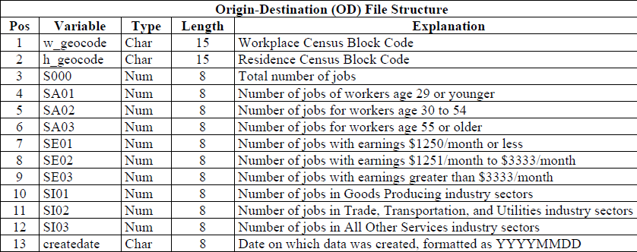
Releasing LODES Data: Downloadable Data

Slide 18
Questions...

Slide 19
Contact Us
Local Employment Dynamics
http://lehd.ces.census.gov
Please send your comments to:
CES.OnTheMap.Feedback@census.gov.
Join ListServ
lehd-onthemap@lists.census.gov
lehd-general@lists.census.gov

