Slide 1

Boolean Conditions and Operators
BS1220 Workshop 2

Slide 2

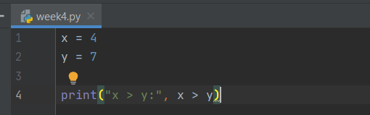
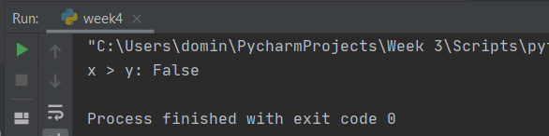
Group A – Greater Than (>)
Greater than is a simple function that checks if one of the value is greater than another
Example:
If x = 4, y =7
print("x > y:", x > y)
This would produce the answer of "False" as 4 is not greater than 7
Benefits of Boolean:
Boolean can save time by refining a search to cast a larger or small web for searching, eg looking only for academic papers
Disadvantages of Boolean:

Slide 3


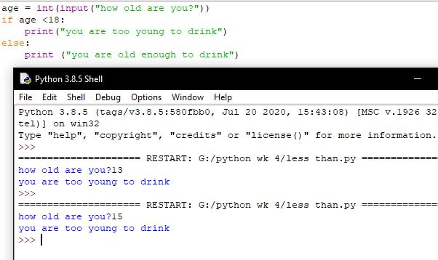

Group B – Less Than (<)
The less than operator compares two values – If value A is less than value B – output TRUE
How it works:
The less than operator compares two given integers, this can be used to assess if a number is less than another.
How the Boolean operator is used within Python
Benefits:
Drawbacks:
Allows you to determine whether a value is less than another value
The less than value will return false if the two values are equal. This might not be the desired output for this instance.

Slide 4
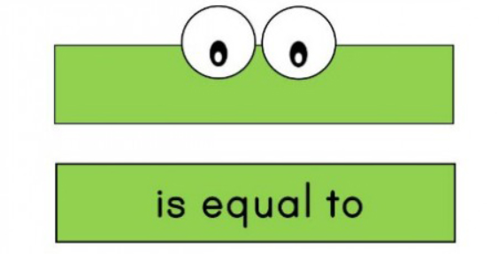
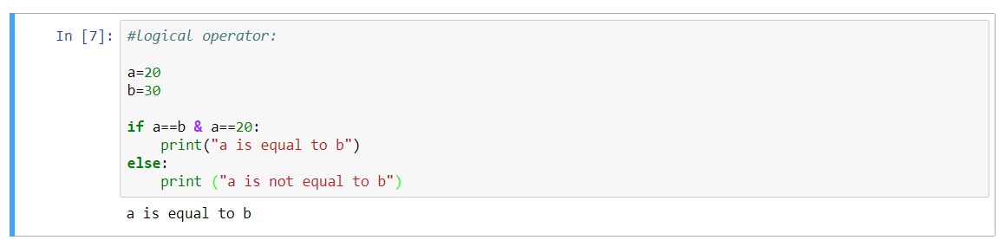
Group C – Equal To (==)
Just in case you want a crocodile
xd
If one number is exactly equal to another.
Used as part of "if" statement, tests whether a is equal to b.
Will equate to a false outcome if a string is stated as well as integer.
This isn't however how the CPU compares numbers. The CPU will take one number and subtract the other looking for a result of 0 if they are the same

Slide 5
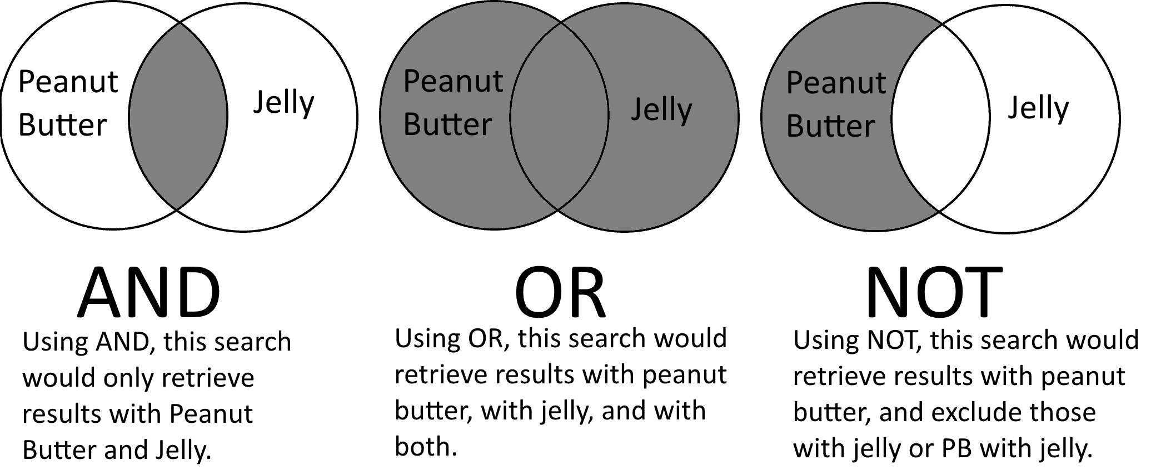
Group D – AND
A AND B = C
A | B | C
0 | 0 | 0
0 | 1 | 0
1 | 0 | 0
1 | 1 | 1
Both conditions must be true for output to be true
Useful when you need to recognise when 2 specific items are both true
Python: "if A == 1 AND B == 2:
Do something"

Slide 6





Group E – OR
If either term (or both) is true, it will be in the returned.
Benefits | Drawbacks
Allow for multiple statement condition to be meet in operator | Unable to tell specific info
The OR Statement can be used to SET selected bits when used in a mask without affecting other bits
A | B | C = A OR B
0 | 0 | 0
0 | 1 | 1
1 | 0 | 1
1 | 1 | 1
#python syntax
a = 200 b = 33 c = 500 if a > b OR a > c: print("At least one of the conditions is True")

Slide 7

Group F – NOT
Drawbacks of the NOT operator:
If many NOT operators are used together, then it may be difficult for another programmer to read the code.
What the Boolean operator is:
NOT, also known as an "inverter" outputs the opposite of the input. For example, input 1 = output 0 and vice versa.
How the Boolean operator / condition works:
Example of the Boolean Operator in Practice:
"architect" NOT "data architect
How is the NOT operator used in Python:
condition = True if not condition: print("The condition is false") else: print("The condition is true") number = 5 if not number == 5: print("The number is not 5") else: print("The number is 5")
Benefits of Boolean Operator :
NOT can be useful because it narrows the search by removing defined words or phrases from your results
Input | Output
1 | 0
0 | 1

