Slide 1
Informational Cities Database
Brandon Pardi
Isaac Luengas

Slide 2
Abstract
Aim to create a database full of varying information for thousands of different cities to help people stay informed on potential hazards where they live

Slide 3
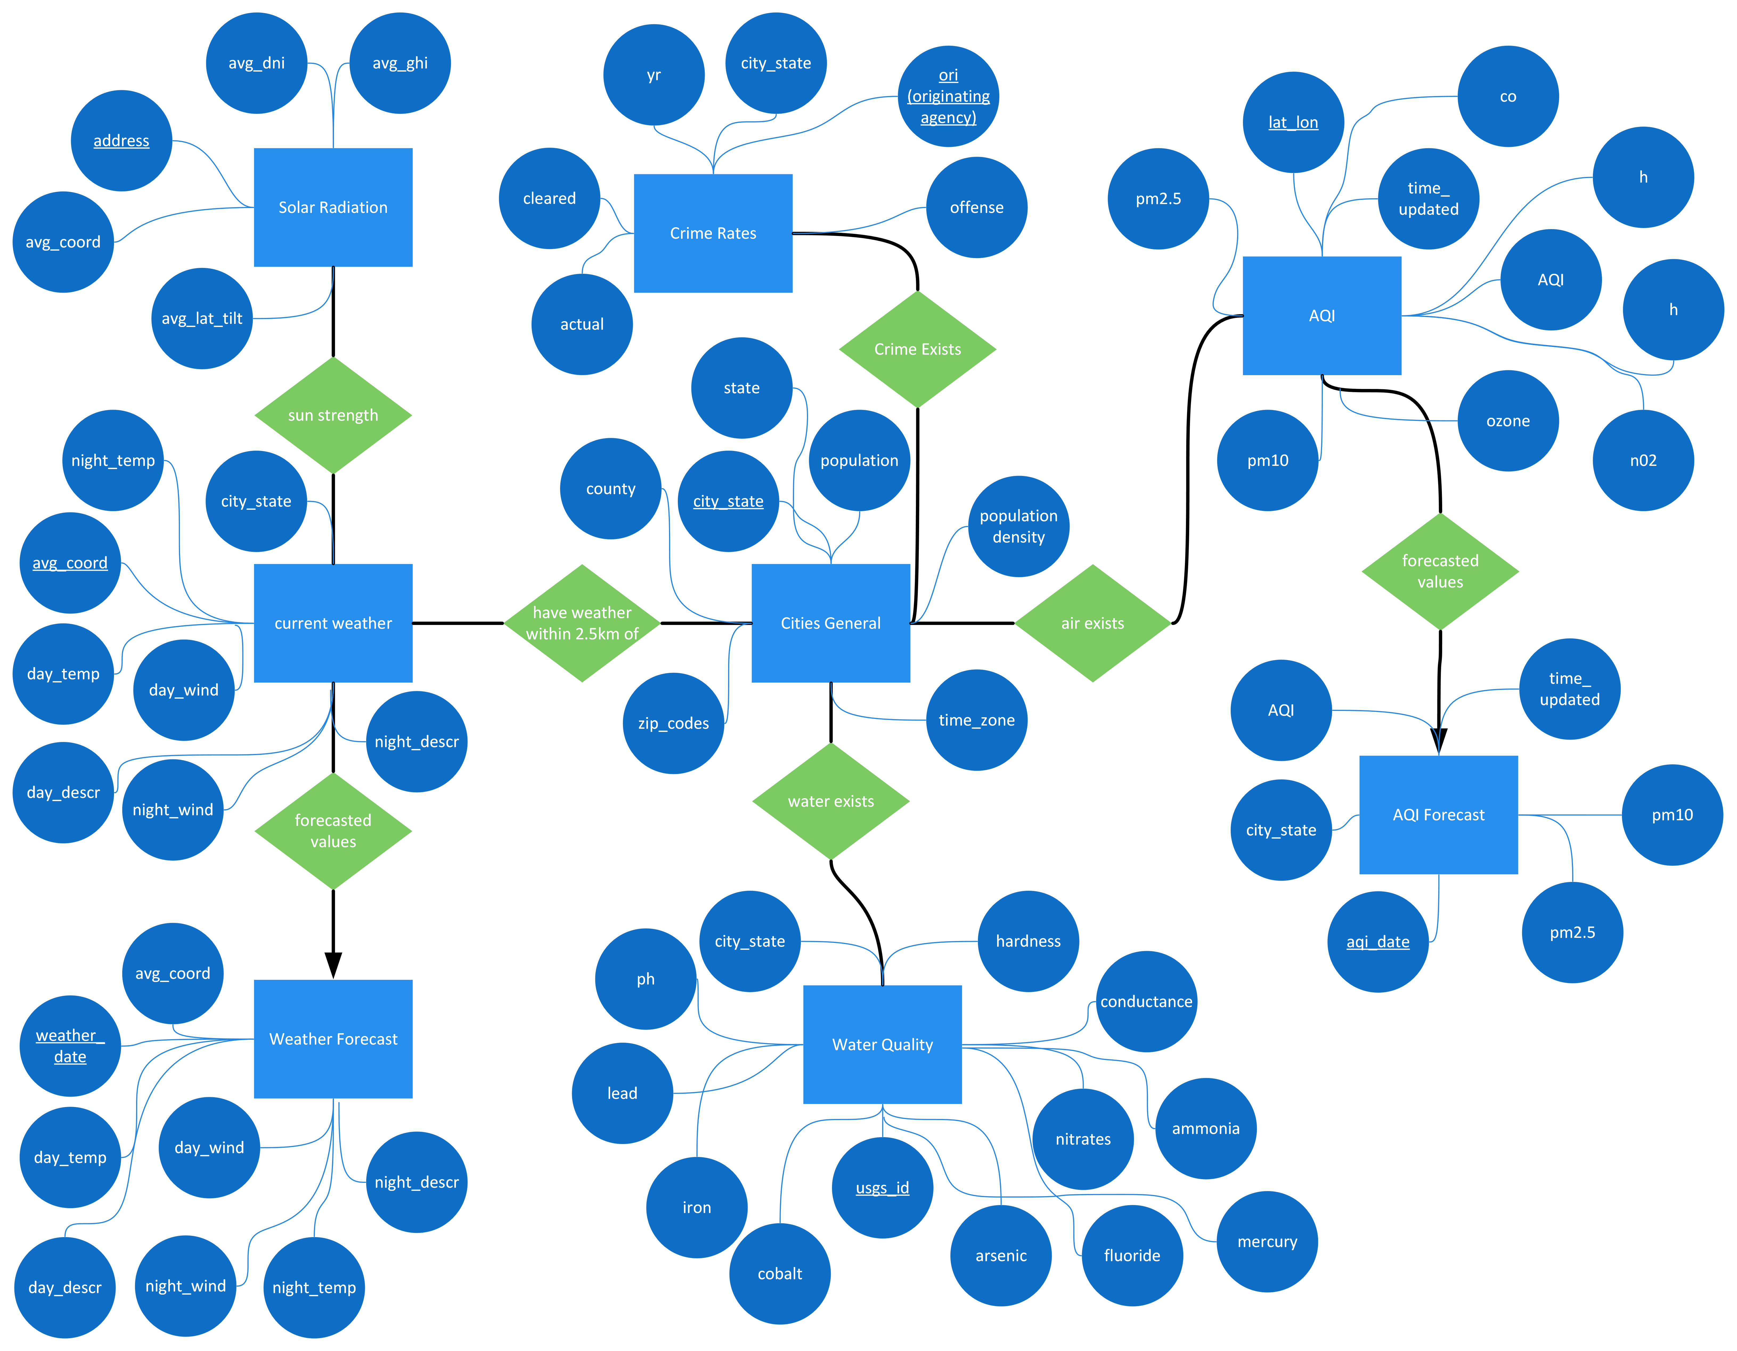

ER Diagram

Slide 4
USE Case
Diagram

Slide 5
Relational schema

