Slide 1
Snake with sdl2
Brandon Pardi
Andrew Garza
Badrul Babul

Slide 2


Introduction
The classic arcade game snake, where you try to grow your snake character by eating fruit pieces on the screen.
We implemented this project using SDL2, an OpenGL wrangler with more focus on game design.

Slide 3
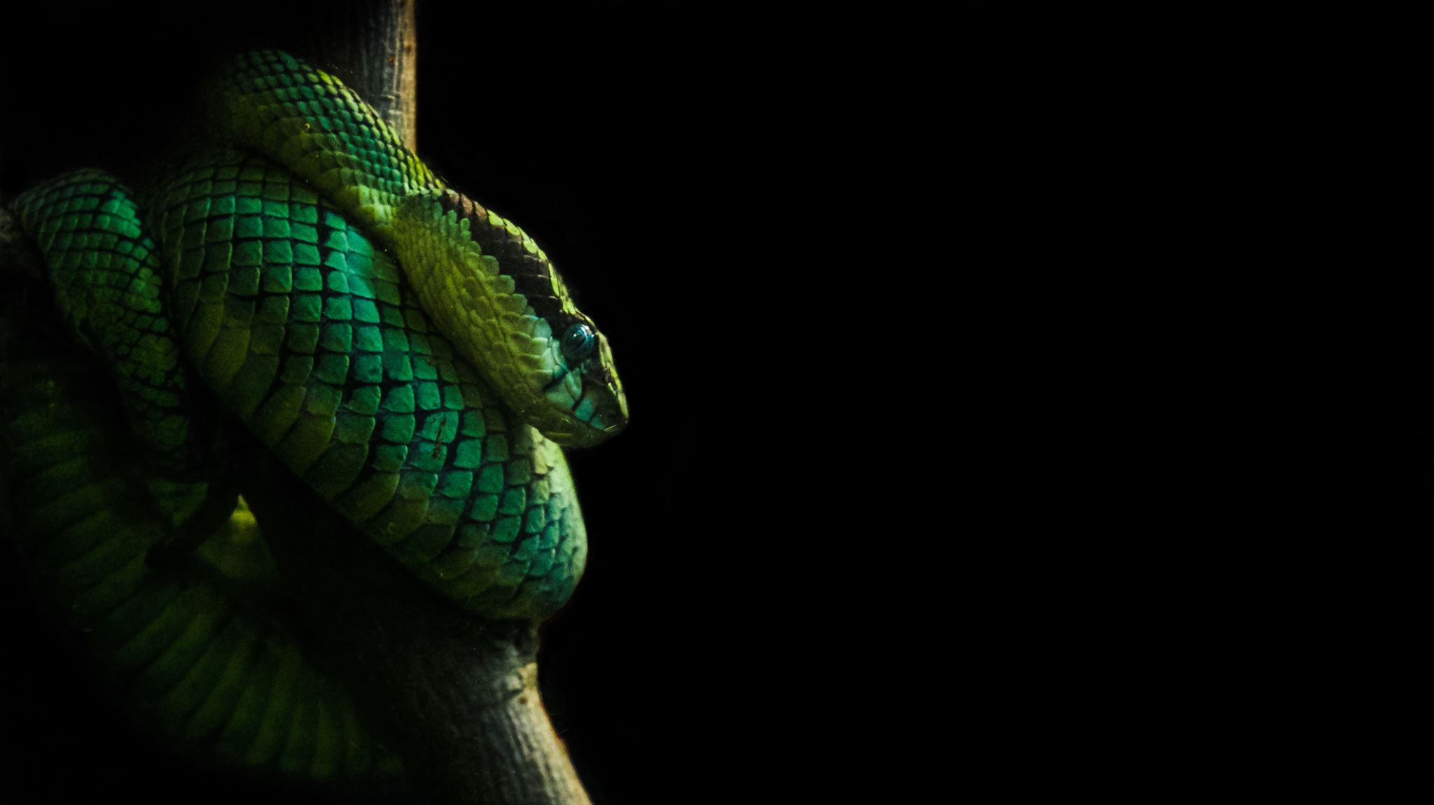
Implementation

Slide 4

Game Logic
-> Keyboard input determines snake direction of movement
-> Snake is navigated to food
-> Snake eats food and grow in size (score increased)
-> repeat

Slide 5
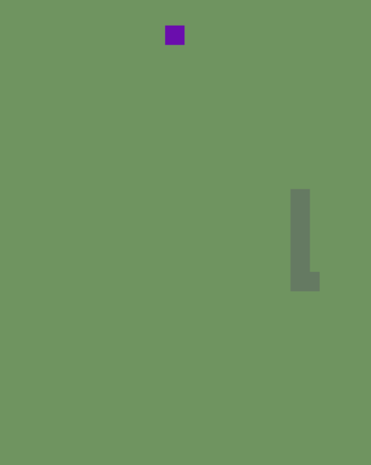
Main
Main function pretty simple
Initialize game class and SDL
While loop calls event handler, update, and renderer functions from Game class
After while exited (when Game class determines game executing over) free the memory.
Ensure while loop iterates at a constant 60 fps

Slide 6
Snake and fruit
Simple classes to hold location and size of snake and fruit, as well as initializers
Hold x and y coordinates of snake and fruit
Snake needs to know its direction, velocity, and score
Snake class also holds array of other snake body parts
Fruit will have a random location generator for each time the snake collects it
Both will have init functions to initialize their SDL rectangle objects to be rendered to screen

Slide 7
Game Class
The money maker
Initializes SDL objects like window and renderer, as well as snake and fruit
Update function checks for wall collision to end game, as well as sets snake velocity and calls random fruit position generator
Render will create all necessary rect objects and display them to the screen
Event handler will check for events like arrow key inputs and adjust direction accordingly, ESC key to pause game, and check if game has ended
Lastly memory clear will destroy all objects created by the game

Slide 8

DEMO!

