Slide 1
Introduction to Single Board Computer (SBC)
An overview of Raspberry Pi zero 2w

Slide 2
Overview
Introduction to SBC
Overview of Raspberry Pi Zero 2 W and its benefits
Getting started with RPi Zero 2 W
Programming and development with RPi Zero 2W

Slide 3
What is a Single Board Computer (SBC)?
A complete computer built on a single circuit board.
Processor, memory, storage, and input/output options, all in one compact package.
Affordable compared to traditional PCs
Can be used for a variety of projects, from education to industrial applications
Low power consumption

Slide 4
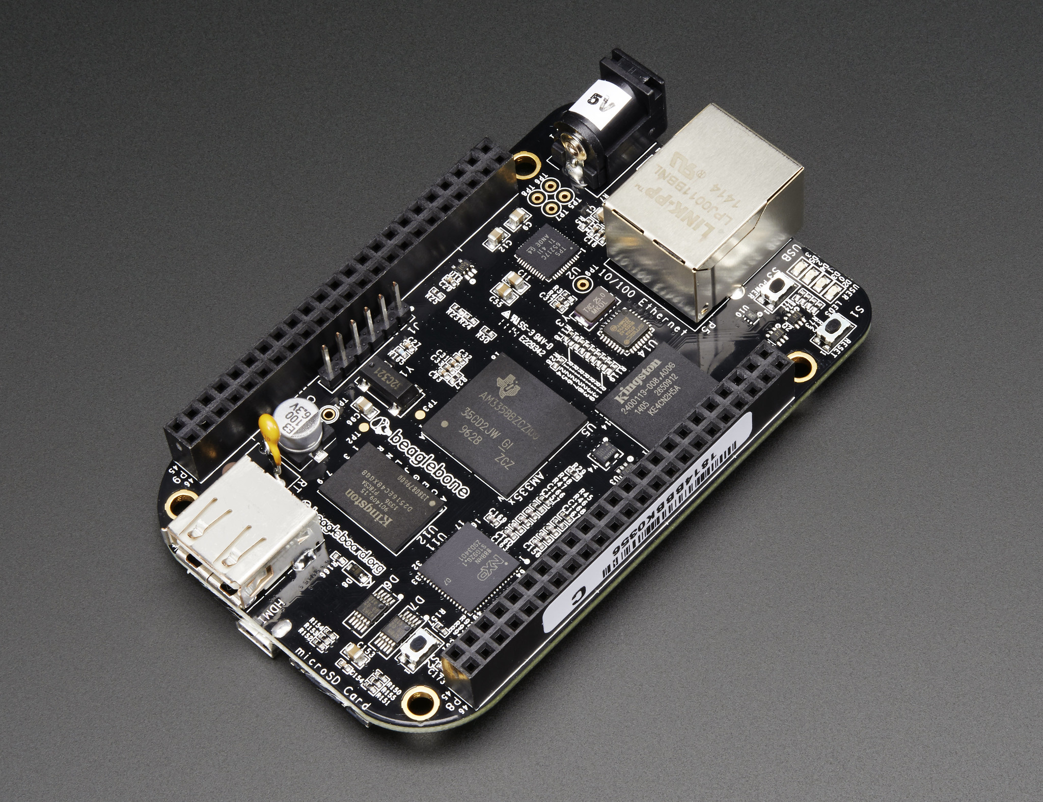
Popular SBCs
Raspberry Pi
Orange Pi
BeagleBone
Fig: Raspberry Pi
Fig: Orange Pi
Fig: BegaleBone Black

Slide 5
Raspberry Pi Zero 2W: An Introduction
A small, low-cost, and powerful version of the Raspberry Pi
Ideal for embedded AI projects
Quad-core ARM Cortex-A53 (1 GHz), 512 MB LPDDR2, Wi-Fi (802.11 b/g/n), Bluetooth 4.2
Mini HDMI for display and microSD card for OS and data
40 GPIO pins
Requires 5V power supply via Micro-USB
Smaller than a credit card (65mm x 30mm)

Slide 6
Why Raspberry Pi Zero 2W?
Very affordable (~$15) and low power consumption
Small enough for portable or embedded applications
Good online community support for troubleshooting, tutorials, and projects
Ideal for learning programming, electronics and prototyping
Fig: Raspberry Pi Zero 2 W

Slide 7
Getting Started with RPi Zero 2W
Download Raspberry Pi OS from the official website
Flash the OS onto the microSD card using tools like Etcher
Insert the microSD card into the Raspberry Pi Zero 2W
Power up and follow on-screen instructions to complete the setup

Slide 8
Programming and Development on RPi Zero
Python is most common for embedded ML projects
C/C++ can be used or more complex projects with hardware control
A Linux-based OS (Raspberry Pi OS) designed specifically for the Raspberry Pi
Can be run in GUI or headless mode (without a monitor)
GPIO libraries for interfacing with external sensors, LEDs, motors
PiCamera for camera-based projects

Slide 9
Thank You
Any Questions?

