Slide 1
An Overview of the Components in the Kit
Specification summary of the kit components to be used

Slide 2
Component List Overview
The kit includes the following major components
Vilros RPI Zero 2 W Kit
M5Stack Core 2
ArduCam
AHT20, GY521 (MPU 6050), INMP441, VL53L0X, BMI 160, APDS-9960
64GB and 32GB MicroSD Cards
Jumper wires and prototyping board

Slide 3
Raspberry Pi Zero 2 W Kit
A Raspberry Pi Zero 2 W with power supply, case and some other components.
Fig: Velros RPi Zero 2 W starter kit

Slide 4
M5Stack Core 2
An ESP32 based development board with various integrated sensors, microphone, speaker and display
Wi-Fi and BLE connectivity
Fig: M5Stack Core 2

Slide 5
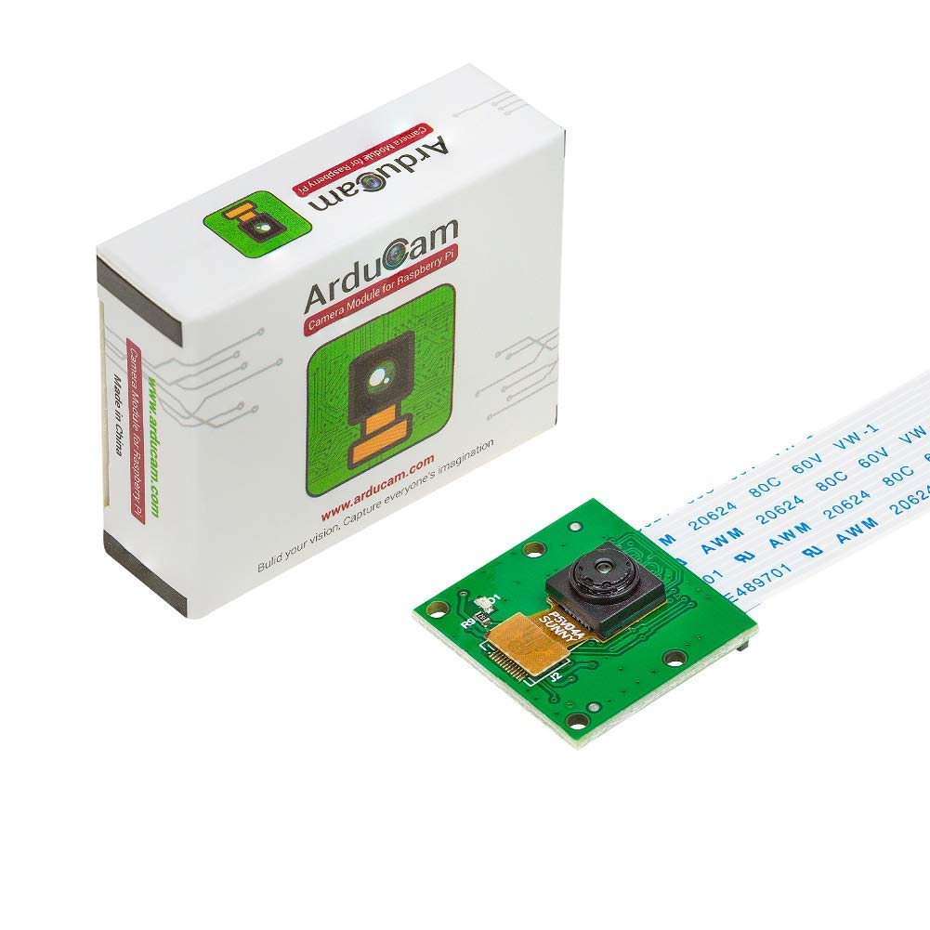
ArduCam
5MP OV5647 Camera module for Raspberry Pi
Fig: ArduCam

Slide 6
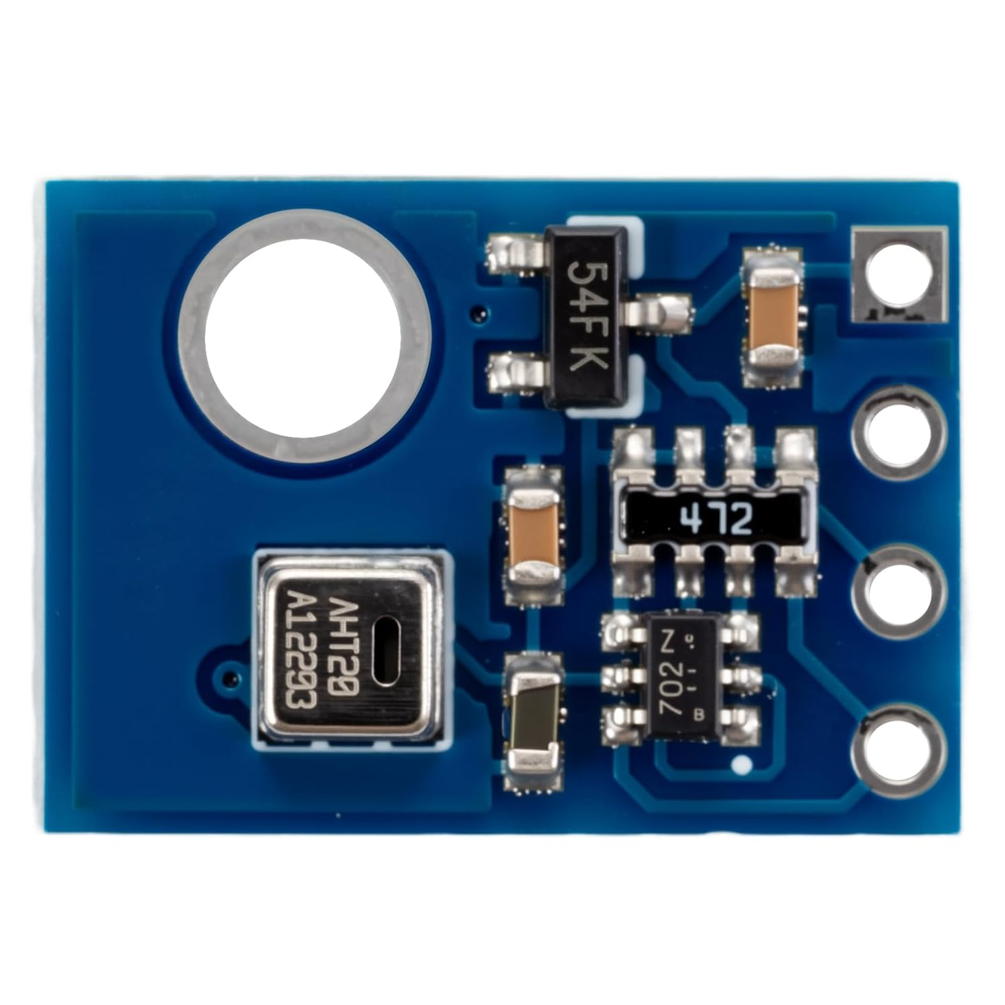
AHT20 (Temperature & Humidity Sensor)
Digital temperature and humidity sensor
Communication Interface: I2C
Power Supply: 2.3V to 5V
Accuracy:
  Temperature: ±0.3°C
  Humidity: ±3% RH
Fig: AHT20

Slide 7
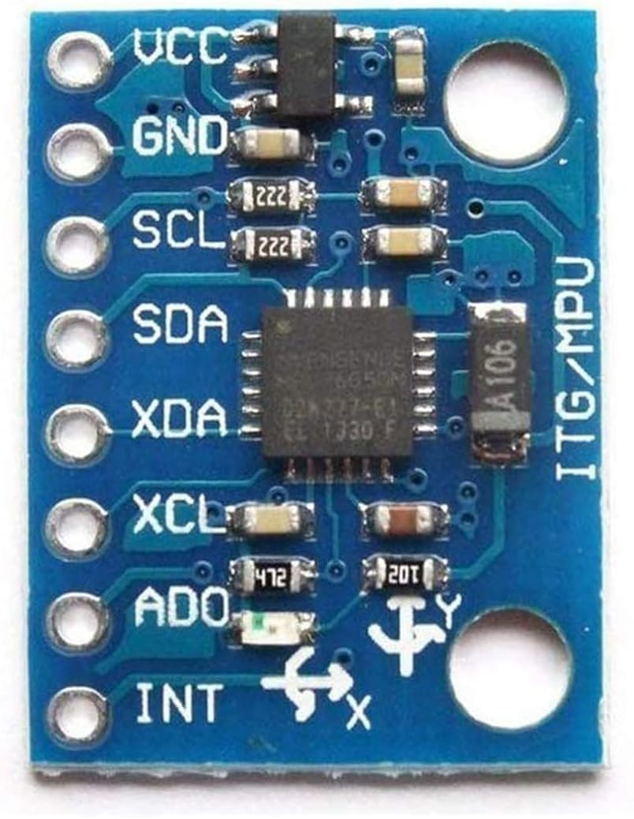
MPU6050 (3-axis accelerometer and 3-axis gyroscope)
6-axis motion sensor
Sensor Range:
  Accelerometer: ±2g, ±4g, ±8g, ±16g
  Gyroscope: ±125°/s, ±250°/s, ±500°/s, ±1000°/s, ±2000°/s
Communication Interface: I2C
Operating Voltage: 2.375V to 3.46V
Fig: BMI 160

Slide 8
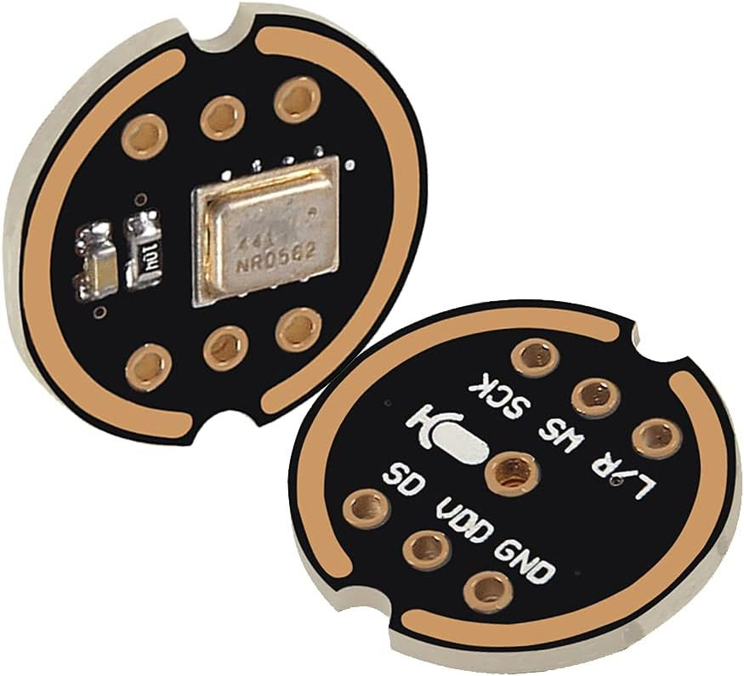
INMP441 (MEMS Microphone)
Omni directional digital microphone
High signal-to-noise ratio (SNR) : > 65 dB
Communication Interface: I2S (Inter-IC Sound)
Power Supply: 1.8V to 3.6V
Fig: INMP441

Slide 9
VL53L0X (Time-of-Flight Distance Sensor)
Accurate distance measurement using laser light
Communication Interface: I2C
Power Supply: 2.6V to 3.5V
Measurement Range: 30 mm to 2 meters
Fig: VL53L0X

Slide 10
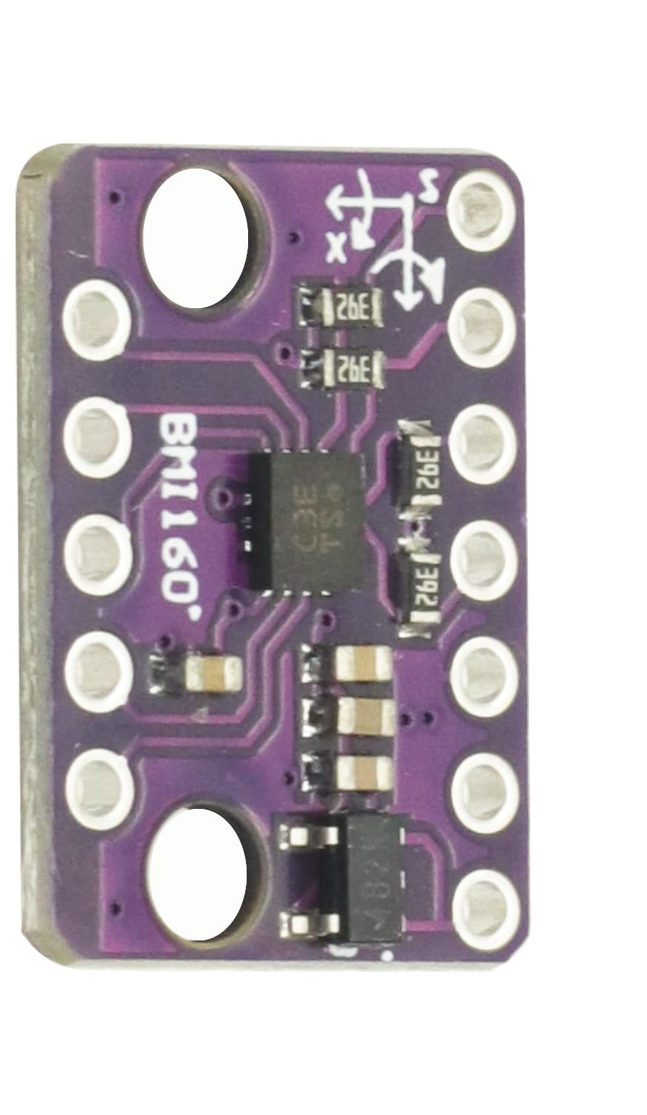
BMI160 (3-axis accelerometer and 3-axis gyroscope)
6-axis motion sensor
Sensor Range:
  Accelerometer: ±2g, ±4g, ±8g, ±16g
  Gyroscope: ±125°/s, ±250°/s, ±500°/s, ±1000°/s, ±2000°/s
Communication Interface: I2C and SPI interface options
Operating Voltage: 1.8V to 3.6V
Fig: BMI 160

Slide 11
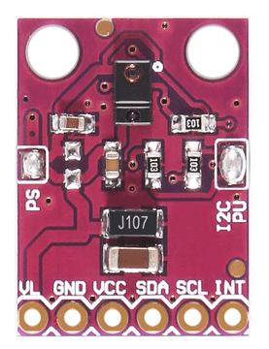
APDS-9960 (Ambient Light, Proximity, RGB, and Gesture Sensor)
Multi-function sensor (light, proximity, RGB, gesture)
Integrated ambient light, proximity, and gesture detection
Provides data for color, light intensity, and gestures
Communication Interface: I2C
Power Supply: 2.4V to 3.6V
Fig: APDS-9960

Slide 12
Jumper Wires and Micro SD Cards
Male to Male jumpers
Male to Female jumpers
Female to Female jumpers
A 64GB SD card to be used with RPI
A 32GB SD card to be used with M5Stack

Slide 13
Thank You
Any Questions?

