Slide 1
High Performance Computing (HPC) Crash Course
Brandon Reyes
For help email: rc-help@colorado.edu

Slide 2

What do we want to achieve?
Goal: Obtain an overview of a common workflow on an HPC system
Audience: Individuals who are new to HPC systems

Slide 3

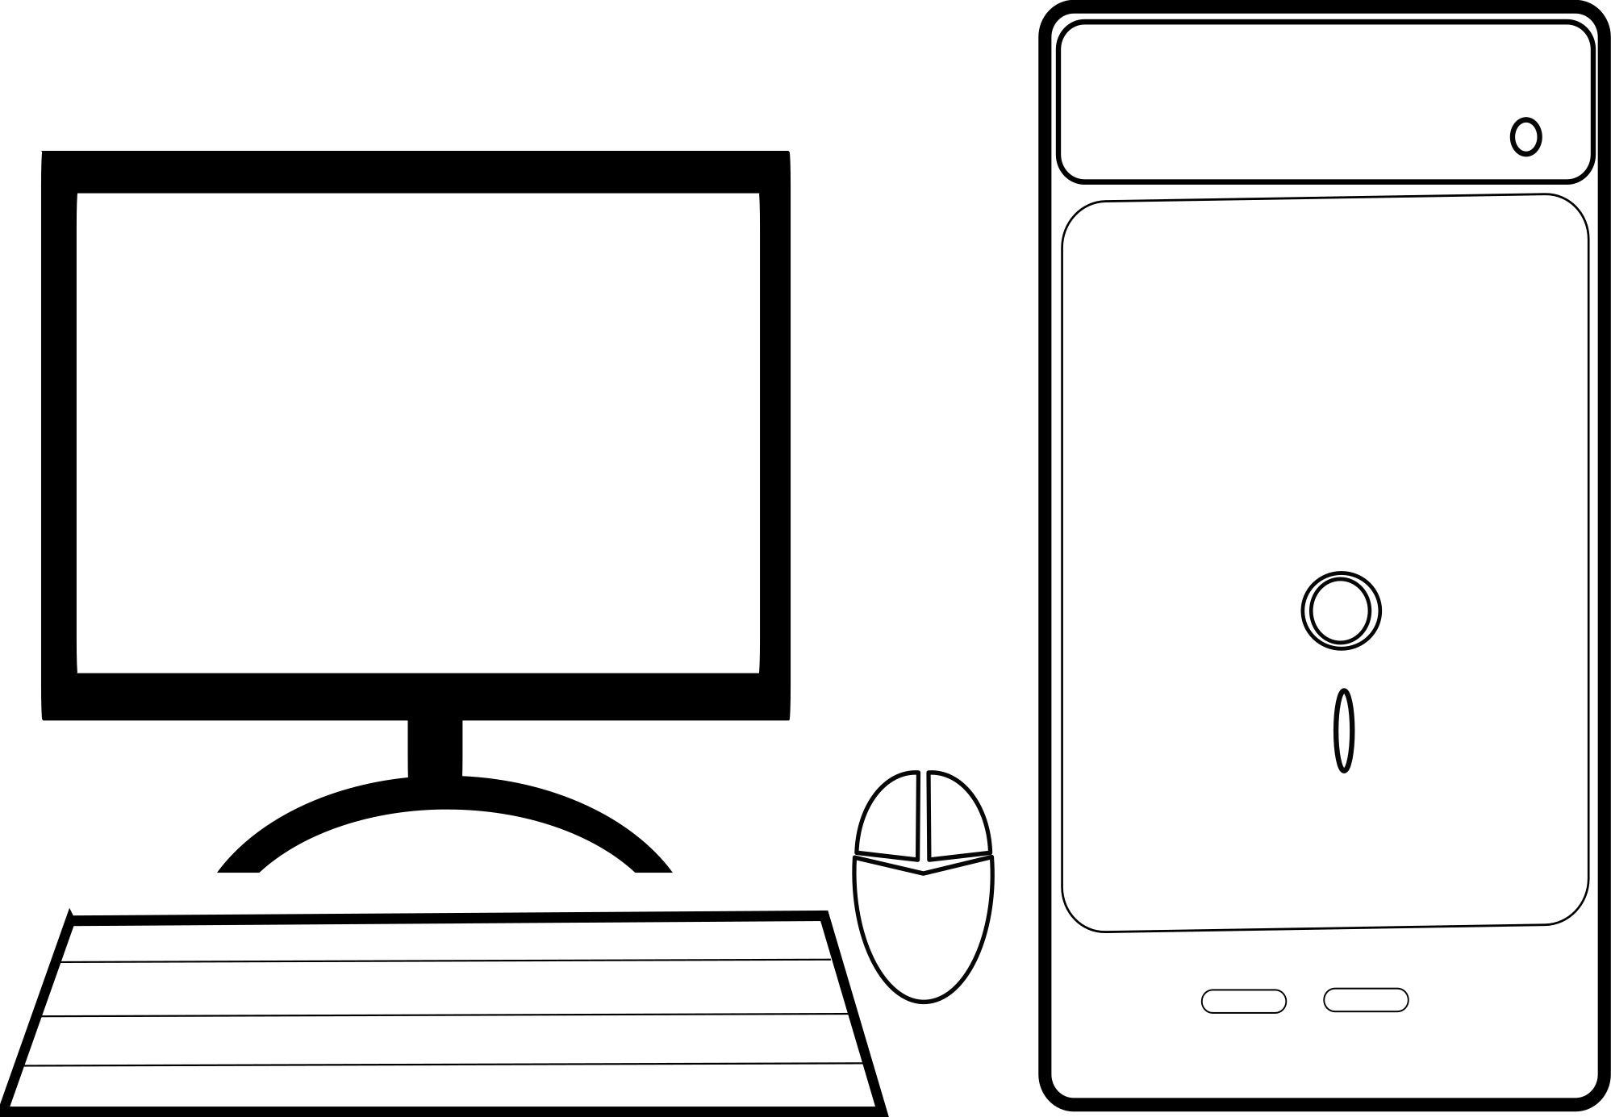

What is an HPC system?
Let’s keep it simple!

Slide 4
Some Perks of an HPC system
Perks | HPC System
Common software and programming languages are easily available (modules) | ✓
Large storage, RAM, and number of CPUs or GPUs (✚ multiple nodes) | ✓
Independent tasks or parallel applications can be completed significantly faster | ✓

Slide 5
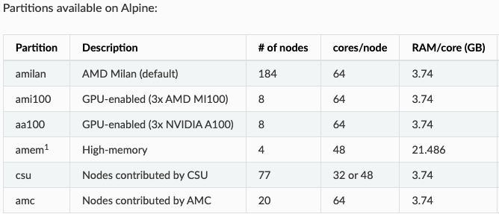
Alpine Stats
~ 239 GB per node!

Slide 6
Command-line Interface (CLI)
Text-based interaction with operation system
A simple HPC workflow will use the CLI to:
Access HPC
Work with folders (directories) and files
View or edit files (text editor)
Submit our code to the HPC system
Help us monitor the HPC jobs
Hardware (cores, RAM)
Operating System (Linux)
Shell (Bash)
CLI

Slide 7
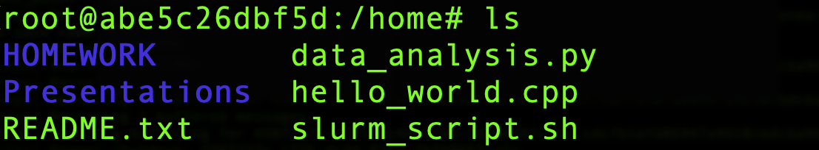
What does a CLI look like?
Real world CLI
Documentation CLI
$ ls

Slide 8
Accessing an HPC system
Create a Research Computing account
Set up Duo 2-factor Authentication
Open a terminal
$ ssh username@login.rc.colorado.edu
ssh is a secure way to access a computer over a network
$ module load slurm/alpine
Allows one to submit jobs to Alpine (more on this later)

Slide 9

Parallel Application
Parallel Application Pseudocode
Node
Output
1
Odd
1 # assign work to core
2 if core number is even:
3 print(“Even”)
4 else:
5 print(“Odd”)
2
Even
3
Odd
4
Even

Slide 10

Slurm Job scripts
slurm_script.sh
Account to be used
Hardware to be used
Runtime of job
Job name
Output location
Modules needed
Program to be run

Slide 11
Submitting a slurm script
Monitor Jobs
$ squeue --user=your_rc-username
$ module load slurm/alpine
$ sbatch slurm_script.sh
$ sstat --jobs=your_job-id

Slide 12
Overview of HPC workflow
Login to HPC
Obtain HPC friendly application
Create SLURM job script
Monitor jobs
Obtain output
Submit job

Slide 13
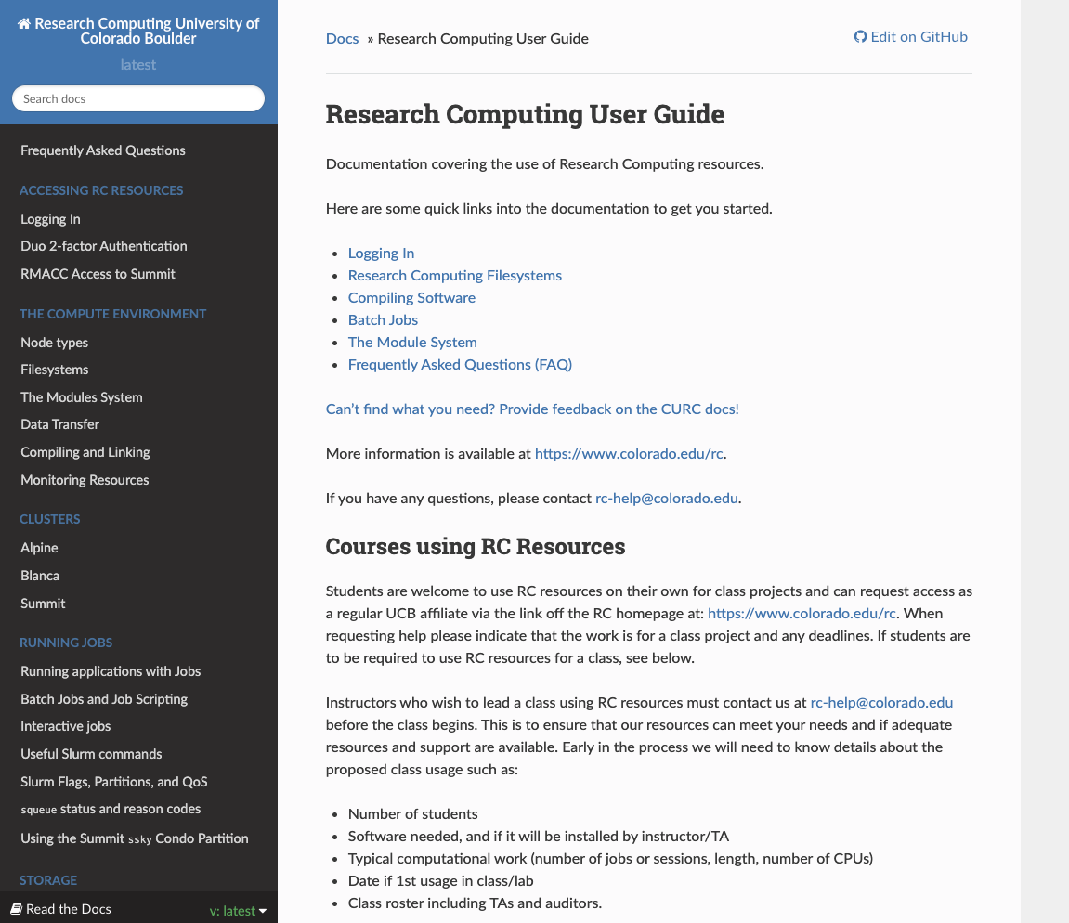
Further Help
Documentation
curc.readthedocs.io
rc-help@colorado.edu

Slide 14
Thank You!

Slide 16
When should you use an HPC system?
Your calculation consumes more memory (RAM) than you have
You need to run a large number of tasks that are independent
Your application can be run in parallel (more on this later)

Slide 17
What does a CLI look like?
Real world CLI
Documentation CLI
/home $ ls
HOMEWORK data_analysis.py
Presentations hello_world.cpp
README.txt slurm_script.sh
Access to a CLI:
macOS and Ubuntu (Linux)
Start up a terminal
Windows
PuTTY (terminal emulator)

Slide 18
Parallel Application
Parallel Application Pseudocode
Node
Output
1 # get parallel library
2 Load_MPI(…)
3
4 # get core number
5 core = MPI_get_core_number(…)
6
7 # print core number
8 print(“core number: ” core)
0
core number: 0
1
core number : 1
2
core number : 2
3
core number : 3

Slide 19
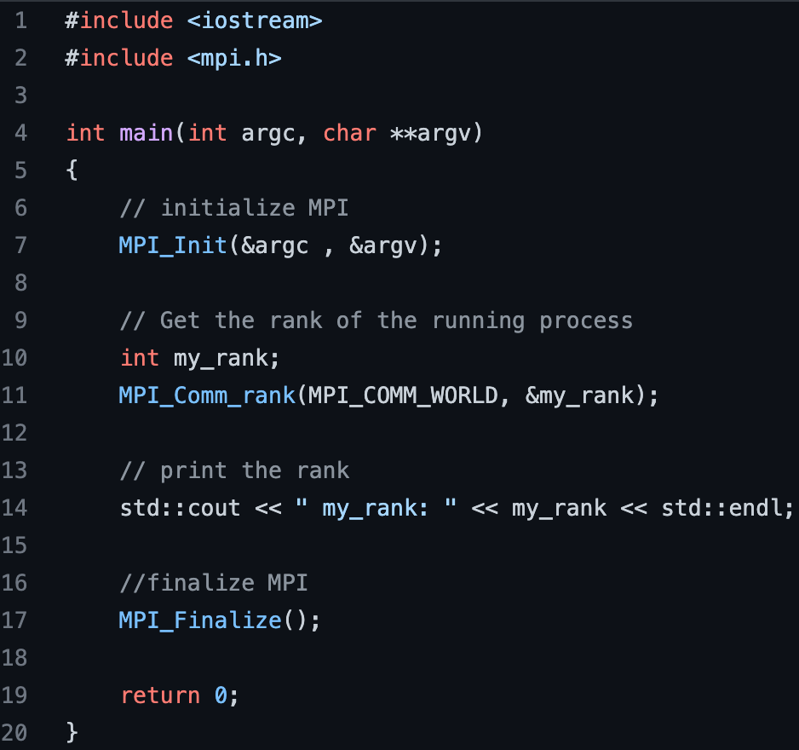
Parallel Concept
Parallel Application
Node
Output
MPI Hello World
0
my_rank: 0
1
my_rank: 1
2
my_rank: 2
3
my_rank: 3

Slide 20
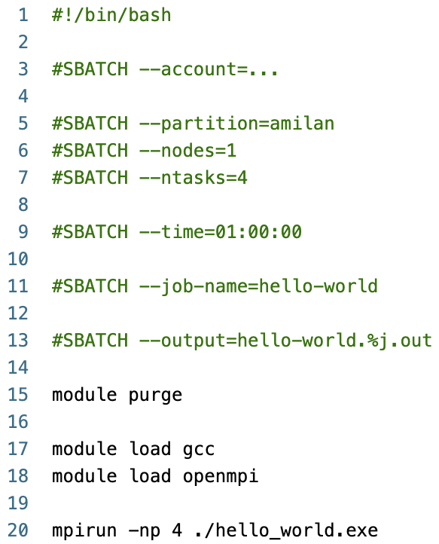
Slurm Job scripts
slurm_script.sh
Account to be used
Hardware to be used
Runtime of job
Job name
Output location
Modules needed
Program to be run

Slide 21
Submitting a slurm script
Login Node
Not for running code!!
$ module load slurm/alpine
Compile Code (if needed)
$ acompile –ntasks=2 –time=01:00:00
Monitor Jobs
$ squeue --user=your_rc-username
$ sbatch slurm_script.sh
$ sstat --jobs=your_job-id

