Slide 1

Module 1: Getting Familiar with RC

Slide 2
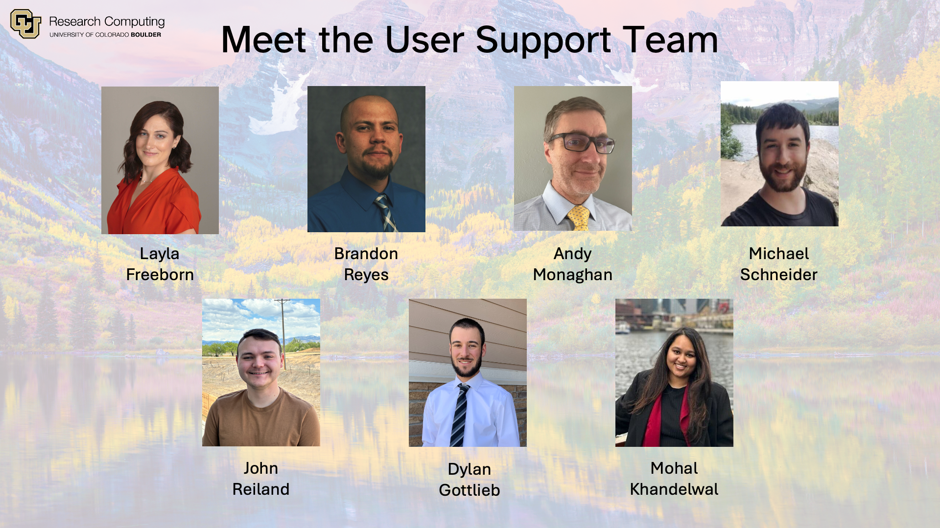
2

Slide 3
RC Resources
Tech Support
High Performance Computing
Data Management
Cloud Computing
Secure Research
Human Support
Training Materials & Workshops
Consultations & Office Hours
Help Tickets
Notes:
The Secure Research manages the CMMC environment (Preserve), but we can help users connect with the SR team if they have confidential data (e.g. HIPA, Financial, FERPA, Government data, etc.)

Slide 4
Ask Questions
Discuss Ideas
Notes:
This workshop is meant to be empowering and information-rich – to help you get the most out of your HPC workflow.
Feel free to ask questions during the presentations and to discuss ideas/thoughts during breaks and the hands-on portion of the workshop.

Slide 5
Learning Goals
HPC
Overview

Slide 6
Learning Goals
HPC
Overview
Nodes &
Partitions

Slide 7
Learning Goals
HPC
Overview
Nodes &
Partitions
Data
Storage

Slide 8
Learning Goals
HPC
Overview
Nodes &
Partitions
Data
Storage
System
Access

Slide 9
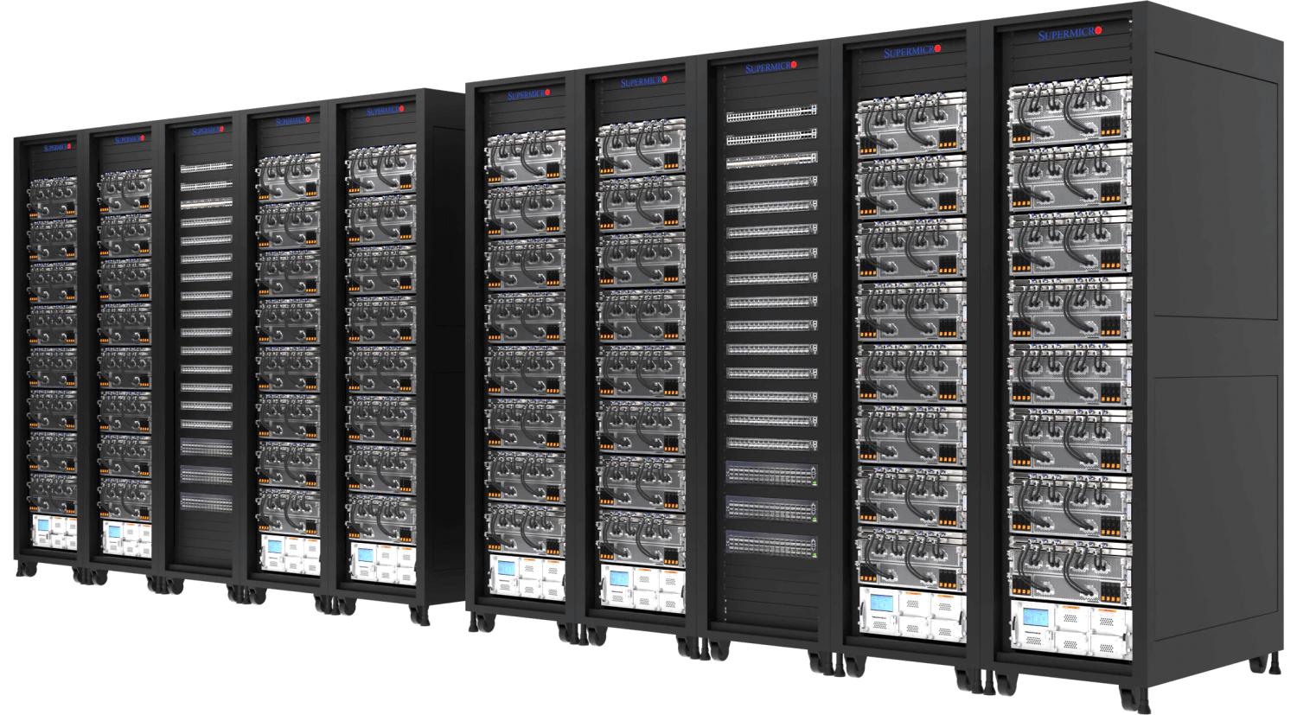
High Performance Computing
Overview
Nodes
Data
Login
Notes:
HPC System
Many CPU’s and GPUs – Thousands of cores
RAM & Storage measured in Terabytes and Petabytes
Hardware built for stability and high up-time, best for distributed jobs

Slide 10

High Performance Computing
Overview
Nodes
Data
Login
Notes:
Traditional PC:
- 1 CPU with a few cores and maybe a GPU (not always)
- RAM & Storage measured in GB’s
- Less Hardware, but potentially much faster hardware (clockspeed)

Slide 11
High Performance Computing
Scale
vs
Speed
Overview
Nodes
Data
Login
Notes:
Be careful when comparing the performance of your personal computer and an HPC system.
You may find your personal computer runs some jobs faster than the HPC system but remember an HPC system’s strength comes from its ability to scale.
An HPC system provides 100’s of CPU’s, terabytes of RAM, and petabytes of data storage.

Slide 12
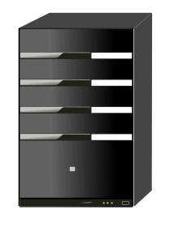
What can I use HPC for?
Tiny Job
Big Job
Tiny Job
Tiny Job
Parallel Jobs
Serial Jobs
Overview
Nodes
Data
Login
Notes:
Parallel Jobs - Divide and Conquer
A job that can be divided into smaller pieces, which can be independently run.
Serial Jobs
A collection of small jobs which can be done simultaneously

Slide 13
What can I use HPC for?
Big Data
Viz/Rendering
Shared Work Environment
Overview
Nodes
Data
Login
Notes:
Big Data:
- Require lots of RAM (memory) or data storage
- Need more CPU’s, distributed system
Visualization Rendering
Unique Hardware
- GPU’s, Linux, Shared team environment

Slide 14
HPC Cluster: Alpine
Heterogeneous cluster
Hardware provided by CU Boulder, CSU, and AMC
Access available to CU Boulder, CSU, AMC and RMACC users
Overview
Nodes
Data
Login
Notes:
Update Icon

Slide 15
Node Types
LOGIN
COMPILE
COMPUTE
Overview
Nodes
Data
Login

Slide 16
Node Types
LOGIN
COMPILE
COMPUTE
Entry to system
View or edit files
Submit jobs
Overview
Nodes
Data
Login
Notes:
Do not run software applications on a login node!
Examples:
No loading anaconda, do not run python scripts, or start a compiled software program.

Slide 17
Node Types
LOGIN
COMPILE
COMPUTE
View or edit files
Submit jobs
Compile code
Install software
Overview
Nodes
Data
Login

Slide 18
Node Types
LOGIN
COMPILE
COMPUTE
Run scheduled jobs
Handle calculations
Overview
Nodes
Data
Login

Slide 19
Alpine Partitions
COMPUTE
Overview
Nodes
Data
Login
Notes:
Compute nodes are organized into partitions – logical groups of similarly spec’d hardware.
Partitions make it easier to request specific resources and ensure a more consistent user experience.
The Alpine Cluster has four primary partitions.
Detailed Information on Alpine Hardware: https://curc.readthedocs.io/en/latest/clusters/alpine/alpine-hardware.html

Slide 20
Alpine Partitions
acpu
General Usage
Overview
Login
Nodes
Data
Notes:
amilan:
285 Nodes
64 CPU Cores per Node
3.75 GB of RAM per CPU (240 GB total)
Detailed Information on Alpine Hardware: https://curc.readthedocs.io/en/latest/clusters/alpine/alpine-hardware.html

Slide 21
Alpine Partitions
acpu
General Usage
amem
High Memory
Overview
Nodes
Data
Login
Notes:
amem:
22 Nodes
48 CPU Cores per node (12)
64 CPU Cores per node (10)
21.5 GB of RAM per CPU (1 TB total)
Detailed Information on Alpine Hardware: https://curc.readthedocs.io/en/latest/clusters/alpine/alpine-hardware.html

Slide 22
Alpine Partitions
aa100
al40
ah200
artxpro6000
Nvidia GPUs
acpu
General Usage
amem
High Memory
Overview
Nodes
Data
Login
Notes:
aa100
12 Nodes
64 CPU Cores per Node
3.75 GB of RAM per CPU (240 GB total)
3 GPU’s per Node (Nvidia A100)

Slide 23
Alpine Partitions
aa100
al40
ah200
artxpro6000
Nvidia GPUs
acpu
General Usage
amem
High Memory
ami100
AMD GPUs
Overview
Nodes
Data
Login
Notes:
ami100
8 Nodes
64 CPU Cores per Node
3.75 GB of RAM per CPU (240 GB total)
3 GPU’s per Node (AMD MI100)
Detailed Information on Alpine Hardware: https://curc.readthedocs.io/en/latest/clusters/alpine/alpine-hardware.html

Slide 24
Data Storage
Core
Personal Storage
Includes 3 Directories
/home (2 GB)
/projects (250 GB)
/scratch (10 TB)
Overview
Nodes
Data
Login

Slide 25
Data Storage
Core
PL
Personal Storage
Includes 3 Directories
/home (2 GB)
/projects (250 GB)
/scratch (10 TB)
PetaLibrary
Tiered Storage
Active, Archive
Requires Funding
Starts at 1 TB
Overview
Nodes
Data
Login

Slide 26
Core
Home
Personal data
Config files
OnDemand data
Do not share!
2 GB
Overview
Nodes
Data
Login
Notes:
Documentation on Filesystem/Storage: https://curc.readthedocs.io/en/latest/compute/filesystems.html

Slide 27
Core
Home
Projects
Personal data
Config files
OnDemand data
Do not share!
Code, Job scripts
Installed software
Shared data
2 GB
250 GB
Overview
Nodes
Data
Login
Notes:
Documentation on Filesystem/Storage: https://curc.readthedocs.io/en/latest/compute/filesystems.html

Slide 28
Core
Home
Projects
Scratch
Personal data
Config files
OnDemand data
Do not share!
Code, Job scripts
Installed software
Shared data
Job data (in/out)
Shared data
Deleted after 90 days
2 GB
250 GB
10 TB
Overview
Nodes
Data
Login
Notes:
Documentation on Filesystem/Storage: https://curc.readthedocs.io/en/latest/compute/filesystems.html

Slide 29
PetaLibrary
Active
Performance tier
Accessible by all nodes
No file limit
Overview
Nodes
Data
Login
Notes:
Documentation on PetaLibrary: https://curc.readthedocs.io/en/latest/storage/petalibrary/index.html

Slide 30
PetaLibrary
Active
Archive
Performance tier
Accessible by all nodes
No file limit
Integrity tier
Accessible by login node
10,000 file limit
Overview
Nodes
Data
Login
Notes:
Documentation on PetaLibrary: https://curc.readthedocs.io/en/latest/storage/petalibrary/index.html

Slide 31

Data Sharing: Within RC
/home ← Private!!!
/project
/scratch
PetaLibrary Space
Overview
Nodes
Data
Login
Notes:
*Users manage access to their /project and /scratch directories.
RC Staff manage access to the PetaLibrary Space

Slide 32
Data Sharing: Outside RC
Tools for data transfers:
Globus (Recommended)
Terminal/Command Line:
rsync
rclone
sftp
scp
Overview
Nodes
Data
Login
Notes:
DTN require internal CU Network access (VPN)

Slide 33
Data Transfer Nodes
DATA (DTN)
Support data transfers
Can be selected when using scp, sftp, or ssh transfers
dtn.rc.colorado.edu
Overview
Nodes
Data
Login

Slide 34
Acceptable data storage and use
CURC systems and services should not be used to store any data that is US government Classified, nor any Controlled Unclassified Information.
For users requiring storage for sensitive data types, please see the secure research computing resources:
https://www.colorado.edu/rc/secure-research-computing-resources
Overview
Nodes
Data
Login

Slide 35

Cloud Computing
CURC supports AWS, Azure, and GCP
Alternative or augmentation to HPC
Interested? Contact rc-help@colorado.edu
Overview
Nodes
Data
Login
Notes:
Cloudbursting

Slide 36
How to Access RC Resources?
Get an RC account
Set up two-factor authentication with Duo
Log in via 1) terminal or 2) OnDemand
Create greatness! (responsibly)
Overview
Nodes
Data
Login

Slide 37
Getting an Account
CU Boulder, CSU users and affiliates:
Request an account through the RC Account request portal:
https://rcamp.rc.colorado.edu/accounts/account-request/create/organization
AMC, RMACC users and affiliates:
Visit the AMC or RMACC tab under “Getting a CURC account” in the CURC documentation:
https://curc.readthedocs.io/en/latest/getting_started/logging-in.html
Overview
Nodes
Data
Login

Slide 38
Your RC Account
Access to:
Alpine Cluster
Core Storage
PetaLibrary Storage*
OnDemand
Approximately 2,000 Service Units (SUs) per month
*If purchased
Overview
Nodes
Data
Login
Notes:
https://ondemand.rc.colorado.edu/
https://ondemand-rmacc.rc.colorado.edu/

Slide 39
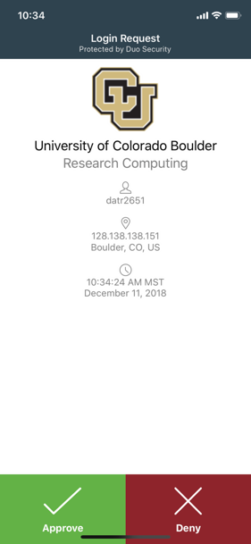
Duo Authentication
Duo smartphone app (recommended)
Phone Call/Text is an alternatives
Overview
Nodes
Data
Login

Slide 40
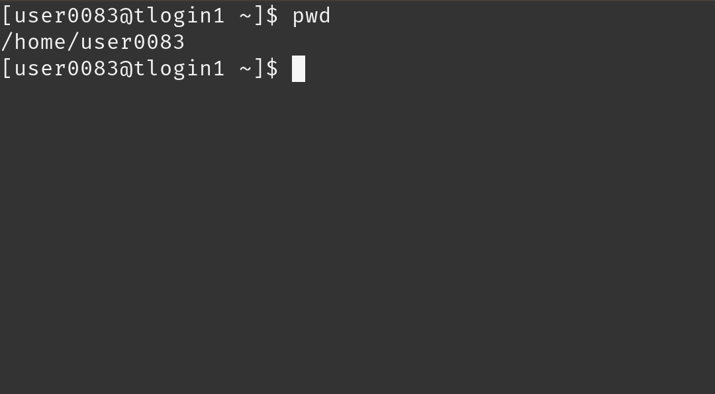
Terminal Access
Mac or Linux
Terminal application
Windows
PuTTY
Powershell
Overview
Nodes
Data
Login

Slide 41
Demo: Logging in via Terminal
To login to an RC login node* :
$ ssh <username>@login.rc.colorado.edu
Supply your institutional password and your Duo app will alert you to confirm the login
* Exclusive to CU and CSU accounts. Available on request for AMC. Not available to RMACC.
Overview
Nodes
Data
Login

Slide 42
Demo: logging in with OnDemand
CURC OnDemand is a browser based, integrated, single access point for all of your HPC resources at CU Research Computing.
CU Boulder: Visit https://ondemand.rc.colorado.edu.
All other Institutions: Visit https://ondemand-rmacc.rc.colorado.edu/
Overview
Nodes
Data
Login

Slide 43
Help! I’m stuck, where do I go?
Documentation: curc.readthedocs.io/
Trainings with Center for Research Data and Digital Scholarship (CRDDS): https://www.colorado.edu/crdds/
Helpdesk: rc-help@colorado.edu
Consult Hours (Tuesday 12:00-1:00 in-person or virtually, Thursday 1:00-2:00 virtually)
Or….

Slide 44
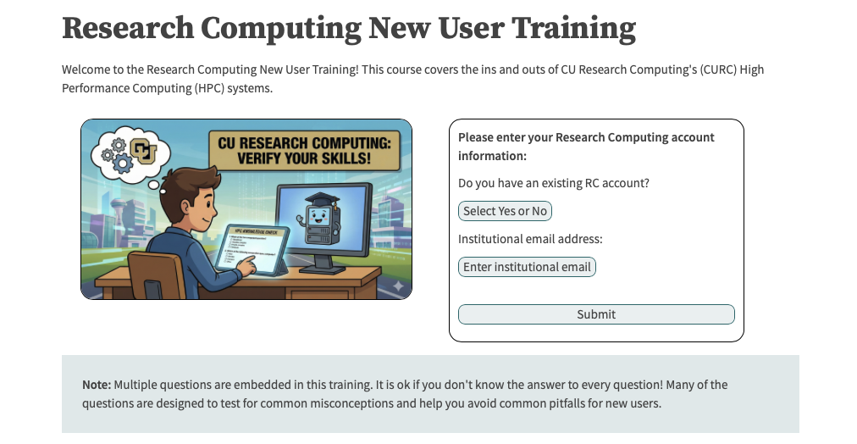
…try CURC’s new self-paced training!
https://researchcomputing.github.io/New_User_Async_Training

Slide 45
Helpdesk Tickets
To: rc-help@colorado.edu
Dear Research Computing,
I am running into issues running my Python script. I am using a conda environment called my_python_env with the pytorch software, and I am receiving the following error. I am not sure how to troubleshoot. My job ID is 620350. Let me know what I can try!
sbatch: error: Batch job submission failed: Invalid partition name specified.
Thanks, John
To: rc-help@colorado.edu
Dear Research Computing,
Help! My code won’t run! Help!
Help please, John

Slide 46

Documentation
https://curc.readthedocs.io/en/latest/

