Slide 1
Reproducible Data Science Environments with {rix}
Bruno Rodrigues

Slide 2
Intro: Who am I
Bruno Rodrigues, head of the statistics and data strategy departments at the Ministry of Research and Higher education in Luxembourg

Slide 3
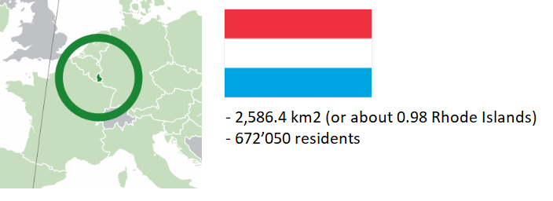
Intro: Who am I

Slide 4
Intro: Who am I
Slides available online at https://b-rodrigues.github.io/r-medicine-rix
Code available at: https://github.com/b-rodrigues/r-medicine-rix

Slide 5
Things I want to talk about
Identify what must be managed for reproducibility
Give a short intro to {rix} and Nix

Slide 6
What I mean by reproducibility
Ability to recover exactly the same results from an analysis

Slide 7
Turning our analysis reproducible
We need to answer these questions
. . .
How easy would it be for someone else to rerun the analysis?
How easy would it be to update the project?
How easy would it be to reuse this code for another project?
What guarantee do we have that the output is stable through time?

Slide 8
Reproducibility is on a continuum (1/2)
Here are the 4 main things influencing an analysis’ reproducibility:
Version of R used
Versions of packages used
Operating system
Hardware

Slide 9
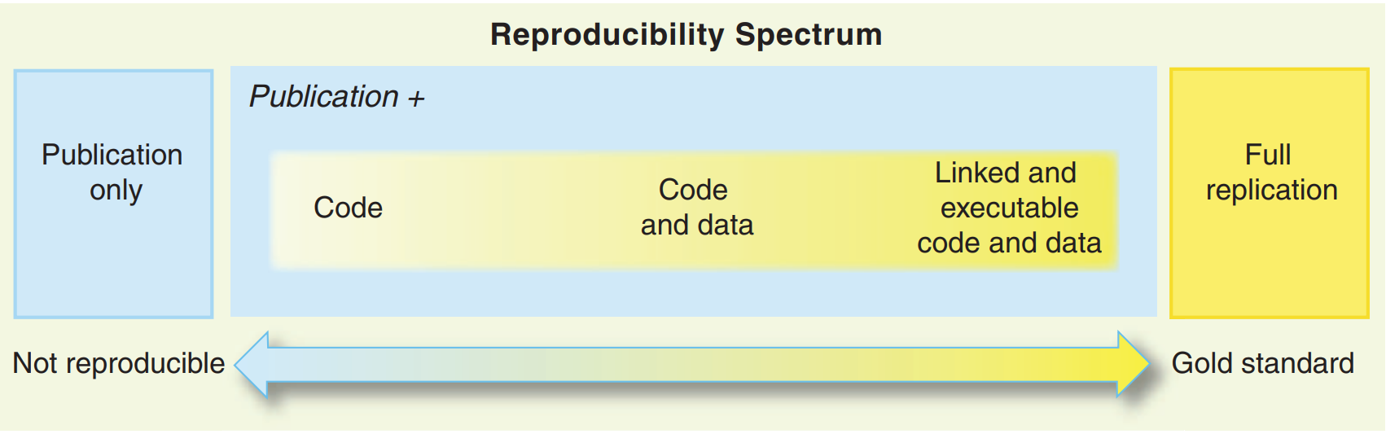
Reproducibility is on a continuum (2/2)

Slide 10
Source: Peng, Roger D. 2011. “Reproducible Research in Computational Science.” Science 334 (6060): 1226–27

Slide 11
Recording packages with {renv} 1/2
Most popular package for reproducibility, and very easy to use:
Open an R session in the folder containing the scripts
Run renv::init() and check the folder for renv.lock

Slide 12
Recording packages with {renv} 2/2
But:
Records, but does not restore the version of R
Installation of old packages can fail (due to missing OS-dependencies)

Slide 13
Going further with Docker: handling R and system-level dependencies
Docker is a containerisation tool that you install on your computer
Docker allows you to build images and run containers (a container is an instance of an image)
Docker images:
contain all the software and code needed for your project
are immutable (cannot be changed at run-time)
can be shared on- and offline

Slide 14
Docker: a panacea?
Docker is very useful and widely used
But the entry cost is high (familiarity with Linux is recommended)
Single point of failure (what happens if Docker gets bought, abandoned, etc? quite unlikely though)
Not actually dealing with reproducibility per se, we’re “abusing” Docker in a way
Btw, check out the Rocker project

Slide 15
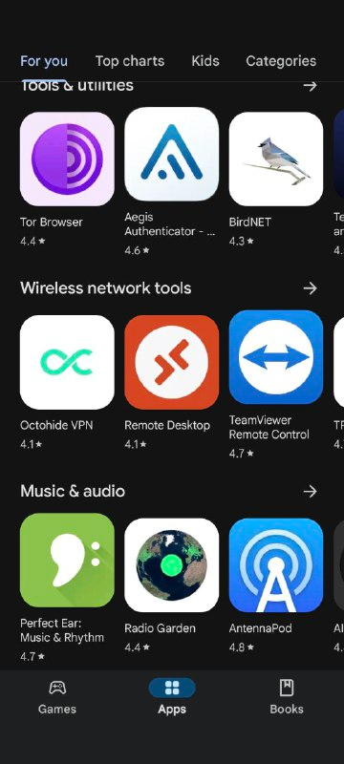
The Nix package manager (1/2)
Package manager: tool to install and manage packages
Package: any piece of software (not just R packages)
A popular package manager:
. . .
Google Play Store

Slide 16
The Nix package manager (2/2)
Gold standard of reproducibility: R, R packages and other dependencies must be managed
Nix is a package manager actually focused on reproducible builds
Nix deals with everything, with one single text file (called a Nix expression)!
These Nix expressions always build the exact same output

Slide 17
rix: reproducible development environments with Nix (1/5)
{rix} (website) makes writing Nix expression easy!
Simply use the provided rix() function:
. . .
library(rix) rix(date = "2025-01-27", r_pkgs = c("dplyr", "ggplot2"), system_pkgs = NULL, git_pkgs = NULL, tex_pkgs = NULL, ide = "code", project_path = ".")

Slide 18
rix: reproducible development environments with Nix (2/5)
renv.lock files can also be used as starting points:
. . .
library(rix) renv2nix( renv_lock_path = "path/to/original/renv_project/renv.lock", project_path = "path/to/rix_project", override_r_ver = "4.4.1" # <- optional )

Slide 19
rix: reproducible development environments with Nix (3/5)
List required R version and packages
Optionally: more system packages, packages hosted on Github, or LaTeX packages
Optionally: an IDE (Rstudio, Radian, VS Code or “other”)
Work interactively in an (relavitely) isolated, project-specific and reproducible environment!

Slide 20
rix: reproducible development environments with Nix (4/5)
rix::rix() generates a default.nix file
Build expressions using nix-build (in terminal) or rix::nix_build() from R
“Drop” into the development environment using nix-shell
Expressions can be generated even without Nix installed (with some caveats)

Slide 21
rix: reproducible development environments with Nix (5/5)
Can install specific versions of packages (write "dplyr@1.0.0")
Can install packages hosted on Github
Many vignettes to get you started! See here
. . .
Let’s check out scripts/nix_expressions/rix_intro/

Slide 22
Non-interactive use
{rix} makes it easy to run pipelines in the right environment
(Little side note: the best tool to build pipelines in R is {targets})
See scripts/nix_expressions/nix_targets_pipeline
Can also run the pipeline like so:
. . .
cd /absolute/path/to/pipeline/ && nix-shell default.nix --run "Rscript -e 'targets::tar_make()'"

Slide 23
Nix and Github Actions: running pipelines
Possible to easily run a {targets} pipeline on Github actions
Simply run rix::tar_nix_ga() to generate the required files
Commit and push, and watch the actions run!
See here.

Slide 24
Nix and Github Actions: writing papers
Easy collaboration on papers as well
See here
Just focus on writing!

Slide 25
Conclusion
Very vast and complex topic!
At the very least, generate an renv.lock file
Always possible to rebuild a Docker image in the future (either you, or someone else!)
Consider using {targets}: not only good for reproducibility, but also an amazing tool all around
Long-term reproducibility: must use Docker or Nix (better: both!) and maintenance effort is required as well

Slide 26
The end
Contact me if you have questions:
bruno@brodrigues.co
Twitter: @brodriguesco
Mastodon: @brodriguesco@fosstodon.org
Blog: www.brodrigues.co
Book: www.raps-with-r.dev
rix: https://docs.ropensci.org/rix
. . .
Thank you!

