Slide 1
Building fully reproducible data science environments for R and Python with ease using nix, rix, and Docker
Bruno Rodrigues

Slide 2
Intro: Who am I
Bruno Rodrigues, head of the statistics at the Ministry of Research and Higher education in Luxembourg
Slides available online at https://is.gd/repro_basf
Code available at: https://github.com/b-rodrigues/repro_basf

Slide 3
Topics I want to talk about
What I mean by reproducibility
What is Nix, how it works and its complementary relationship to Docker
What I will not discuss (but is very useful!):
FP, Git, Documenting, testing and packaging code, build automation

Slide 4
What I mean by reproducibility
Ability to recover exactly the same results from an analysis
Why would you want that?
Auditing purposes
Updating data (impact should only come from data changes)
Reproducibility as a cornerstone of science
(Work on an immutable dev environment)

Slide 5
Making our scripts reproducible
We need to answer these questions
. . .
How easy would it be for someone else to rerun the analysis?
How easy would it be to update the project?
How easy would it be to reuse this code for another project?
What guarantee do we have that the output is stable over time?

Slide 6
Reproducibility is on a continuum (1/2)
Here are the 4 main things influencing an analysis’ reproducibility:
Version of R used
Versions of packages used
Operating system
Hardware

Slide 7
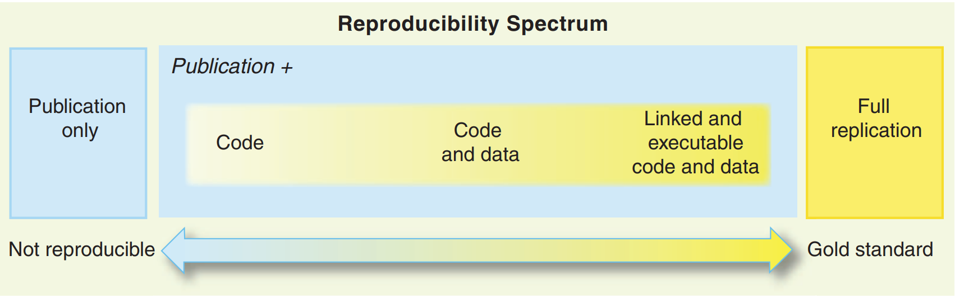
Reproducibility is on a continuum (2/2)

Slide 8
Source: Peng, Roger D. 2011. “Reproducible Research in Computational Science.” Science 334 (6060): 1226–27

Slide 9
Package versioning with renv
renv is commonly used
Run renv::init() to generate library snapshot as a renv.lock file

Slide 10
What an renv.lock file looks like
. . .
{ "R": { "Version": "4.2.2", "Repositories": [ { "Name": "CRAN", "URL": "https://packagemanager.rstudio.com/all/latest" } ] }, "Packages": { "MASS": { "Package": "MASS", "Version": "7.3-58.1", "Source": "Repository", "Repository": "CRAN", "Hash": "762e1804143a332333c054759f89a706", "Requirements": [] }, "Matrix": { "Package": "Matrix", "Version": "1.5-1", "Source": "Repository", "Repository": "CRAN", "Hash": "539dc0c0c05636812f1080f473d2c177", "Requirements": [ "lattice" ] ***and many more packages***

Slide 11
Restoring a library using an renv.lock file
renv.lock file not just a record
Can be used to restore as well!
Run renv::restore()

Slide 12
{renv} alone is not enough
Shortcomings:
. . .
Records, but does not restore the version of R
Installation of old packages can fail (due to missing OS-dependencies)
. . .
but… :
. . .
Generating a renv.lock file is “free”
Provides a blueprint for dockerizing our pipeline
Creates a project-specific library (no interferences)

Slide 13
Going further with Docker: handling R and system-level dependencies
Docker is a containerisation tool
Docker allows you to build images and run containers (a container is an instance of an image)
Docker images:
contain all the software and code needed for your project
are immutable (cannot be changed at run-time)
can be shared on- and offline

Slide 14
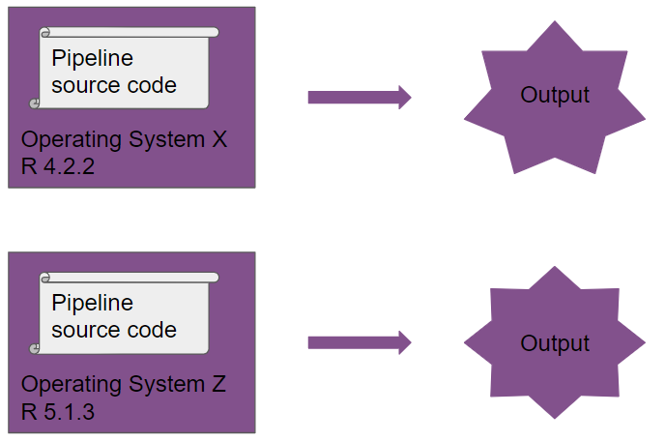
Without Docker

Slide 15
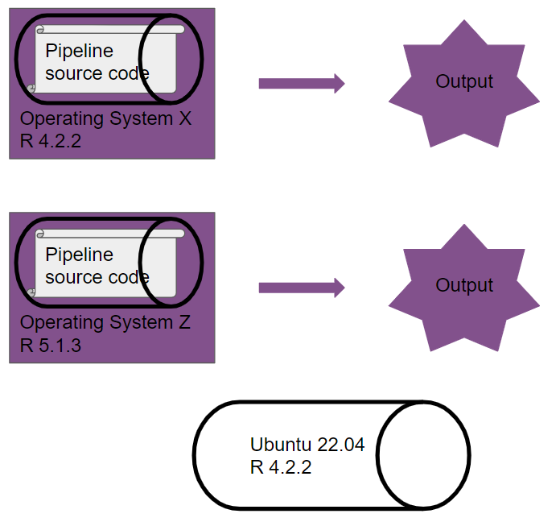
With Docker

Slide 16
Dockerizing a project (1/3)
Dockerizing a project could look like this:
At image build-time:
install R (or use an image that ships R)
install packages (using our renv.lock file)
copy all scripts to the image
run the analysis (non-interactively)
At container run-time:
copy the outputs of the analysis from the container to your computer
possible to “log in” into a running container to inspect code and outputs

Slide 17
Dockerizing a project (2/3)
Restoring packages with {renv} can be tricky:
. . .
#> * installing *source* package ‘ModelMetrics’ ... #> ** package ‘ModelMetrics’ successfully unpacked and MD5 sums checked #> ** using staged installation #> ** libs #> /usr/bin/clang++ -std=gnu++11 -I"/opt/R-devel/lib64/R/include" -DNDEBUG -I'/home/docker/R/Rcpp/include' -I/usr/local/include -fpic -g -O2 -c RcppExports.cpp -o RcppExports.o #> /usr/bin/clang++ -std=gnu++11 -I"/opt/R-devel/lib64/R/include" -DNDEBUG -I'/home/docker/R/Rcpp/include' -I/usr/local/include -fpic -g -O2 -c auc_.cpp -o auc_.o #> auc_.cpp:2:10: fatal error: 'omp.h' file not found #> #include #> ^~~~~~~ #> 1 error generated. #> make: *** [/opt/R-devel/lib64/R/etc/Makeconf:178: auc_.o] Error 1 #> ERROR: compilation failed for package ‘ModelMetrics’

Slide 18
Dockerizing a project (2/3)
The older the renv.lock file, the harder to restore!
Gets very complicated if you add Python and/or other tools.

Slide 19
Dockerizing a project (3/3)
ALSO! Image build process not reproducible per se, only running containers is
YOU need to make sure build process is reproducible (or store the built images)
Need to fix version of R
Base image layer becomes unsupported at some point

Slide 20
Docker conclusion
Docker is very useful and widely used
But the entry cost is high (familiarity with Linux is recommended)
Single point of failure (what happens if Docker gets bought, abandoned, etc? quite unlikely though)
Not actually dealing with reproducibility per se, we’re “abusing” Docker in a way

Slide 21
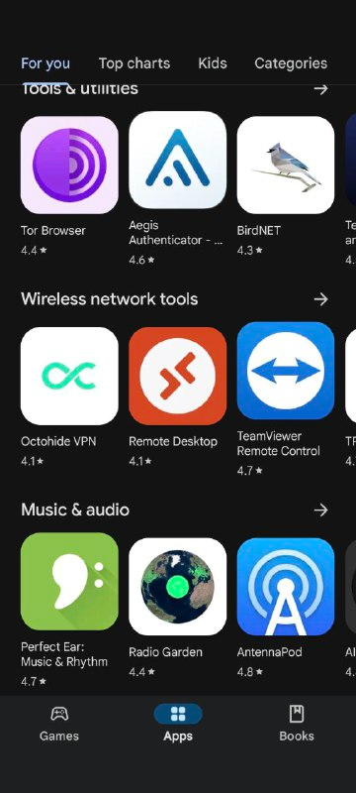
The Nix package manager (1/2)
Package manager: tool to install and manage packages
Package: any piece of software (not just R packages)
Example of popular package manager:
. . .
Google Play Store

Slide 22
The Nix package manager (2/2)
Reproducibility: R, R packages and other dependencies must be managed
Nix deals with everything, with one single text file (called a Nix expression)!
Nix is a package manager actually focused on reproducible builds
These Nix expressions always build the exact same output

Slide 23
A basic Nix expression (1/6)
let pkgs = import (fetchTarball "https://github.com/NixOS/nixpkgs/archive/976fa3369d722e76f37c77493d99829540d43845.tar.gz") {}; system_packages = builtins.attrValues { inherit (pkgs) R ; }; in pkgs.mkShell { buildInputs = [ system_packages ]; shellHook = "R --vanilla"; }
There’s a lot to discuss here!

Slide 24
A basic Nix expression (2/6)
Written in the Nix language (not discussed)
Defines the repository to use (with a fixed revision)
Lists packages to install
Defines the output: a development shell

Slide 25
A basic Nix expression (3/6)
Software for Nix is defined as a mono-repository of tens of thousands of expressions on GitHub
GitHub: we can use any commit to pin package versions for reproducibility!
For example, the following commit installs R 4.3.1 and associated packages:
. . .
pkgs = import (fetchTarball "https://github.com/NixOS/nixpkgs/archive/976fa3369d722e76f37c77493d99829540d43845.tar.gz") {};
Let’s take a look at the repository…

Slide 26
A basic Nix expression (4/6)
system_packages: a variable that lists software to install
In this case, only R:
. . .
system_packages = builtins.attrValues { inherit (pkgs) R ; };

Slide 27
A basic Nix expression (5/6)
Finally, we define a shell:
. . .
pkgs.mkShell { buildInputs = [ system_packages ]; shellHook = "R --vanilla"; }
. . .
This shell will come with the software defined in system_packages (buildInputs)
And launch R --vanilla when started (shellHook)

Slide 28
A basic Nix expression (6/6)
Writing these expressions requires learning a new language
While incredibly powerful, if all we want are per-project reproducible dev shells…
…then {rix} will help!

Slide 29
Nix expressions
Nix expressions can be used to install software
But we will use them to build per-project development shells
We will include R, LaTeX packages, or Quarto, Python, Julia….
Nix takes care of installing every dependency down to the compiler!

Slide 30
rix: reproducible development environments with Nix (1/5)
{rix} (website) makes writing Nix expressions easy!
Simply use the provided rix() function:
. . .
library(rix) rix( date = "2025-02-17", r_pkgs = "ggplot2", py_conf = list( py_version = "3.12", py_pkgs = c("polars", "great-tables") ), overwrite = TRUE )

Slide 31
rix: reproducible development environments with Nix (2/5)
renv.lock files can also be used as starting points:
. . .
library(rix) renv2nix( renv_lock_path = "path/to/original/renv_project/renv.lock", project_path = "path/to/rix_project", override_r_ver = "4.4.1" # <- optional )

Slide 32
rix: reproducible development environments with Nix (3/5)
List required R version and packages
Optionally: more system packages, packages hosted on GitHub, or LaTeX packages
Optionally: an IDE (RStudio, Radian, VS Code or “other”)
Work interactively in an isolated, project-specific and reproducible environment!

Slide 33
rix: reproducible development environments with Nix (4/5)
Time for a demonstration, see scripts/nix_expressions/docker/
First outside of Docker
Then we dockerize
. . .
(you’ll find many other examples in the repository)

Slide 34
rix: reproducible development environments with Nix (5/5)
Can install specific versions of packages (write "dplyr@1.0.0")
Can install packages hosted on GitHub
Many vignettes to get you started! See here

Slide 35
Non-interactive use
{rix} makes it easy to run pipelines in the right environment
(Little side note: the best tool to build pipelines in R is {targets})
See scripts/nix_expressions/nix_targets_pipeline
Can also run the pipeline like so:
. . .
cd /absolute/path/to/pipeline/ && nix-shell default.nix --run "Rscript -e 'targets::tar_make()'"

Slide 36
Nix and GitHub Actions: running pipelines
Possible to easily run a {targets} pipeline on GitHub actions
Simply run rix::tar_nix_ga() to generate the required files
Commit and push, and watch the actions run!
See here.

Slide 37
Nix and GitHub Actions: writing papers
Easy collaboration on papers as well
See here
Just focus on writing!

Slide 38
Conclusion
Very vast and complex topic!
At the very least, generate an renv.lock file
Always possible to rebuild a Docker image in the future (either you, or someone else!)
Consider using {targets}: not only good for reproducibility, but also an amazing tool all around
Long-term reproducibility: must use Nix (with or without Docker) or store Docker images
Maybe check out my other packages (in early dev): {rixpress}

Slide 39
The end
Contact me if you have questions:
bruno@brodrigues.co
Twitter: @brodriguesco
Mastodon: @brodriguesco@fosstodon.org
Blog: www.brodrigues.co
Book: www.raps-with-r.dev
rix: https://docs.ropensci.org/rix
. . .
Thank you!

