Slide 1
Building fully reproducible data science environments for R and python with ease using nix, rix, and Docker
Bruno Rodrigues

Slide 2
Intro: Who am I
Bruno Rodrigues, head of the statistics and data strategy departments at the Ministry of Research and Higher education in Luxembourg
Slides available online at https://is.gd/repro_basf
Code available at: https://github.com/b-rodrigues/repro_basf

Slide 3
Thing I want to talk about
Identify what must be managed for reproducibility
Learn about the following tools to turn your projects reproducible
{renv}, Docker and Nix
What I will not discuss (but is very useful!):
FP, Git, Documenting, testing and packaging code, build automation with {targets}

Slide 4
What I mean by reproducibility
Ability to recover exactly the same results from an analysis
Why would you want that?
Auditing purposes
Update of data (only impact must be from data update)
Reproducibility as a cornerstone of science
(Work on an immutable dev environment) . . .
“But if I have the original script and data, what’s the problem?”

Slide 5
A typical project’s setup
Our project: housing in Luxembourg
Data to analyse: vente-maison-2010-2021.xlsx in the data folder
2 scripts to analyse data (in the scripts/project_start folder):
One to scrape the Excel file save_data.R
One to analyse the data analysis.R

Slide 6
Project start - What’s wrong with these scripts?
The first two scripts -> script-based workflow
Just a long series of calls
No functions
difficult to re-use!
difficult to test!
difficult to parallelise!
lots of repetition!
Also: usually we want a report not just a script
No record of package, nor R, versions used

Slide 7
Turning our scripts reproducible
We need to answer these questions
. . .
How easy would it be for someone else to rerun the analysis?
How easy would it be to update the project?
How easy would it be to reuse this code for another project?
What guarantee do we have that the output is stable through time?

Slide 8
Reproducibility is on a continuum (1/2)
Here are the 4 main things influencing an analysis’ reproducibility:
Version of R used
Versions of packages used
Operating system
Hardware

Slide 9
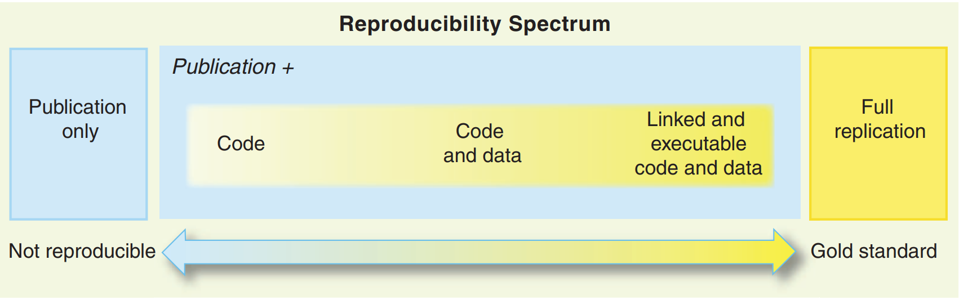
Reproducibility is on a continuum (2/2)

Slide 10
Source: Peng, Roger D. 2011. “Reproducible Research in Computational Science.” Science 334 (6060): 1226–27

Slide 11
Recording packages and R version used with renv
Create a renv.lock file in 2 steps!
Open an R session in the folder containing the scripts
Run renv::init() and check the folder for renv.lock
. . .
(renv::init() will take some time to run the first time)

Slide 12
What an renv.lock file looks like
. . .
{ "R": { "Version": "4.2.2", "Repositories": [ { "Name": "CRAN", "URL": "https://packagemanager.rstudio.com/all/latest" } ] }, "Packages": { "MASS": { "Package": "MASS", "Version": "7.3-58.1", "Source": "Repository", "Repository": "CRAN", "Hash": "762e1804143a332333c054759f89a706", "Requirements": [] }, "Matrix": { "Package": "Matrix", "Version": "1.5-1", "Source": "Repository", "Repository": "CRAN", "Hash": "539dc0c0c05636812f1080f473d2c177", "Requirements": [ "lattice" ] ***and many more packages***

Slide 13
Restoring a library using an renv.lock file
renv.lock file not just a record
Can be used to restore as well!
Run renv::restore()

Slide 14
{renv} conclusion
Shortcomings:
. . .
Records, but does not restore the version of R
Installation of old packages can fail (due to missing OS-dependencies)
. . .
but… :
. . .
Generating a renv.lock file is “free”
Provides a blueprint for dockerizing our pipeline
Creates a project-specific library (no interferences)

Slide 15
Going further with Docker: handling R and system-level dependencies
Docker is a containerisation tool that you install on your computer
Docker allows you to build images and run containers (a container is an instance of an image)
Docker images:
contain all the software and code needed for your project
are immutable (cannot be changed at run-time)
can be shared on- and offline

Slide 16
“Hello, Docker!”
Start by creating a so-called Dockerfile
Dockerfile = recipe for an image, starts off an existing base image
Build the image: docker build -t hello .
Run a container: docker run --rm --name hello_container hello
--rm: remove the container after running
--name some_name: name your container some_name

Slide 17
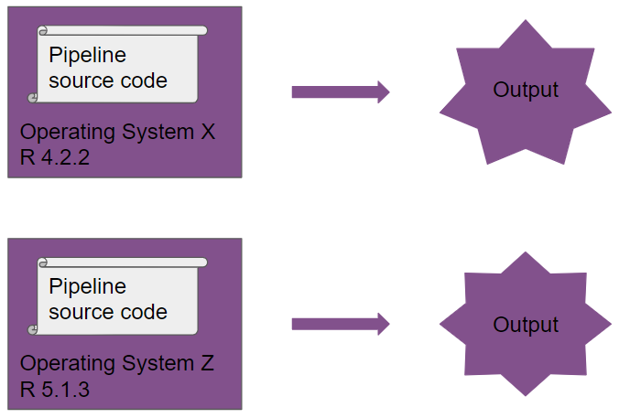
Without Docker

Slide 18
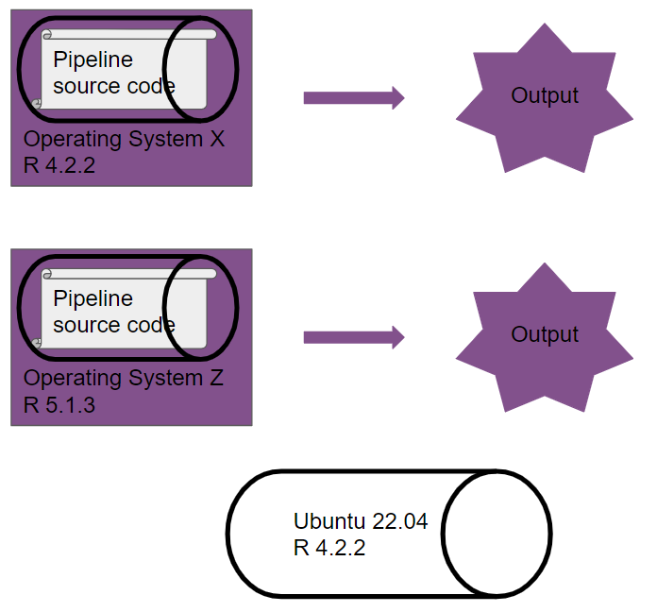
With Docker

Slide 19
Dockerizing a project (1/3)
At image build-time:
install R (or use an image that ships R)
install packages (using our renv.lock file)
copy all scripts to the image
run the analysis using targets::tar_make()
At container run-time:
copy the outputs of the analysis from the container to your computer
possible to “log-in” into a running container to inspect code and outputs

Slide 20
Dockerizing a project (2/3)
The completed and built image can be shared, or just the Dockerfile (and users can then rebuild the image)
The outputs will always stay the same!
Working interactively using Docker can be challenging though

Slide 21
Dockerizing a project (3/3)
But! Image build process not reproducible per se, only running containers is
YOU need to make sure build process is reproducible (or store the built images)
Need to fix version of R
Base image layer becomes unsupported at some point

Slide 22
The Rocker project
It is possible to build new images from other images
The Rocker project provides many images with R, RStudio, Shiny, and other packages pre-installed
I recommend the “r-ver” images, specifically made for reproducibility

Slide 23
Docker: a panacea?
Docker is very useful and widely used
But the entry cost is high (familiarity with Linux is recommended)
Single point of failure (what happens if Docker gets bought, abandoned, etc? quite unlikely though)
Not actually dealing with reproducibility per se, we’re “abusing” Docker in a way

Slide 24
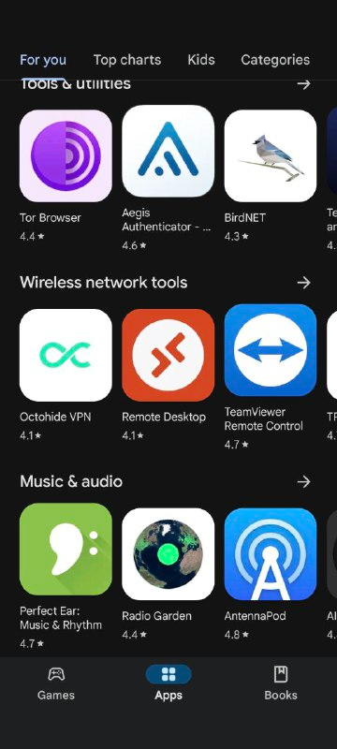
The Nix package manager (1/2)
Package manager: tool to install and manage packages
Package: any piece of software (not just R packages)
A popular package manager:
. . .
Google Play Store

Slide 25
The Nix package manager (2/2)
Reproducibility: R, R packages and other dependencies must be managed
Nix is a package manager actually focused on reproducible builds
Nix deals with everything, with one single text file (called a Nix expression)!
These Nix expressions always build the exact same output

Slide 26
A basic Nix expression (1/6)
let pkgs = import (fetchTarball "https://github.com/NixOS/nixpkgs/archive/976fa3369d722e76f37c77493d99829540d43845.tar.gz") {}; system_packages = builtins.attrValues { inherit (pkgs) R ; }; in pkgs.mkShell { buildInputs = [ system_packages ]; shellHook = "R --vanilla"; }
There’s a lot to discuss here!

Slide 27
A basic Nix expression (2/6)
Written in the Nix language (not discussed)
Defines the repository to use (with a fixed revision)
Lists packages to install
Defines the output: a development shell

Slide 28
A basic Nix expression (3/6)
Software for Nix is defined as a mono-repository of tens of thousands of expressions on Github
Github: we can use any commit to pin package versions for reproducibility!
For example, the following commit installs R 4.3.1 and associated packages:
. . .
pkgs = import (fetchTarball "https://github.com/NixOS/nixpkgs/archive/976fa3369d722e76f37c77493d99829540d43845.tar.gz") {};
Let’s take a look at the repository…

Slide 29
A basic Nix expression (4/6)
system_packages: a variable that lists software to install
In this case, only R:
. . .
system_packages = builtins.attrValues { inherit (pkgs) R ; };

Slide 30
A basic Nix expression (5/6)
Finally, we define a shell:
. . .
pkgs.mkShell { buildInputs = [ system_packages ]; shellHook = "R --vanilla"; }
. . .
This shell will come with the software defined in system_packages (buildInputs)
And launch R --vanilla when started (shellHook)

Slide 31
A basic Nix expression (6/6)
Writing these expressions requires learning a new language
While incredibly powerful, if all we want are per-project reproducible dev shells…
…then {rix} will help!

Slide 32
Nix expressions
Nix expressions can be used to install software
But we will use them to build per-project development shells
We will include R, LaTeX packages, or Quarto, Python, Julia….
Nix takes care of installing every dependency down to the compiler!

Slide 33
CRAN and Bioconductor
CRAN is the repository of R packages to extend the language
As of writing, +20000 packages available
Biocondcutor: repository with a focus on Bioinformatics: +2000 more packages
Almost all available through nixpkgs in the rPackages set!
Find packages here

Slide 34
rix: reproducible development environments with Nix (1/5)
{rix} (website) makes writing Nix expression easy!
Simply use the provided rix() function:
. . .
library(rix) rix(r_ver = "4.3.1", #date = "2025-01-27", <- a date also works r_pkgs = c("dplyr", "ggplot2"), system_pkgs = NULL, git_pkgs = NULL, tex_pkgs = NULL, ide = "code", project_path = ".")

Slide 35
rix: reproducible development environments with Nix (2/5)
renv.lock files can also be used as starting points:
. . .
library(rix) renv2nix( renv_lock_path = "path/to/original/renv_project/renv.lock", project_path = "path/to/rix_project", override_r_ver = "4.4.1" # <- optional )

Slide 36
rix: reproducible development environments with Nix (3/5)
List required R version and packages
Optionally: more system packages, packages hosted on Github, or LaTeX packages
Optionally: an IDE (Rstudio, Radian, VS Code or “other”)
Work interactively in an isolated, project-specific and reproducible environment!

Slide 37
rix: reproducible development environments with Nix (4/5)
rix::rix() generates a default.nix file
Build expressions using nix-build (in terminal) or rix::nix_build() from R
“Drop” into the development environment using nix-shell
Expressions can be generated even without Nix installed

Slide 38
rix: reproducible development environments with Nix (5/5)
Can install specific versions of packages (write "dplyr@1.0.0")
Can install packages hosted on Github
Many vignettes to get you started! See here
. . .
Let’s check out scripts/nix_expressions/rix_intro/

Slide 39
Non-interactive use
{rix} makes it easy to run pipelines in the right environment
(Little side note: the best tool to build pipelines in R is {targets})
See scripts/nix_expressions/nix_targets_pipeline
Can also run the pipeline like so:
. . .
cd /absolute/path/to/pipeline/ && nix-shell default.nix --run "Rscript -e 'targets::tar_make()'"

Slide 40
Nix and Github Actions: running pipelines
Possible to easily run a {targets} pipeline on Github actions
Simply run rix::tar_nix_ga() to generate the required files
Commit and push, and watch the actions run!
See here.

Slide 41
Nix and Github Actions: writing papers
Easy collaboration on papers as well
See here
Just focus on writing!

Slide 42
Conclusion
Very vast and complex topic!
At the very least, generate an renv.lock file
Always possible to rebuild a Docker image in the future (either you, or someone else!)
Consider using {targets}: not only good for reproducibility, but also an amazing tool all around
Long-term reproducibility: must use Docker or Nix (better: both!) and maintenance effort is required as well

Slide 43
The end
Contact me if you have questions:
bruno@brodrigues.co
Twitter: @brodriguesco
Mastodon: @brodriguesco@fosstodon.org
Blog: www.brodrigues.co
Book: www.raps-with-r.dev
rix: https://docs.ropensci.org/rix
. . .
Thank you!

