Slide 1
Reproducible data science environments with {rix}
Bruno Rodrigues

Slide 2
Intro: Who am I
Bruno Rodrigues, head of the statistics department at the Ministry of Research and Higher Education in Luxembourg

Slide 3
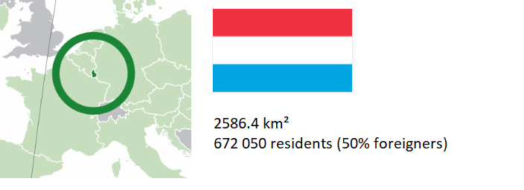
Intro: Luxembourg?

Slide 4
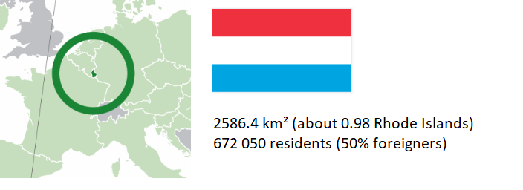
Intro: Luxembourg?

Slide 5
Intro: where to find the code
Slides available online:
https://b-rodrigues.github.io/repro_oak_ridge
Code available here:
https://github.com/b-rodrigues/repro_oak_ridge

Slide 6
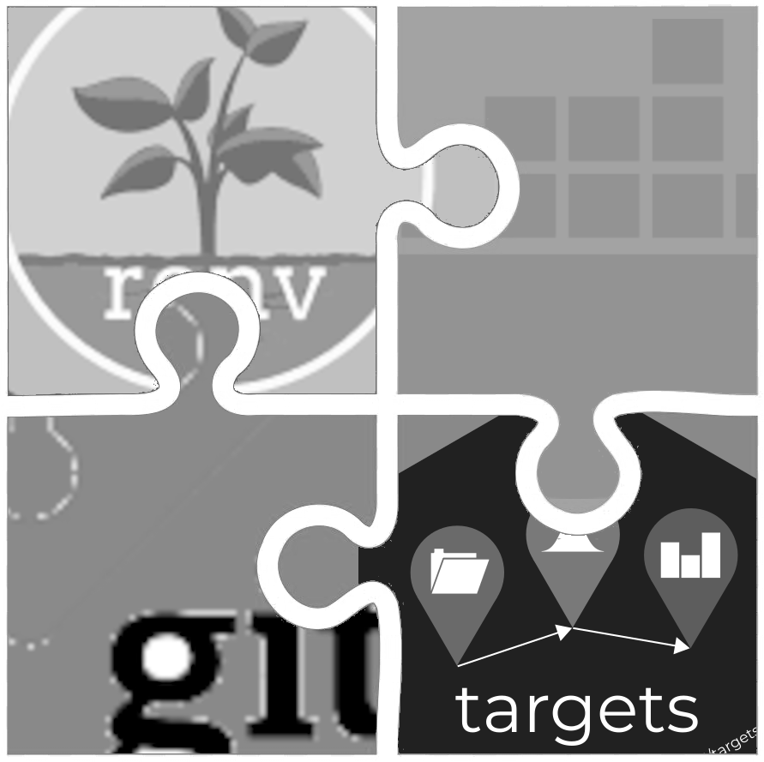
What I’ll be talking about
The puzzle you know:

Slide 7
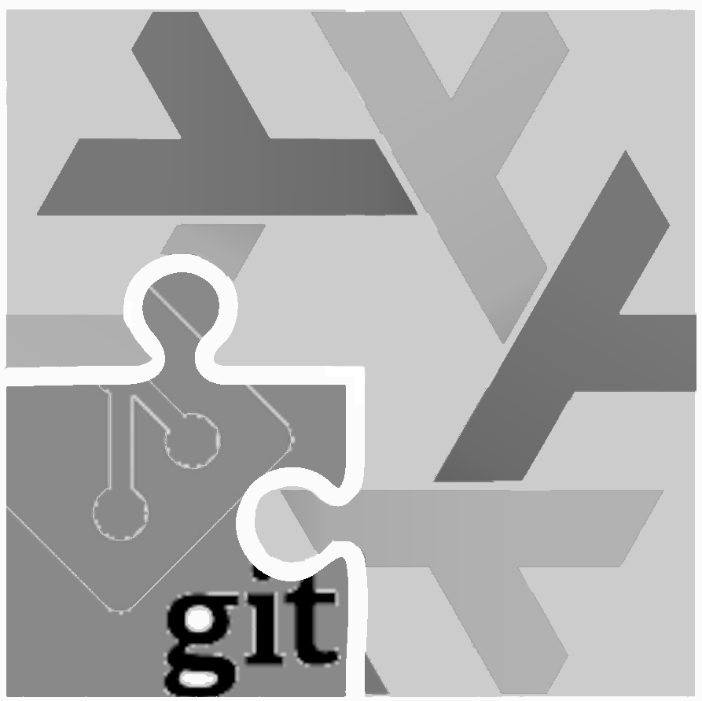
What I’ll be talking about
The puzzle with Nix:

Slide 8
Available solutions for R
{renv} or {groundhog}: simple to use, but:
  Doesn’t save the R version
  Installing old packages may fail (system dependencies)
Docker goes further:
  Manages R and system dependencies
  Containers executable anywhere
But:
  Not inherently reproducible

Slide 9
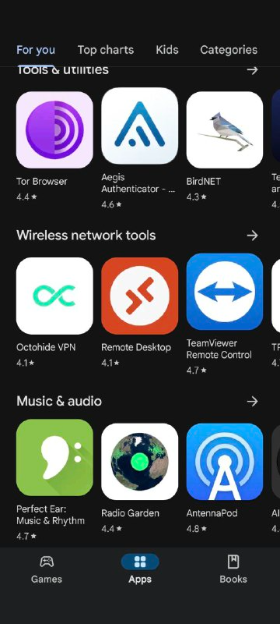
The Nix package manager (1/2)
Package manager: tool for installing and managing packages
Package: any software (not just R packages)
A popular package manager:
. . .
Google Play Store

Slide 10
The Nix package manager (2/2)
To ensure reproducibility: R, R packages, and other dependencies must be explicitly managed
Nix is a package manager truly focused on reproducible builds
Nix manages everything using a single text file (called a Nix expression)!
These expressions always produce exactly the same result

Slide 11
rix: reproducible development environments with Nix (1/5)
{rix} (website) simplifies writing Nix expressions!
Just use the provided rix() function:
. . .
library(rix)
rix(date = "2025-06-13",
r_pkgs = c("dplyr", "ggplot2"),
system_pkgs = NULL,
git_pkgs = NULL,
tex_pkgs = NULL,
ide = "code",
project_path = ".")

Slide 12
rix: reproducible development environments with Nix (2/5)
renv.lock files can also serve as a starting point:
. . .
library(rix)
renv2nix(
renv_lock_path = "path/to/original/renv_project/renv.lock",
project_path = "path/to/rix_project",
override_r_ver = "4.4.1" # <- optional
)

Slide 13
rix: reproducible development environments with Nix (3/5)
List the R version and required packages
Optionally:
  system packages, GitHub packages, or LaTeX packages
  an IDE (RStudio, Radian, VS Code, or “other”)
  a version of Python and Python packages to include
  a version of Julia and Julia packages to include

Slide 14
rix: reproducible development environments with Nix (4/5)
rix::rix() generates a default.nix file
Build the expressions with nix-build (in terminal) or rix::nix_build() from R
Access the development environment with nix-shell
Expressions can be generated even without Nix installed (with some limitations)

Slide 15
rix: reproducible development environments with Nix (5/5)
Can install specific versions of packages (write "dplyr@1.0.0")
Can install packages hosted on GitHub
Many vignettes to get started! See here

Slide 16
Polyglot environments with rix
rix() supports Python and Julia alongside R:
. . .
rix(date = "2025-06-09",
r_pkgs = c("tidyr", "dplyr", "ggplot2", "languageserver"),
py_conf = list(
py_version = "3.13",
py_pkgs = c("polars", "scikit-learn")
),
ide = "none",
project_path = ".",
overwrite = TRUE)
Julia: use jl_conf = list(jl_version = "1.10", jl_pkgs = c(...))
See: scripts/nix_expressions/02_native_vscode_example/

Slide 17
Demo
Basics: scripts/nix_expressions/01_rix_intro/
Native VS Code/Positron on Windows: scripts/nix_expressions/02_native_vscode_example/
Nix and {targets}: scripts/nix_expressions/03_nix_targets_pipeline
Nix and Docker: scripts/nix_expressions/04_docker/
Nix and {shiny}: scripts/nix_expressions/05_shiny
GitHub Actions: see here

Slide 18
Polyglot pipelines with {rixpress}
{rixpress} allows chaining processing steps in R and Python
Uses {rix} to create a reproducible (via Nix) execution environment for the pipeline
Each pipeline step is a Nix derivation
Data transfer: automatic via reticulate or universal format (JSON)

Slide 19
An example of a polyglot pipeline
list(
rxp_py_file(…), # Read a CSV with Python
rxp_py(…), # Filter with Polars
rxp_py2r(…), # Python → R transfer
rxp_r(…), # Transformation in R
rxp_r2py(…), # R → Python transfer
rxp_py(…), # Another Python step
rxp_py2r(…), # Back to R
rxp_r(…) # Final step
) |> rixpress()
Each step is named and typed (py, r, r2py, etc.)
Ability to add files (functions.R, images…)

Slide 20
To learn more about rixpress:
GitHub Repository
Website
Repository of demos

Slide 21
Fin
Contact me if you have questions:
bruno@brodrigues.co
Twitter: @brodriguesco
Mastodon: @brodriguesco@fosstodon.org
Blog: www.brodrigues.co
Book: www.raps-with-r.dev
rix: https://docs.ropensci.org/rix
rixpress: https://b-rodrigues.github.io/rixpress/
. . .
Thanks!

