Slide 1
Reproducible data science with Nix and T
Bruno Rodrigues

Slide 2
Intro: Who am I
Bruno Rodrigues, head of the statistics department at the Ministry of Research and Higher Education in Luxembourg

Slide 3
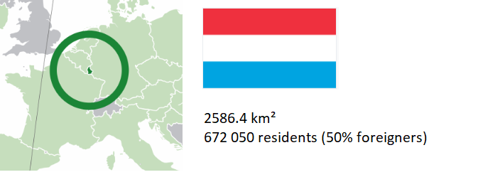
Intro: Luxembourg?

Slide 4
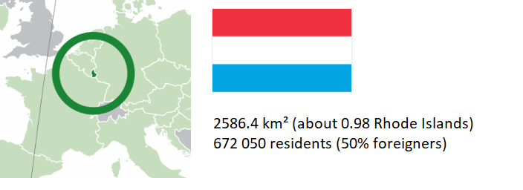
Intro: Luxembourg?

Slide 5
Intro: Luxembourg?
Sole Grand-Duchy in the World
3 official languages (Luxembourguish, German, French)
A founder of the European Union

Slide 6
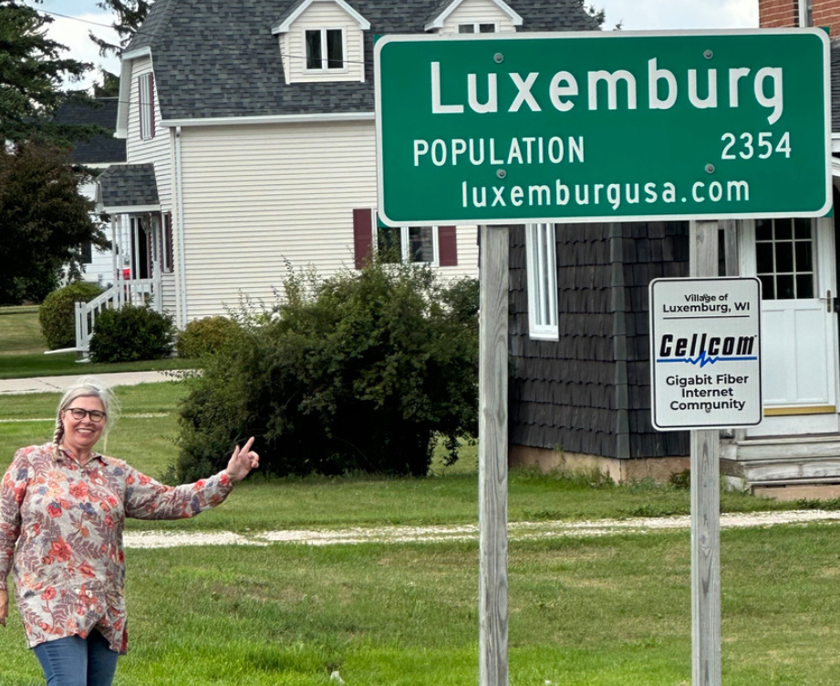
Intro: Luxembourg?
The US and Luxembourg are good friends
19th and 20th century, lots of immigration
One of my dreams is to visit Luxembourg (WI)
. . .

Slide 7

Intro: Luxembourg?
The USA liberated Luxembourg from the Nazis in 1944 (September 10th)
René Arend, a luxembourguish chef invented the McNugget and McRib (so I’d say we’re even)
. . .

Slide 8
Intro: where to find the code
Slides available online:
https://b-rodrigues.github.io/repro_r_pharma
Code available here:
https://github.com/b-rodrigues/repro_r_pharma

Slide 9
What I’ll be talking about
Reproducibility of data projects

Slide 10
Available solutions for R
{renv} or {groundhog}: simple to use, but:
Doesn’t save the R version
Installing old packages may fail (system dependencies)
Docker goes further:
Manages R and system dependencies
Containers executable anywhere
But:
Not inherently reproducible

Slide 11
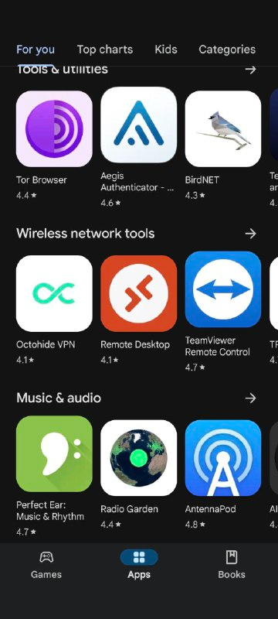
The Nix package manager (1/2)
Package manager: tool for installing and managing packages
Package: any software (not just R packages)
A popular package manager:
. . .
Google Play Store

Slide 12
The Nix package manager (2/2)
To ensure reproducibility: R, R packages, and other dependencies must be explicitly managed
Nix is a package manager truly focused on reproducible builds
Nix manages everything using a single text file (called a Nix expression)!
These expressions always produce exactly the same result

Slide 13
rix: reproducible development environments with Nix (1/2)
{rix} (website) simplifies writing Nix expressions!
Just use the provided rix() function:
. . .
library(rix) rix(date = "2025-06-13", r_pkgs = c("dplyr", "ggplot2"), system_pkgs = NULL, git_pkgs = NULL, tex_pkgs = NULL, ide = "code", project_path = ".")

Slide 14
rix: reproducible development environments with Nix (2/2)
rix::rix() generates a default.nix file
Build the expressions with nix-build (in terminal) or rix::nix_build() from R
Access the development environment with nix-shell
Expressions can be generated even without Nix installed (with some limitations)

Slide 15
Polyglot environments with rix
rix() supports Python and Julia alongside R:
. . .
rix(date = "2025-06-09", r_pkgs = c("tidyr", "dplyr", "ggplot2", "languageserver"), py_conf = list( py_version = "3.13", py_pkgs = c("polars", "scikit-learn") ), ide = "none", project_path = ".", overwrite = TRUE)
Julia: use jl_conf = list(jl_version = "1.10", jl_pkgs = c(...))
See: scripts/nix_expressions/02_native_positron_example/

Slide 16
Demo
Basics: scripts/nix_expressions/01_rix_intro/
Native VS Code/Positron on Windows: scripts/nix_expressions/02_native_positron_example/
Nix and {targets}: scripts/nix_expressions/03_nix_targets_pipeline
Nix and Docker: scripts/nix_expressions/04_docker/
Nix and {shiny}: scripts/nix_expressions/05_shiny
GitHub Actions: see here

Slide 17
Polyglot pipelines with {rixpress}
{rixpress} allows chaining processing steps in R, Python and Julia
Uses {rix} to create a reproducible (via Nix) execution environment for the pipeline
Each pipeline step is a Nix derivation
Data transfer: automatic via reticulate or universal format (JSON)

Slide 18
An example of a polyglot pipeline
list( rxp_py_file(…), # Read a CSV with Python rxp_py(…), # Filter with Polars rxp_py2r(…), # Python → R transfer rxp_r(…), # Transformation in R rxp_r2py(…), # R → Python transfer rxp_py(…), # Another Python step rxp_py2r(…), # Back to R rxp_r(…) # Final step ) |> rixpress()
Each step is named and typed (py, r, r2py, etc.)
Ability to add files (functions.R, images…)

Slide 19
To learn more about rixpress:
GitHub Repository
Website
Repository of demos

Slide 20
T, a new DSL for polyglot data science
Reproducibility is often an afterthought, with ad-hoc tools
Nix eases the pain, but humans have to play ball! (biggest challenge)
What could a “reproducible by design” language look like?
This is T, a language whose package manager is Nix and pipelines are first-class citizens

Slide 21
T is reproducible by design
A new T project is a Nix project:
. . .
nix shell github:b-rodrigues/tlang
. . .
t init --project

Slide 22
T is reproducible by design
my_analysis/ ├── tproject.toml # Project configuration and dependencies ├── flake.nix # Reproducible environment definition ├── README.md # Project overview ├── AGENTS.md # Onboarding guide for AI Agents ├── T-LANGUAGE-REFERENCE.md # Tiered language reference for LLMs (git-ignored) ├── src/ │ └── pipeline.t # Your main analysis script ├── data/ # Place your raw data files here ├── outputs/ # Output directory for results └── tests/ # Unit tests for your analysis

Slide 23
T is reproducible by design
Add R, Python or Julia dependecies to tproject.toml
Run t update
Exit the temporary shell and run nix develop
Environment is set up, ready to use!
What pipelines look like see here

Slide 24
Learning a new language in 2026?!
Learning a new language just for pipelines? Never!!
T is built to be llm-friendly
Projects ship AGENTS.md, T-LANGUAGE-REFERENCE.md and src/pipeline.t itself is a cheatsheet
LLMs should be able to wire your project using T without much issue!

Slide 25
Caveat Emptor
This is a 100% vibe-coded side-project by yours truly…
…but throughly tested (2000+ unit tests and 60+ end-to-end tests)
I wanted to stress-test the idea of a “reproducible by design” language
Challenges: input/output between languages

Slide 26
How did I build T?
100% LLM generated Ocaml code
Start with a specification doc
Keep brainstorming, refining…
Give the doc to an LLM
Let another LLM review the work
Implement and review tests
Repeat!

Slide 27
Fin
Contact me if you have questions:
bruno@brodrigues.co
Twitter: @brodriguesco
Mastodon: @brodriguesco@fosstodon.org
Blog: www.brodrigues.co
Book: www.raps-with-r.dev
rix: https://docs.ropensci.org/rix
rixpress: https://b-rodrigues.github.io/rixpress/
T: https://tstats-project.org/ . . .
Thanks!

