Slide 1
Reproducible data science with Nix, {rix} and {rixpress}
Bruno Rodrigues

Slide 2
Intro: Who am I
Bruno Rodrigues, head of the statistics department at the Ministry of Research and Higher Education in Luxembourg

Slide 3
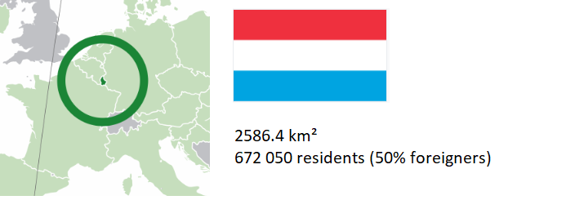
Intro: Luxembourg?

Slide 4
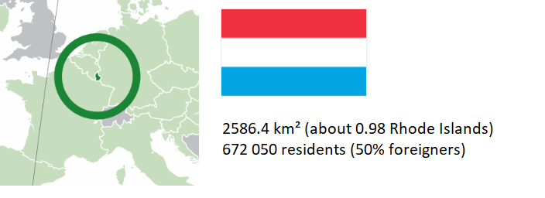
Intro: Luxembourg?

Slide 5
Intro: where to find the code
Slides available online:
https://b-rodrigues.github.io/repro_ukraine
Code available here:
https://github.com/b-rodrigues/repro_ukraine

Slide 6
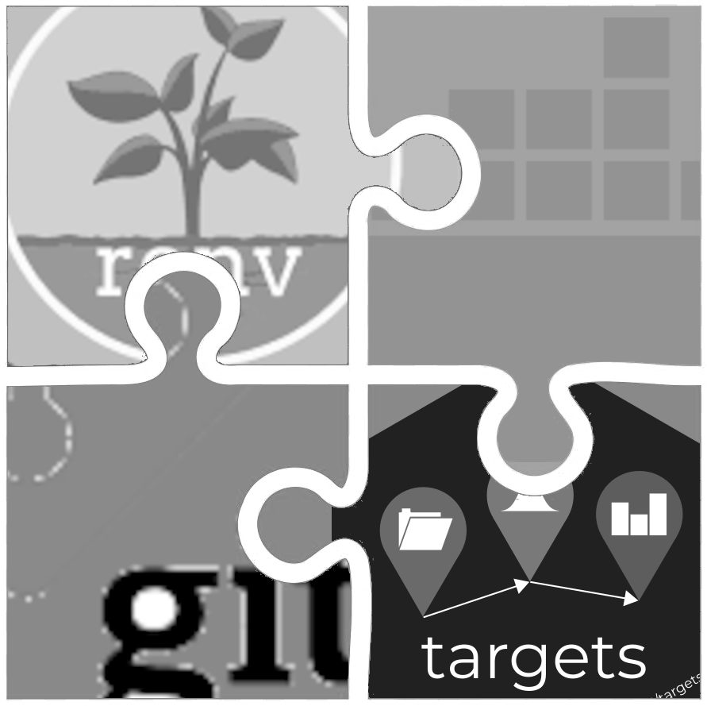
This workshop in a nutshell
The reproducibility puzzle you know

Slide 7
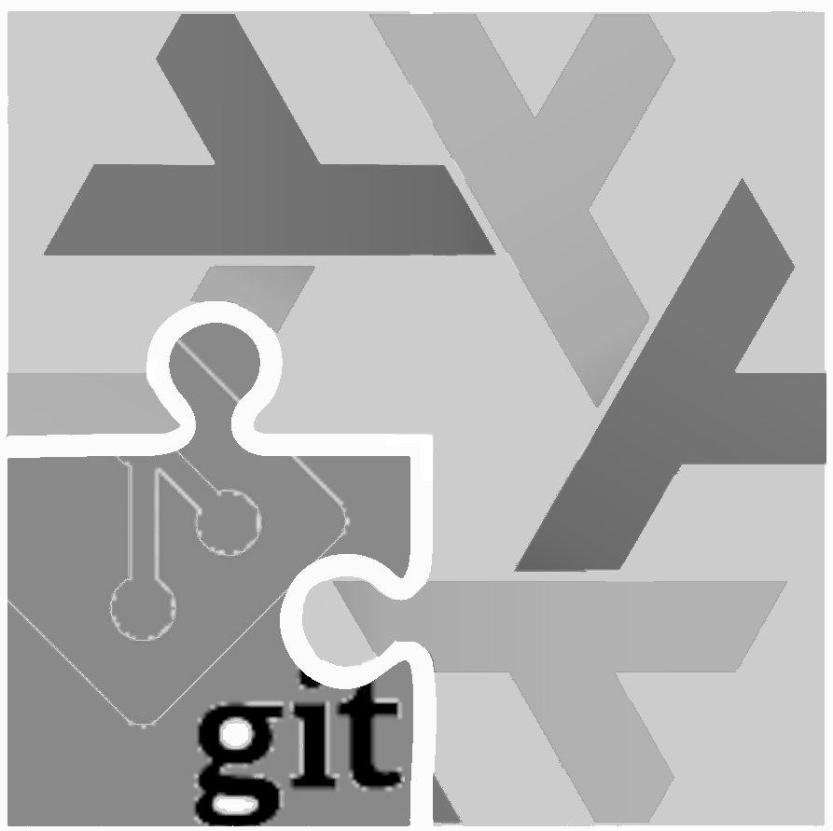
This workshop in a nutshell
The reproducibility puzzle with Nix

Slide 8
But why bother?
Easier to collaborate
Easier to reproduce
Easier to debug
Ultimately, peace of mind!
Also, see latest discussions around {ggplot2} 4.0.0

Slide 9
Part 1: Reproducible environments for data science with {rix}

Slide 10
Available solutions for R (1/2)
{renv} or {groundhog}: simple to use, but:
Doesn’t save the R version
Installing old packages may fail (system dependencies)
Docker goes further:
Manages R and system dependencies
Uses immutable and shareable img
Containers executable anywhere

Slide 11
Available solutions for R (2/2)
Docker limitations:
Learning curve (Linux knowledge recommended)
Not originally designed for reproducibility
See: Rocker

Slide 12
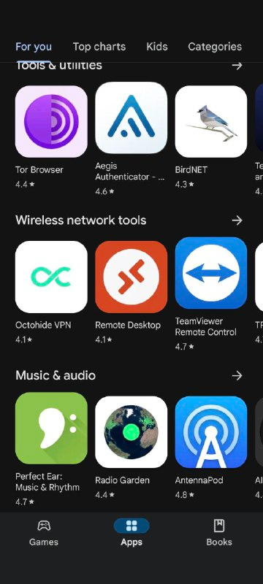
The Nix package manager (1/2)
Package manager: tool for installing and managing packages
Package: any software (not just R packages)
A popular package manager:
. . .
Google Play Store

Slide 13
The Nix package manager (2/2)
To ensure reproducibility: R, R packages, and other dependencies must be explicitly managed
Nix is a package manager truly focused on reproducible builds
Nix manages everything using a single text file (called a Nix expression)!
These expressions always produce exactly the same result

Slide 14
rix: reproducible development environments with Nix (1/5)
{rix} (website) simplifies writing Nix expressions!
Just use the provided rix() function:
. . .
library(rix) rix(date = "2025-06-02", r_pkgs = c("dplyr", "ggplot2"), system_pkgs = NULL, git_pkgs = NULL, tex_pkgs = NULL, ide = "code", project_path = ".")

Slide 15
rix: reproducible development environments with Nix (2/5)
renv.lock files can also serve as a starting point:
. . .
library(rix) renv2nix( renv_lock_path = "path/to/original/renv_project/renv.lock", project_path = "path/to/rix_project", override_r_ver = "4.4.1" # <- optional )

Slide 16
rix: reproducible development environments with Nix (3/5)
List the R version and required packages
Optionally:
system packages, GitHub packages, or LaTeX packages
an IDE (RStudio, Radian, VS Code, or “other”)
a version of Python and Python packages to include
a version of Julia and Julia packages to include

Slide 17
rix: reproducible development environments with Nix (4/5)
rix::rix() generates a default.nix file
Build the expressions with nix-build (in terminal) or rix::nix_build() from R
Access the development environment with nix-shell
Expressions can be generated even without Nix installed (with some limitations)

Slide 18
rix: reproducible development environments with Nix (5/5)
Can install specific versions of packages (write "dplyr@1.0.0")
Can install packages hosted on GitHub
Many vignettes to get started! See here

Slide 19
Super quickstart
Uninstall R and RStudio
Install Nix (on win/linux or on macOS)
Start a temporary Nix shell to bootstrap your environments:
. . .
nix-shell -p R rPackages.rix
Source a gen_env.R script that generates a default.nix and build that!

Slide 20
Demo
Basics: scripts/nix_expressions/01_rix_intro/
renv2nix: scripts/nix_expressions/02_renv2nix/
Native Code/Positron on Windows: scripts/nix_expressions/03_native_vscode_example/
Nix and {targets}: scripts/nix_expressions/04_nix_targets_pipeline/
Nix and Docker: scripts/nix_expressions/05_docker/
Nix and {shiny}: scripts/nix_expressions/06_shiny/
GitHub Actions: see here

Slide 21
Part 2: Reproducible analytical pipelines with {rixpress}

Slide 22
Introduction (1/3)
Nix is actually more than just a mere package manager
Nix is complete end-to-end build tool that leverages functional programming principles to ensure reproducible builds
Users write Nix expressions which are then translated into Nix derivations
Derivation: a specification for running an executable on precisely defined input files to repeatably produce output files at uniquely determined file system paths. (source)

Slide 23
Introduction (2/3)
Essentially: a derivation is a recipe with precisely defined inputs, steps, and a fixed output.
Given identical inputs and build steps → always produce exact same output
All inputs to a derivation must be explicitly declared.
Inputs include not just data files, but also software dependencies, configuration flags, and environment variables, essentially anything necessary for the build process.
The build process takes place in a hermetic sandbox to ensure the exact same output is always produced.

Slide 24
Introduction (3/3)
{rix}: output is a shell that contains required software
{rixpress}: output is whatever is the output of your pipeline (cleaned dataset, Quarto/Rmd document, model predictions, model parameters/weights, model itself…)

Slide 25
rixpress
{rixpress} allows chaining processing steps in R and Python
Uses {rix} to create a reproducible (via Nix) execution environment for the pipeline
Each pipeline step is a Nix derivation
Data transfer: automatic via reticulate or universal format (CSV, JSON, Parquet…)

Slide 26
An example of a polyglot pipeline
list( rxp_py_file(…), # Read a CSV with Python rxp_py(…), # Filter with Polars rxp_py2r(…), # Python → R transfer rxp_r(…), # Transformation in R rxp_r2py(…), # R → Python transfer rxp_py(…), # Another Python step rxp_py2r(…), # Back to R rxp_r(…) # Final step ) |> rixpress()
Each step is named and typed (py, r, r2py, etc.)
Ability to add files (functions.R, img…)

Slide 27
Defining a derivation (input data)
rxp_r_file( name = mtcars, path = 'data/mtcars.csv', read_function = \(x) (read.csv(file = x, sep = "|")) )

Slide 28
Defining a derivation (some computation)
rxp_r( name = filtered_mtcars, expr = filter(mtcars, am == 1) )

Slide 29
Typical structure of a rixpress project
. ├── data │ └── dataset.csv # input data (can be many files) ├── functions.py # user-defined Python functions ├── functions.R # user-defined R function ├── gen-env.R # rix script to generate execution env ├── gen-pipeline.R # rixpress script to generate pipeline ├── my_paper # folder containing Quarto doc │ ├── section.qmd # Qmd file │ ├── img # Folder containing img for document │ │ └── graph.png # Image to add to paper │ └── main.qmd # Main Qmd file └── Readme.md # Readme

Slide 30
Defining Quarto or Rmd documents
Use rxp_read() to include pipeline outputs:
rixpress::rxp_read("mtcars_head")
All created objects can be dynamically loaded into the document
Possible to include additional files (content.qmd, img…)

Slide 31
Using rixpress (1/3)
Start from an empty folder;
Drop into a temporary shell:
. . .
nix-shell --expr "$(curl -sl https://raw.githubusercontent.com/ropensci/rix/main/inst/extdata/default.nix)"

Slide 32
Using rixpress (2/3)
Start project structure using rixpress::rxp_init();
Edit gen-env.R and gen-pipeline.R;
Write code in gen-pipeline.R and build pipeline using rxp_make();
Inspect outputs using rxp_inspect();
View outputs using rxp_read() (load them using rxp_load();
View DAG of pipeline using rxp_ggdag() or rxp_visnetwork()

Slide 33
Using rixpress (3/3)
Build artifacts get saved and re-used across runs;
Possible to export and import them using import_nix_archive() and export_nix_archive() (very useful on CI!);
To set up GitHub Actions use rxp_ga();
Logs of runs get saved, and possible to reload older versions of build artifacts (see vignette).

Slide 34
Transfer with JSON (or other universal format)
Advantage: avoids using reticulate
Add a Python serialization function:
. . .
def serialize_to_json(pl_df, path): with open(path, 'w') as f: f.write(pl_df.write_json())
And on the R side:
. . .
rxp_r( name = "x", expr = my_fun(data), unserialize_function = "jsonlite::fromJSON" )

Slide 35
Interactive demo
See scripts/rixpress_demo

Slide 36
To learn more:
Repository GitHub
Website
Repository of demos

Slide 37
Fin
If you have questions:
bruno@brodrigues.co
Twitter: @brodriguesco
Mastodon: @brodriguesco@fosstodon.org
Blog: www.brodrigues.co
Book: www.raps-with-r.dev
rix: https://docs.ropensci.org/rix
rixpress: https://b-rodrigues.github.io/rixpress/
Thanks!

