Slide 1
Reproducible environments for data science with {rix}
Bruno Rodrigues

Slide 2
Intro: Who am I
Bruno Rodrigues, Head of the Statistics Department at the Ministry of Research and Higher Education in Luxembourg

Slide 3
Intro: Contents
Slides available online:
https://b-rodrigues.github.io/repro_ulisboa
Code available here:
https://github.com/b-rodrigues/repro_ulisboa

Slide 4

What I will talk about
The puzzle you know:

Slide 5

What I will talk about
The puzzle with Nix:

Slide 6
Available solutions for R
{renv} or {groundhog}: easy to use, but:
Doesn’t save the version of R
Installing older packages can fail (system dependencies)
Docker goes further:
Manages R and system dependencies
Containers can run anywhere
But:
Not inherently reproducible

Slide 7
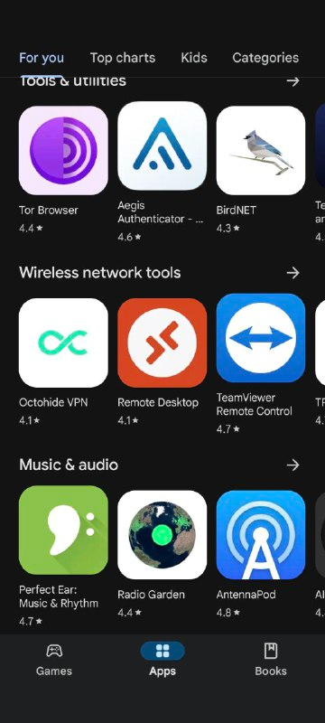
The Nix package manager (1/2)
Package manager: a tool to install and manage packages
Package: any software (not just R packages)
A popular package manager:
. . .
Google Play Store

Slide 8
The Nix package manager (2/2)
To ensure reproducibility: R, R packages, and other dependencies must be managed explicitly
Nix is a package manager truly focused on reproducible builds
Nix manages everything using a single text file (called a Nix expression)!
These expressions always produce the exact same result

Slide 9
rix: reproducible development environments with Nix (1/5)
{rix} (website) simplifies writing Nix expressions!
Just use the provided rix() function:
. . .
library(rix) rix(date = "2025-06-13", r_pkgs = c("dplyr", "ggplot2"), system_pkgs = NULL, git_pkgs = NULL, tex_pkgs = NULL, ide = "code", project_path = ".")

Slide 10
rix: reproducible development environments with Nix (2/5)
renv.lock files can also serve as a starting point:
. . .
library(rix) renv2nix( renv_lock_path = "path/to/original/renv_project/renv.lock", project_path = "path/to/rix_project", override_r_ver = "4.4.1" # <- optional )

Slide 11
rix: reproducible development environments with Nix (3/5)
List the R version and required packages
Optional:
system packages, GitHub packages, or LaTeX packages
an IDE (Rstudio, Radian, VS Code or “other”)
a Python version and Python packages to include
a Julia version and Julia packages to include

Slide 12
rix: reproducible development environments with Nix (4/5)
rix::rix() generates a default.nix file
Build the expressions with nix-build (in terminal) or rix::nix_build() from R
Enter the development environment with nix-shell
Expressions can be generated even without Nix installed (with some limitations)

Slide 13
rix: reproducible development environments with Nix (5/5)
Can install specific package versions (write "dplyr@1.0.0")
Can install packages hosted on GitHub
Many vignettes to get started! See here

Slide 14
Temporary shells
Test tools, or bootstrap an environment using
. . .
nix-shell -p R rPackages.rix

Slide 15
Demonstration
Basics: scripts/nix_expressions/01_rix_intro/
Native VS Code/Positron on Windows: scripts/nix_expressions/02_native_vscode_example/
Nix and {targets}: scripts/nix_expressions/03_nix_targets_pipeline
Nix and Docker: scripts/nix_expressions/04_docker/
Nix and {shiny}: scripts/nix_expressions/05_shiny
GitHub Actions: see here

Slide 16
Polyglot pipelines with {rixpress}
{rixpress} lets you chain processing steps in both R and Python
Uses {rix} to create a reproducible (Nix-based) execution environment for the pipeline
Each pipeline step is a Nix derivation
Data transfer: automatic via reticulate or universal formats (JSON)

Slide 17
An example mixed pipeline
list( rxp_py_file(…), # Read a CSV with Python rxp_py(…), # Filter with Polars rxp_py2r(…), # Python → R transfer rxp_r(…), # Transform in R rxp_r2py(…), # R → Python transfer rxp_py(…), # Another Python step rxp_py2r(…), # Back to R rxp_r(…) # Final step ) |> rixpress()
Each step is named, typed (py, r, r2py, etc.)
You can add files (functions.R, images…)

Slide 18
Transfer with JSON (or other universal format)
Advantage: avoids using reticulate
Add a Python serialization function:
. . .
def serialize_to_json(pl_df, path): with open(path, 'w') as f: f.write(pl_df.write_json())
And on the R side:
. . .
rxp_r( name = "x", expr = my_fun(data), unserialize_function = "jsonlite::fromJSON" )

Slide 19
Document generation (Quarto or Rmd)
Easily integrate pipeline output into a .qmd:
. . .
```r rixpress::rxp_read("mtcars_head") ```
. . .
All created objects can be dynamically loaded in the document
You can pass additional files (content.qmd, images…)

Slide 20
Interactive demo
See scripts/rixpress_demo

Slide 21
To learn more
Repository GitHub
Website
rixpress examples repository

Slide 22
Fin
Contact me if you have questions:
bruno@brodrigues.co
Twitter : @brodriguesco
Mastodon : @brodriguesco@fosstodon.org
Blog : www.brodrigues.co
Livre : www.raps-with-r.dev
rix : https://docs.ropensci.org/rix
rixpress : https://b-rodrigues.github.io/rixpress/
. . .
Obrigado!

